Slide 1
Global Migration

Slide 2
Global Migration Stats:
3.1% of the world’s population lives outside their country of origin (214 million people)
Sixty percent of the world’s international migrants reside in more developed regions
Most of the world’s migrants live in Europe (70 million in 2010), followed by Asia (61 million) & North America (50 million)

Slide 3
What country has the highest % of a foreign born population?
Qatar in the Middle East at 87%
Why? ~Foreign workers comprise as much as 85% of the total population and make up about 90% of the total labor force
Most are South and Southeast Asians, followed by Egyptians, Palestinians, Jordanians, Lebanese, Syrians, Yemenis, and Iranians

Slide 4
What have been the trends over the past 25 years?
Globalization of migration – more countries are affected by migration at the same time
Acceleration of migration – once migration starts, it is likely to snowball through chain migration
Differentiation of migration – more different types of migration (refugees, family migrants, labor force migrants)
“Feminization” of migration – women are playing an increasing role in all regions and all types of migration (49% of international migrants)

Slide 5
Women continue…
• Women have increased in rural to urban movement in Africa, Latin America and Asia; many are seeking economic opportunities outside of a husband’s control
Also making up large group of refugees
47% of refugees/asylum seekers are female
50% of women are “stateless” (not having any recognized citizenship in a state or nation)

Slide 6
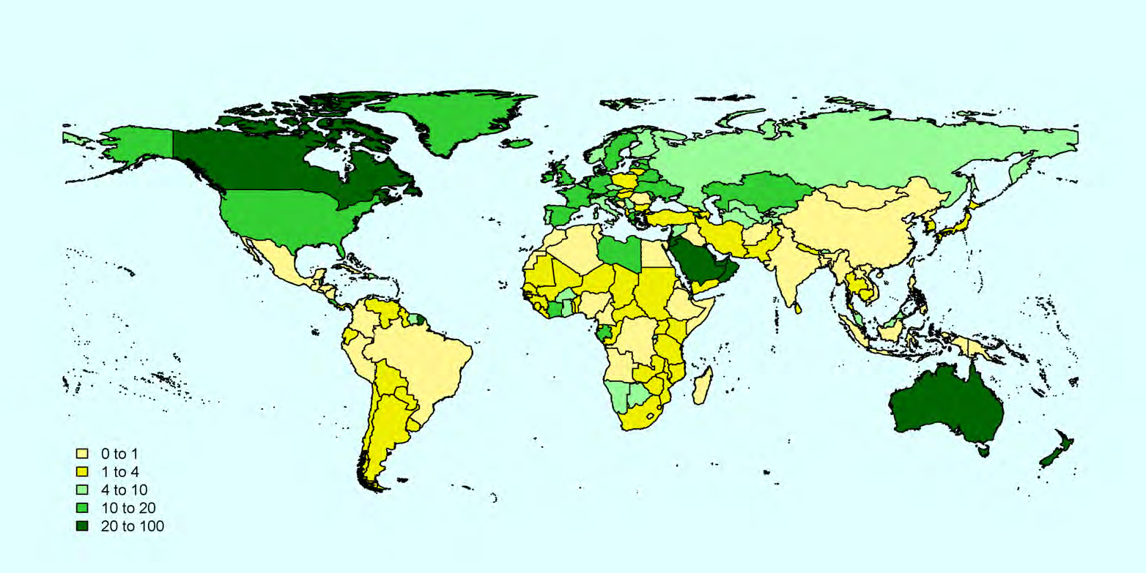
Total Migrants as % of the Population 2010

Slide 7
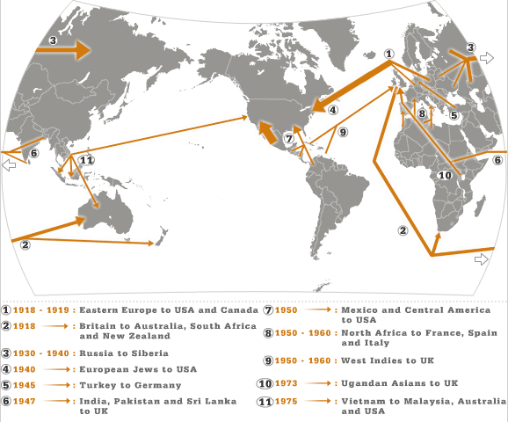
Some major migration movements in 20th century

Slide 8
Site:
All statistics are according to:
UNITED NATIONS: Department of Economic and Social Affairs: Population Division
The UN categories Mexico as part of the Central America Region with Northern America being the USA, Canada, Bermuda, Greenland and Saint Pierre & Miquelon
The Caribbean was a separate category

Slide 9
Points to Ponder…
If movement and migration of peoples have been the norm throughout human history, why is it now considered a “problem” or “issue”?
What has changed?
(Think about this but don’t answer now)

Slide 10
The Jewish Diaspora
Diaspora: the dispersion or spreading of something that was originally localized (as a people, language or culture)
The dispersion of the Jewish people outside Israel; from the destruction of the temple in Jerusalem in 587-86 BC/BCE when they were exiled to Babylonia up to the present time

Slide 11
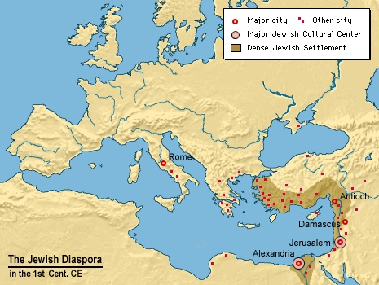

Slide 12
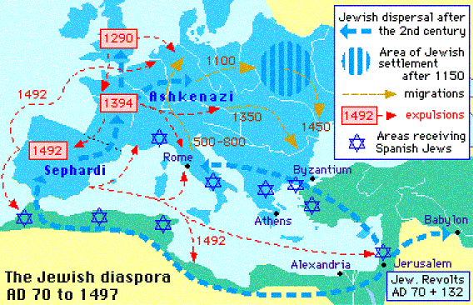

Slide 13
Jewish Population Worldwide
An understanding of the Jewish Diaspora is essential to an understanding of the spread of early Christianity, the Middle Ages, the Crusades and Reconquista, & Modern World History
After the Holocaust many returned to Palestine (Israel) or migrated to the USA
About 42% of the world’s Jewish population lives in Israel with another 40% in the USA

Slide 14
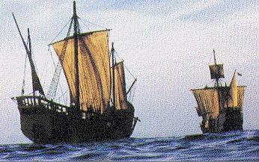
The Columbian Exchange
1492-1504 Four Voyages

Slide 15
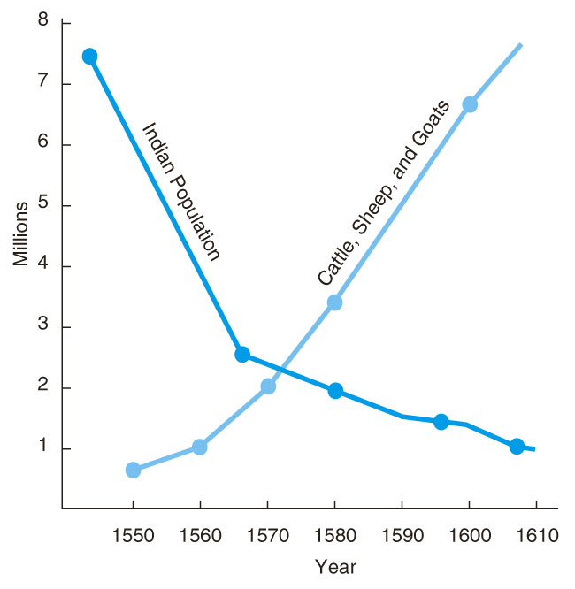
Columbian Exchange
The exchange of goods, crops, animals, people, and disease from the Old World to the New World and vice versa

Slide 16
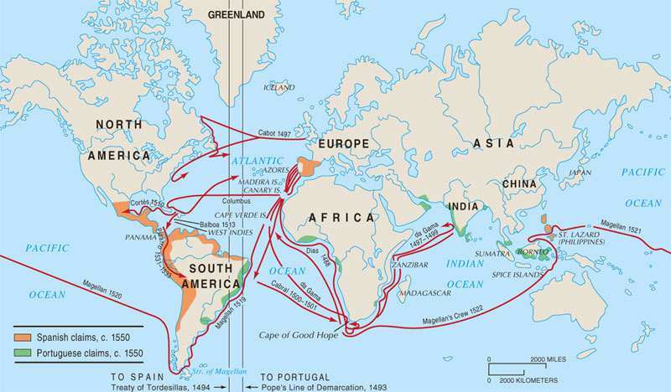
Columbian Exchange

