Slide 1
Unit 3 Chapter 4
Folk & Popular Culture

Slide 2
Where Are Folk and Popular Leisure Activities Distributed?
Geographers study how culture influences behavior.
Difference between habit and custom
Habit is a repetitive act performed by an individual.
One college student wears jeans with colorful patches.
Custom is a repetitive act performed by a group.
All college students from the American South wear jeans with colorful patches.

Slide 3
Where Are Folk and Popular Leisure Activities Distributed?
Characteristics of Folk and Popular Culture
Origin
Folk Culture
Anonymous hearths
Possible to have multiple hearths each originating independently
Anonymous sources
Unknown dates
Unidentified originators
Popular Culture
Product of developed countries
Typically North American or European
Origin often traceable to specific person or corporation in a particular place
Notes:
Culture originates at a hearth, a center of innovation.
Popular music and other elements of popular culture, such as food and clothing, arise from a combination of advances in industrial technology and increases in leisure time.

Slide 4
Where Are Folk and Popular Leisure Activities Distributed?
Characteristics of Folk and Popular Culture
Diffusion
Folk Culture
Smaller scale and slower transmissions from one location to another primarily through relocation diffusion (migration)
Popular Culture
Tends to be transmitted by way of hierarchical diffusion
Diffuses rapidly and extensively form hearths or nodes of innovation with help of modern communications
Notes:
Examples include American popular music during the 1940s when the Armed forces Radio Network broadcast music to American soldiers and to citizens where American soldiers were stationed or fighting during WWII.

Slide 5
Where Are Folk and Popular Leisure Activities Distributed?
Characteristics of Folk and Popular Culture
Distribution
Folk Culture
Combination of local physical and cultural factors influence distinctive distributions.
Isolation from other cultures because of physical barriers—e.g., distance and mountain ranges
Religion
Popular Culture
Widely distributed across many countries with little regard for physical factors
Principal obstacle to access is lack of income to purchase the material

Slide 6
Where Are Folk and Popular Leisure Activities Distributed?
Origin and Diffusion of Folk and Popular Music
Folk Music
Originates anonymously
Transmitted orally
Modifications to songs over successive generations to represent changes in conditions.
Content of songs centers on events in daily life that are familiar to the majority of people.
Life-Cycle events
E.g., birth, death, or marriage
Environmental features
E.g., agriculture or climate
Migration of people also diffuses the music.

Slide 7
Where Are Folk and Popular Leisure Activities Distributed?
Origin and Diffusion of Folk and Popular Music
Popular Music
Music written by specific individuals with the intent of being…
Sold
Performed in front of a paying audience
Often displays a high degree of technical skill
Musicians often have strong connections with other similar musicians that may span the globe.
Limited connections with local musicians of different genres

Slide 8
Where Are Folk and Popular Leisure Activities Distributed?
Origin and Diffusion of Folk and Popular Sports
Sports originated as isolated folk customs and diffused like other folk culture via relocation diffusion.
Example:
Football (soccer) originated in England in the eleventh century.
Transformation from folk to popular sport began in 1800s when organized clubs were formed in the UK.
Professional players hired
Standardized rules and organized professional league established in 1863 in UK marks formal transition from folk sport to popular sport.
Notes:
In late 1800s, British exported associated football (soccer) around the world.
Began with continental Europe
Other Countries include: The Netherlands, Spain, Russia.
Later diffused even farther by radio and TV.

Slide 9
Where Are Folk and Popular Leisure Activities Distributed?
Folk and Popular Material Culture
Include:
Clothing
Food
Shelter
Diffusion
Folk material culture diffuses slowly through process of migration.
Popular material culture diffuses rapidly.
Access determined by having sufficient income to embrace it.

Slide 10
Where Are Folk and Popular Leisure Activities Distributed?
Folk and Popular Clothing
Folk Clothing Preferences
Style of clothing worn in response to distinctive agricultural practices and climatic conditions
Ex.
Folk custom in the Netherlands to wear wooden shoes because of practical uses in wet climates.
Fur-lined boots protect against cold in arctic climates.
Popular Clothing Preferences
Style of clothing generally reflects occupation and income rather than particular environment.
Ex.
Business suits worn by professionals
Designer clothes worn by the affluent

Slide 11
Where Are Folk and Popular Leisure Activities Distributed?
Rapid Diffusion of Popular Clothing Styles
Improved communications central to rapid diffusion
Ex. Time for original designs for women’s dresses to be designed in fashion capitals—e.g., Paris or London—and reproductions available in stores has diminished from years to a few weeks.
Jeans is an important symbol of the diffusion of Western popular culture.
Local Diversity
Japan: customized with patches and cutouts
Korea: frayed, ripped, or shredded
Italy: bleached on seat of jeans

Slide 12
Where Are Folk and Popular Leisure Activities Distributed?
Folk and Popular Food Preferences
People adapt their food preferences to conditions in the environment.
Asia
Rice: milder, moister regions
Wheat: drier regions
Europe
Italy: preference for quick-frying foods resulted from fuel shortages
Northern Europe: abundant wood supply encouraged slow stewing and roasting of foods

Slide 13
Where Are Folk and Popular Leisure Activities Distributed?
Folk and Popular Food Preferences
Food Taboos
Many folk customs attribute a signature, or distinctive characteristic, to everything in nature.
People may desire or avoid certain foods, as a result of perceived beneficial or harmful natural traits.
A restriction imposed by a social custom to eat particular plants or animals that are believed to embody negative forces is a taboo.
Ancient Hebrews in the Bible forbidden to eat animals that did not chew their cud or that have cloven feet and fish lacking fins or scales.
Muslims embrace the taboo against eating pork.
Hindus embrace the taboo against consuming cattle.
Notes:
Taboos often related to environmental concerns.
Hebrews: Pig, for example, is more suited for sedentary farming not pastoral nomadism.
Muslims: Pigs are unsuited for the dry lands of the Arabian Peninsula. They would compete with humans for food and water and not be a beast of burden.
Hindu: Huge numbers of oxen are needed to for agriculture in India.
Environmental concerns account for only a part of the reason for recognizing taboos.

Slide 14
Where Are Folk and Popular Leisure Activities Distributed?
Folk and Popular Food Preferences
Popular Food Culture
Differences among Countries
Cola preferences can be influenced by politics.
Soviet Union: Pepsi permitted for sale in country
Russia: Many former Soviets switched to Coke, because Pepsi was associated with communism.
Cola preferences can be influenced by religion.
Southwest Asia: Predominantly Muslim countries boycotted products sold in Jewish Israel—e.g., Coke.

Slide 15
Where Are Folk and Popular Leisure Activities Distributed?
Folk and Popular Food Preferences
Popular Food Culture
Regional Differences within the United States
Americans may choose beverages or snacks based on what is produced, grown, or imported locally.
Wine consumption relatively high in California where most of the U.S. production is located.
Cultural backgrounds affect the amount and types of alcohol and snack foods consumed.
Relatively little alcohol is consumed in Utah because of the strong presence of the Church of Latter-day Saints that advocates against drinking alcohol.
High consumption in Nevada where resorts located.
Texans may prefer tortilla chips in greater numbers because of strong Hispanic American presence.

Slide 16
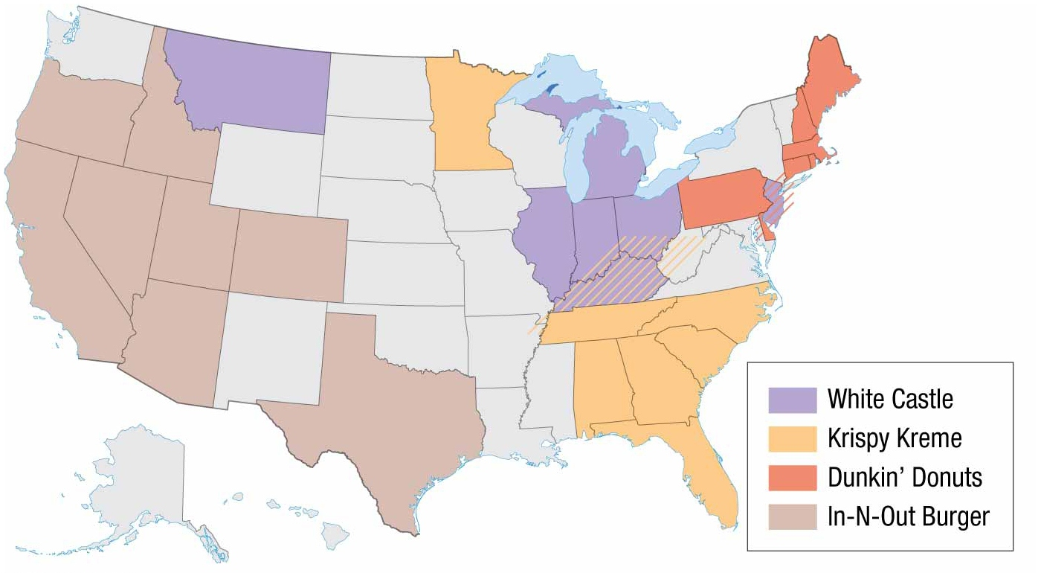
Notes:
FIGURE 4-21 FAST-FOOD RESTAURANT PREFERENCES Dunkin’ Donuts is especially popular in the Northeast, Krispy Kreme in the Southeast, White Castle in the Midwest, and In-N-Out Burger in the Southwest.

Slide 17
Where Are Folk and Popular Leisure Activities Distributed?
Distribution of Folk and Popular Housing
Environmental Influences on Folk Housing
Available resources influence building materials used on folk houses—e.g., stone, grass, sod, and skins.
Two Most Common
Wood
Brick
Climate and local topography influence design of housing structures.
R. W. McColl compared houses in four Chinese villages.
All used similar building materials, including adobe and timber from desert poplar tree.
Distinct designs in each location attributed to local cultural preference and local geography.

Slide 18
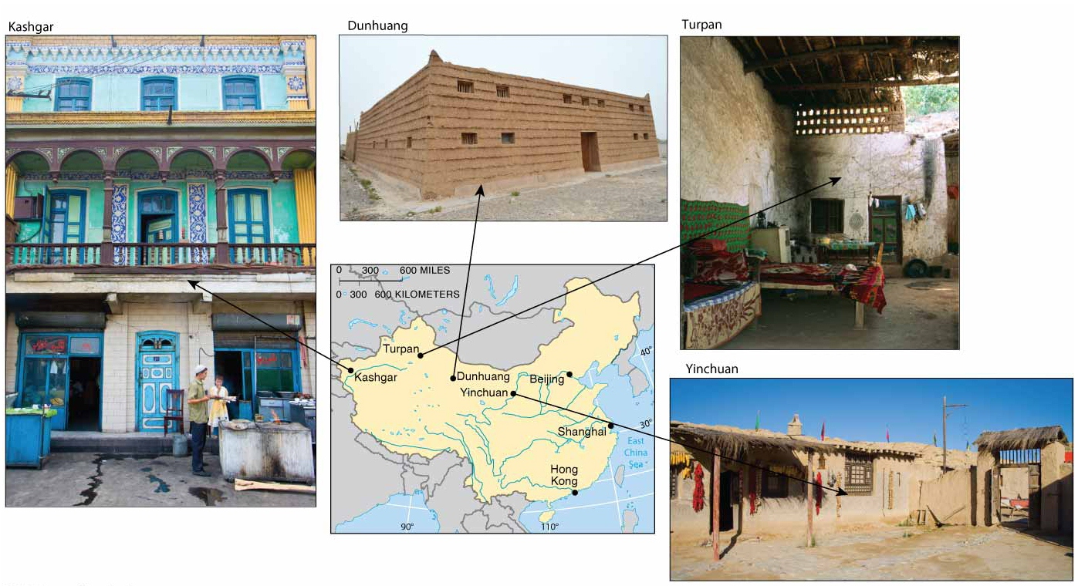
Notes:
FIGURE 4-23 HOUSE TYPES IN FOUR WESTERN CHINA COMMUNITIES House types in four communities of western China. Houses have second-floor open-air patios in Kashgar, small open courtyards in Turpan, large private courtyards in Yinchuan, and sloped roofs in Dunhuang.

Slide 19
Where Are Folk and Popular Leisure Activities Distributed?
Distribution of Folk and Popular Housing
Sacred Spaces in Houses
Distinctive form of folk houses may derive from religious or other customary beliefs.
Sacred Features—e.g., Walls, Door Orientation, Corners
Houses in south central part of Java face south—the direction of the South Sea Goddess who holds the key to Earth.
Eastern wall of a house is sacred in Fiji.
All directions except south have significance in folk houses in Madagascar.

Slide 20
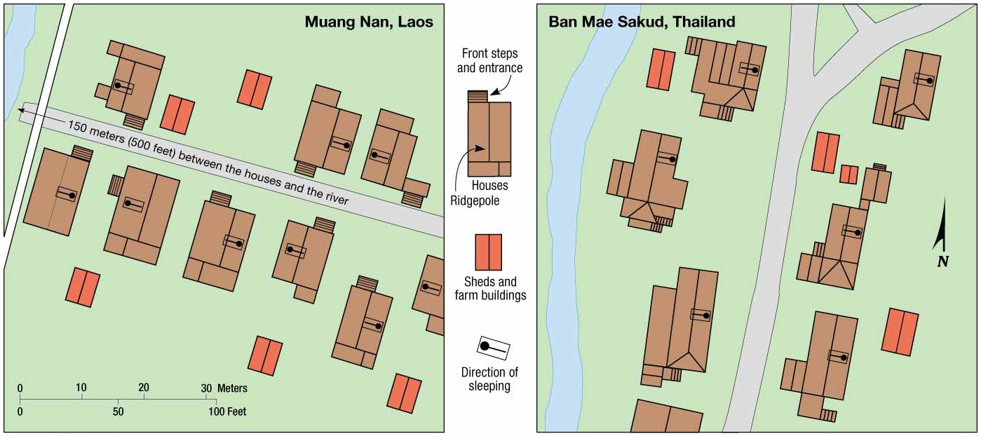
Notes:
FIGURE 4-24 SACRED HOUSING SPACE (top) Houses of Lao people in northern Laos. The fronts of Lao houses, such as those in the village of Muang Nan, Laos, face one another across a path, and the backs face each other at the rear. Their ridgepoles (the centerline of the roof) are set perpendicular to the path but parallel to a stream, if one is nearby. Inside adjacent houses, people sleep in the orientation shown, so neighbors are headto-head or feet-to-feet. (bottom) Houses of Yuan and Shan peoples in northern Thailand. In the village of Ban Mae Sakud, Thailand, the houses are not set in a straight line because of a belief that evil spirits move in straight lines. Ridgepoles parallel the path, and the heads of all sleeping persons point eastward.

Slide 21
Where Are Folk and Popular Leisure Activities Distributed?
Distribution of Folk and Popular Housing
U.S. Folk Housing
Style of pioneer homes reflected whatever upscale style was prevailing at the place on the East Coast from which they migrated.
Geographer Fred Kniffen identified three major hearths, or nodes, of folk house forms in the United States.
Middle Atlantic: Principal house type known as an “I”-house with one room deep and at least two rooms wide.
Lower Chesapeake/Tidewater: Principal house type characterized by one story, with a steep roof and chimneys at either end.
New England: Principal house style was box shaped with a central hall.

Slide 22
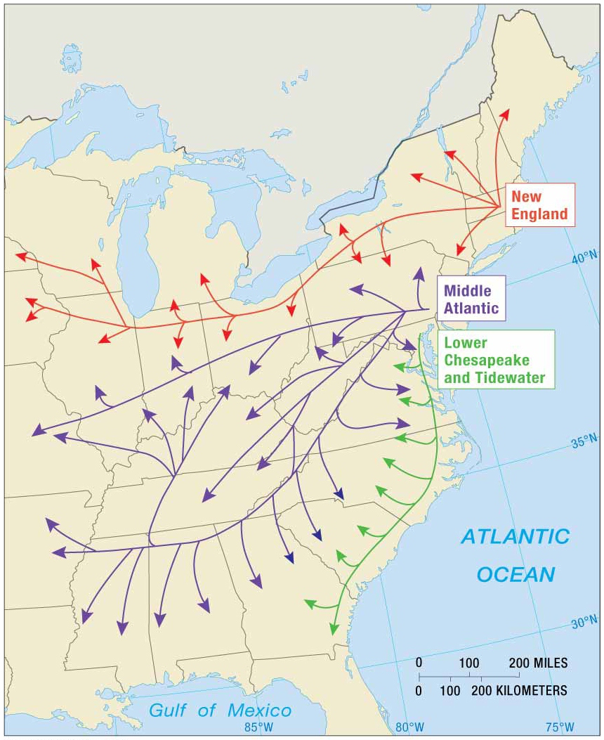
Notes:
FIGURE 4-25 HEARTHS OF U.S. FOLK HOUSING U.S. house types in the United States originated in three main source areas and diffused westward along different paths. These paths coincided with predominant routes taken by migrants from the East Coast toward the interior of the country.

Slide 23
Where Are Folk and Popular Leisure Activities Distributed?
Distribution of Folk and Popular Housing
U.S. Popular Housing
Since mid-twentieth century, houses display popular culture rather than regional influences.
Most people no longer build their own houses but instead are mass-produced by construction companies.
Houses show the influence of shapes, materials, detailing, and other features of architectural style in vogue at any one point in time.

Slide 24
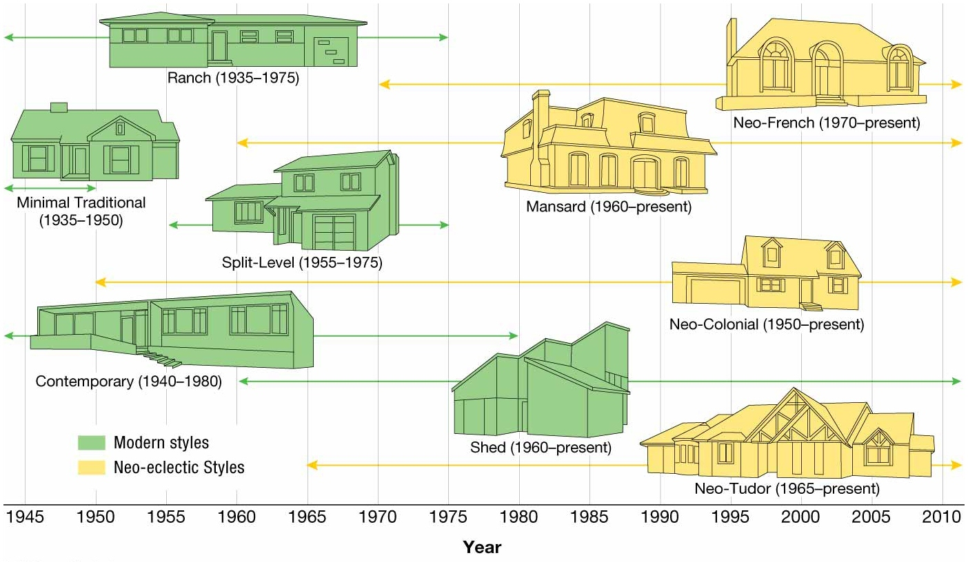
Notes:
FIGURE 4-26 U.S. HOUSE TYPES, 1945 TO PRESENT The dominant type of house construction in the United States was minimal traditional during the late 1940s and early 1950s,
followed by ranch houses during the late 1950s and 1960s. The split-level was a popular variant of the ranch between the 1950s and 1970s, and the contemporary style was popular
for architect-designed houses during the same period. The shed style was widely built in the late 1960s. Neo-eclectic styles, beginning with the mansard, were in vogue during the late 1960s. The neo-Tudor was popular in the 1970s and the neo-French in the 1980s. The neo-colonial style has been widely built since the 1950s but has never dominated popular architecture.

Slide 25
Why Is Access to Folk and Popular Culture Unequal?
Electronic Diffusion of Popular Culture
Principal obstacle to accessing popular culture is lack of access to electronic media.
Most important electronic media format to popular culture is TV for two reasons.
Watching TV is most popular leisure activity in the world.
TV is most important mechanism for rapidly diffusing popular culture around the world.

Slide 26
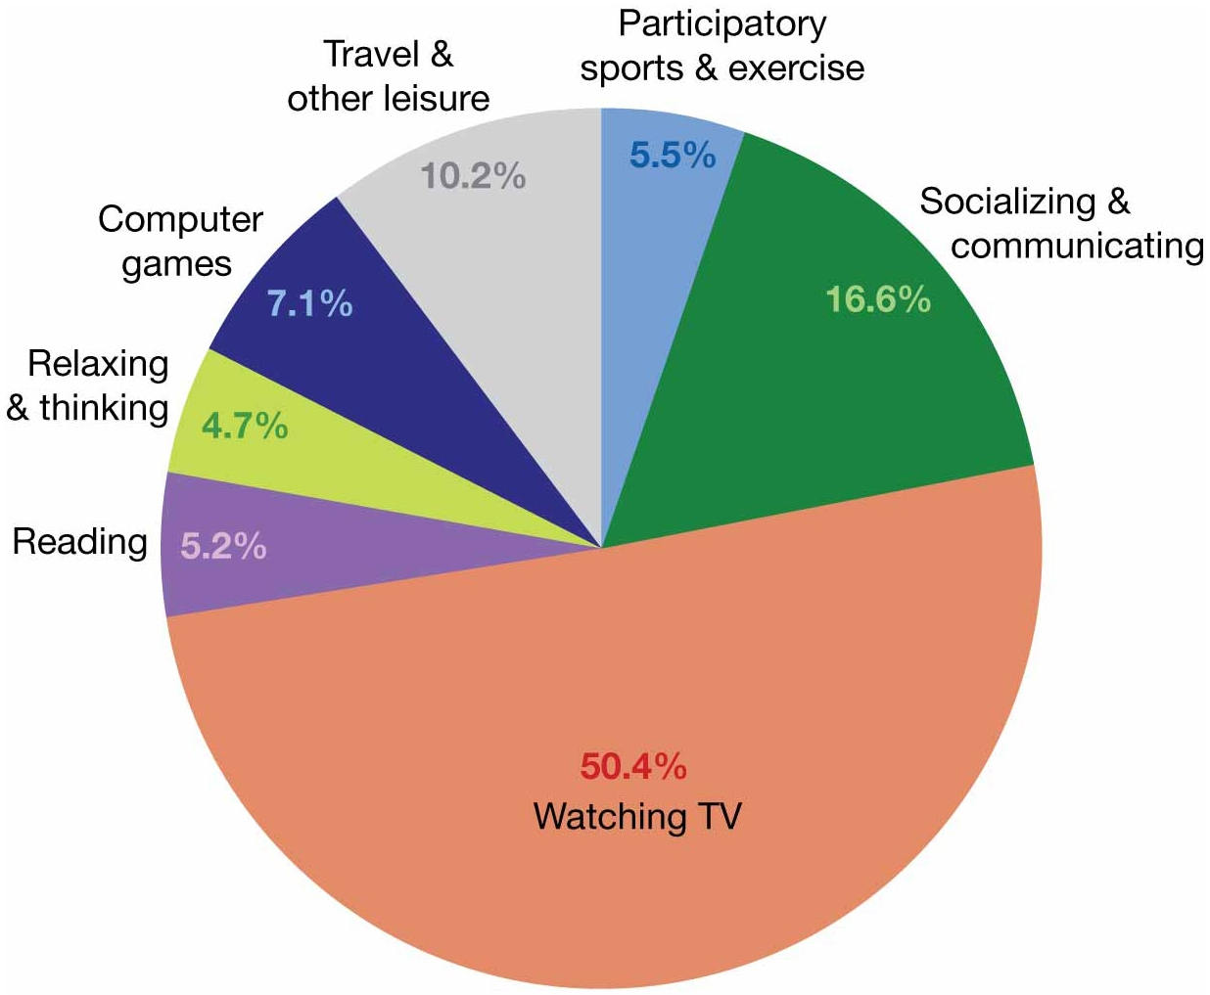
Notes:
FIGURE 4-31 HOW AMERICANS SPEND THEIR WEEKENDS Watching TV is by far the most common leisure activity for Americans.

Slide 27
Why Is Access to Folk and Popular Culture Unequal?
Electronic Diffusion of Popular Culture
Diffusion of TV: Mid-Twentieth Century
TV technology originated simultaneously in multiple hearths in the early twentieth century— e.g., UK, France, Germany, Japan, Soviet Union, and the United States.
Over the course of the twentieth century, the United States went from dominating the world share of TVs to being nearly equal in rates of ownership with most developing countries.
Notes:
Through the second half of the 20th century, television diffusive from the United States to Europe and other developed countries and then to developing countries.

Slide 28
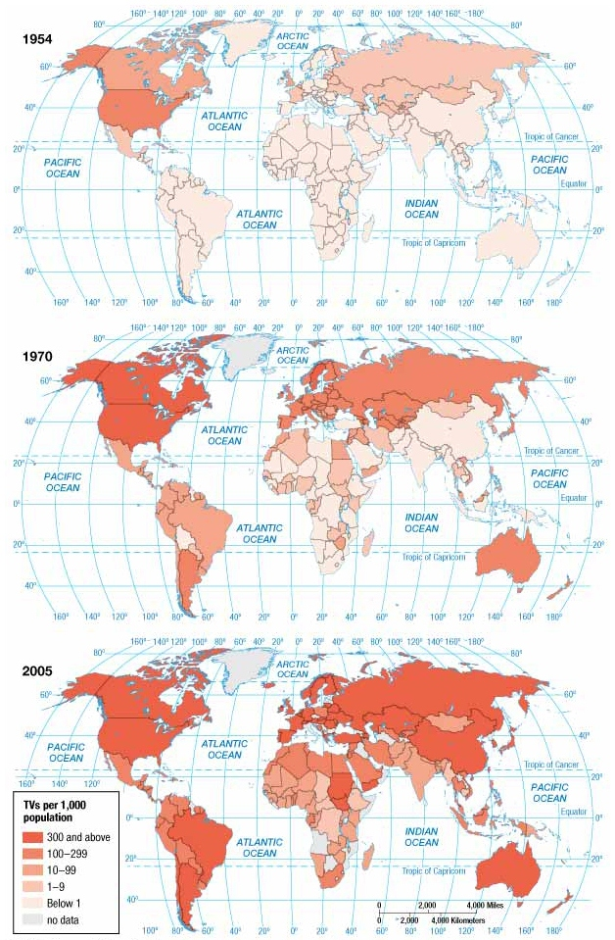
Notes:
FIGURE 4-28 DIFFUSION OF TV Televisions per 1,000 inhabitants in (top) 1954, (middle) 1970, and (bottom) 2005. Television has diffused from North America and Europe to other regions of the world. The United States and Canada had far more TV sets per capita than any other country as recently as the 1970s, but several European countries now have higher rates of ownership.

Slide 29
Why Is Access to Folk and Popular Culture Unequal?
Electronic Diffusion of Popular Culture
Diffusion of the Internet: Late Twentieth Century
Diffusion follows pattern established by TV but at a more rapid rate.
In 1995, Internet users in the United States accounted for more than half of the global users.
By 2011, 77 percent of the U.S. population accessed the Internet.
Accounted for 10 percent of the global users.
Global share decreased by roughly 40 percent in less than 10 years.

Slide 30
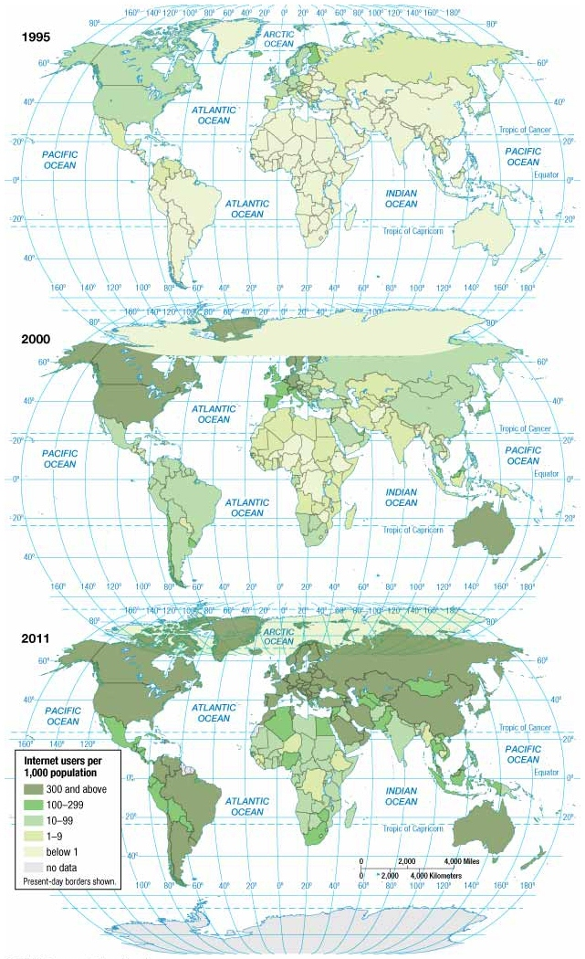
Notes:
FIGURE 4-32 DIFFUSION OF THE INTERNET Internet users per 1,000 inhabitants in (top) 1995, (middle) 2000, and (bottom) 2011. Compare to the diffusion of TV ( Figure
4-28 ). Internet service is following a pattern in the twenty-first century similar to the pattern of diffusion of television in the twentieth century. The United States started out with a much higher rate of usage than elsewhere, until other countries caught up. The difference is that the diffusion of television took a half-century and the diffusion of the Internet only a decade.

Slide 31
Why Is Access to Folk and Popular Culture Unequal?
Electronic Diffusion of Popular Culture
Diffusion of Social Media: Twenty-First Century
Same diffusion pattern as TV and Internet
Facebook
In 2008, Facebook users in United States consisted of 1/3 of all global users.
By 2011, global share decreased to 1/5.
Twitter
United States was source of 1/3 of all tweets in 2010.
Second leader of tweets is India.
Notes:
Same pattern holds true for YouTUBE.

Slide 32
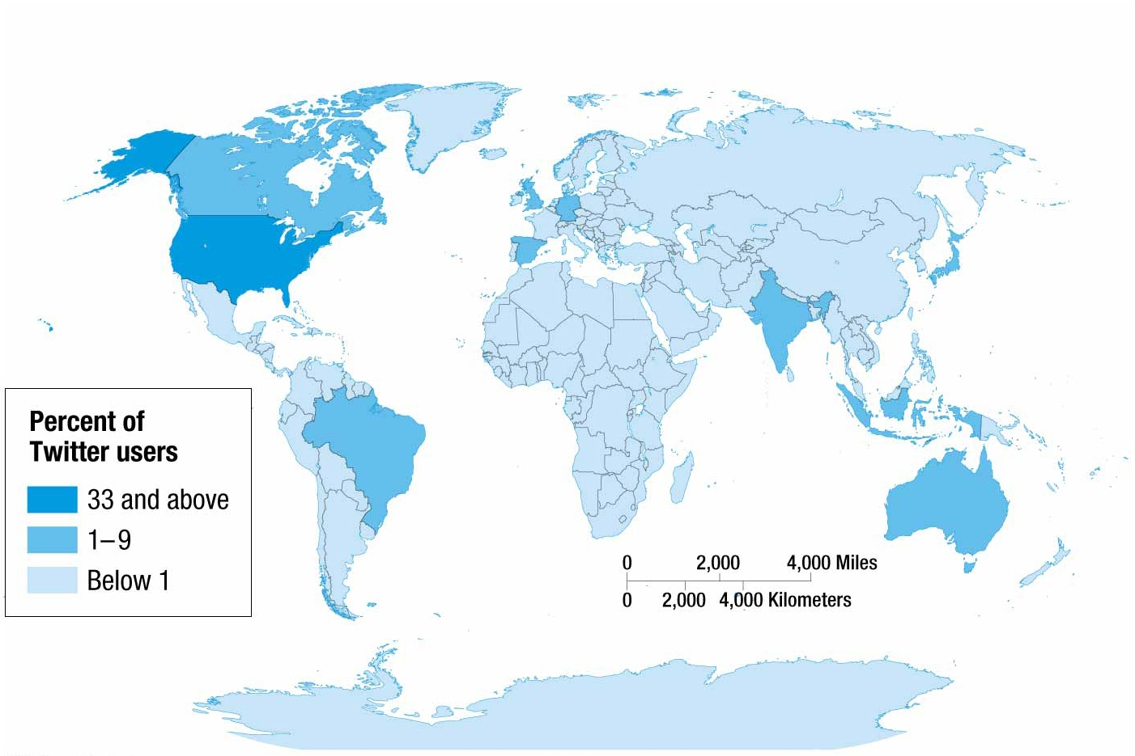
Notes:
FIGURE 4-35 DISTRIBUTION OF TWITTER USERS More than one-third of the world’s Twitter users were in the United States in 2011.

Slide 33
Why Is Access to Folk and Popular Culture Unequal?
Challenges in Accessing Electronic Media
External Threat: Developed Countries Control the Media
TV industry dominated by Japan, UK, and United States.
Leaders of developing countries could view dominance as impressing American values upon viewers.
Upward social mobility
Freedom for women
Glorification of youth
Stylized violence

Slide 34
Why Is Access to Folk and Popular Culture Unequal?
Challenges in Accessing Electronic Media
External Threat: Developed Countries Control the Media
News
News media in developing countries dominated by the government, whereas media in the United States is largely private commercial stations.
Many African and Asian government officials criticize freedom of the press in the United States.
Allegedly media do not convey an accurate view of other countries.

Slide 35
Where Are Folk and Popular Leisure Activities Distributed?
Challenges in Accessing Electronic Media
Internal Threat: Social Media
Limiting Access to TV
Satellite dishes enable people to access information that would otherwise be censored by their governments.
Some governments attempt to limit Internet content including:
Political Content
Opposition to local government
Social Content
Socially sensitive material, such as gambling or sex
Conflict and Security
Armed conflict, border disputes, or militant groups
Internet Tools
Email, Internet hosting, and Internet searches

Slide 36
Why Do Folk and Popular Culture Face Sustainability Challenges?
Sustainability Challenges for Folk Culture
Increased connection with popular culture makes maintaining centuries-old practices difficult.
Impacts of globalization on the landscape creates challenges in maintaining a unique landscape.
Global diffusion of popular culture beliefs has challenged the subservience of women to men that is embedded in some folk customs.

Slide 37
Why Do Folk and Popular Culture Face Sustainability Challenges?
Sustainability Challenges for Popular Culture
Diffusion of some popular customs can adversely impact environmental quality in two ways:
Pollution of the Landscape
Uniform landscapes used to generate product recognition. e.g., motels and fast-food restaurants
Golf courses remake the environment by drastically modifying its natural state.
Depletion of Scarce Natural Resources
Diffusion of some popular customs increases demand for animal products and for raw materials—e.g., minerals and fossil fuels.

Slide 38
Summary
Traits and leisure activities associated with folk culture tend to diffuse more slowly than those of popular culture.
Folk clothing tends to be greatly influenced by local environmental conditions, whereas popular culture clothing tends to represent income and occupation.
Important elements of material culture include clothing, food, and shelter.

Slide 39
Summary
Popular culture is diffused around the world through electronic media that began with the TV. It has since phased over into the Internet and Social Media.
Globalization and greater connectivity have fostered a world where new ideas are spread more rapidly and fewer places of isolation exist.

