Slide 1
Unit 3 Chapter 5
Languages

Slide 2
Where Are Languages Distributed?
Language is a system of communication through speech, a collection of sounds that a group of people understands to have the same meaning.
Literary tradition refers to a system of written communication.
Many countries designate at least one official language to be used for official documents and public objects—e.g., road signs and money.
Notes:
Ethnologue, which is quoted throughout this chapter, is an authoritative sources of languages. It estimates of the world has 6,909 languages. Only 11 of these languages, including English, are spoken by at least 100 million people

Slide 3
Where Are Languages Distributed?
World’s languages organized into:
Language Families: collection of languages related through a common ancestral language
Language Branches: collection of languages within a family related through a common ancestral language. Differences are not as significant or as old as between families.
Language Groups: collection of languages within a branch that share a common origin in the relatively recent past and display similar grammar and vocabulary.

Slide 4
Where Are Languages Distributed?
Classification of Languages
2/3 of the world’s population speak a language that belongs to the Indo-European or Sino-Tibetan language family.
2 to 6 percent of the world’s population speak a language that fits into one of seven other language families.
Remainder of population speaks a language belonging to one of 100 smaller families.

Slide 5
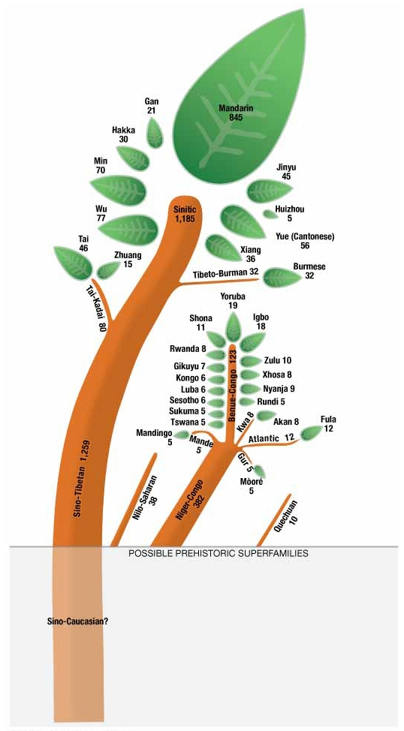
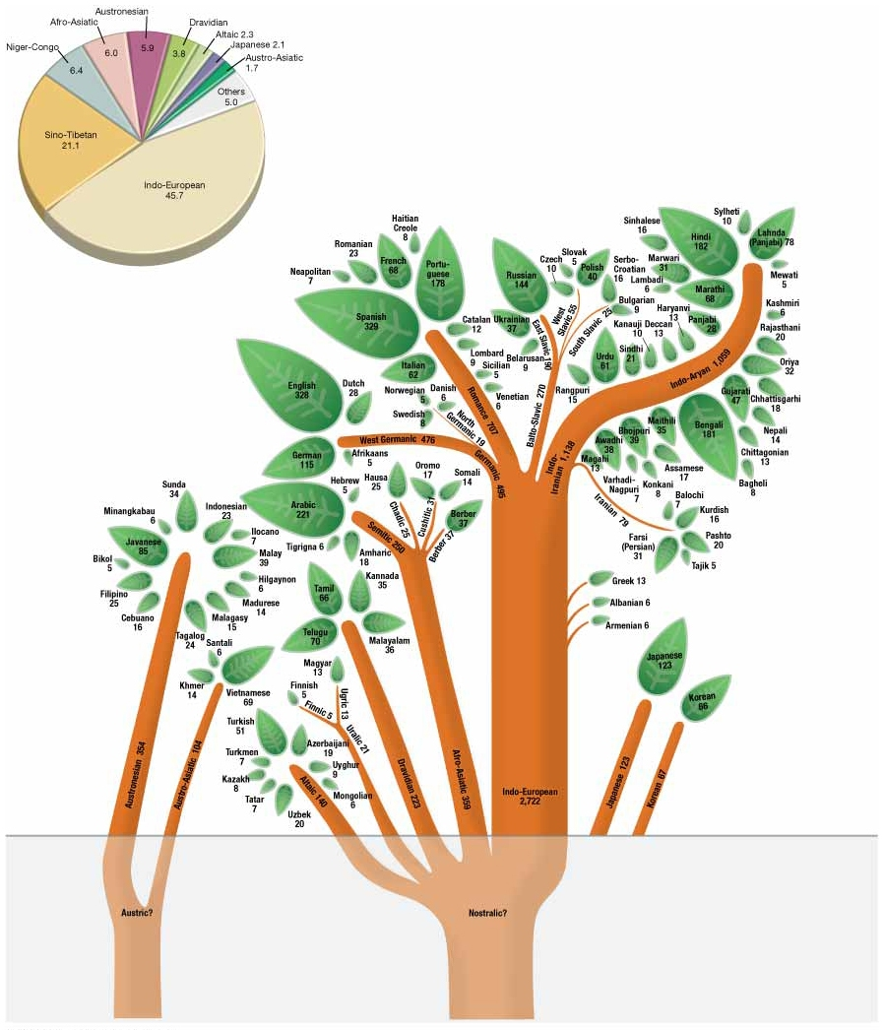
Notes:
FIGURE 5-3 LANGUAGE FAMILY TREE Language families with at least 10 million speakers according to Ethnologue are shown as trunks of trees. Some language families are divided into branches and groups. Individual languages that have more than 5 million speakers are shown as leaves. Below ground level, the language tree’s “roots” are shown, but these are speculative because they predated recorded history.
FIGURE 5-4 SHARE OF EACH LANGUAGE FAMILY The chart shows the percentage of people who speak a language from each major family.

Slide 6
Where Are Languages Distributed?
Distribution of Language Families
The two largest language families are…
Indo-European
Predominate language family in Europe, South Asia, North America and Latin America.
Sino-Tibetan
Encompasses languages spoken in the People’s Republic of China and several smaller countries in Southeast Asia.
No single Chinese language
Mandarin is the most-used language in the world and the official language of both the People’s Republic of China and Taiwan.
Notes:
Mandarin is one of six official languages in the U.N.

Slide 7
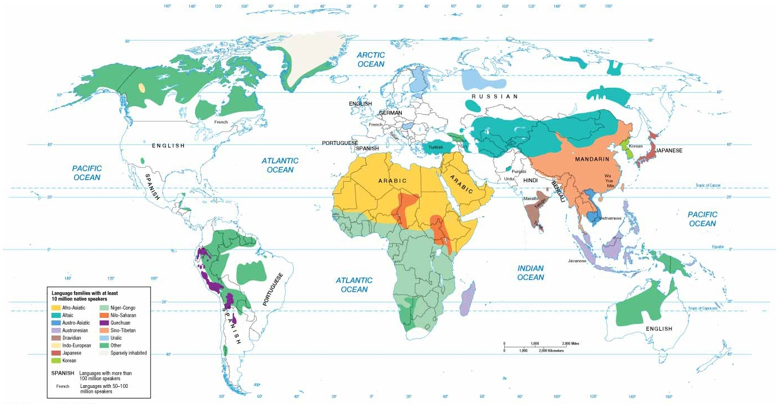
Where Are Languages Distributed?
Notes:
FIGURE 5-5 DISTRIBUTION OF LANGUAGE FAMILIES Most language can be classified into one of a handful of language families.

Slide 8
Where Are Languages Distributed?
Other Asian Language Families
Several other language families spoken by large numbers of people in East and Southeast Asia.
Isolation on islands and peninsulas contributed to overall independent development.
Austronesian
Austro-Asiatic
Tai Kadai
Japanese
Korean

Slide 9
Where Are Languages Distributed?
Languages of Southwest Asia and North Africa and Central Asia
Two largest language families are…
Afro-Asiatic
Arabic is major language.
Official language in 24 countries of S.W. Asia and North Africa
One of the six official languages in U.N.
Altaic
Altaic language with most speakers is Turkish.
Altaic language became official language of several countries that gained independence when Soviet Union broke up—e.g., Azerbaijan, Kazakhstan, and Turkmenistan.

Slide 10
Where Are Languages Distributed?
African Language Families
More than 1,000 distinct languages have been documented.
Several thousand dialects recognized.
Most lack a written tradition.
Niger-Congo
Swahili
First language of 800,000 people
Official language of Tanzania
Spoken by 30 million Africans
Language used to speak with outsiders from different villages

Slide 11
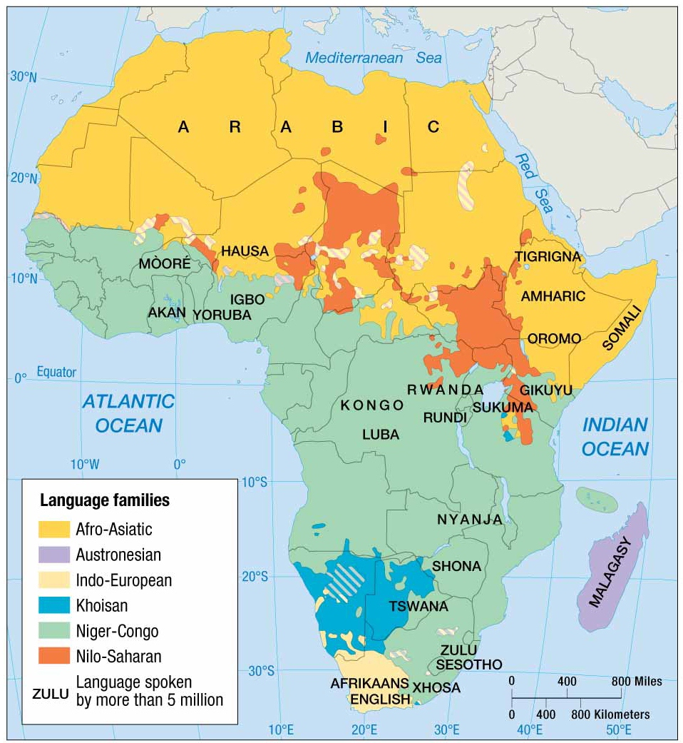
Notes:
FIGURE 5-8 AFRICA’S LANGUAGE FAMILIES More than 1,000 languages have been identified in Africa, and experts do not agree on how to classify them into families, especially languages in central Africa. Languages with more than 5 million speakers are named on the map. The great number of languages results from at least 5,000 years of minimal interaction among the thousands of cultural groups inhabiting the African continent. Each group developed its own language, religion, and other cultural traditions in isolation from other groups.

Slide 12
Why Is English Related to Other Languages?
Distribution of Indo-European Branches
Four most widely spoken branches
Germanic branch
Spoken primarily in northwestern Europe and North America
Divides into High and Low Germanic subgroups
English is classified in the Low Germanic group
Indo-Iranian branch
Spoken primarily in South Asia
Most speakers of the language branch
Subdivided into eastern group (Indic) and western group (Iranian)
Notes:
English belongs to Indo-European, the world’s most widely spoken language family.
Indic
438 languages spoken in India, including 29 with at least 1 million speakers.
Iranian
Major languages include Persian (aka Farsi) in Iran, Pashto (eastern Afghanistan and western Iran), and Kurdish (Kurds in western Iran, northern Iraw, and eastern Turkey). All written with the Arabic alphabet.

Slide 13
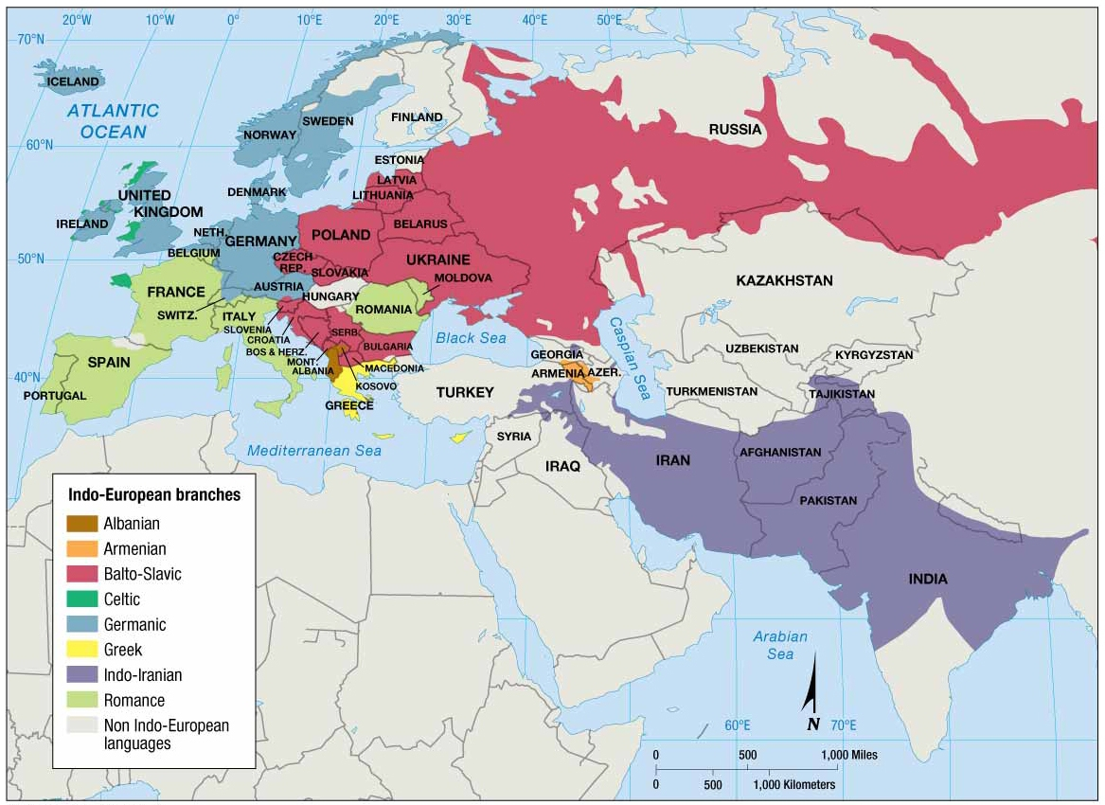
Notes:
FIGURE 5-9 BRANCHES OF THE INDOEUROPEAN LANGUAGE FAMILY Most Europeans speak languages from the Indo-European language family. In Europe, the three most widely used branches are Germanic (north and west), Romance (south and west), and Slavic (east). The fourth major branch, Indo-Iranian, clustered in southern and western Asia, has more than 1 billion speakers, the greatest number of any Indo-European branch

Slide 14
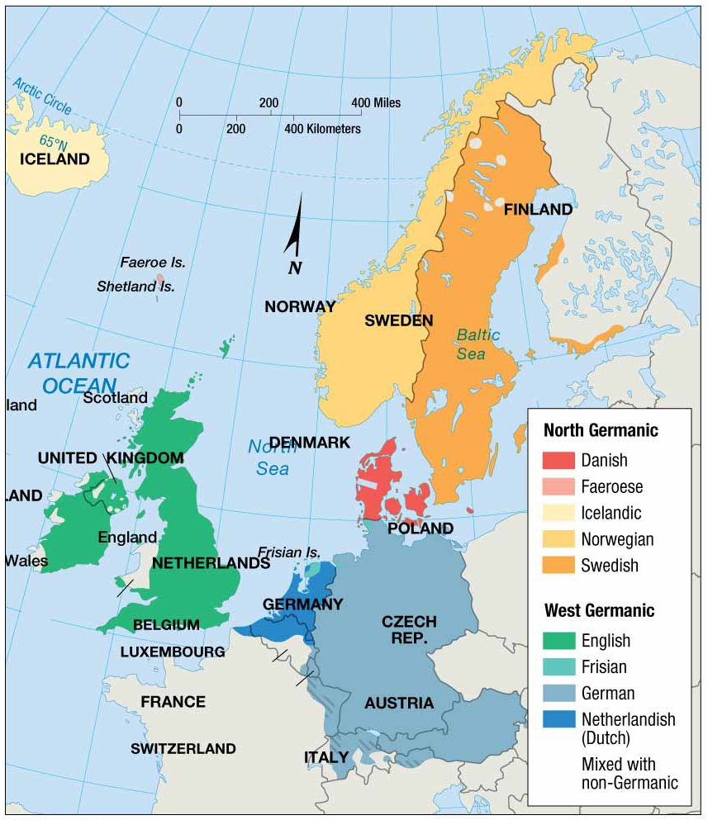
Notes:
FIGURE 5-10 LANGUAGE GROUPS OF THE GERMANIC BRANCH Germanic languages predominate in Northern and Western Europe.

Slide 15
Why Is English Related to Other Languages?
Distribution of Indo-European Branches
Four most widely spoken branches
Balto-Slavic branch
Spoken primarily in Eastern Europe
Divided into…
East Slavic and Baltic Groups: most widely used language is Russian followed by Ukrainian and Belarusan.
West and South Slavic Groups: most spoken west Slavic language is Polish followed by Czech and Slovak, while the most widely spoken south language is Serbo-Croatian.

Slide 16
Why Is English Related to Other Languages?
Distribution of Indo-European Branches
Four most widely spoken branches
Romance branch
Spoken primarily in southwestern Europe and Latin America
Most widely used are Spanish, Portuguese, French, and Italian.
Regions where spoken languages tend to correspond to the political boundaries of Spain, Portugal, France, and Italy

Slide 17
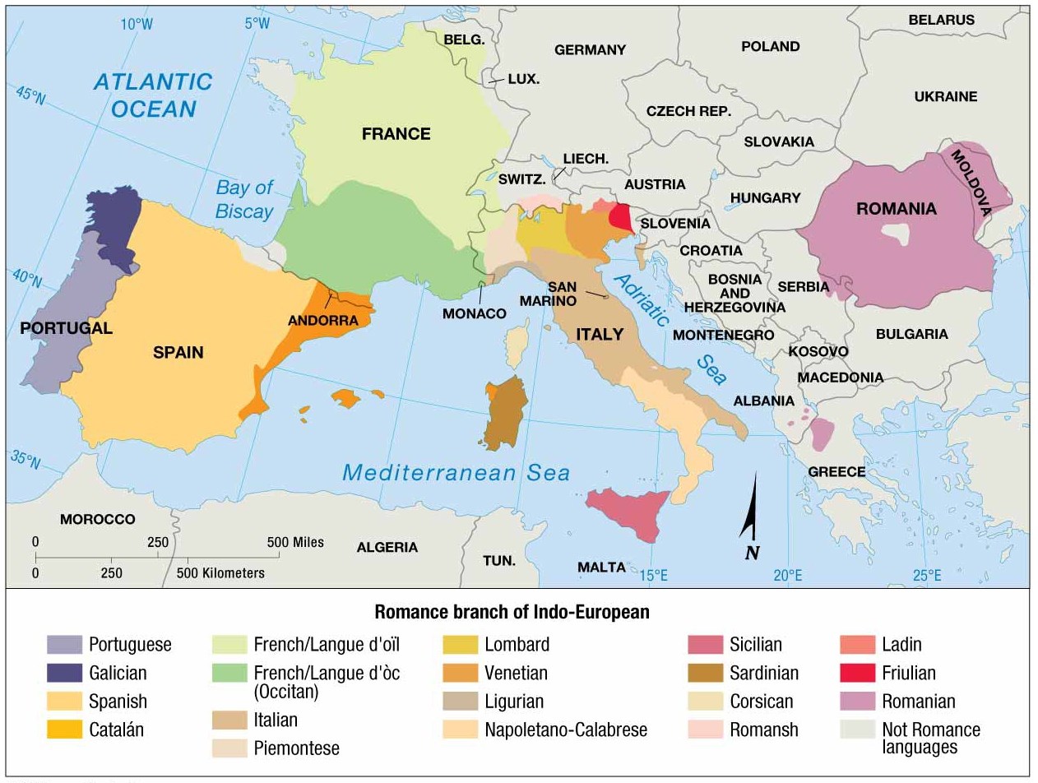
Notes:
FIGURE 5-13 ROMANCE BRANCH OF THE INDO-EUROPEAN LANGUAGE FAMILY Romance branch languages predominate in southwestern Europe.

Slide 18
Why Is English Related to Other Languages?
Origin and Diffusion of Language Families
Modern English has evolved primarily from the language spoken by three Germanic tribes invading the British Isles.
Angles- from southern Denmark
Jutes- from northern Denmark
Saxons- from northwestern Germany
Over time, others invaded England and their languages influenced the basic English.
Vikings from present-day Norway
Normans from present-day Normandy in France spoke French.

Slide 19
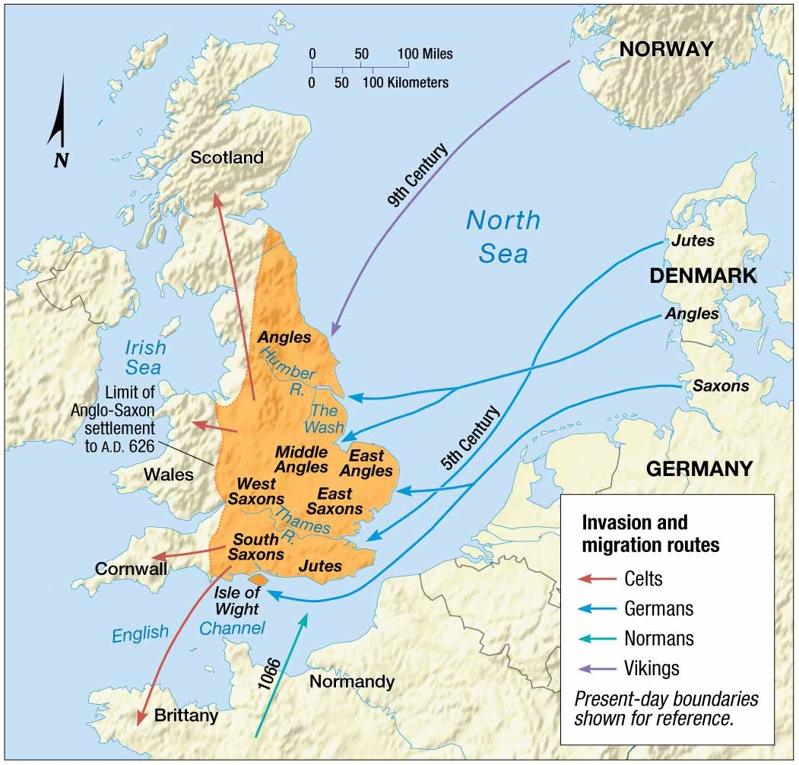
Notes:
FIGURE 5-15 INVASIONS OF ENGLAND The first speakers of the language that became known as English were tribes that lived in present-day Germany and Denmark. They invaded England in the fifth century. The Jutes settled primarily in southeastern England, the Saxons in the south and west, and the Angles in the north, eventually giving the country its name—Angles’ Land, or England. Invasions by Vikings in the ninth century and Normans in the eleventh century brought new words to the language spoken in the British Isles. The Normans were the last successful invaders of England.

Slide 20
Why Is English Related to Other Languages?
Origin and Diffusion of Language Families
English diffuses across the world.
English language migrated with the people of England when they established colonies over four centuries.
English is an official language in most former British colonies.
Diffusion to North America
First successful colony was Jamestown, VA, in 1607.
Defeat of France by England secured English as the dominant language in North America.
United States responsible for diffusing English to several places—e.g., Philippines.

Slide 21
Why Is English Related to Other Languages?
Origin and Diffusion of Language Families
Indo-European
It is theorized that Germanic, Romance, Balto-Slavic, and Indo-Iranian languages all stemmed from a common ancestral language.
Proto-Indo-European
Linguists and anthropologists continue to debate when and where the Proto-Indo-European language originated and how it diffused.
Two Theories
Nomadic Warrior Hypothesis
Sedentary Farmer Hypothesis
Notes:
The debate over place of origin and paths of diffusion is significant; one argues that language diffused primarily through warfare and conquest, and another theory argues that the diffusion resulted from peaceful sharing of food.

Slide 22
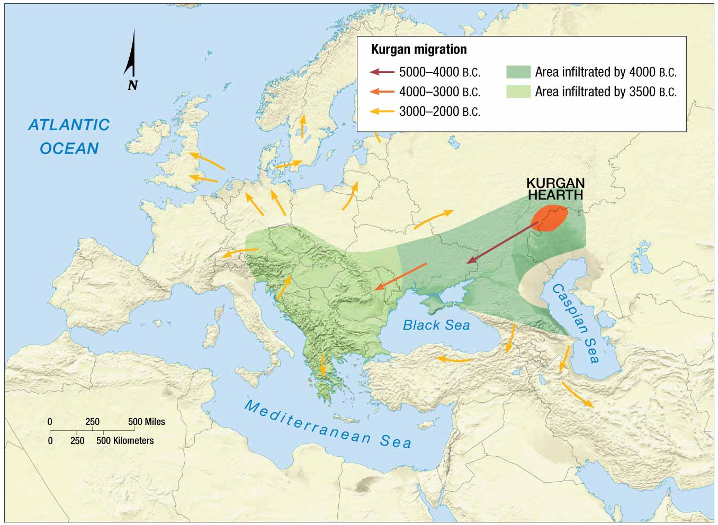
Notes:
FIGURE 5-18 ORIGIN AND DIFFUSION OF INDO-EUROPEAN (NOMADIC WARRIOR THEORY) The Kurgan homeland was north of the Caspian Sea, near the present-day border between Russia and Kazakhstan. According to this theory, the Kurgans may have infiltrated into Eastern Europe beginning around 4000 b.c. and into central Europe
and Southwest Asia beginning around 2500 b.c.

Slide 23
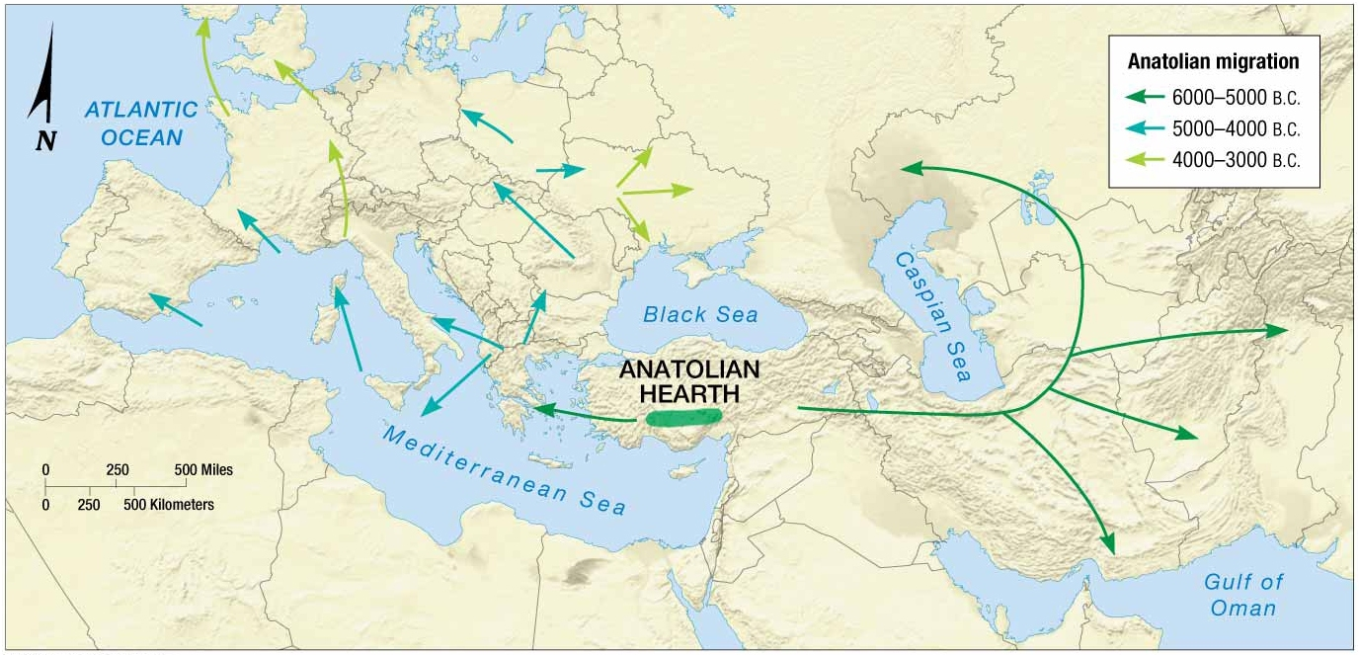
Notes:
FIGURE 5-19 ORIGIN AND DIFFUSION OF INDOEUROPEAN (SEDENTARY FARMER THEORY ) Indo-European may have originated in present-day Turkey 2,000 years before the Kurgans. According to this theory, the language diffused along with agricultural innovations west into Europe and east into Asia.

Slide 24
Why Do IndWhvidual Languages Vary amonPlaces?
Dialects of English
A dialect is a regional variation of a language distinguished by distinctive vocabulary, spelling, and pronunciation.
Boundaries of where regional words are used can be mapped; such a word usage boundary is known as an isogloss.
Large number of speakers and widespread distribution in the United States has contributed to the existence of a large number of English dialects.

Slide 25
Why Do Individual Languages Vary among Places?
Dialects in the United States
The 13 original colonies can be grouped into three dialect regions.
New England
Inhabited by settlers from England
Southeastern
About ½ came from southeastern England, while the others represented a diversity of social-class backgrounds.
Midlands
Most diverse group—e.g., Quakers from north of England, Scots and Irish, German, Dutch, and Swedish migrants.

Slide 26
Why Do Individual Languages Vary among Places?
Current Dialect Differences in the East
Some English words are specific to a dialect.
Rural life
Food
Objects from daily activities
Language differences tend to be greatest in rural areas because of limited interaction with people from other dialect regions.
Mass media has reduced the number of regionally distinctive words.
Notes:
Most words that are specific to a dialect pertain to rural life, food, or objects from daily activities.

Slide 27
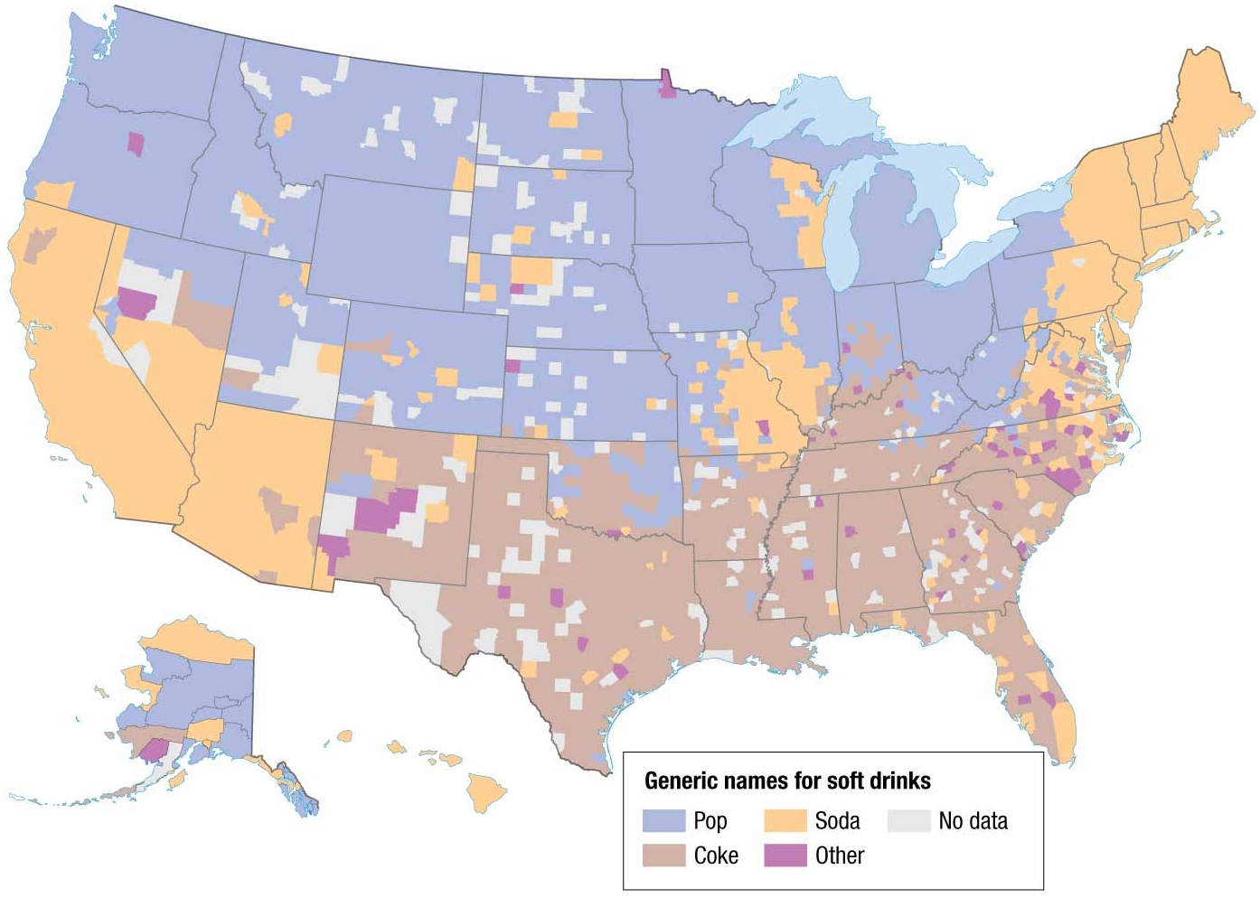
Notes:
FIGURE 5-22 SOFT-DRINK DIALECTS Soft drinks are called soda in the Northeast and Southwest, pop in the Midwest and Northwest, and Coke in the South. The map reflects voting at www.popvssoda.com.

Slide 28
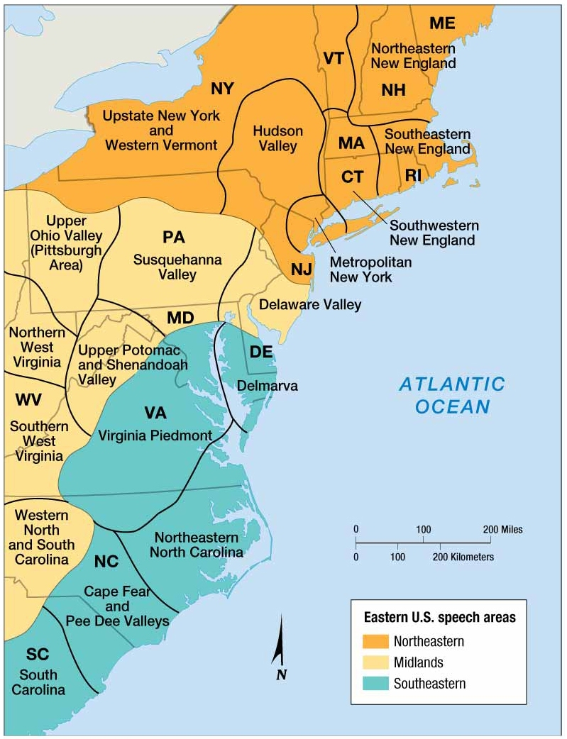
Notes:
FIGURE 5-20 DIALECTS IN THE EASTERN UNITED STATES The most comprehensive classification of dialects in the United States was made by Hans Kurath in 1949. He found the greatest diversity of dialects in the eastern part of the country, especially in vocabulary used on farms. Kurath divided the eastern United States into three major dialect regions—Northern, Midlands, and Southern—each of which contained a number of important subareas. Compare this to the map of source areas of U.S. house types (FIGURE 4-25). As Americans migrated west, they took with them distinctive house types as well as distinctive dialects.

Slide 29
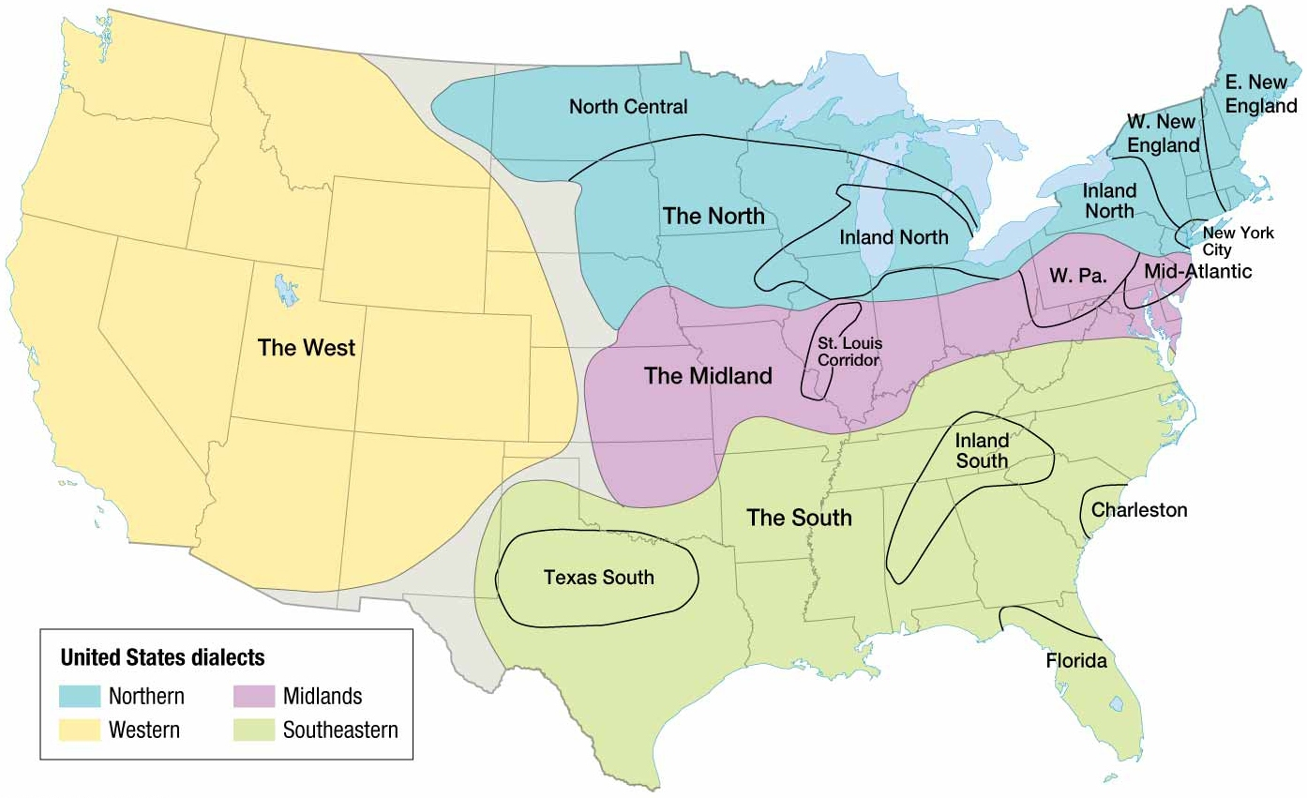
Notes:
FIGURE 5-21 U.S. DIALECTS AND SUBDIALECTS The four major U.S. dialect regions are Northern, Southern, Midlands, and West.

Slide 30
Why Do Individual Languages Vary among Places?
Dialects in the United Kingdom
Languages with multiple dialects may recognize one as the standard language that is widely recognized as the most acceptable for government, business, education, and mass communication.
Ex. England’s is known as British Received Pronunciation (BRP).

Slide 31
Why Do Individual Languages Vary among Places?
British and American English Dialects
English language is noticeably different than English spoken in England in three ways.
Vocabulary
Settlers in America encountered many new objects and experiences not present in England.
Climate and geography differ significantly between England and America.
Spelling
Noah Webster sought to make English used in America distinct from England to reduce cultural dependence by changing spellings of words in his dictionary.
Pronunciation
Chief cause was limited interaction between speakers of varying dialects.
Notes:
Reasons for differences.
Isolation
Separation by Atlantic Ocean allowed two languages to develop independently.
Limited travel and communications
Few people traveled between the U.S. and England during the 18th and 19th centuries and no form of communication that transmitted voices across the ocean, thus pronunciation of words developed independently.

Slide 32
Why Do Individual Languages Vary among Places?
Distinguishing between Languages and Dialects
Dialect or language
Increasingly difficult to determine whether two languages are distinct or whether they are dialects of the same language.
Several languages in Italy that have been traditionally classified as dialects of Italian are now viewed by Ethnologue as distinct enough to merit consideration as a new language.
Examples include Emiliano-Romagnolo, Liguri, Lombard, and Sicilian.
Notes:
Ethnologue is a leading authoritative source on languages.

Slide 33
Why Do People Preserve Local Languages?
Language Diversity
Difficulties can arise at the boundary between two languages.
Varying degrees of difficulties
Belgium
Southern Belgians (Walloons) speak French.
Northern Belgians (Flemings) speak Flemish.
Pressure from Flemish speakers led to the division of Belgium into two independent regions with each controlling their own cultural affairs, public health, road construction, and urban development.
Switzerland
Cont’d on next slide.
Notes:
Antagonism between the Flemings and Walloons is aggravated by economic and political differences. Historically, Flemings dominated Belgians economy and politics, and French is the official state language

Slide 34
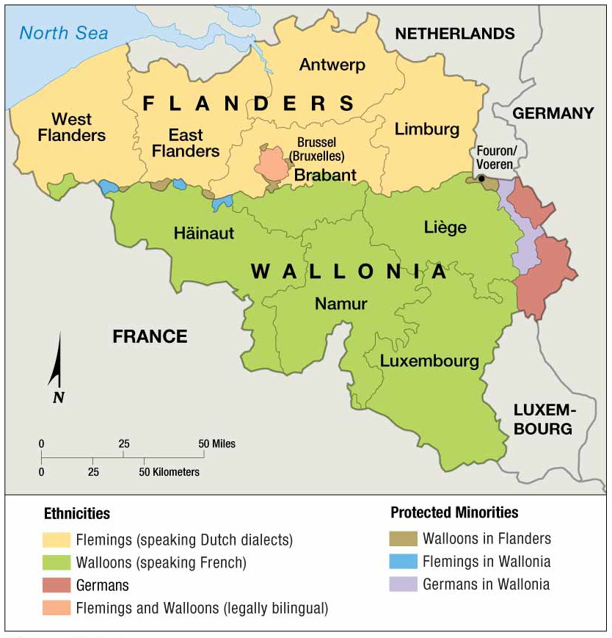
Notes:
FIGURE 5-27 LANGUAGES IN BELGIUM FLEMINGS in the north speak Flemish, a Dutch dialect. Walloons in the south speak French. The two groups have had difficulty sharing national power.

Slide 35
Why Do People Preserve Local Languages?
Language Diversity
Difficulties can arise at the boundary between two languages.
Varying degrees of difficulties
Switzerland
Peacefully exists with multiple languages.
Switzerland attributes success to decentralized government, in which local authorities hold most of the power, and decisions are frequently made on a local level by voter referenda.
Four official languages—German (65%), French (18%), Italian (10%), and Romansh (1%)

Slide 36
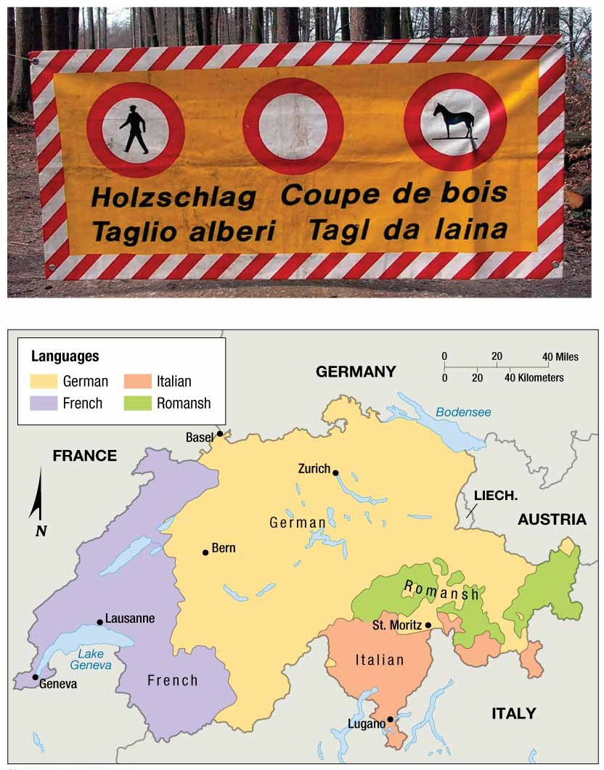
Notes:
FIGURE 5-29 LANGUAGE DIVERSITY IN SWITZERLAND The map shows Switzerland’s four official languages. The photo shows a sign that prevents hikers, vehicles, and horses from entering the forest because of timber cutting. German is top left, French top right, Italian lower left, and Romansh lower right. Switzerland lives peacefully with four official languages, including Romansh, which is used by only 1 percent of the population.

Slide 37
Why Do People Preserve Local Languages?
Isolated Languages
An isolated language is one unrelated to any other and therefore not attached to any language family.
Arise from lack of interaction with speakers of other languages.
Ex. Basque in Europe
Only language currently spoken that survives since the period before the arrival of Indo-European speakers.
First language of 666,000 people in the Pyrenees Mountains of northern Spain and southwestern France.
Mountain chain serving as a natural barrier to diffusion helped them preserve their language.
Ex. Icelandic
Language has changed less than any other Germanic language.

Slide 38
Why Do People Preserve Local Languages?
Extinct and Revived Languages
An extinct language is one that is no longer spoken or read in daily activities by anyone in the world.
Presently, 473 languages nearly extinct
46 in Africa
182 in Americas
84 in Asia
9 in Europe
152 in Pacific
Ex. Native Americans
74 languages extinct in the United States that were once spoken by Native Americans.
Notes:
Hebrew is a rare case of a language being revived. Efforts are being made to update the ancient language to reflect modern advances, such as words for telephones, cars, and electricity.

Slide 39
Why Do People Preserve Local Languages?
Preserving Endangered Languages: Celtic
Linguists expect hundreds of languages will become extinct during the twenty-first century.
Only about 300 languages are said to be safe from extinction.
Celtic Language
Significant to English speakers because of its primacy in the British Isles.
Survives only in remote parts of Scotland, Wales, and Ireland, and on the Brittany peninsula of France.
Celtic speakers must work hard to preserve their language in face of diffusion by others who have greater political and economic strength.

Slide 40
Why Do People Preserve Local Languages?
Global Dominance of English
A lingua franca is a language of international communication.
Ex. English
First language of 328 million people
Spoken fluently by another ½ to 1 billion people.
Official language in 57 countries
People in smaller countries learn English to participate more fully in the global economy and culture.
Other Examples
Swahili in East Africa
Hindi in South Asia
Indonesian in Southeast Asia
Russian in former Soviet Union.

Slide 41
Why Do People Preserve Local Languages?
Global Dominance of English
English on the Internet
Majority of content on Internet is in English.
Dominance of content in English is waning.
Percentage of English-language online users declined from 46 percent in 2000 to 27 percent in 2010.
Mandarin will likely replace English as the most-frequently used online language before 2020.

Slide 42
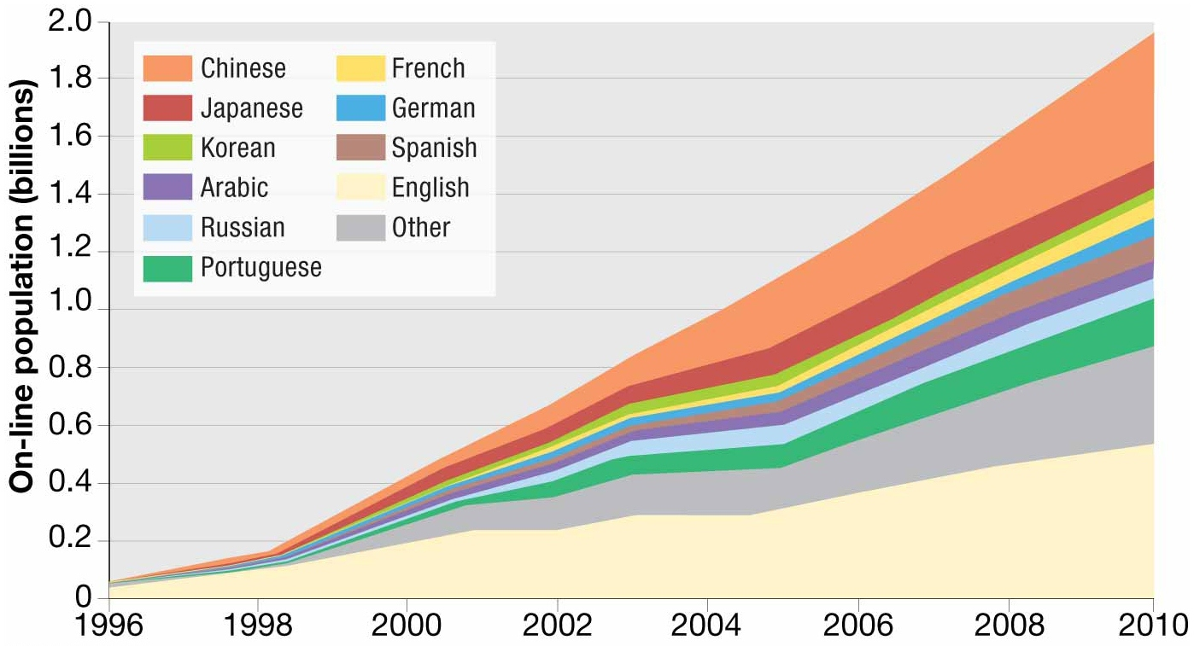
Notes:
FIGURE 5-50 LANGUAGES OF ONLINE SPEAKERS English remains the most widely used language on the Internet, but Chinese is growing more rapidly.

Slide 43
Why Do People Preserve Local Languages?
Global Dominance of English
Expansion Diffusion of English
Recent growth in the use of English is an example of expansion diffusion—the spread of a trait through the snowballing effect of an idea.
Expansion has occurred in two ways with English.
English is changing through diffusion of new vocabulary, spelling, and pronunciation.
English words are fusing with other languages.
Ex. Words, such as cowboy, hamburger, jeans, and T-shirt were allowed to diffuse into French.
Ex. English words have spurred the creation of English-like words to replace traditional Spanish words, such as parquin (Spanglish) for estacionamiento (Spanish)
Notes:
Unlike most exmaples of expansion diffusion, English has been a bottom-to-top approach with percolated from common usage rather than brought by the elite.

Slide 44
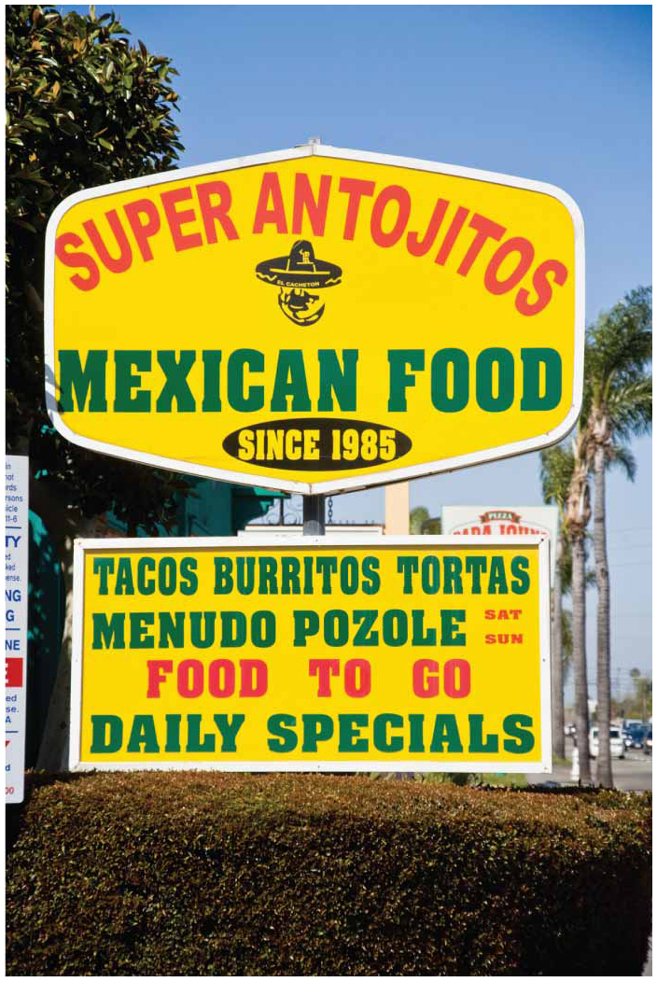
Notes:
FIGURE 5-46 SPANGLISH A restaurant in Santa Ana, California, mixes Spanish and English.

Slide 45
Why Do People Preserve Local Languages?
Spanish and French in the United States and Canada
Spanish
Increasingly important language in recent years in United States because of large-scale immigration from Latin America.
Some communities now issue public notices, government documents, and advertisements in Spanish.
Radio stations and TV now broadcast in Spanish in places where most of the 35 million Spanish speakers live.
In reaction, 30 states and number of localities have laws making English the official language.
Some courts have judged these laws to be unconstitutional restrictions on free speech.

Slide 46
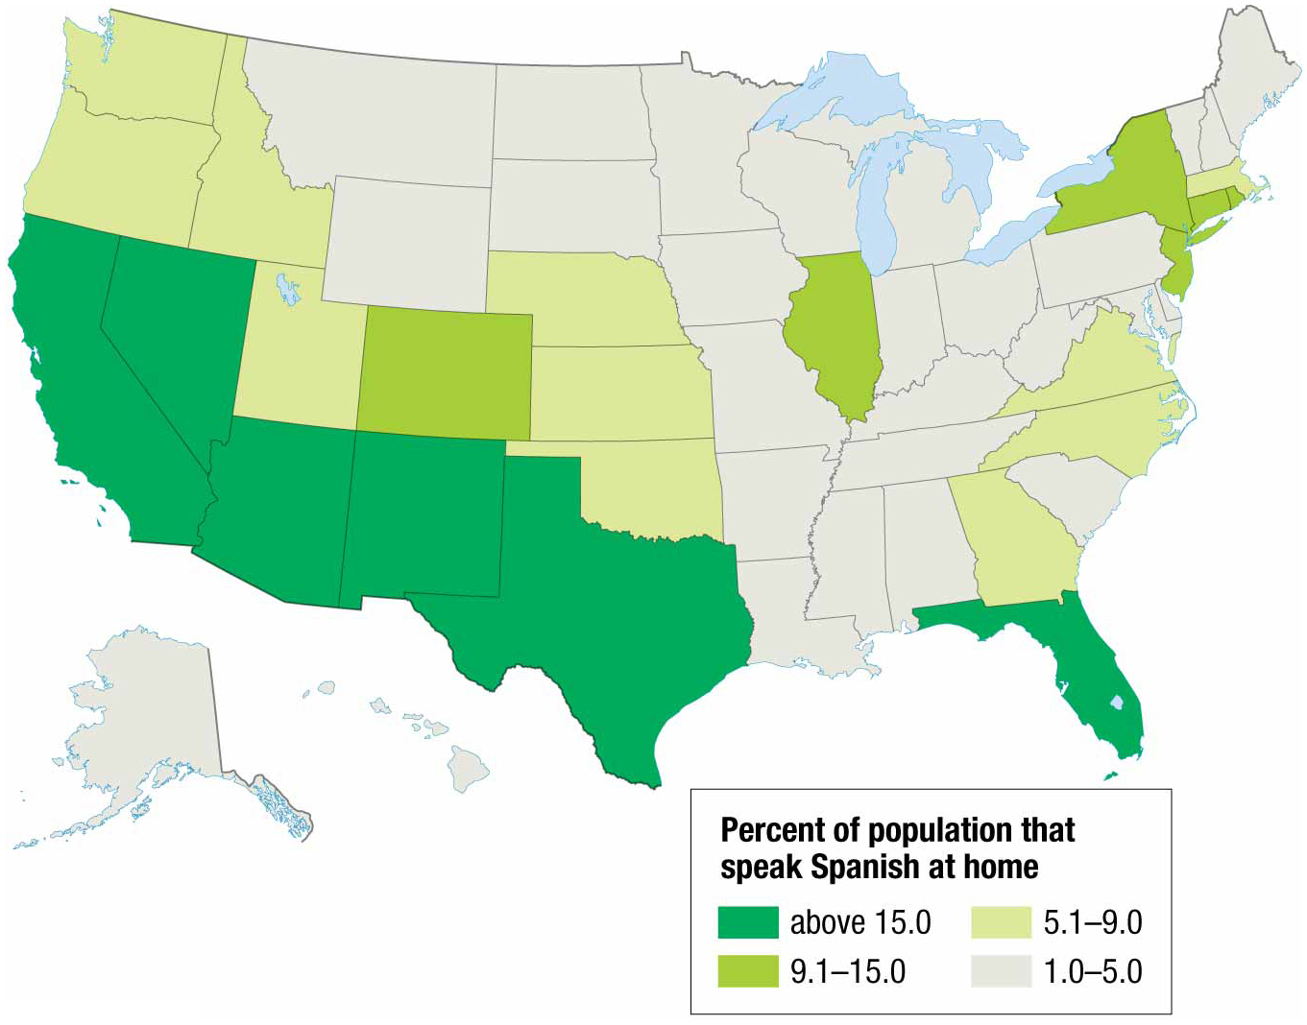
Notes:
FIGURE 5-48 SPANISH SPEAKERS IN THE UNITED STATES The largest percentages of Spanish speakers are in the Southwest and in Florida.

Slide 47
Why Do People Preserve Local Languages?
Spanish and French in the United States and Canada
French
Québec government has made the use of French mandatory in many daily activities.
Québec faces challenges integrating a large number of immigrants from Europe, Asia, and Latin America who don’t speak French.
Immigrants prefer to use English as the lingua franca because of its greater global usage.

