Slide 1
Unit 3 Chapter 6
Religions

Slide 2
Where Are Religions Distributed?
Distribution of Religions
Geographers distinguish two types of religions:
Universalizing religions- attempt to be global by appealing to all people regardless of location or culture.
58 percent of world’s population practices a universalizing religion.
Christianity: 2.1 billion Christians
Islam: 1.5 billion Muslims
Buddhism: 376 million Buddhists
Ethnic religions- appeal primarily to one group of people living in one place.
26 percent of world’s population practices an ethnic religion.
Notes:
16% of world’s population are atheists or agnostics.
Atheism is the least that God does exist.
Agnosticism is belief that nothing can be known about whether God exists.

Slide 3
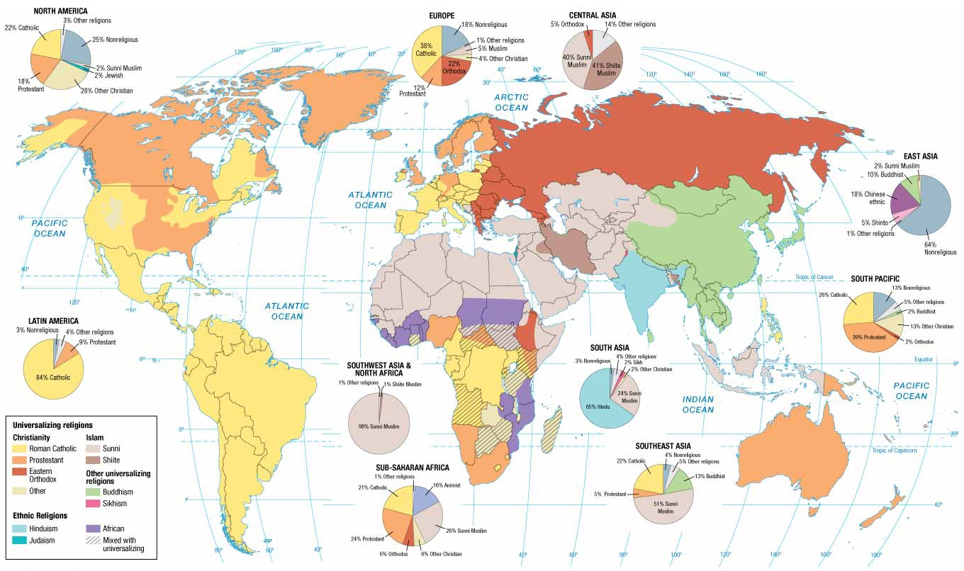
Notes:
FIGURE 6-3 WORLD DISTRIBUTION OF RELIGIONS The pie charts show the share of major religions in each world region.

Slide 4
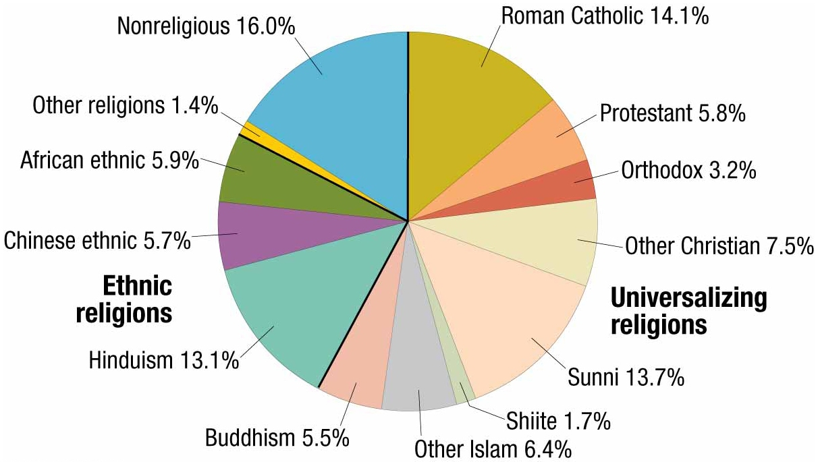
Notes:
FIGURE 6-4 ADHERENTS OF WORLD RELIGIONS Nonreligious includes atheists and agnostics.

Slide 5
Where Are Religions Distributed?
Branches of Universalizing Religions
Three principal universalizing religions divided into branches, denominations, and sects.
A branch is a large and fundamental division within a religion.
A denomination is a division of a branch that unites a number of local congregations in a single legal and administrative body.
A sect is a relatively small group that has broken away from an established denomination.

Slide 6
Where Are Religions Distributed?
Branches of Universalizing Religions
Branches of Christianity in Europe
Three major branches include…
Roman Catholic (51 percent of the world’s Christians)
Protestant (24 percent of the world’s Christians)
Orthodox (11 percent of the world’s Christians)
Distributions
Roman Catholicism dominant branch in southwestern and eastern Europe.
Protestantism dominant branch in northwestern Europe.
Orthodoxy dominant branch in eastern and southeastern Europe.
Notes:
Division between Roman Catholicism and Protestantism often have sharp boundaries even if the dividing line is in the middle of a country.

Slide 7
Where Are Religions Distributed?
Branches of Universalizing Religions
Branches of Christianity in the Western Hemisphere
93 percent of Christians in Latin America are Roman Catholic.
40 percent in North America
Protestant churches have approximately 82 million members in the United States.
Baptist church has largest number of adherents (37 million).
Notes:
Division between Roman Catholicism and Protestantism often have sharp boundaries even if the dividing line is in the middle of a country.

Slide 8
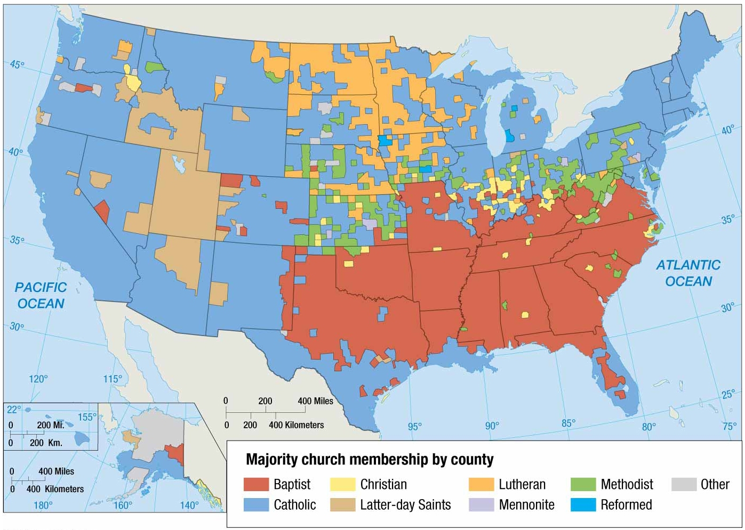
Notes:
FIGURE 6-7 DISTRIBUTION OF CHRISTIANS IN THE UNITED STATES The shaded areas are U.S. counties in which more than 50 percent of church membership is concentrated in either Roman Catholicism or one Protestant denomination. The distinctive distribution of religious groups within the United States results from patterns of migration, especially from Europe in the nineteenth century and from Latin America in recent years.

Slide 9
Where Are Religions Distributed?
Islam
Branches of Islam
Two major branches include…
Sunni
Largest branch in most Muslim countries in Southwest Asia and North Africa
83 percent of all Muslims
Shiite
Greatly concentrated in the Middle Eastern countries of Iran, Azerbaijan, Iraq, Oman, and Bahrain
16 percent of all Muslims

Slide 10
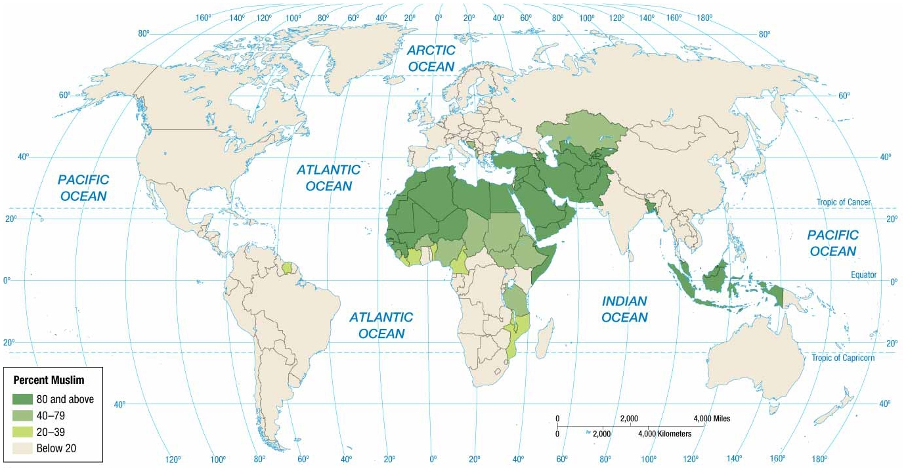
Notes:
FIGURE 6-8 DISTRIBUTION OF MUSLIMS At least 80 percent of the population adheres to Islam in Southwest Asia & North Africa and selected countries in Southeast Asia.

Slide 11
Where Are Religions Distributed?
Buddhism
Branches of Buddhism
Three major branches include…
Mahayana
56 percent of Buddhists
Located primarily in China, Japan, and Korea
Theravada
38 percent of Buddhists
Located primarily in Cambodia, Laos, Myanmar, Sri Lanka, and Thailand
Vajrayana
6 percent of Buddhists
Located primarily in Tibet and Mongolia.
Notes:
Buddhism, the third of the world’s major universalizing religions, is cluster primarily in East Asia and Southeast Asia.

Slide 12
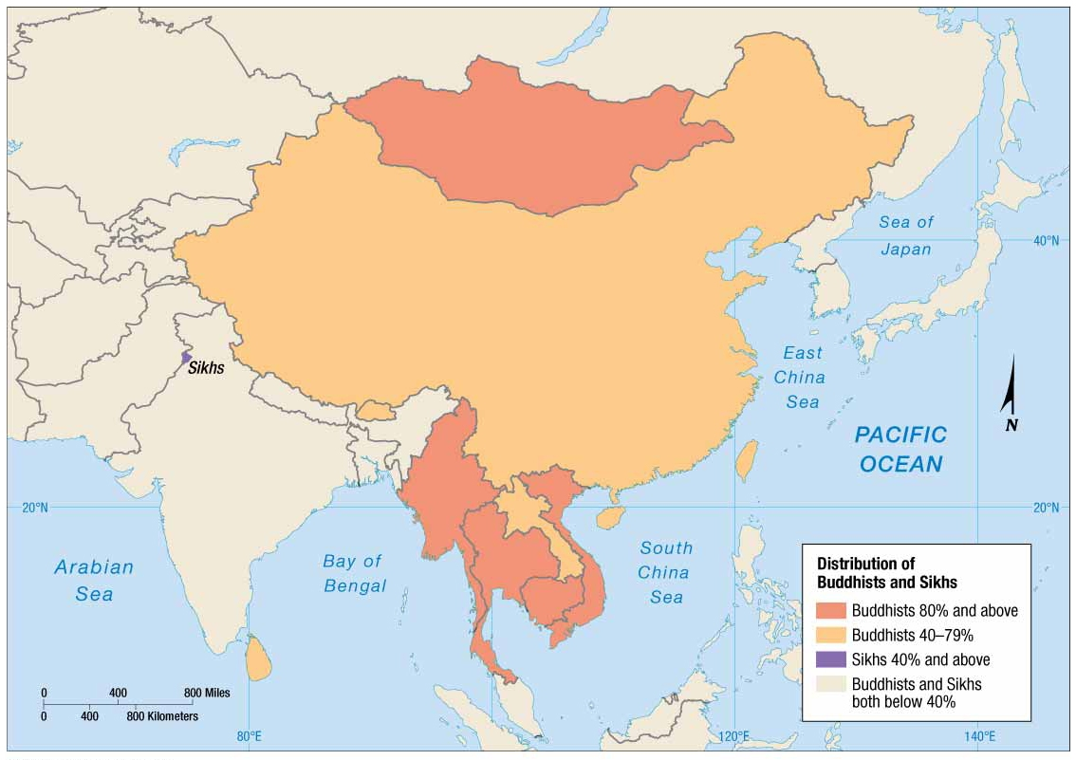
Notes:
FIGURE 6-9 DISTRIBUTION OF BUDDHISTS AND SIKHS At least 40 percent of the population adheres to Buddhism in East Asia and Southeast Asia. At least 40 percent of the population adheres to Sikhism in northwestern India.

Slide 13
Where Are Religions Distributed?
Ethnic Religions
Often remain within the culture where they originated.
Typically have relatively more clustered distributions than do universalizing religions.
Ethnic religion with largest number of followers is Hinduism.
900 million adherents
Nearly all concentrated in India and Nepal

Slide 14
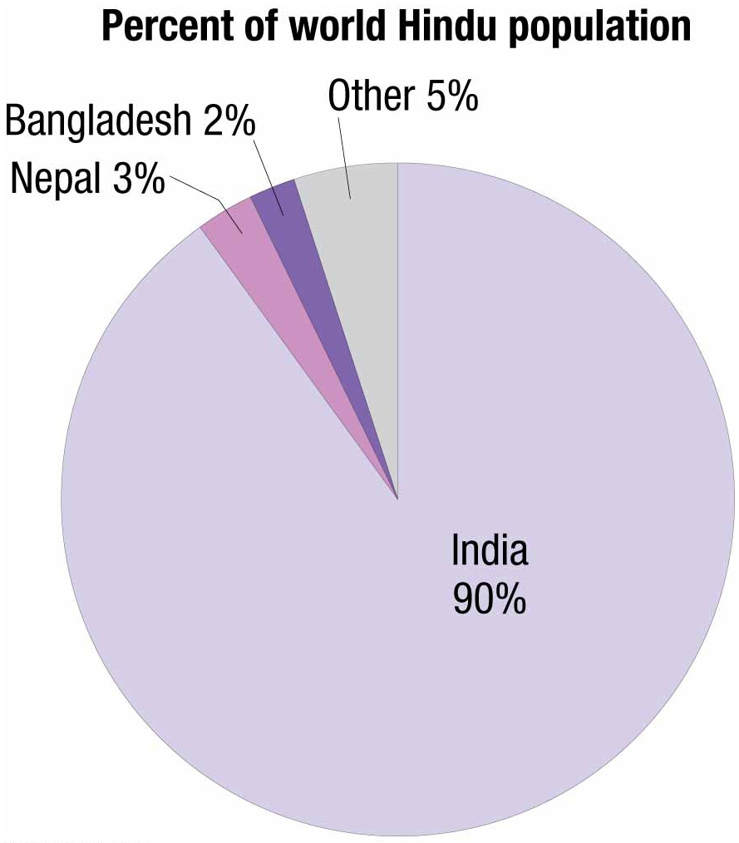
Notes:
FIGURE 6-10 DISTRIBUTION OF HINDUS All but 10 percent of the world’s Hindus live in India.

Slide 15
Where Are Religions Distributed?
Ethnic Religions
A combination of Buddhism (a universalizing religion) with Confucianism, Taoism, and other traditional Chinese practices is practiced in East Asia and Southeast Asia.
Blending or combining of several traditions is known as syncretism.
Animism is an ethnic religion whose followers believe that inanimate objects or natural events, such as natural disasters, have spirits and conscious life.
100 million Africans adhere to animism.

Slide 16
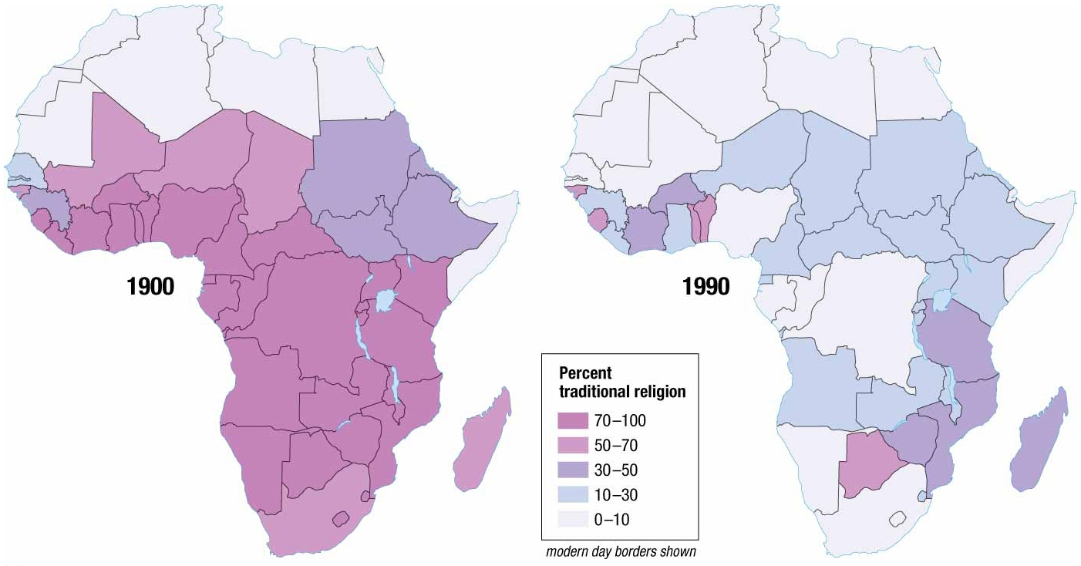
Notes:
FIGURE 6-12 DISTRIBUTION OF AFRICAN TRADITIONAL RELIGIONS The percentage of animists in sub-Saharan Africa has declined from more than 70 percent in 1900 to around 12 percent in 2010. As recently as 1980, some 200 million Africans—half the population of the region at the time—were classified as animists. Followers of traditional African religions now constitute a clear majority of the population only in Botswana. The rapid decline in animists in Africa has been caused by increases in the numbers of Christians and Muslims.

Slide 17
Where Are Religions Distributed?
Ethnic Religions
Judaism
First recorded religion to espouse monotheism, belief that there is only one God.
Contrasts polytheism- the worship of a collection of gods.
Distribution
2/5 live in the United States
2/5 live in Israel.
Christianity and Islam find some of their roots in Judaism.

Slide 18
Why Do Religions Have Different Distributions?
Origins of Religions
Universalizing regions have precise places of origin.
Often based on events in the life of an influential man.
Ethnic religions not tied to single historical individual; often have unclear or unknown origins.
Buddhism
Founded: ~2,500 years ago
Founder: Siddhartha Gautama
Origin: India

Slide 19
Why Do Religions Have Different Distributions?
Origins of Religions
Christianity
Founded: ~2,000 years ago
Founding: Based on teachings of Jesus
Origin: Region located in present-day Palestine
Islam
Founded: ~1,500 years ago
Founder: Prophet Muhammad
Origin: Makkah (Mecca) located in present-day Saudi Arabia

Slide 20
Why Do Religions Have Different Distributions?
Diffusion of Religions
Asia is home to each hearth for Christianity, Islam, and Buddhism.
Followers transmitted the messages preached in the hearths to people elsewhere.
Each of the three main universalizing religions has a distinct diffusion pattern.

Slide 21
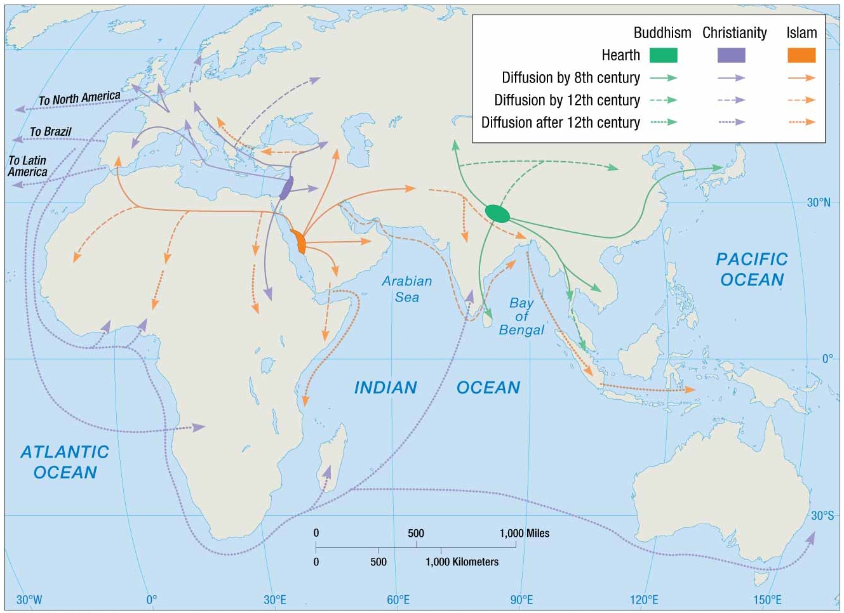
Notes:
FIGURE 6-18 DIFFUSION OF UNIVERSALIZING RELIGIONS Buddhism’s hearth is in present-day Nepal and northern India, Christianity’s in present-day Israel, and Islam’s in present-day Saudi Arabia. Buddhism diffused primarily east toward East Asia and Southeast Asia, Christianity west toward Europe, and Islam west toward northern Africa and east toward southwestern Asia.

Slide 22
Why Do Religions Have Different Distributions?
Diffusion of Religions
Christianity
Hierarchical Diffusion
Emperor Constantine helped diffuse the religion throughout the Roman Empire by embracing Christianity.
Relocation Diffusion
Missionaries, individuals who help transmit a religion through relocation diffusion, initially diffused the religion along protected sea routes and the excellent Roman roads.
Migration and missionary activity by Europeans since 1500 have extended Christianity all over the world.
Permanent resettlement in the Americas, Australia, and New Zealand
Notes:
Further diffusion was achieved by conversion of indigenous populations to Christianity.

Slide 23
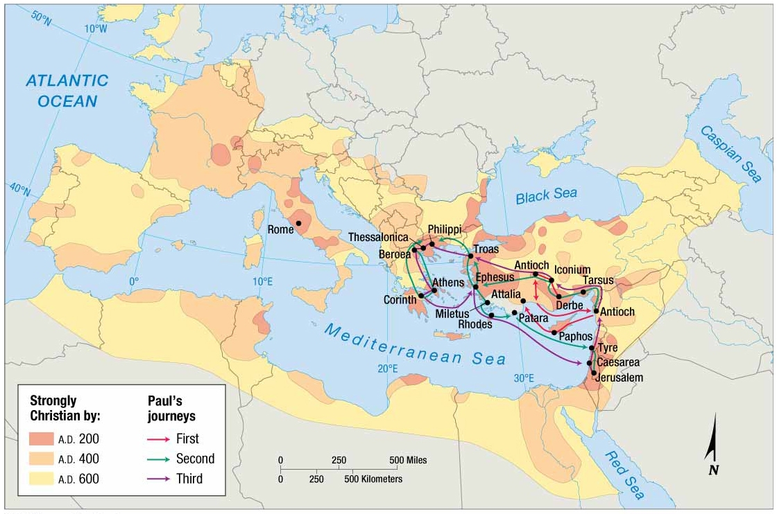
Notes:
FIGURE 6-19 DIFFUSION OF CHRISTIANITY Christianity began to diffuse from Palestine through Europe during the time of the Roman Empire and continued after the empire’s collapse. Paul of Tarsus, a disciple of Jesus, traveled especially extensively through the Roman Empire as a missionary.

Slide 24
Why Do Religions Have Different Distributions?
Diffusion of Religions
Islam
Muhammad’s successors organized followers into armies and led a conquest to spread the religion over an extensive area of…
Africa
Asia
Europe
Relocation diffusion of missionaries to portions of sub-Saharan Africa and Southeast Asia transmitted the religion well beyond its hearth.

Slide 25
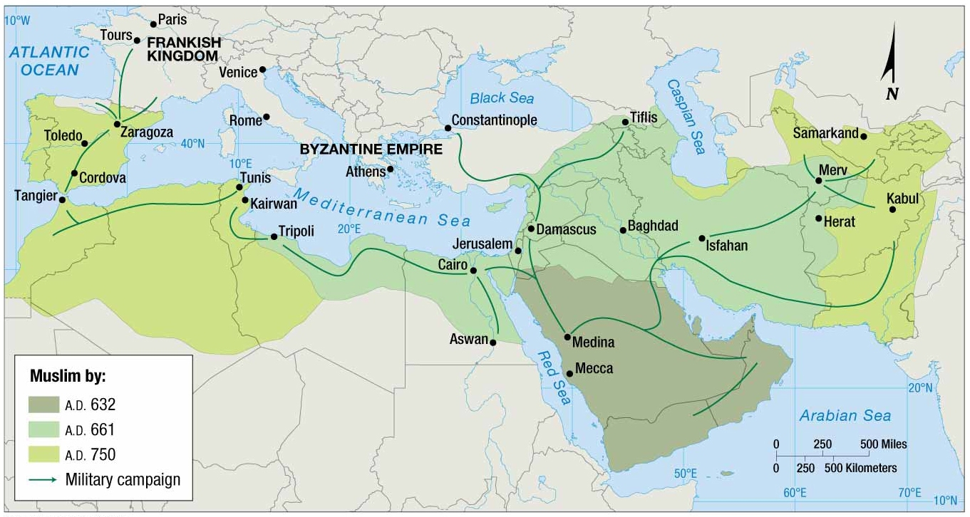
Notes:
FIGURE 6-20 DIFFUSION OF ISLAM Islam diffused rapidly from its point of origin in present-day Saudi Arabia. Within 200 years, Muslims controlled much of Southwest Asia & North Africa and southwestern Europe. Subsequently, Islam became the predominant religion as far east as Indonesia.

Slide 26
Why Do Religions Have Different Distributions?
Diffusion of Religions
Buddhism
Diffused relatively slowly from its origin in northeastern India.
Emperor Asoka accredited with much of its diffusion throughout the Magadhan Empire (273 to 232 B.C.).
Missionaries sent to territories neighboring the empire.
Buddhism introduced to China along trade routes in the first century A.D.

Slide 27
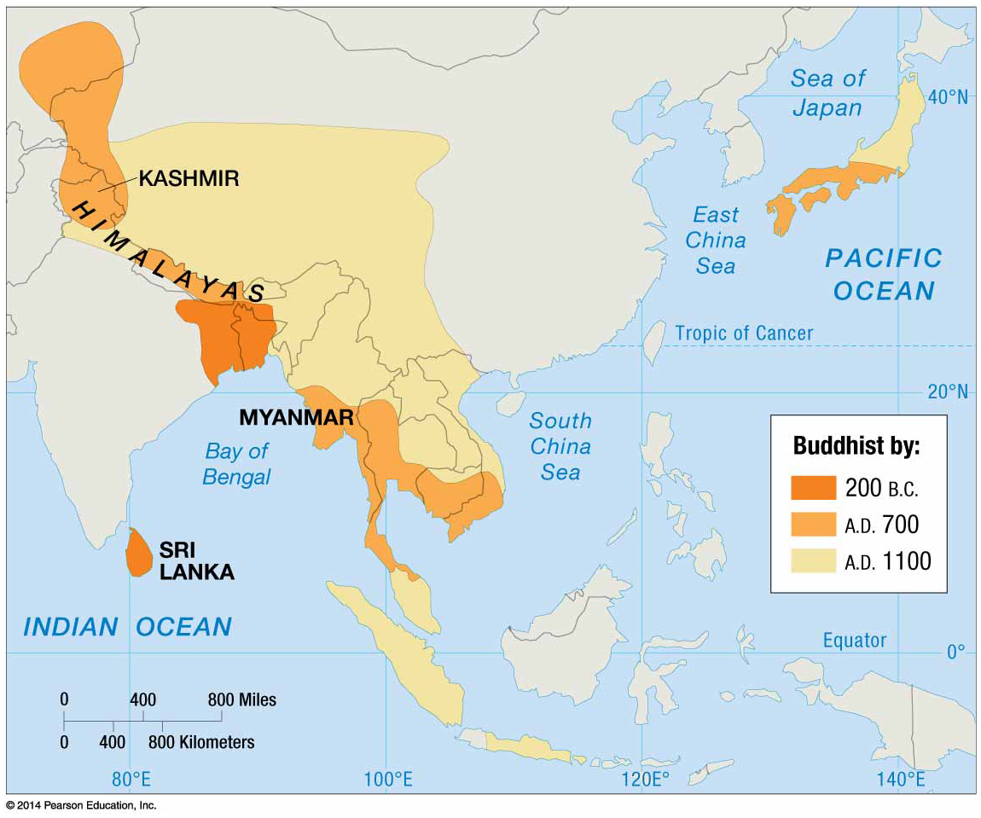
Notes:
FIGURE 6-21 DIFFUSION OF BUDDHISM Buddhism diffused slowly from its core in northeastern India. Buddhism was not well established in China until 800 years after Buddha’s death.

Slide 28
Why Do Religions Have Different Distributions?
Diffusion of Religions
Ethnic Religions
Most have limited, if any, diffusion.
Lack missionaries
Diffusion to new places is possible, if adherents migrate for economic gains and are not forced to adopt a strongly entrenched universalizing religion.
Judaism’s diffusion is unlike other ethnic religions because it is practiced well beyond its place of origin.
Other nationalities have historically persecuted Jews living in their midst because of their retention of Judaism.

