Slide 1
Unit 3 Chapter 6
Religions

Slide 2
Why Do Religions Organize Space in Distinctive Patterns?
Sacred Space
Geographers study the impact on the landscape made by all religions.
Places of worship are sacred structures that physically anchor religion to landscape.
Christian Church
More significant role in Christianity than in other religions because of belief that building is the house of God.
Church traditionally largest and tallest building in a community. Additional significance given to it by locating it in a prominent location—e.g., square or center of town
No single architectural style
Bahá’í Houses of Worship
Dispersed to different continents
Open to adherents of all religions

Slide 3
Why Do Religions Organize Space in Distinctive Patterns?
Sacred Space
Muslim Mosques
Space for community assembly
Not viewed as a sanctified place
Attention to cardinal directions is emphasized— e.g., pulpit at end of a courtyard faces Makkah.
Distinctive feature is a minaret, a tower where a man known as a muezzin summons people to worship.
Buddhist Pagodas
Prominent and ornate element on landscape that often includes tall, many-sided towers arranged in a series of tiers, balconies, and slanting roofs.
Contain relics believed to be a portion of Buddha’s body or clothing.
Not designed for congregational worship.

Slide 4
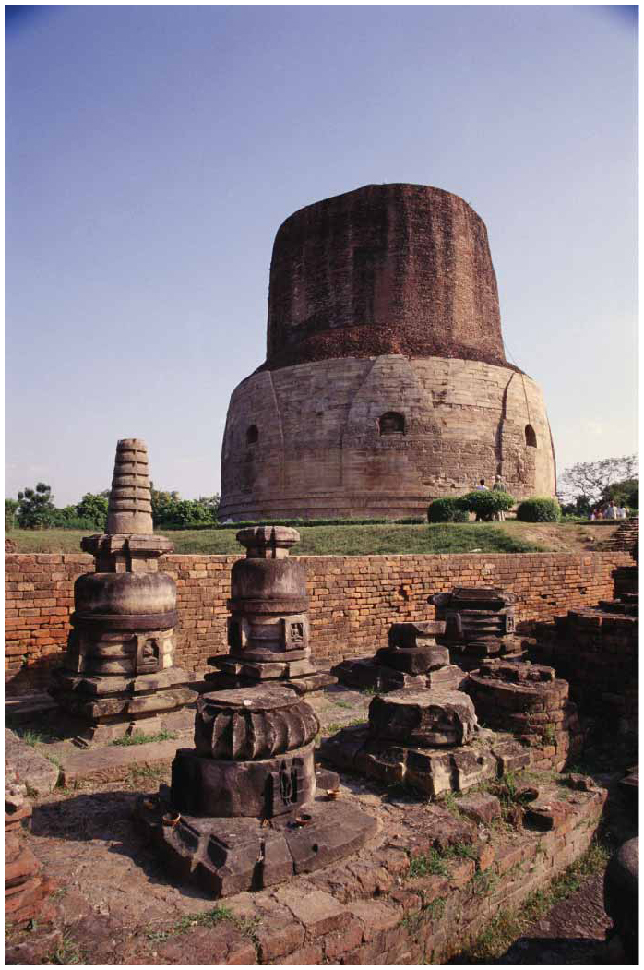
Notes:
FIGURE 6-23 BUDDHIST PAGODA, SARNATH, INDIA The Dhamek pagoda, in Deer Park, Sarnath, was built in the third century B.C., and is probably the oldest surviving Buddhist structure in the world.

Slide 5
Why Do Religions Organize Space in Distinctive Patterns?
Sacred Places in Universalizing Religions
Cities and places associated with the founder’s life are endowed with holiness.
Not necessarily in close proximity of each other
Not needed to be related to any particular physical environment
Buddhism and Islam place most emphasis on identifying shrines that mark locations of important events in the life of Buddha or Muhammad.
Pilgrimages, journeys for religious purposes, are incorporated in Islamic doctrine.

Slide 6
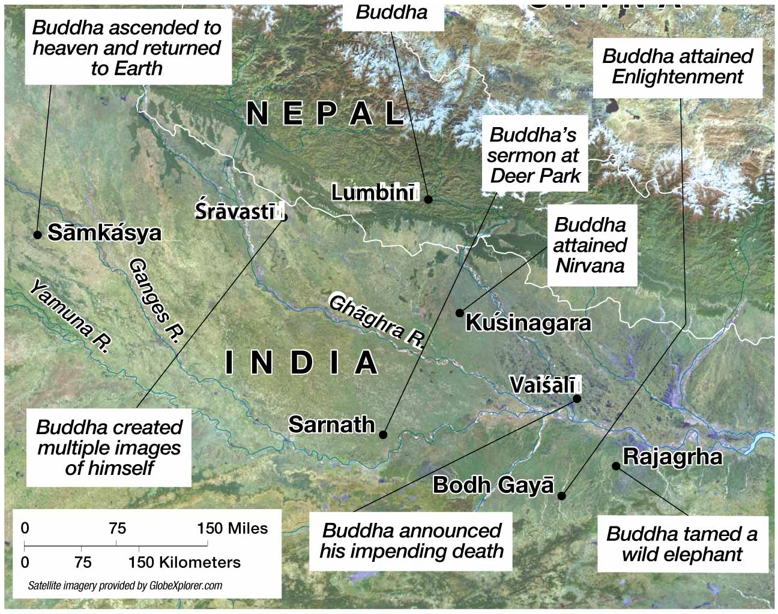
Notes:
FIGURE 6-26 HOLY PLACES IN BUDDHISM Most are clustered in northeastern India and southern Nepal because they were the locations of important events in Buddha’s life.

Slide 7
Why Do Religions Organize Space in Distinctive Patterns?
Sacred Places in Universalizing Religions
Holy Places in Islam
Holiest locations are in cities associated with Prophet Muhammad.
Holiest City is Makkah (Mecca), birthplace of Muhammad.
Now contains the holiest object in the Islamic landscape—al-Ka’ba—a cubelike structure encased in silk that stands in Islam’s largest mosque, Masjid al-Haram.
Second-most-holy place is Madinah (Medina).
Muhammad’s tomb is in Madinah.
Notes:
The Ka’ba, thought to have been built by Abraham and Ishmael, contains a black stone given to Abraham by Gabriel as a sign of the covenant with Ishmael and the Muslim people.

Slide 8
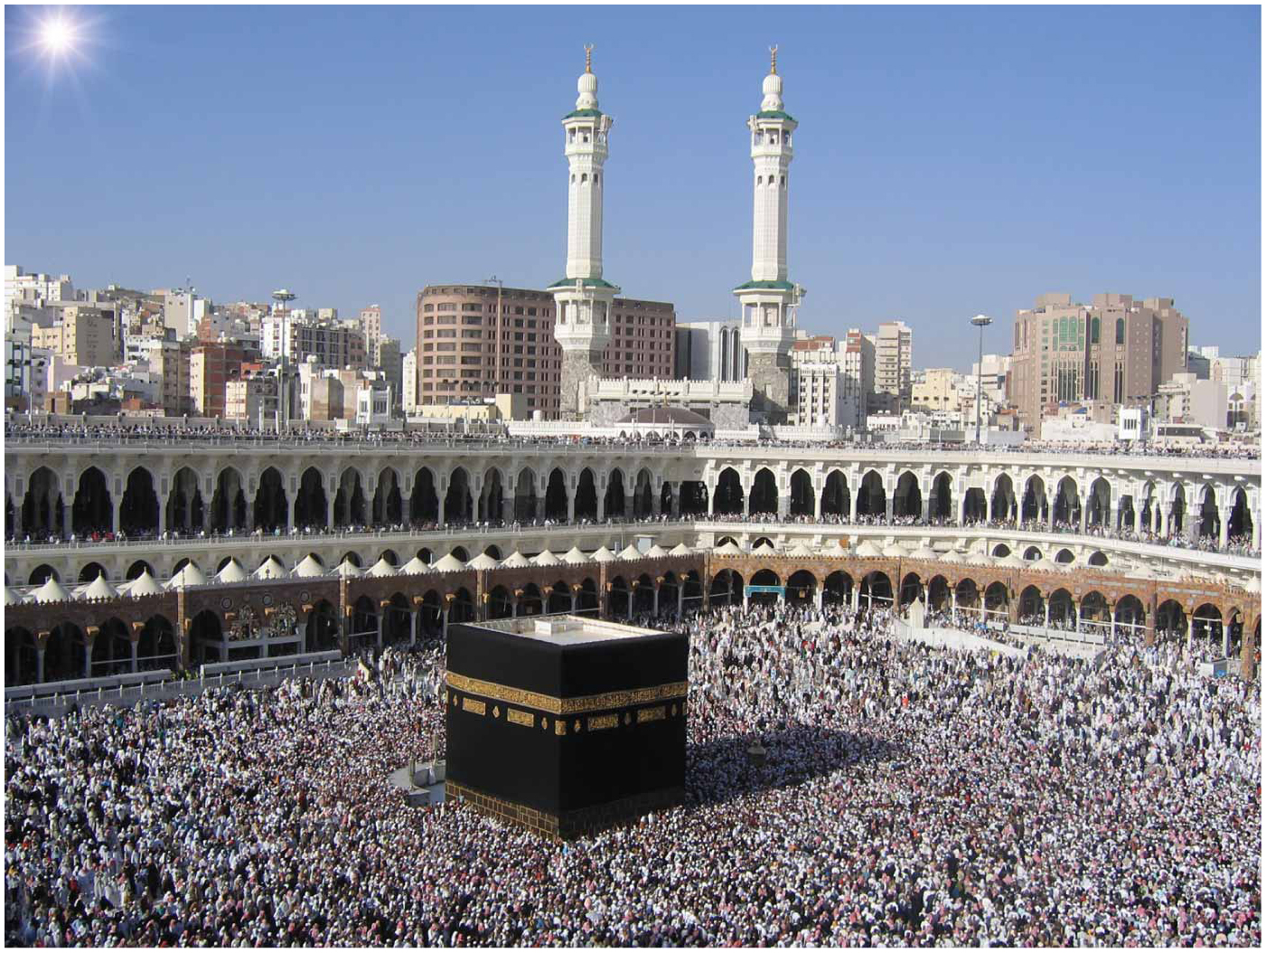
Notes:
FIGURE 6-29 MASJID AL-HARAM, MAKKAH, SAUDI ARABIA The black cube-like Ka’ba at the center of Masjid al-Haram (Great Mosque) in Makkah is Islam’s holiest object.

Slide 9
Why Do Religions Organize Space in Distinctive Patterns?
The Landscape in Ethnic Religions
Ethnic religions are closely tied to the physical geography of a particular place.
Hindu Landscape
Hinduism closely tied to physical geography of India
Mt. Kailas is holy because it is home to Siva.
Holiest places are riverbanks and coastlines.
Hindus believe that they achieve purification by bathing in holy rivers—e.g., Ganges River
Solstice
Special significance in some ethnic religions
Stonehenge is a prominent remnant of a pagan structure aligned so that sun rises between two stones on solstices.

Slide 10
Why Do Religions Organize Space in Distinctive Patterns?
Disposing of the Dead
Climate, topography, and religious doctrine combine to create differences in practices to shelter the dead.
Burial
Christians, Muslims, and Jews typically bury the deceased in designated areas called cemeteries.
Cemeteries were typically only public open space in congested urban places prior to the nineteenth century.
Cremation
Hindus wash the bodies of the deceased with water from the Ganges River first, then burn them with a slow fire on a funeral pyre.

Slide 11
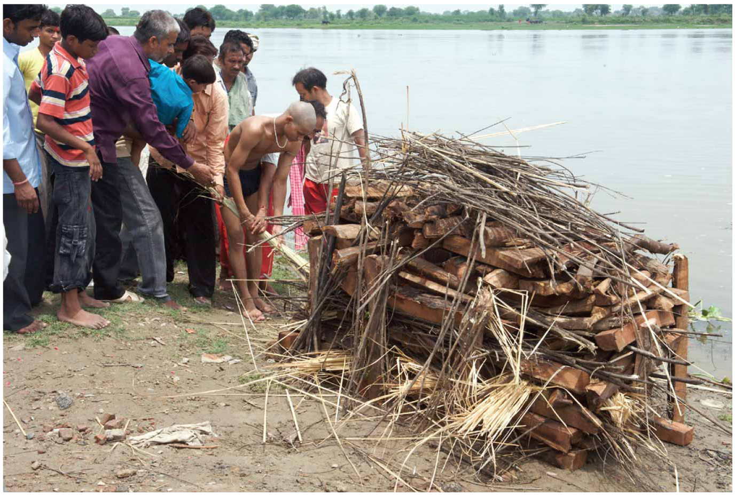
Notes:
FIGURE 6-34 HINDU CREMATION Family members cover a body with wood for cremation, Agra, India.

Slide 12
Why Do Religions Organize Space in Distinctive Patterns?
Religious Settlements and Place Names
Most human settlements serve an economic purpose, but some are established primarily for religious reasons.
Utopian settlement is an ideal community built around a religious way of life.
Salt Lake City culminated the utopian movement in the United States when it was built by the Mormons.
Roman Catholic immigrants have frequently given religious place names, or toponyms, to settlements primarily in the U.S. Southwest and Quebec.
Notes:
Layout of Salt Lake City is based on a plan of the city of Zion given to the church by the prophet Joseph Smith.

Slide 13
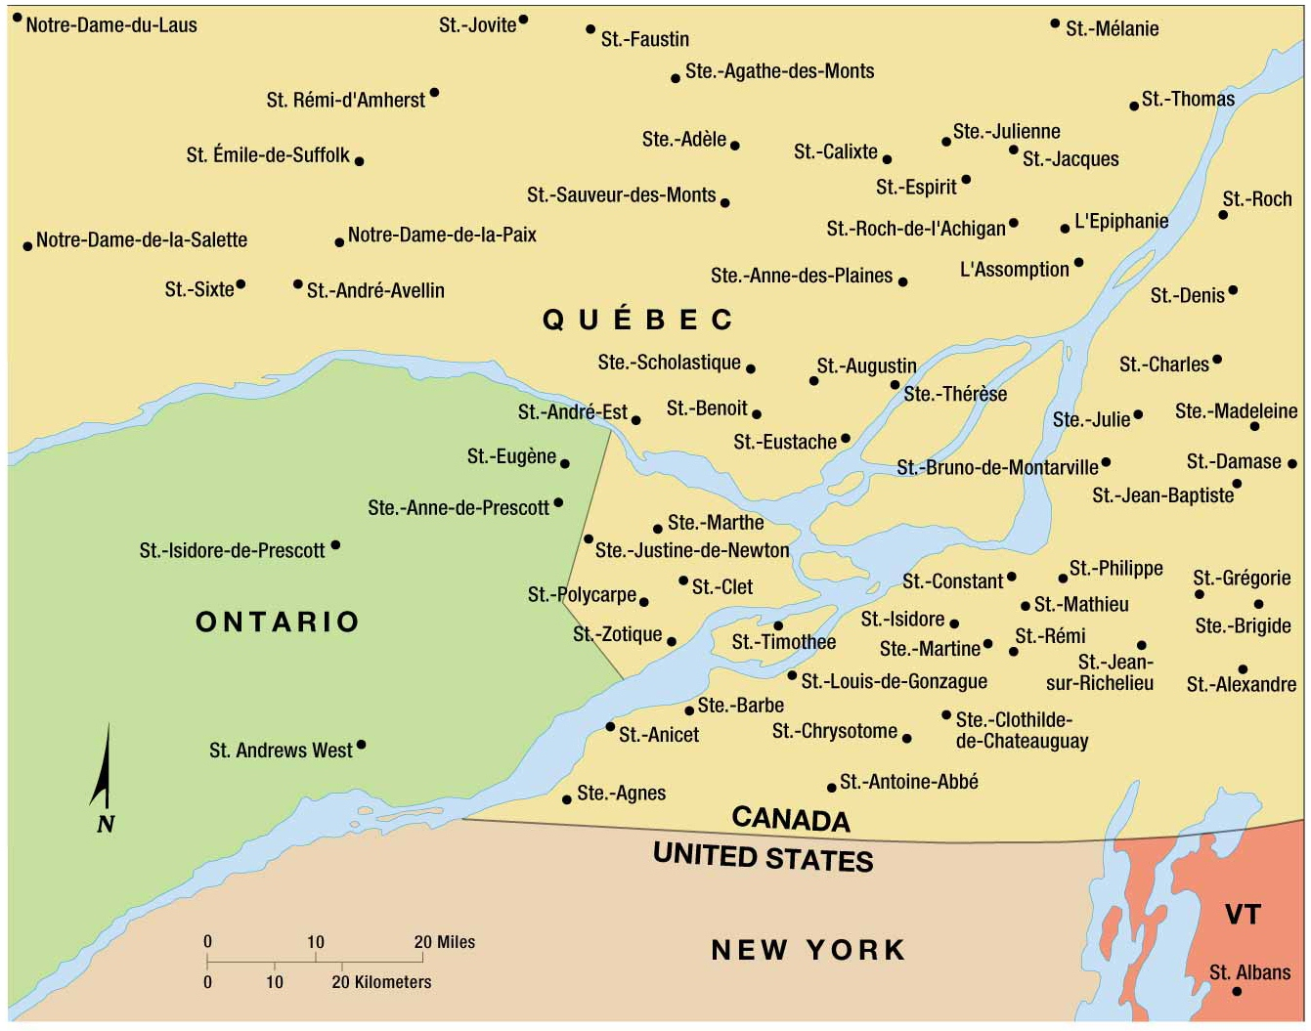
Notes:
FIGURE 6-36 RELIGIOUS TOPONYMS Place names near Québec’s boundaries with Ontario and the United States show the impact of religion on the landscape. In Québec, a province with a predominantly Roman Catholic population, a large number of settlements are named for saints, where relatively few religious toponyms are found in predominantly Protestant Ontario, New York, and Vermont.

Slide 14
Why Do Religions Organize Space in Distinctive Patterns?
The Calendar
Universalizing and ethnic religions approach the calendar differently.
Ethnic Religion
Holidays are closely aligned with natural events associated with the physical geography of the homeland.
Prominent feature is celebration of the seasons.
Closely tied to local agriculture
Universalizing Religion
Major holidays relate to events in the life of the founder rather than the seasons of one particular place.
Ramadan (Islam): part of five pillars of faith
Easter (Christian): resurrection of Jesus

Slide 15
Why Do Religions Organize Space in Distinctive Patterns?
Administration of Space
Universalizing religions must be connected to ensure consistency of doctrine.
Hierarchical Religions
Exemplifies a well-defined geographic structure and organizes territory into local administrative units.
Roman Catholic Church created administrative units on much of Earth’s inhabited land with each being headed by a leader who is accountable to the next higher-ordered leader.
Locally Autonomous Religions
Islam
No religious hierarchy
No formal territorial organization
Notes:
Islam
Everyone is expected to participate in the rituals and is encouraged to pray privately.

Slide 16
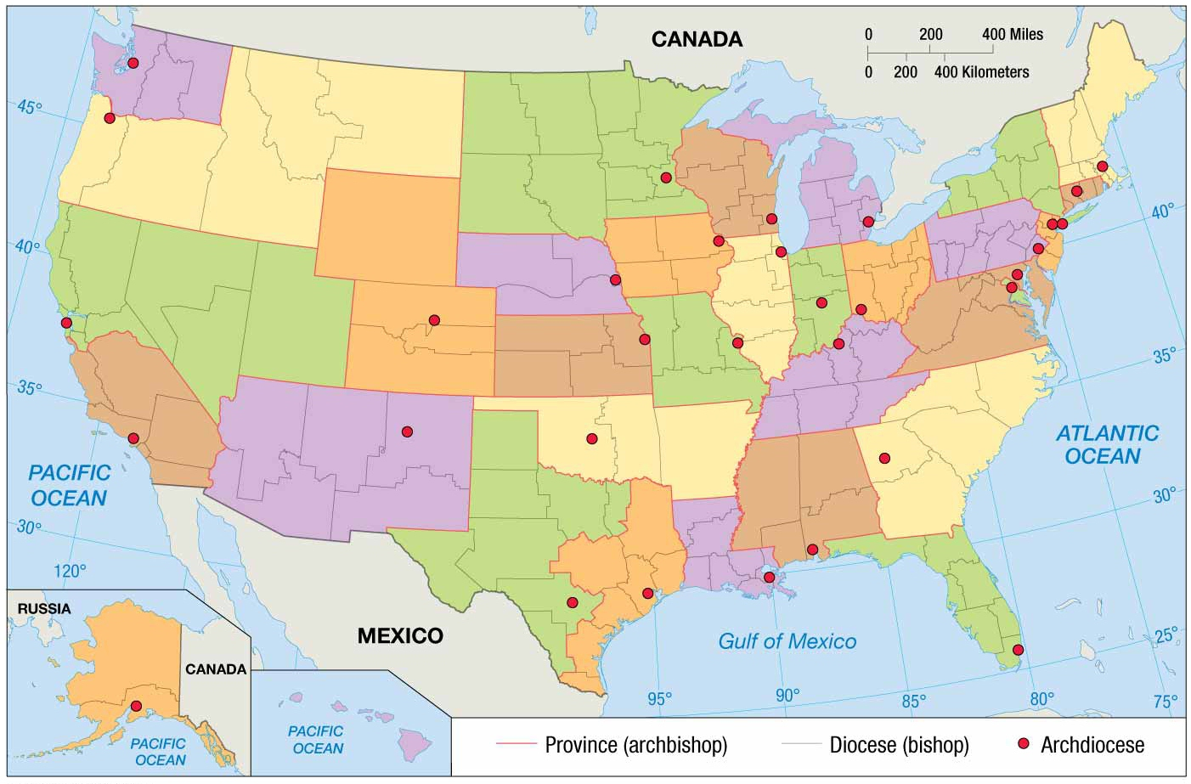
Notes:
FIGURE 6-40 ROMAN CATHOLIC HIERARCHY IN THE UNITED STATES The Roman Catholic Church divides the United States into provinces, each headed by an archbishop. Provinces are subdivided into dioceses, each headed by a bishop. The archbishop of a province also serves as the bishop of a diocese. Dioceses that are headed by archbishops are called archdioceses.

Slide 17
Why Do Territorial Conflicts Arise among Religious Groups?
Religion versus Government Policies
Religious groups may oppose policies seen as contradicting their religious values.
Religion is element of cultural diversity that has led to most conflict in places.
Religious fundamentalism, a literal interpretation and strict adherence to basic principles of a religion, has spurred more intense conflict recently.
Taliban versus Western Values
Taliban’s control of Afghanistan’s government in the 1990s led to strict laws opposing Western values.
“Western, non-Islamic” leisure activities banned
Ex: Soccer stadiums converted to settings for executions and floggings.

Slide 18
Why Do Territorial Conflicts Arise among Religious Groups?
Religion versus Religion
Conflicts most likely to occur at a boundary between two religious groups.
Religious Wars in Ireland
A small faction chose to join the United Kingdom when Ireland became independent in 1937.
46 percent protestant and 40 percent Roman Catholic (2001)
Roman Catholics have been victimized by discriminatory practices, such as exclusion form higher-paying jobs and better schools.
Belfast, the capital city, is highly segregated.
Protests by Roman Catholics began in 1968 with bloodshed of both Protestants and Roman Catholics.

Slide 19
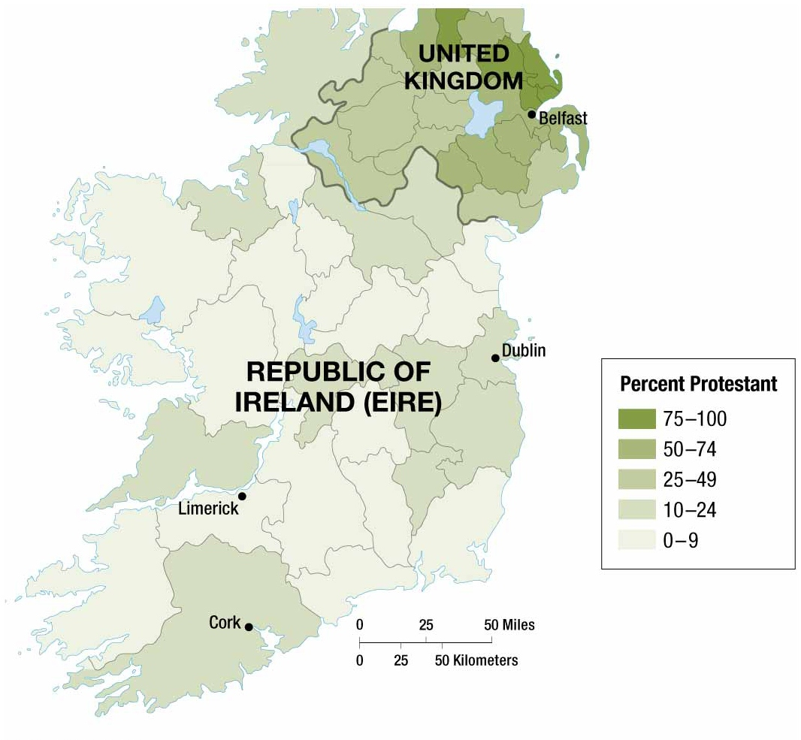
Notes:
FIGURE 6-47 DISTRIBUTION OF CATHOLICS AND PROTESTANTS IN IRELAND, 1911 Long a colony of England, Ireland became a self-governing dominion within the British Empire in 1921. In 1937, it became a completely independent country, but 26 districts in the north of Ireland chose to remain part of the United Kingdom. The Republic of Ireland today is 87 percent Roman Catholic, whereas Northern Ireland has a Protestant majority. The boundary between Roman Catholics and Protestants does not coincide precisely with the international border, so Northern Ireland includes some communities that are predominantly Roman Catholic. This is the root of a religious conflict that continues today.

Slide 20
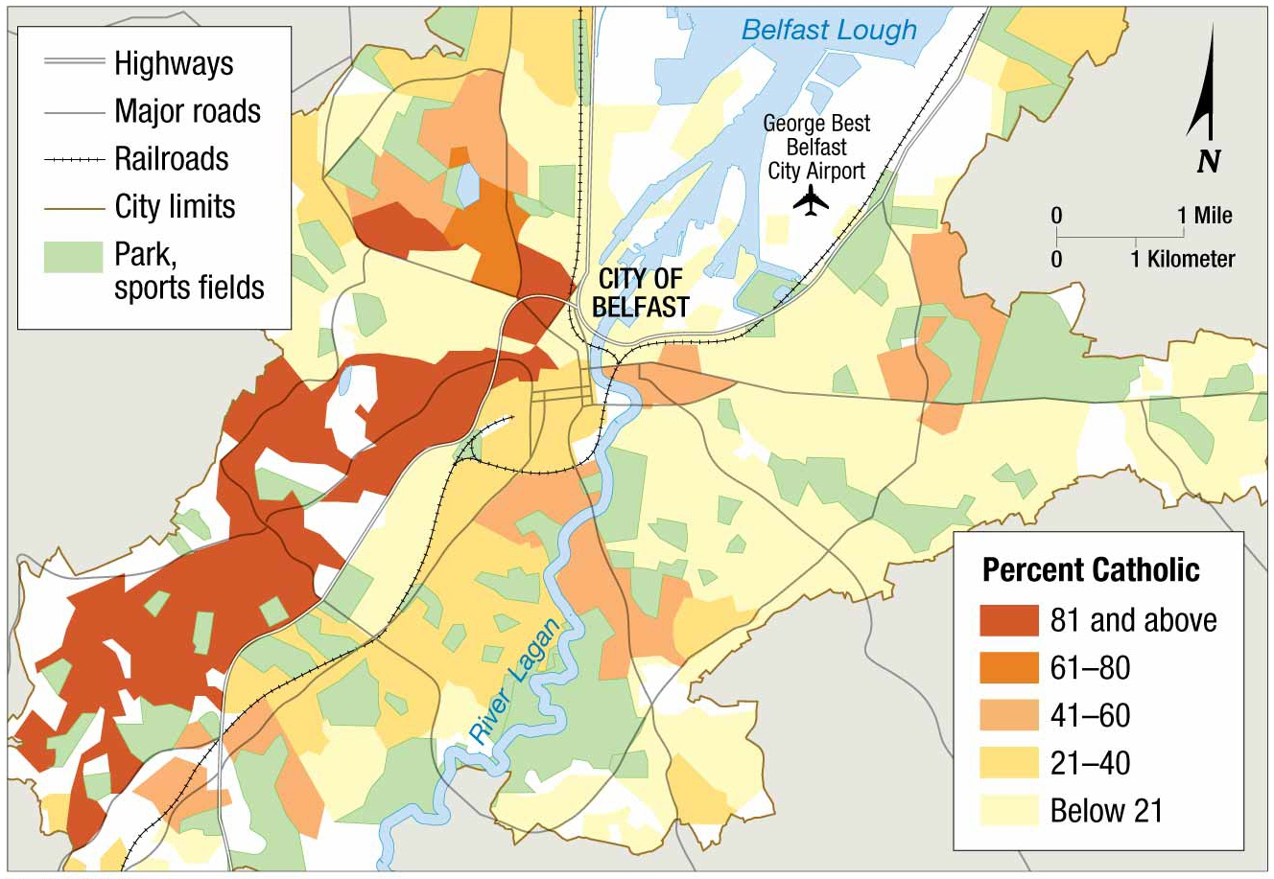
Notes:
FIGURE 6-48 DISTRIBUTION OF CATHOLICS AND PROTESTANTS IN BELFAST Belfast, Northern Ireland, is highly segregated. Most Roman Catholics live to the west, and Protestants to the east.

Slide 21
Why Do Territorial Conflicts Arise among Religious Groups?
Religious Wars in the Middle East
Conflict in the Middle East is among the world’s longest standing.
Jews, Christians, and Muslims have fought nearly 2,000 years to control the same small strip of Land in the Eastern Mediterranean.
Judaism: special claim to the territory it calls the Promised Land where major events in the development in the religion occurred.
Islam: Muslim army conquered this land in seventh century A.D. Jerusalem is the third holiest city to Muslims, because it is believed to be where Muhammad ascended into heaven.
Christianity: considers it the Holy Land and Jerusalem the Holy City, because the major events in Jesus’s life, death, and resurrection occurred there.
Notes:
Although they can trace their origins to Abraham, the religions have diverged in ways that make cohabitation difficult.
T0 recapture the Holy Land from its Muslim conquerors, European Christian launched a series of military campaigns, known as Crusades come over 150-year period.

Slide 22
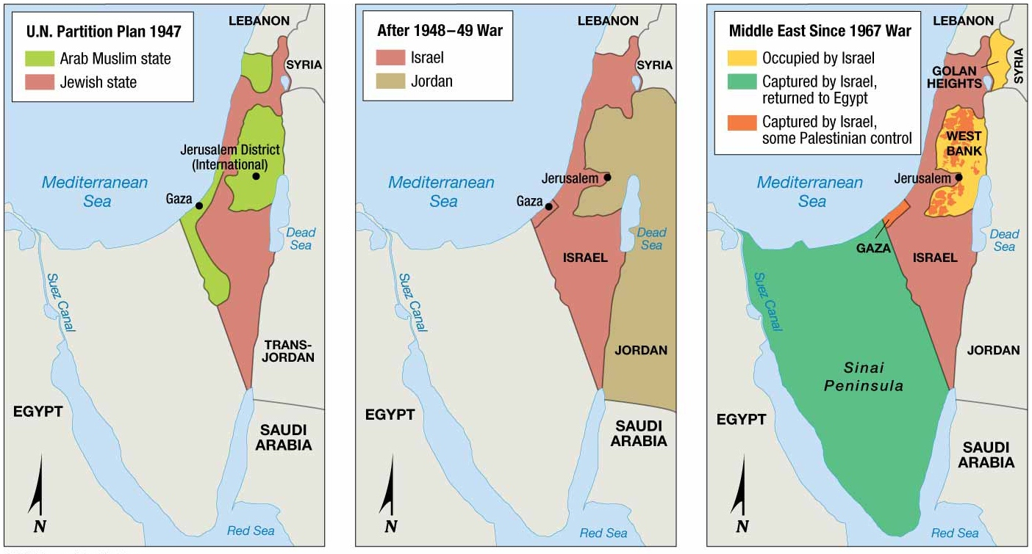
Notes:
FIGURE 6-49 BOUNDARY CHANGES IN ISRAEL/PALESTINE (left) The 1947 UN partition plan, (center) Israel after the 1948–1949 war, (right) Israel and its neighbors since the 1967 Six-Day War.

Slide 23
Why Do Territorial Conflicts Arise among Religious Groups?
Conflicting Perspectives of the Holy Land
After the 1973 war, the Palestinians emerged as Israel’s principal opponent.
Palestinians viewed themselves as the legitimate rulers of Israel.
Biggest obstacle to peace in the Middle East is the status of Jerusalem.
Peace will likely not be possible, if one religion has political control over Jerusalem.
Notes:
Most sacred space for Muslims in Jerusalem was built on on top of the most sacred space for Jews.

Slide 24
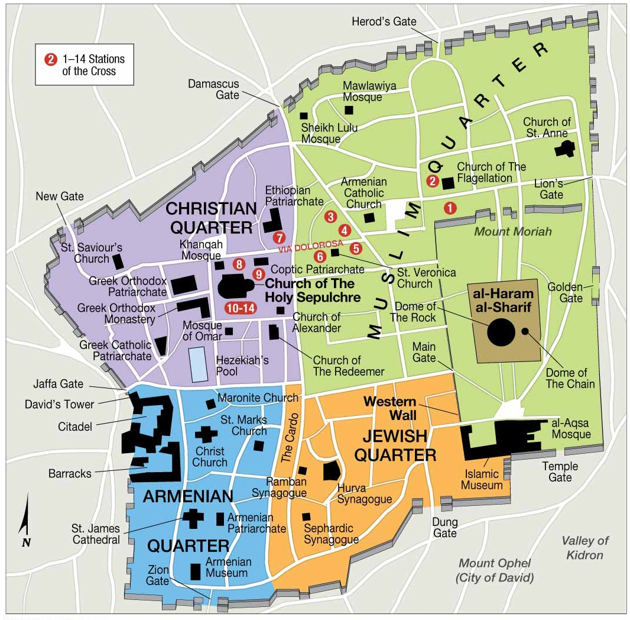
Notes:
FIGURE 6-53 OLD CITY OF JERUSALEM The Old City of Jerusalem is less than 1 square kilometer (0.4 square miles). It is divided into four quarters.

