Slide 1
Unit 3
Chapter 7
Ethnicities

Slide 2
Where Are Ethnicities Distributed?
Ethnicity is identity with a group of people who share the cultural traditions of a particular homeland or hearth.
Race is identity with a group of people who share a biological ancestor.
Distribution of persons of color matters to geographers.
One’s skin color can determine where they reside, attend school, spend their leisure time, and perform life’s daily activities in some societies.
Notes:
At worst, biological classification by race is the basis for racism, which is the belief that race is the primary determine of human traits and capacities and that racial differences produce an inherent superiority of a particular race.

Slide 3
Where Are Ethnicities Distributed?
Every 10 years, the U.S. Bureau of the Census conducts a counting of the population.
Its survey identifies three main ethnicities.
Asian American
Americans from many countries in Asia
African American
Americans who identify as a group with an extensive cultural tradition with origins in Africa
Hispanic
Americans who are from Spanish-speaking countries.
Notes:
2010 Census combines black (race) and African American (ethnicity)
Today, many Americans are of mixed ancestry and may or may not choose to identify with a single race or ethnicity.

Slide 4
Distribution of Ethnicities in the United States
Ethnic groups may live in particular regions and particular communities within cities and states.
Regional Scale
Hispanics: Clustered in the Southwest
African Americans: Clustered in the Southeast
Asian Americans: Clustered in the West
Notes:
2010 Census combines black (race) and African American (ethnicity)
Today, many Americans are of mixed ancestry and may or may not choose to identify with a single race or ethnicity.

Slide 5
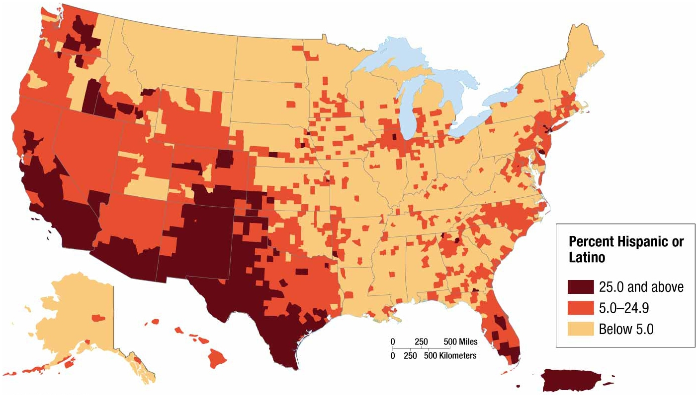
Distribution of Ethnicities in the United States
Notes:
FIGURE 7-7 DISTRIBUTION OF HISPANICS IN THE UNITED STATES The counties with the highest percentages in 2010 are in the Southwest, near the Mexican border, and in northern cities.

Slide 6
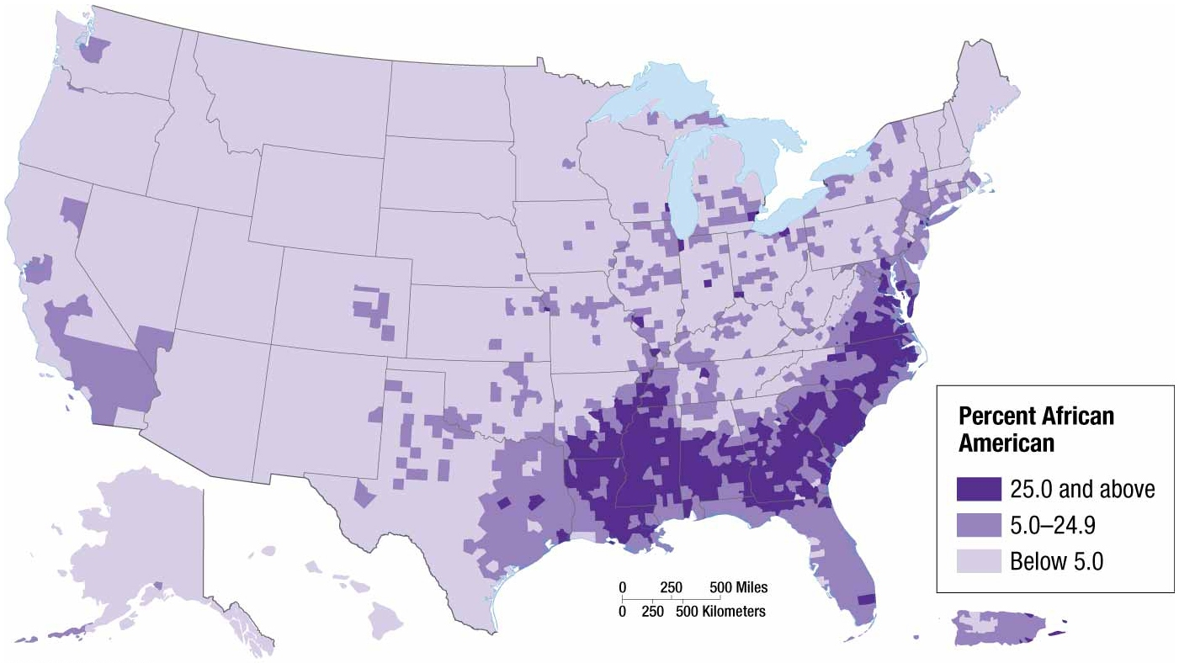
Distribution of Ethnicities in the United States
Notes:
FIGURE 7-8 DISTRIBUTION OF AFRICAN AMERICANS IN THE UNITED STATES The counties with the highest percentages of African Americans are in the rural South and in northern cities.

Slide 7
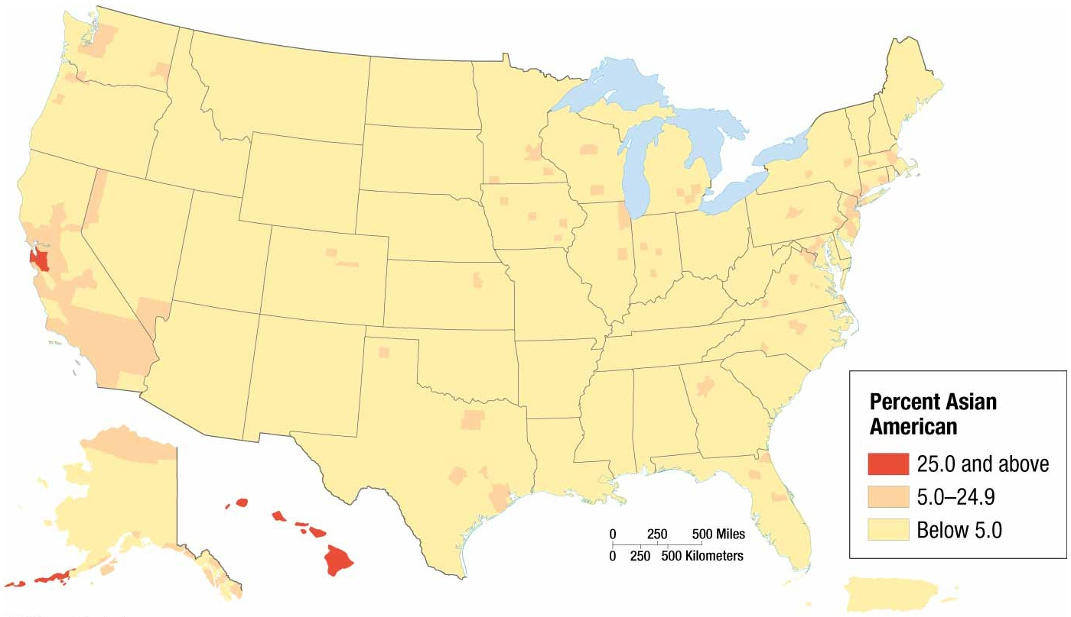
Distribution of Ethnicities in the United States
Notes:
FIGURE 7-9 DISTRIBUTION OF ASIAN AMERICANS IN THE UNITED STATES The counties with the highest percentages of Asian Americans are in Hawaii and California.

Slide 8
Distribution of Ethnicities in the United States
Ethnic groups may live in particular regions and particular communities within cities and states.
Urban Scale
African Americans and Hispanics are highly clustered in urban areas.
Ex: Chicago
Neighborhoods on the south and west side of Chicago have extensive African American clusters.
Ex: Los Angeles
African Americans in south-central L.A.
Hispanics in east L.A.
Asian Americans in south and west L.A.
Notes:
Especially pronounced on the scale of neighborhoods within cities

Slide 9
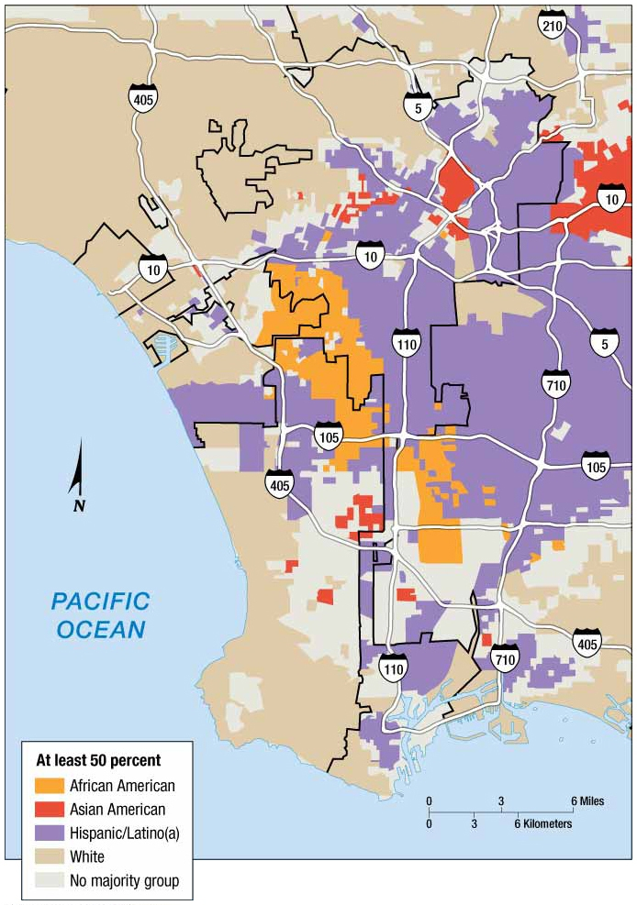
Distribution of Ethnicities in the United States
Notes:
FIGURE 7-11 DISTRIBUTION OF ETHNICITIES IN LOS ANGE LES According to the 2010 Census, African Americans were clustered to the south of downtown Los Angeles and Hispanics to the east. Asian American neighborhoods were contiguous to the African American and Hispanic areas.

Slide 10
Why Do Ethnicities Have Distinctive Distributions?
International Migration of Ethnicities
Most African Americans are descended from Africans forced to migrate to the Western Hemisphere as slaves during the eighteenth century.
Most Asian Americans and Hispanics are descended from voluntary immigrants to the United States during the late twentieth and early twenty-first centuries.

Slide 11
Why Do Ethnicities Have Distinctive Distributions?
Forced Migration from Africa
Different European countries acquired slaves from various regions of Africa, then sent them to the Americas.
Portuguese shipped slaves from their colonies in Angola and Mozambique to their American colony, Brazil.
Other European countries took slaves primarily from a coastal strip of West Africa between Liberia and the Congo, then sent them to the Caribbean islands and Central and South America.

Slide 12
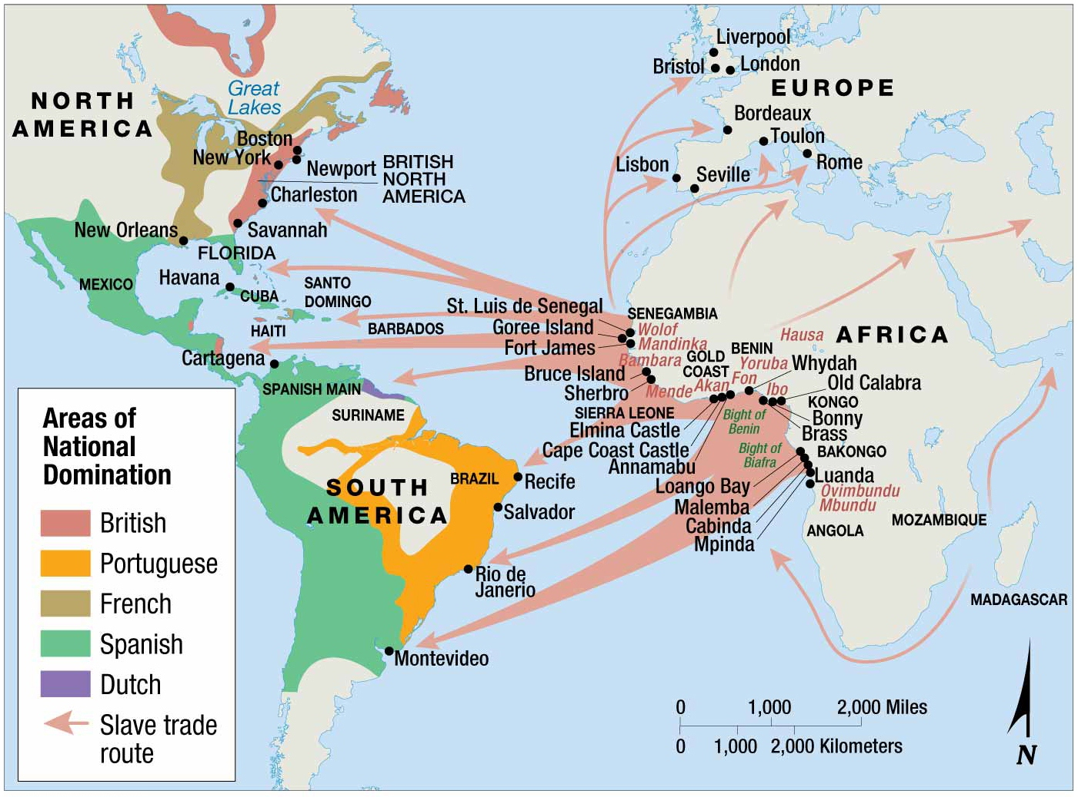
Why Do Ethnicities Have Distinctive Distributions?
Notes:
FIGURE 7-13 ORIGIN AND DESTINATION OF SLAVES Most slaves were transported across the Atlantic from West Africa to the Americas.

Slide 13
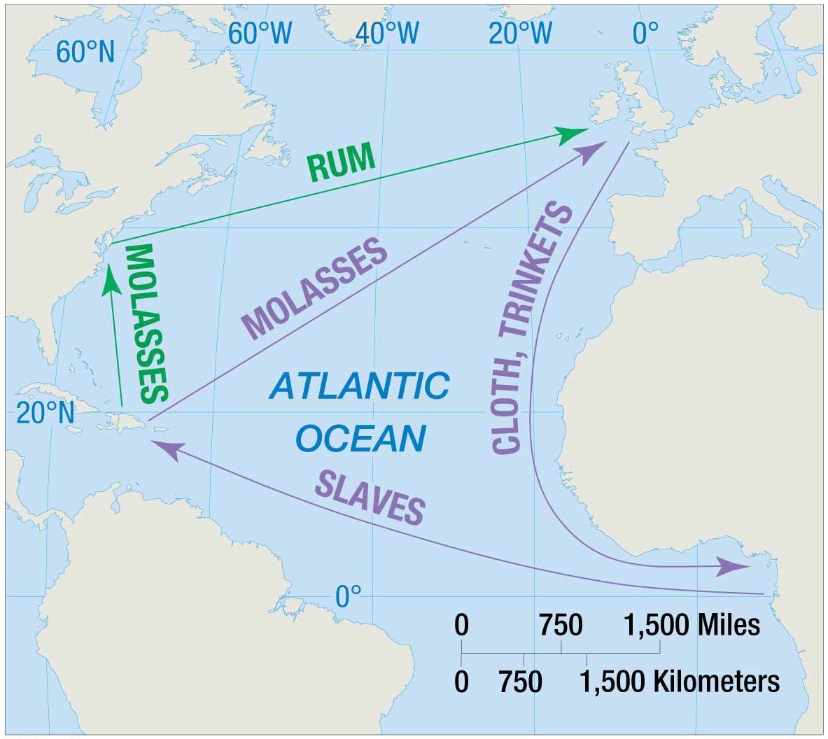
Why Do Ethnicities Have Distinctive Distributions?
Notes:
FIGURE 7-14 TRIANGULAR SLAVE TRADE

Slide 14
Why Do Ethnicities Have Distinctive Distributions?
Voluntary Migration from Latin America and Asia
Latin America
Immigration from Mexico and Puerto Rico fueled rapid growth of Hispanics in the United States beginning in the 1970s.
Third largest group of Hispanics came to United States from Cuba.
Asia
Ranking of sending countries
1) China 2) India 3) Philippines 4) Korea 5) Vietnam
Notes:
Most have come in search of work.

Slide 15
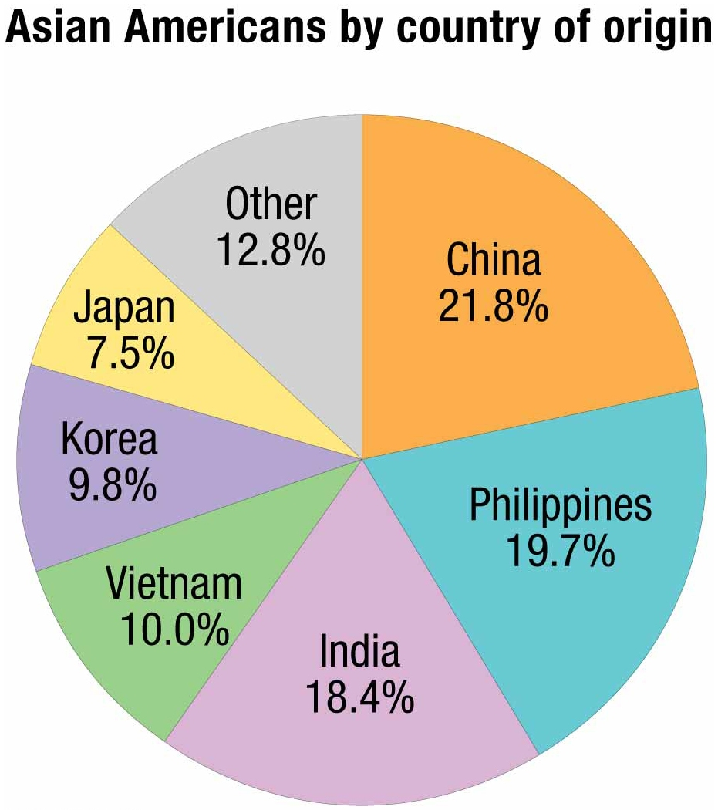
Why Do Ethnicities Have Distinctive Distributions?
Notes:
FIGURE 7-16 ASIAN AMERICANS BY COUNTRY OF ORIGIN Chinese, Filipinos, and Indians comprise one-fifth each of Asian Americans in the United China States.

Slide 16
Why Do Ethnicities Have Distinctive Distributions?
Internal Migration of African Americans
African Americans have displayed two distinct internal migration patterns in the United States during the twentieth century.
Interregional migration from the U.S. South to northern cities during the first half of the twentieth century
Intraregional migration from inner-city ghettos to outer city and inner suburban neighborhoods during the second half of the twentieth century

Slide 17
Why Do Ethnicities Have Distinctive Distributions?
Internal Migration of African Americans
Interregional Migration
Freed as slaves, most African Americans remained in the rural South during the late nineteenth century, working as sharecroppers—works fields rented from a landowner and pays rent by turning over a share of the crops to him or her.
Mechanization of agriculture served as a push factor, while manufacturing jobs in the north acted as a pull factor that encouraged African Americans to migrate to the northern cities.
Traveled by bus and car along the major two-lane long-distance U.S. roads

Slide 18
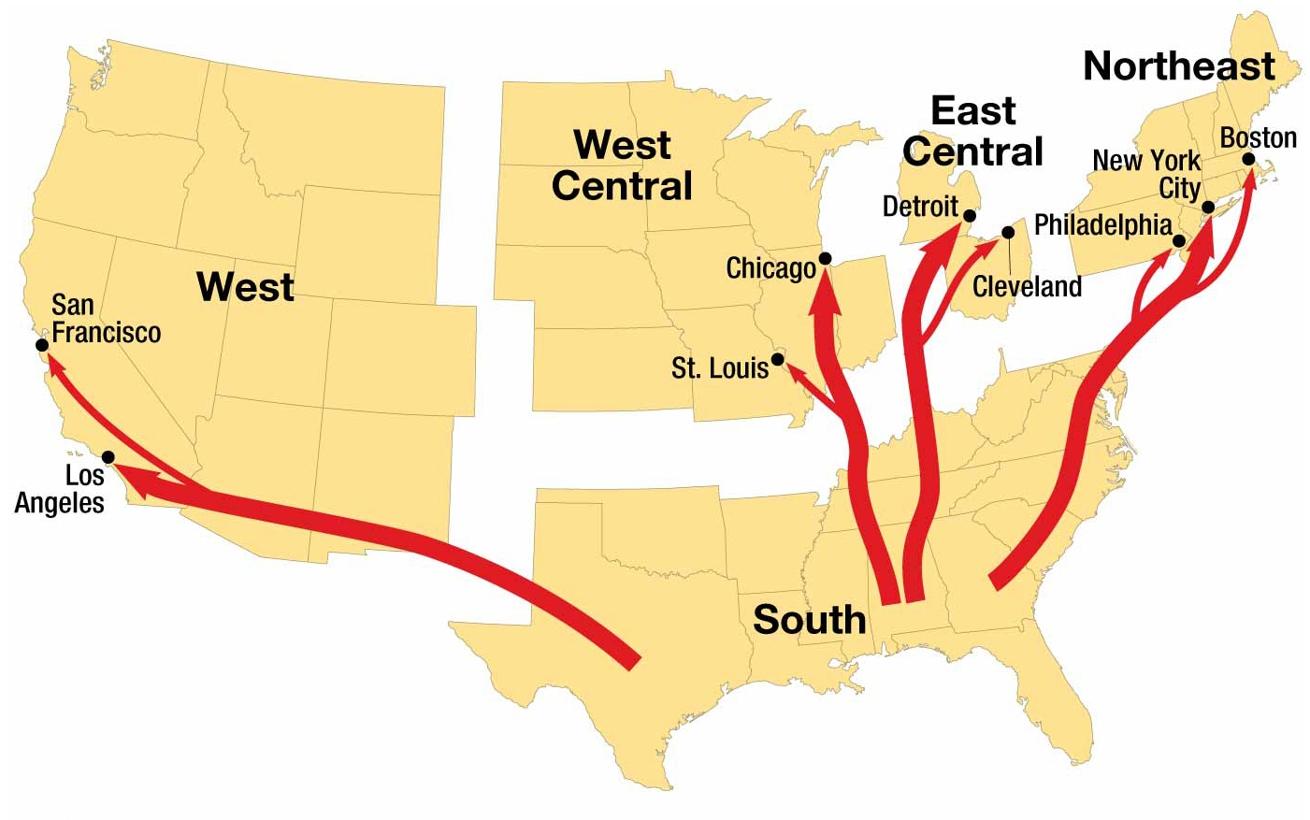
Why Do Ethnicities Have Distinctive Distributions?
Notes:
FIGURE 7-18 INTER REGIONAL MIGRATION OF AFRICAN AMERICANS Migration followed four distinctive channels along the East Coast, east central, west central, and southwest regions of the country.

Slide 19
Why Do Ethnicities Have Distinctive Distributions?
Internal Migration of African Americans
Intraregional Migration
African Americans arriving at northern cities clustered in neighborhoods where existing African Americans already lived.
Areas came to be known as ghettos.
Over time, ghettos grew outward typically along major avenues that radiated out from the center of city.
Many whites fled their neighborhoods when blacks began moving in nearby.
Ex. Detroit’s white population dropped by 1.5 million from 1950 to 2000.

Slide 20
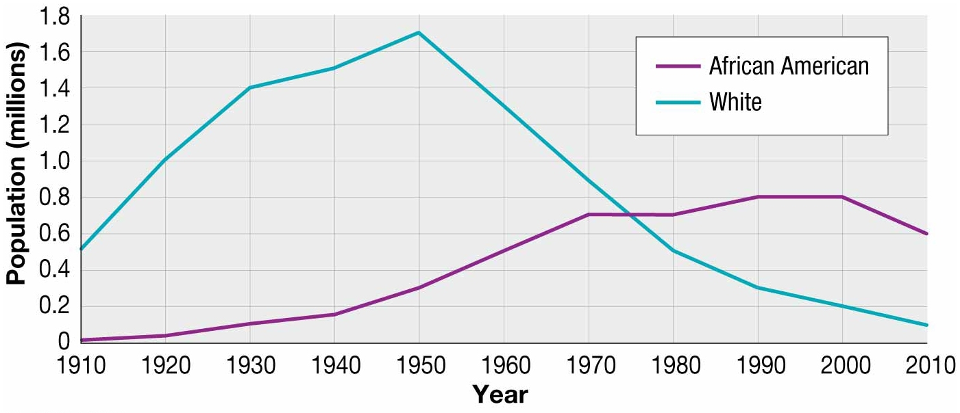
Why Do Ethnicities Have Distinctive Distributions?
Notes:
FIGURE 7-20 ETHNIC POPULATION CHANGE IN DETROIT Between 1950 and 2010, the white population of Detroit declined from 1.7 million to 100,000 today, whereas the African American population increased from 300,000 to 600,000.

Slide 21
Why Do Ethnicities Have Distinctive Distributions?
Segregation by Ethnicity and Race
U.S. Supreme Court upheld a Louisiana law that required blacks and whites to ride in separate railway cars.
Plessy v. Ferguson, states that the law was constitutional, because it provided separate, but equal, treatment of blacks and whites.
Southern states enacted a set of laws commonly referred to as the “Jim Crow” laws to segregate black from whites.
Ex: Blacks had to sit in the backs of buses, and shops, restaurants, and hotels could choose to serve only whites.
Notes:
Landmark Supreme Court decision Brown v Board of Education of Topeka, Kansas, in 1954, ended legalized segregation.

Slide 22
Why Do Ethnicities Have Distinctive Distributions?
South Africa Apartheid
White descendants from Holland enacted a legal system intended to segregate its people called apartheid.
Defined: physical separation of different races into different geographic areas
Newborn baby was classified as being one of four races: 1) black 2) white 3) colored 4) Asian
Each race had a different legal status and associated rights in regards to where one could live, attend school, work, shop, and own land.
Apartheid laws repealed in 1991.

Slide 23
Why Do Conflicts Arise among Ethnicities?
Ethnicities and Nationalities
Nationality is identity with a group of people who share legal attachment and personal allegiance to a particular country.
Nationality shares similar concepts with ethnicity.
Both defined through shared cultural values derived from religion, language, and material culture.
Nationality differs with ethnicity in terms of legal standing.
Nationality defined through shared experiences derived from voting, obtaining a passport, and performing civic duties.
Notes:
Politicians and governments try to instill loyalty through nationalism, which is loyalty and devotion to a nationality.

Slide 24
Why Do Ethnicities Have Distinctive Distributions?
Nationalities in North America
Distinguishing between nationality, ethnicity, and race in the United States
Nationality identifies citizens of the United States
Ethnicity identifies groups with distinct ancestry and cultural traditions.
Ex: African Americans and Hispanic Americans
Race distinguishes blacks and other persons of color from whites.

Slide 25
Why Do Ethnicities Have Distinctive Distributions?
Ethnic Competition
Ethnic Competition in Lebanon
Nearly all Lebanese Christians consider themselves ethnically descended from the ancient Phoenicians.
Lebanon’s Muslims consider themselves Arabs.
Diversity in Lebanon at the surface appears to be more religious than ethnic.

Slide 26
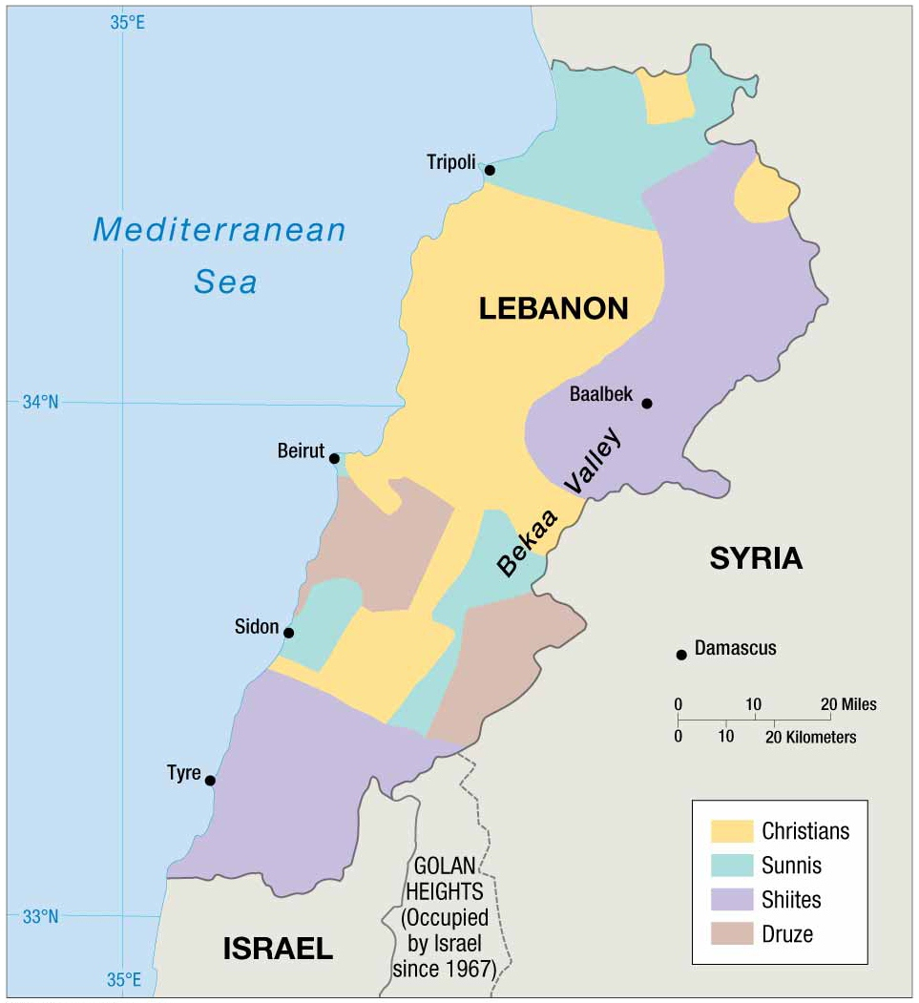
Why Do Ethnicities Have Distinctive Distributions?
Notes:
FIGURE 7-27 ETHNICITIES IN LEBANON Christians dominate in the south and the northwest, Sunni Muslims in the far north, Shiite Muslims in the northeast and south, and Druze in the south-central and southeast.

Slide 27
Why Do Ethnicities Have Distinctive Distributions?
Ethnic Competition
Ethnic Diversity in Sri Lanka
Sri Lanka is inhabited by three principal ethnicities.
Sinhalese (74 percent)
Migrated from northern India in fifth century B.C.
Converted to Buddhism
Tamil (16 percent)
Migrated from India in third century B.C.
Practice Hinduism
Moors (10 percent)
Ethnic Arabs
Migrated from southwest Asia in eighth century A.D.
Practice Islam
Notes:
Dispute between Sri Lanka’s two largest ethnicities extends back more than 2000 years.
Tamils feel that they suffer from discrimination at the hands of the Sinhalese-dominated government.
Long war between the ethnicities ended in 2009, with the defeat of the Tamils.

Slide 28
Why Do Ethnicities Have Distinctive Distributions?
Dividing Ethnicities
Few Ethnicities inhabit an area that matches the territory of a nationality.
Dividing South Asian Ethnicities among Nationalities
Britain’s end of colonial rule of the Indian subcontinent in 1947 gave birth to two new countries—India and Pakistan.
Pakistan comprised of two noncontiguous areas called West and East Pakistan
East Pakistan later became Bangladesh in 1971.
Reason for separating West and East Pakistan from India was differences in ethnicity.
Notes:
The partition of salvation two states resulted in massive migration because the two boundaries to not correspond precisely to the territory inhabited by the two ethnicities.

Slide 29
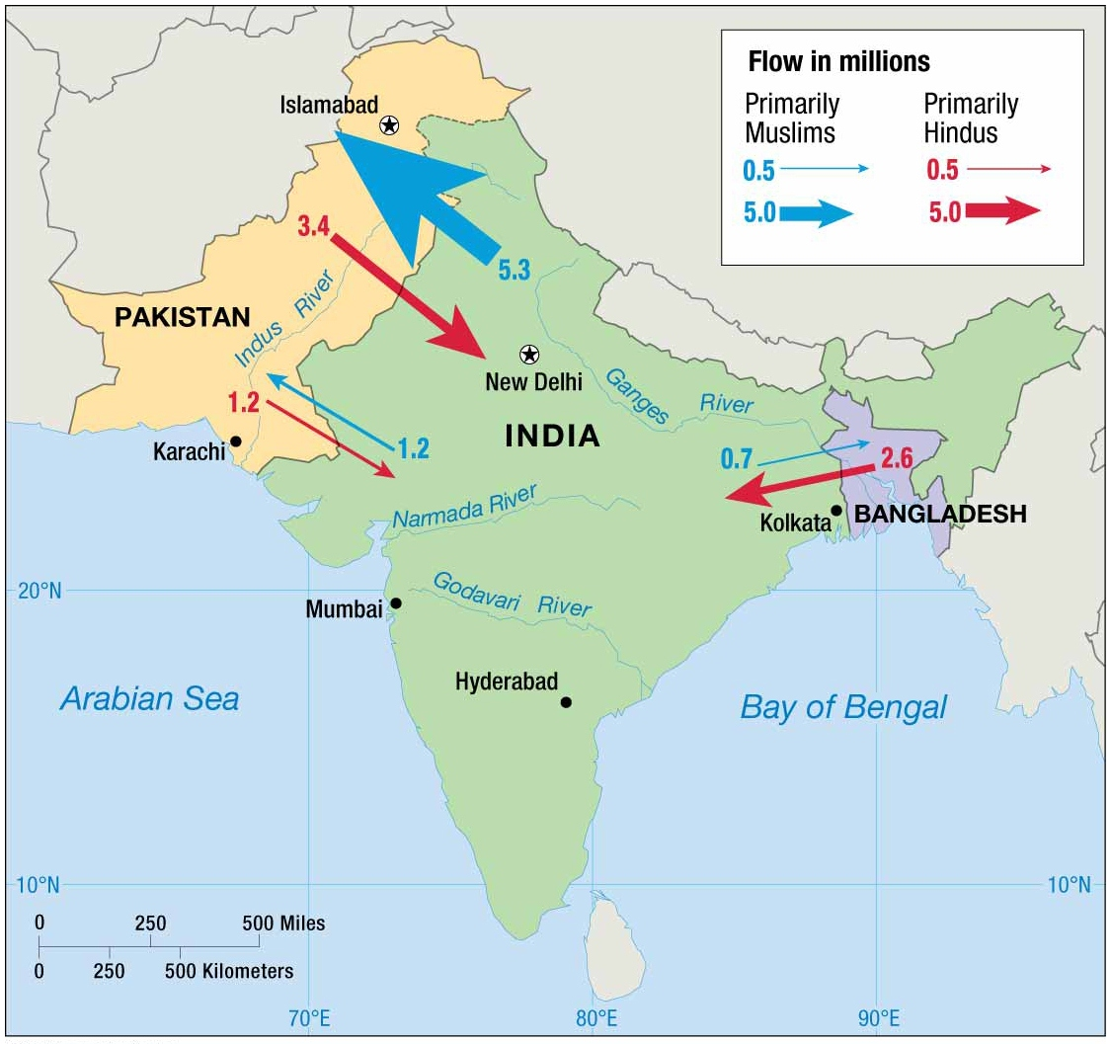
Why Do Ethnicities Have Distinctive Distributions?
Notes:
FIGURE 7-31 ETHNIC DIVISION OF SOUTH ASIA In 1947, British India was partitioned into two independent states, India and Pakistan, which resulted in the migration of an estimated 17 million people. The creation of Pakistan as two territories nearly 1,600 kilometers (1,000 miles) apart proved unstable, and in 1971 East Pakistan became the independent country of Bangladesh.

Slide 30
Why Do Ethnicities Have Distinctive Distributions?
Dividing Ethnicities
Dividing the Kurds among Nationalities
Who are the Kurds?
Sunni Muslims
Speak a language in the Iranian group of the Indo-Iranian Branch of Indo-European.
Feature distinctive literature, dress, and cultural traditions.
An Ethnicity without a Country
After WWI, the European allies demarcated land for the Kurds called Kurdistan.
1923 Treaty of Lausanne established what would have been Kurdistan as part of Turkey.
Today, Kurds are divided among several countries: eastern Turkey, northern Iraq, western Iran, and Syria.
Notes:
1920 Treaty of Sévres giving Kurds a country was never ratified.

Slide 31
Why Do Ethnicities Have Distinctive Distributions?
Ethnic Diversity in Western Asia
Iraq
¾ of Iraqis are Arabs.
2/3 Shiite
1/3 Sunni
1/6 of Iraqis are Kurds.
Most Iraqis have stronger loyalty to a tribe or clan than to a nationality or major ethnicity.
Iran
Most numerous ethnicity is Persian.
Adheres to Shiite Islam
Notes:
1920 Treaty of Sévres giving Kurds a country was never ratified.

Slide 32
Why Do Ethnicities Have Distinctive Distributions?
Ethnic Diversity in Western Asia
Afghanistan
Most numerous ethnicities include Pashtun, Tajik, and Hazara.
Faction of Pashtun called the Taliban (meaning “religious students”) gained control over most of the country in 1995 and proceeded to rule with policies based on Islamic fundamentalism.
Pakistan
Most numerous ethnicity is Punjabi.

Slide 33
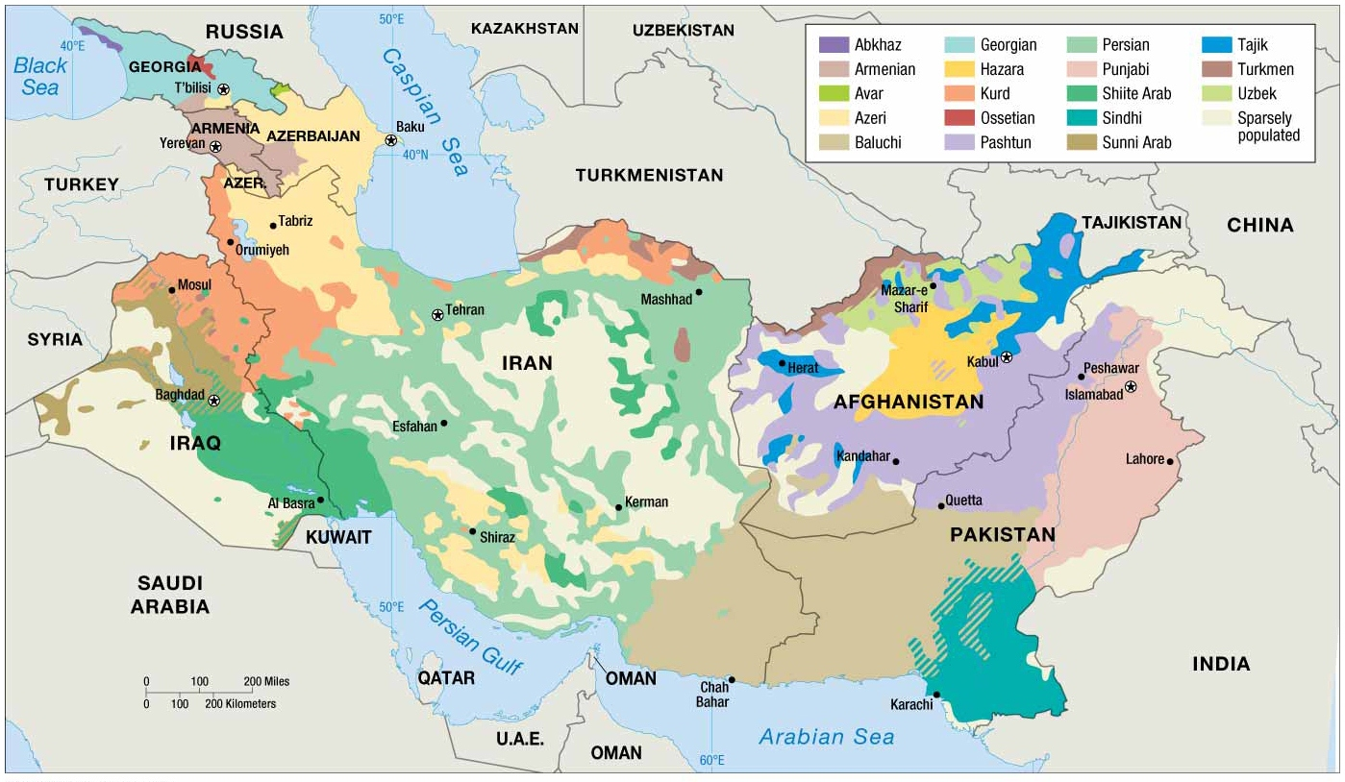
Why Do Ethnicities Have Distinctive Distributions?
Notes:
FIGURE 7-34 ETHNICITIES IN WESTERN ASIA The complex distribution of ethnicities and nationalities across western Asia is a major source of conflict.

Slide 34
Why Do Ethnicities Engage in Ethnic Cleansing and Genocide?
Ethnic cleansing is a process in which a more powerful ethnic group forcibly removes a less powerful one in order to create an ethnically homogeneous region.
Motivation is not to simply defeat an enemy or to subjugate them, instead it is to remove each member of the less powerful ethnicity, including men, women, children, and the elderly.
Ex: Forced migration associated with WWII that included the deportation of millions of Jews, gypsies, and other ethnic groups to concentration camps where most were exterminated

Slide 35
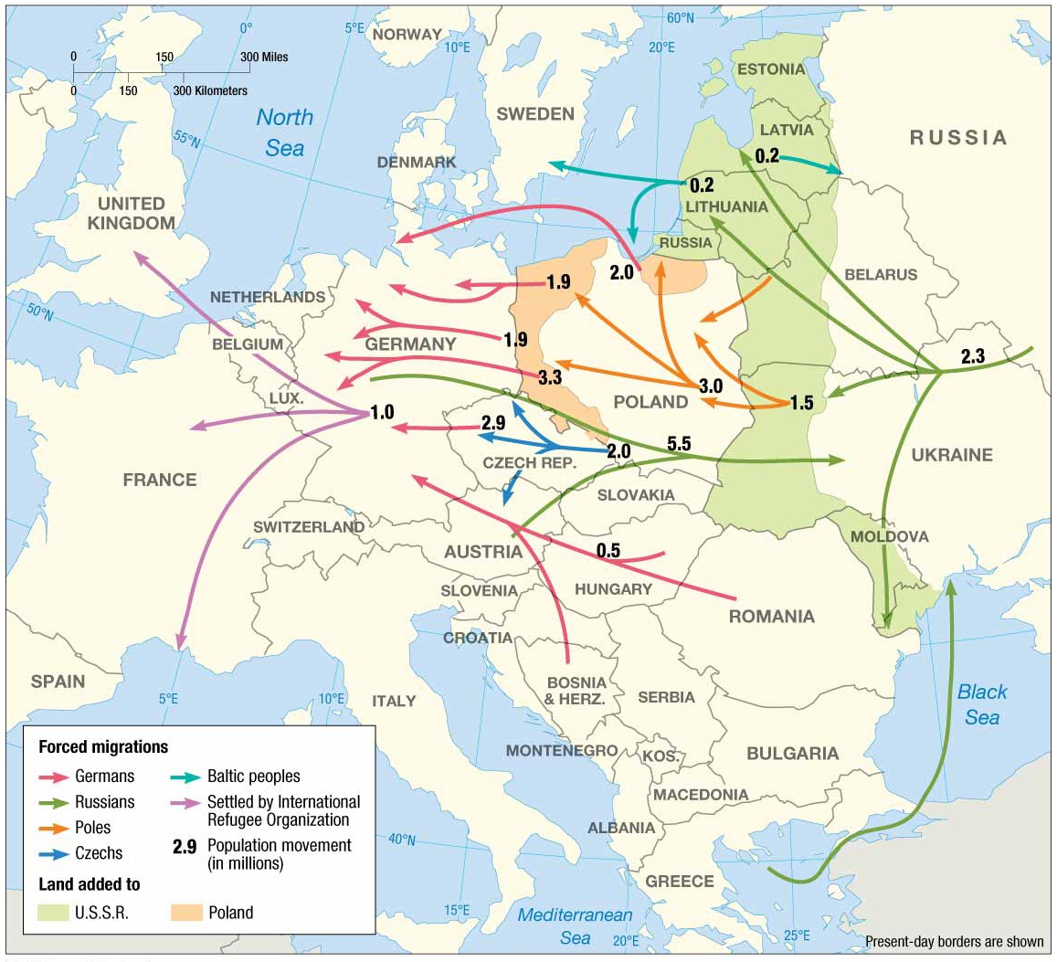
Why Do Ethnicities Engage in Ethnic Cleansing and Genocide?
Notes:
FIGURE 7-37 FORCED MIGRATION OF ETHNICITIES AFTER WORLD WAR II The largest number were Poles forced to move from territory occupied by the Soviet Union (now Russia), Germans forced to migrate from territory taken over by Poland and the Soviet Union, and Russians forced to return to the Soviet Union from Western Europe.

Slide 36
Why Do Ethnicities Engage in Ethnic Cleansing and Genocide?
Ethnic Cleansing in the Balkans
In recent years, ethnic cleansing has occurred in portions of former Yugoslavia.
Bosnia
Serbs and Croats fought to not be part of a multiethnic state with a Muslim plurality.
Motivated to perform ethnic cleansing on Bosnian Muslims to reduce their numbers and to offer an ethnically homogenous group of people to be better candidates for union with Serbia and Croatia.
Ethnic cleansing of Bosnian Muslims created one continuous area of Bosnia Serb domination rather than several discontinuous ones.
Notes:
Complex pattern of ethnic diversity in the region of southeastern Europe known as the Balkan Peninsula.
Balkans include Bosnia, Herzegovina, Kosovo, Albania, Bulgaria, Greece, and Romania, as well as a few other smaller countries once part of Yugoslavia.

Slide 37
Why Do Ethnicities Engage in Ethnic Cleansing and Genocide?
Ethnic Cleansing in the Balkans
Balkanized was a term widely used to describe a small geographic area that could not successfully be organized into one or more stable states, because it was inhabited by multiple, longstanding ethnicities with animosity towards each other.
Balkanization is the process by which a state breaks down through conflicts among its ethnicities.
If peace comes to the Balkans, it will be because ethnic cleansing “worked” tragically.

Slide 38
Why Do Ethnicities Engage in Ethnic Cleansing and Genocide?
Ethnic Cleansing and Genocide in Sub-Saharan Africa
Genocide is the mass killing of a group of people in an attempt to eliminate the entire group from existence.
Ex. Darfur
Darfur’s black Africans launched a rebellion in 2003 because of discrimination experienced.
Sudanese government, with help of marauding Arab nomads, crushed the rebellion.
480,000 have been killed.
2.8 million live in refugee camps in harsh conditions.
Many countries have termed the actions of the Sudanese government as genocide.
Notes:
Actions by Sudanese government include mass murders and rape of civilians. War crime have been filed against them.

Slide 39
Why Do Ethnicities Engage in Ethnic Cleansing and Genocide?
Ethnic Cleansing and Genocide in Central Africa
Rwanda
Genocide involving Hutus murdering hundreds of thousands of Tutsis began in 1994.
Congo
Conflict between Hutus and Tutsis spilled into neighboring countries.
Laurent Kabila, president succeeding Mobutu, permitted Tutsis to kill some of the Hutu residents.
Notes:
Actions by Sudanese government include mass murders and rape of civilians. War crime have been filed against them.

Slide 40
Why Do Ethnicities Engage in Ethnic Cleansing and Genocide?
Ethnic Cleansing and Genocide in Central Africa
Ethnic conflict is widespread in Africa largely because the present-day boundaries of countries do not match the boundaries of ethnic groups.
During nineteenth and twentieth centuries, European countries carved up the continent in to a collection of colonies, with little regard for the distribution of ethnicities.
When colonies became states, some tribes were divided among more than one modern state, and others were grouped with dissimilar tribes.
A recipe for conflict

Slide 41
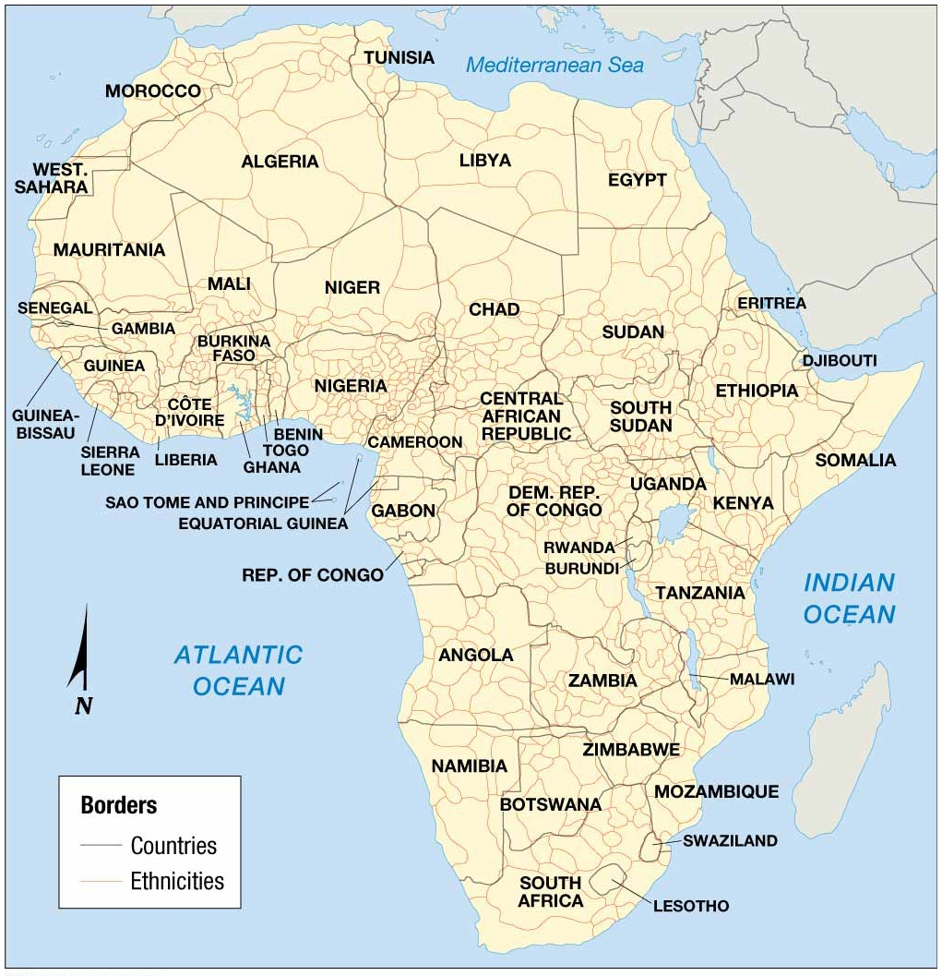
Why Do Ethnicities Engage in Ethnic Cleansing and Genocide?
Notes:
FIGURE 7-50 AFRICA’S MANY ETHNICITIES The territory occupied by ethnic groups in Africa rarely matches the boundaries of countries.

