Slide 1
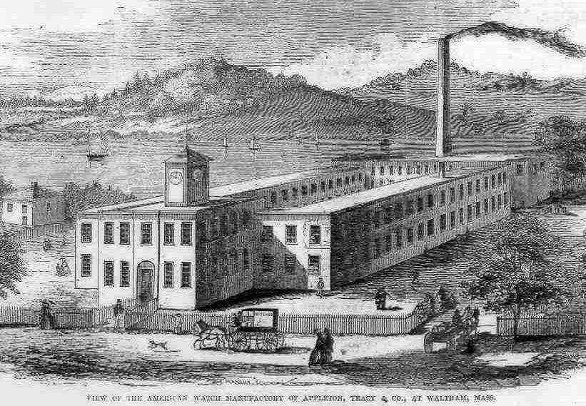
The Industrialization of the United States
Events and Ideas
U.S. History
Unit 2

Slide 2
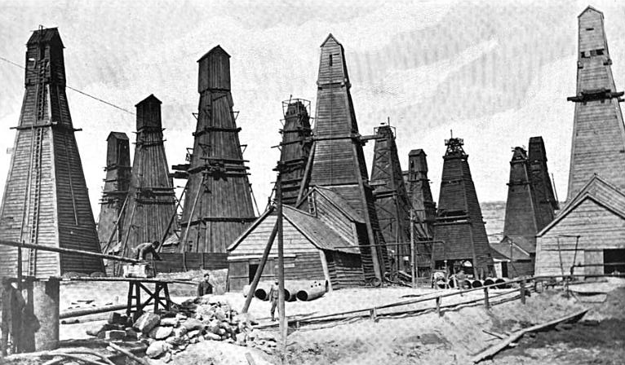
Natural Resources
American industry grew rapidly after the Civil War.
There was an abundance of raw materials in the U.S.
Large amounts of water, timber, coal, iron, and copper.
Petroleum was also discovered.
Turned into Kerosene.
Notes:
Petroleum was discovered.
i. Turned in kerosene.
ii. Kerosene used in lanterns and stoves.
iii. The American oil industry was built on the high demand for kerosene.

Slide 3
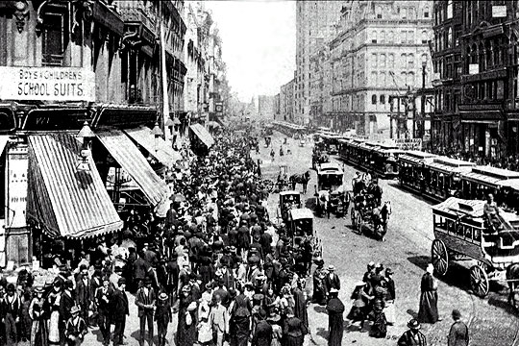
Population Explodes
Tenement District Stores
Between 1860 and 1910, the U.S. population tripled.
Industry had a large workforce and demand for consumer goods increased.
Population growth due to large families and immigration.
1870 to 1910: 20 million immigrants came to the U.S.

Slide 4
Capitalism
The free enterprise system enabled the U.S. to industrialize quickly.
Free enterprise system:
Profit motive = make money.
Entrepreneurs = capital to invest
Laissez-faire = no government interference.
Government kept taxes and spending low.
Dramatic inventions helped industry
Bell & the telephone
Edison & electricity.
Bell Telephone
Company 1915
Notes:
The free enterprise system enabled the US to industrialize quickly.
Free enterprise system:
i. Profit motive = make money.
ii. Entrepreneurs = capital to invest.
iii. Laissez-faire = no government interference.
Government kept taxes and spending low.
Dramatic inventions helped industry.
i. 1876 - Alexander Graham Bell and the telephone.
ii. Thomas Alva Edison and the light bulb and electricity.
a. Phonograph in 1877.
b. Light bulb and electric generator in 1879.
iii. Forms the Edison General Electric company in 1889.

Slide 5
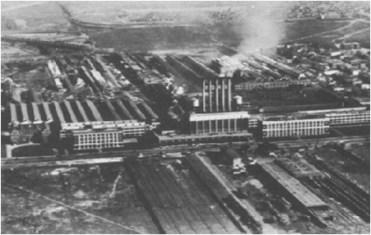
Expansion
In the 1800’s industry in the U.S. experienced a tremendous expansion.
Industrial jobs drew immigrants and rural Americans to cities.
Growing urban population provided cheap labor and a market for new products
Multifamily tenements became overcrowded. They were unsanitary and lacked light and ventilation.

Slide 6
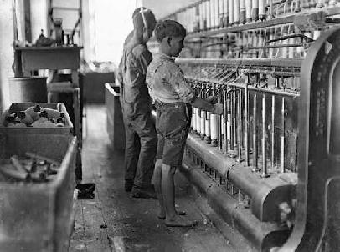
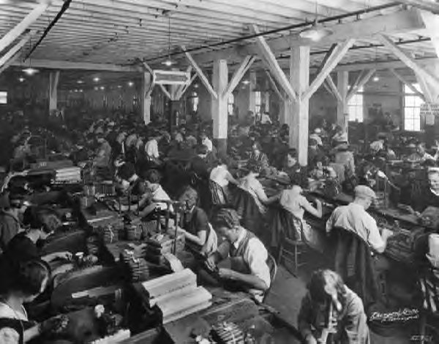
Laborers
Factory workers worked 12 + hours a day, 6 days a week for low wages
Employees often worked with dangerous machinery in unsafe conditions
Women worked long hours in sweatshops without breaks being paid significantly less than men.
Child labor was common. In 1890 there were 1.5 million workers under 15.

Slide 7
12 year old sweatshop worker in New York City, 1903

Slide 8
Railroads: Linking the Nation
US Western Railway
Land Grants
Government gave land grants railroad companies
1850s, federal government granted 28 million acres of public land for railroads
1862 and 1864 Pacific Railway Acts gave land directly to railroad companies
120 million acres awarded total

Slide 9
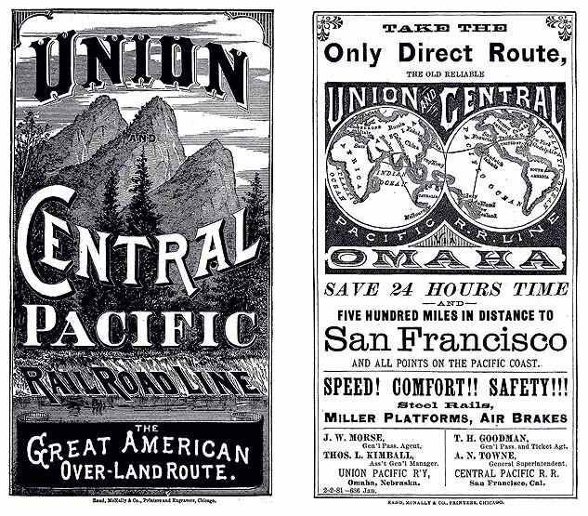
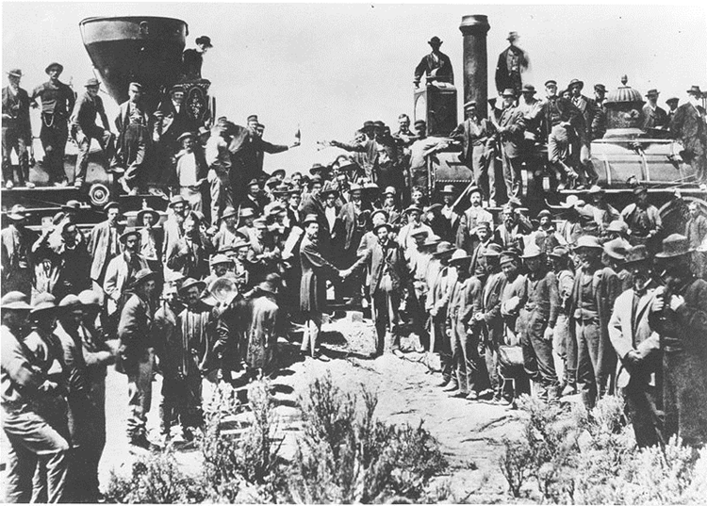
Transcontinental Railroad Completed on May 10, 1869 at Promontory Point, Utah
Revolutionized the economy of the west and led to rapid settlement and movement west.
Considered to be the greatest technological and engineering feat of the 19th century (in the U.S.).
Made trade and travel possible and practical.

Slide 10
Railroads: Linking the Nation
Rapid construction of railroads accelerated the nation’s industrialization
1865, the U.S. had 35,000 miles of track
1883, the American Railway Association split the country into four time zones
1900, the U.S. had 200,000 miles of track
Notes:
Rapid construction of railroads accelerated the nation’s industrialization.
1865, the US had 35,000 miles of track.
1883, the American Railway Association split the country into four time zones.
i. Within the same time zone, the same time would be kept to ensure that trains ran on time.
1900, the US had 200,000 miles of track.

Slide 11
The Rise of Big Business
Big business takes a more leading role in American life.
Vertical and horizontal integration created monopolies.
Vertical integration is when a company owns all of the businesses it depends on.
Example: Carnegie Steel companies bought coal, lime, and iron facilities to provide its corporation with raw materials needed to make steel
Andrew Carnegie

Slide 12
The Rise of Big Business
Horizontal integration: a corporation combines firms that perform a single function.
Example: Standard Oil bought smaller oil companies to gain control of 90% of the oil refining in 1880.
American grew very suspicious of monopolies by the late 1800s.
John D. Rockefeller of Standard Oil

Slide 13
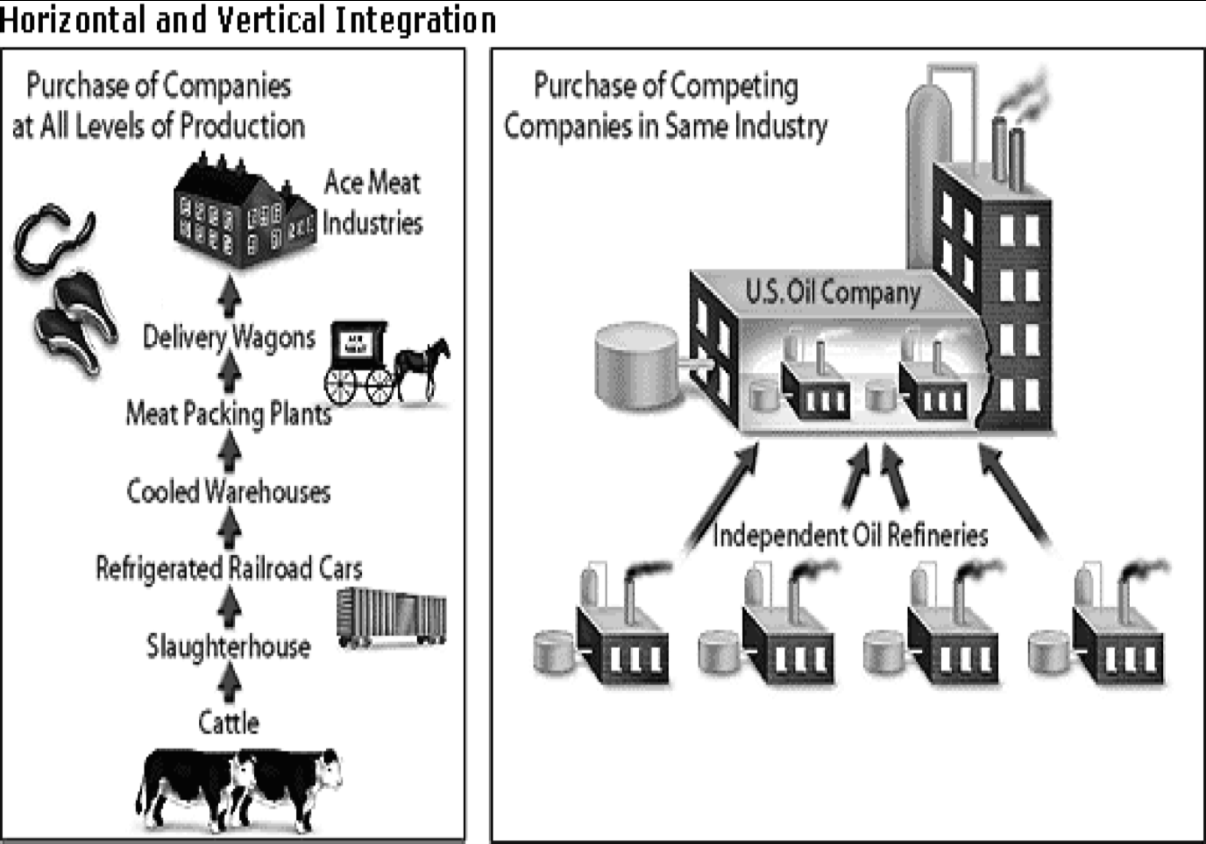
Horizontal and Vertical Integration

Slide 14
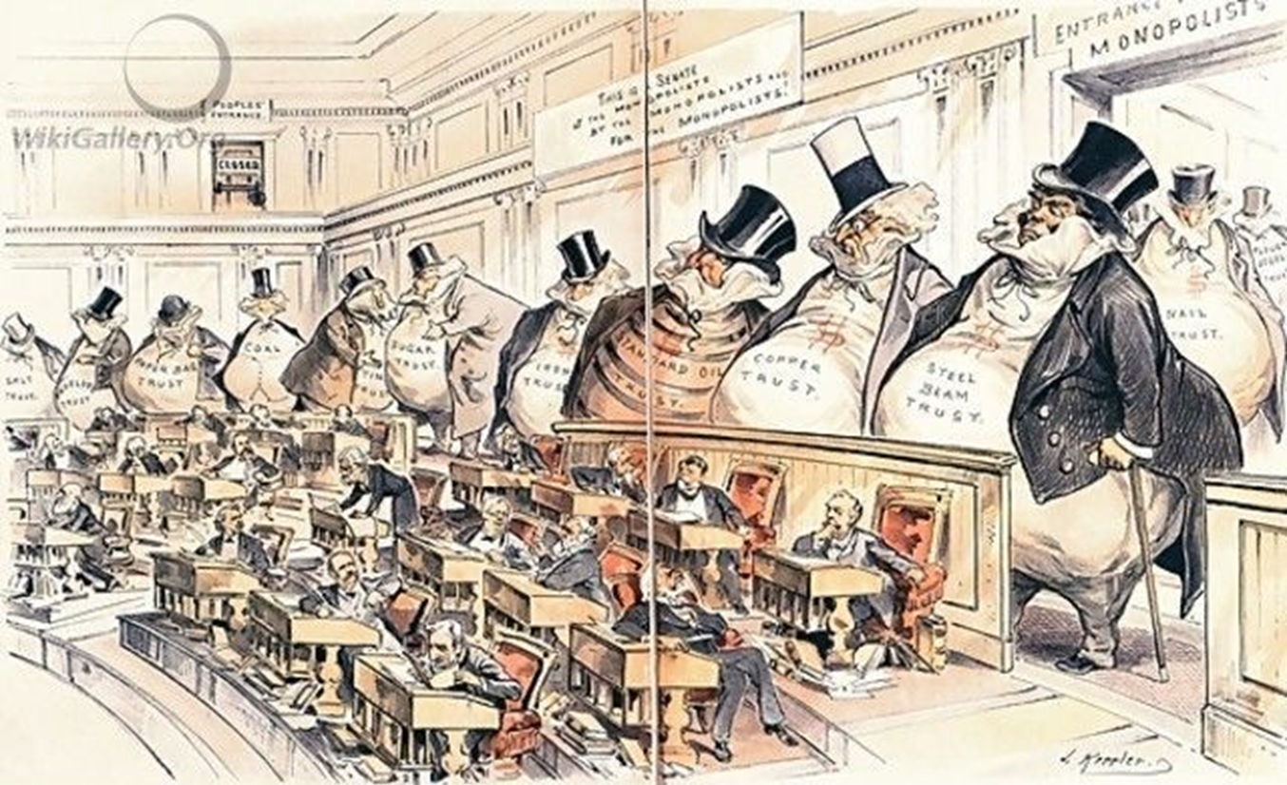
Trust and Cartels
Notes:
A trust is a legal concept that allows one person to manage another persons property. The person who manages another persons property is called a trustee. This arrangement enabled the Standard Oil trustees to control a group of companies as if they were one large merged company.
Many companies also created new organizations called holding companies. A holding company does not produce anything itself. Instead, it owns the stock of companies that produce goods, effectively merging them into one large enterprise.

Slide 15
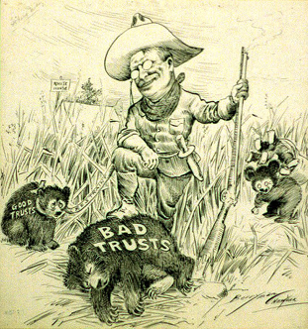
Trust-Busting
By 1900, trusts, legal bodies created to hold stock in many companies, controlled 80% of U.S. industries.
Roosevelt filed 44 antitrust suits under the Sherman Anti-Trust Act
Goal : Break up monopolies and their power in certain industries

Slide 16
Labor Unions
Industrial workers come together to form unions
Working conditions were often unhealthy and dangerous
Workers breathed in lint, dust, and toxic fumes
Heavy machinery caused a large number of injuries
New York City Sweatshop

Slide 17
Labor Unions
Workers who wanted to unionize faced major problems.
There were no laws that gave workers the right to strike or unionize.
Courts ruled against unions and police often prevented labor protests.
Unions were seen as the first step towards Marxism (Communism).
Spindle Boys
Notes:
Karl Marx devoted himself to the task of revolutionary organizing of the working class. For the first few years he and his family lived in extreme poverty. His main source of income was his colleague, Engels, who derived much of his income from his family's business. Later Marx and Engels both began writing for six different newspapers around the world; in England, the United States, Prussia, Austria and South Africa. Most of Marx's journalistic writing, however, was as a European correspondent for the New York Daily Tribune

