Slide 1
Immigrants Come to America
Events and Ideas #2 U.S. History Unit 2

Slide 2
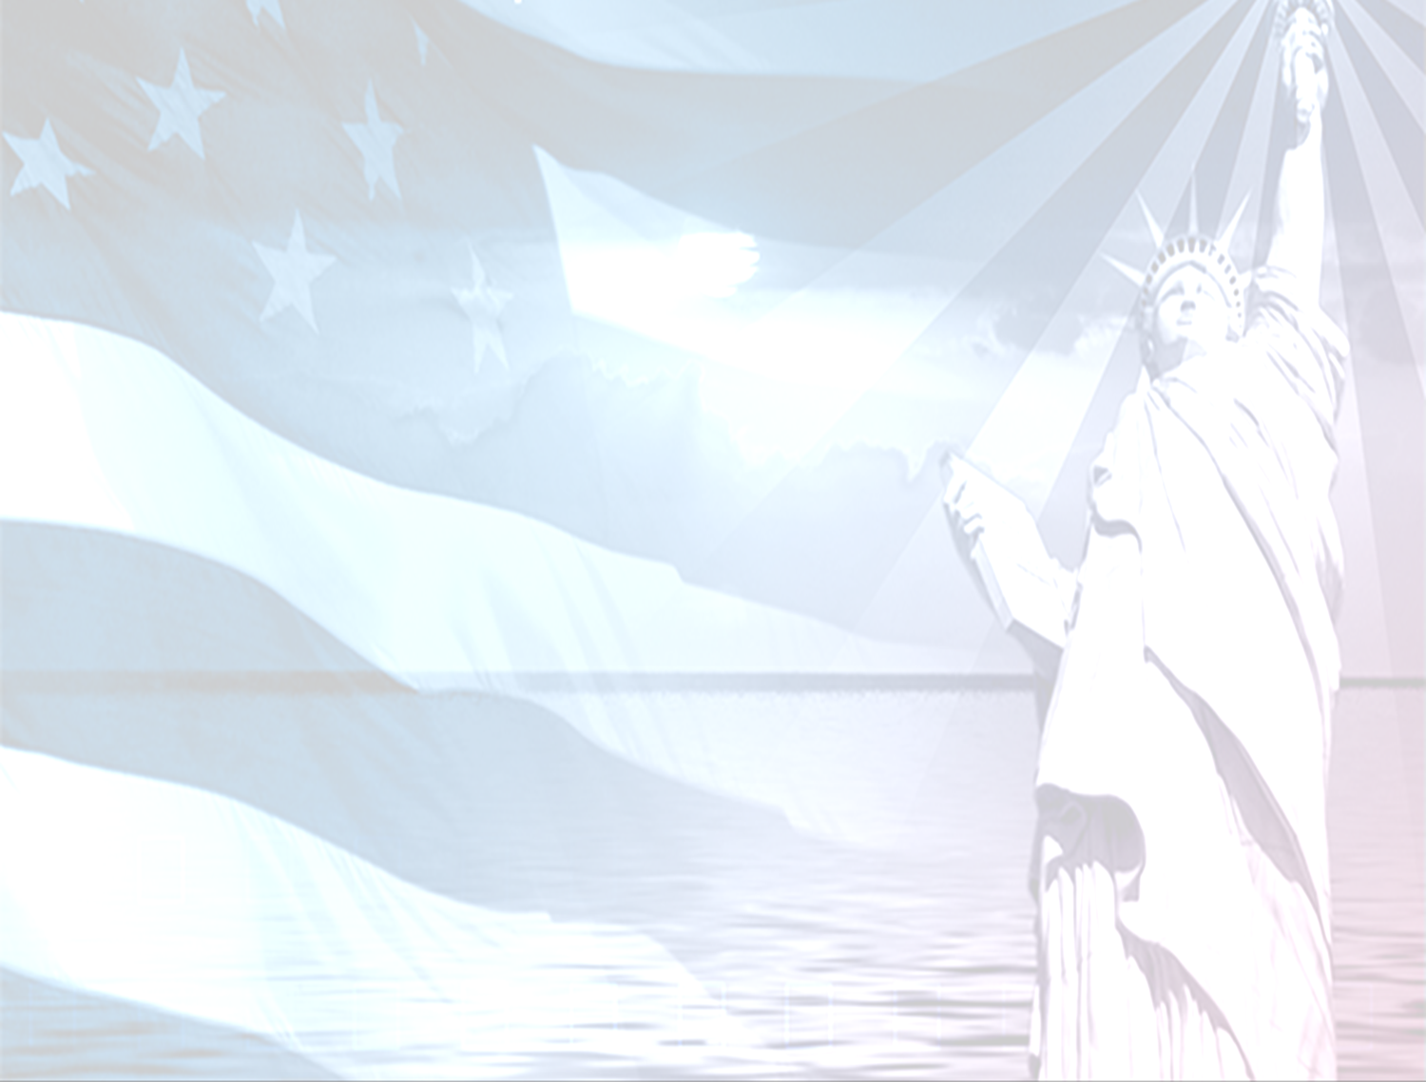
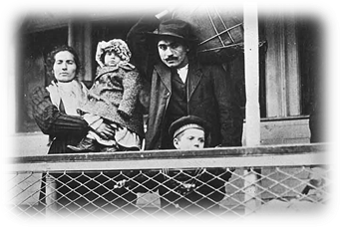
Immigration
Post-1860s, millions of immigrants arrive from Europe and Asia.
More than half are from eastern and southern Europe.
Immigration to the U.S. was driven by poverty.
Governments encouraged their poor to immigrate to the U.S.
Getting to the U.S. was often difficult.
Immigrants disembarking at Ellis Island
Notes:
After the 1860s, millions of immigrants arrive from Europe and Asia.
More than half of all immigrants were from eastern and southern Europe.
i. These were non-English speaking countries of Europe.
They included: Italians, Greeks, Poles, Slavs, Slovaks, Russians, and Armenians.
i. Many of the 14 million immigrants who came to the US between 1860 and 1900 were eastern European Jews.
ii. Many immigrants came to the US for many different reasons but all came for a better life.

Slide 3
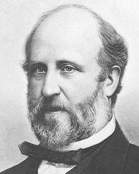
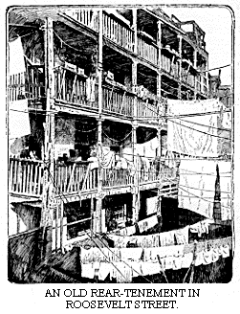
Political Machines
City bosses offered immigrants jobs, housing, or help with becoming full citizens in exchange for their votes.
A constant flow of new immigrants provided steady support for political “Bosses”
William “Boss” Tweed

Slide 4
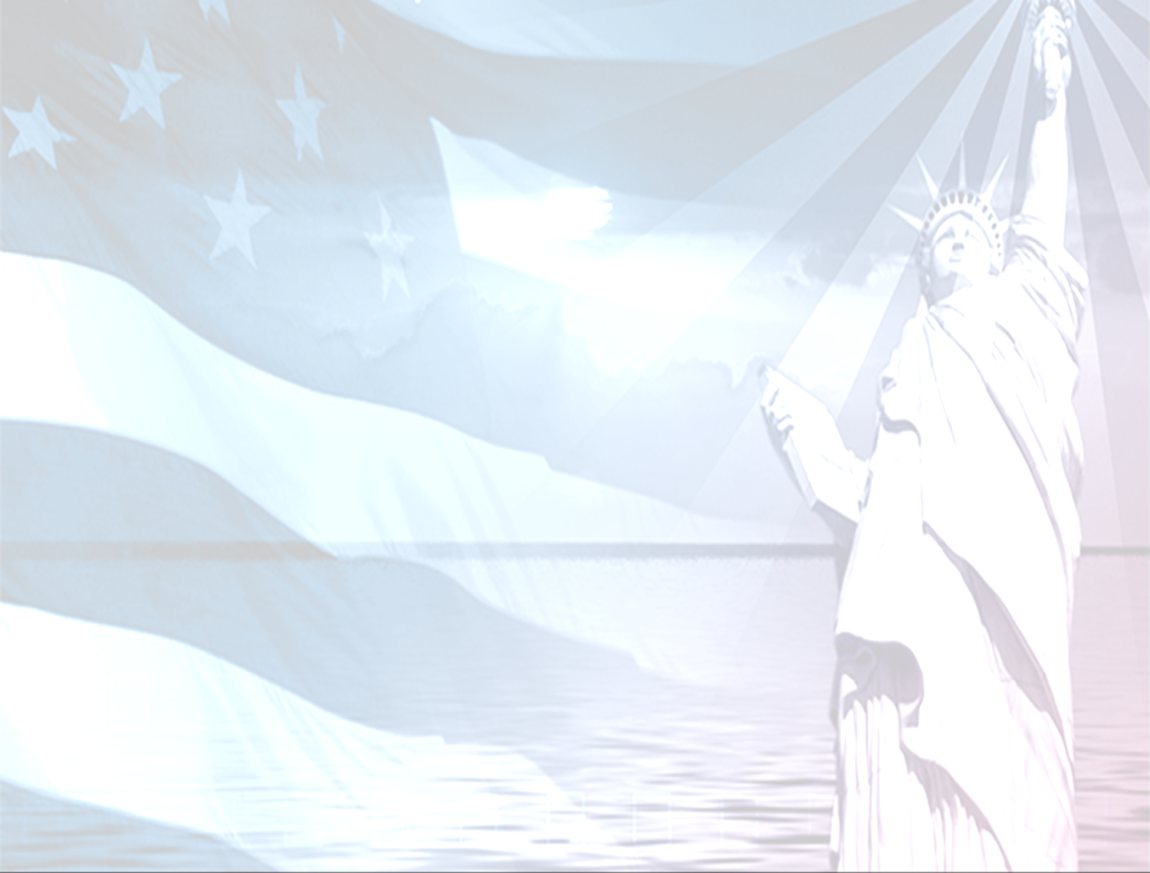
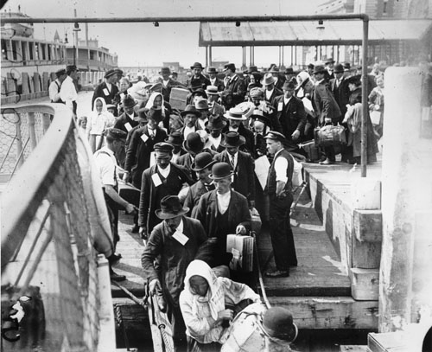
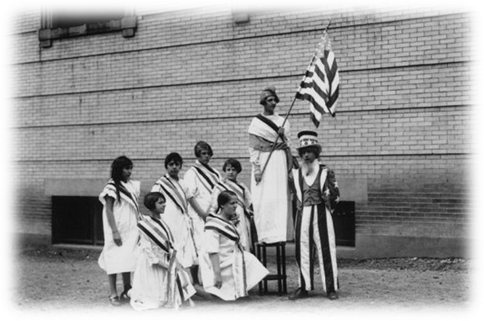
Americanization
With millions of new immigrants, many native-born Americans feared a threat to the American way of life.
They wanted immigrants to assimilate and adopt the language and customs of American society.
Immigrant children attend public schools to learn English, American history & government, and American customs.
Many adult immigrants attended night school. Employers, such as Henry Ford, offered daytime programs to their immigrant workers.

Slide 5
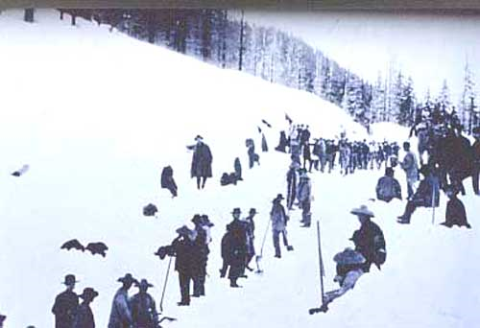
Immigration in the West
Chinese begin to arrive in the U.S. in the mid-1800s.
China was suffering from severe unemployment, poverty, and famine.
Many Chinese immigrants worked laying track for railroads
1882 – Chinese Exclusion Act
From 1910 – 1940, Chinese immigrants went through Angel Island.
Working on the
Transatlantic RR
Medical examination of immigrants.
Notes:
Chinese begin to arrive in the U.S. in the mid-1800s.
i. China had a population of 430 million.
China was suffering from severe unemployment, poverty, and famine.
i. The 1848 discovery of gold in California began to lure the Chinese to the United States.
ii. In 1850, the Taiping Rebellion erupted in China.
iii. 20 million Chinese were end up being killed in the rebellion and many fled China for their very lives.
The Chinese Exclusion Act - May 6, 1882. It was one of the most significant restrictions on free immigration in US history, prohibiting all immigration of Chinese laborers.
The act allowed the US to suspend Chinese immigration.
The Act affected Asians who had already settled in the United States. Any Chinese who left the United States had to obtain certifications for reentry, and the Act made Chinese immigrants permanent aliens by excluding them from U.S. citizenship
The act was initially intended to last for 10 years, but was renewed in 1892 and made permanent in 1902.
It was finally repealed by the Magnuson Act on December 17, 1943.

Slide 6
Nativism
Focused on the Irish in the 1840s and 1850s.
1880s on, anti-immigrant feelings against Asians, Jews, and Eastern Europeans.
Labor unions opposed immigration.
Immigrants were often used as strikebreakers.
Chinatown, San Francisco
Notes:
Nativism is a:
i. Preference for native born people.
ii. And a desire to limit immigration.
iii. I also believe it is a mask for subtle racism or “classism” but not always.
Initially focused on Irish immigrants in the 1840s and 1850s.
i. Rent the movie “Far and Away” for a view of Irish Immigration.
ii. Irish were mostly Catholic.
iii. America is a largely Protestant society at the time and Catholics were feared.
iv. People did not want the Catholic Church getting too much influence on American politics.
Anti-immigrant feelings focused on Asians, Jews, and Eastern Europeans.
i. These groups, not having a foundation of being English speaking whites – looked, sounded and acted more foreign and so, were treated accordingly.
Labor unions opposed immigration.
i. Fear of wages falling.
ii. Workingman’s Party of California forms in the 1870s. It fought Chinese immigration.
iii. American Protective Association formed in 1887. It fought Catholic immigration.

Slide 7
Urbanization
Most immigrants settled into America’s largest cities.
Demand for land in cities made it very expensive.
Mass transit developed in the late 1800s to move large numbers of people.
Notes:
Most immigrants settled into America’s largest cities.
i. No money to purchase a farm and no education kept immigrants in the cities.
Demand for land made it very expensive.
i. Demand raised the price of land.
ii. Owners had an incentive to utilize the land their had as efficiently as possible.
Architects and engineers were forced to grow America up and not out.
i. The industrialization of America helped to bring about new construction techniques.
ii. Steel frame construction finally allowed architects and engineers to build taller and taller buildings.
iii. Soon, New York city would boast that it had more skyscrapers than any other city in the world.
Mass transit developed in the late 1800s to move large numbers of people.
i. In 1890, horsecars – railroad cars pulled by horses – moved 70 percent of the urban traffic in the US.
ii. More than 20 cities, beginning with San Francisco in 1873, installed cable cars, which were pulled by underground cables.
iii. In 1887, engineer Frank J. Sprague developed the electric trolley car.
iv. Traffic will start to become so bad that cities develop ways to raise and lower traffic. Chicago develops an elevated rail car and Boston and New York develop America’s first subway systems.

Slide 8
Urbanization
Cities were often divided by class.
Upper, middle, lower
The wealthy created fashionable districts in the hearts of cities.
The middle class lived in “streetcar suburbs.”
The lower working class filled in the tenement districts.
New York Street Scene, 1905
Notes:
Cities were often divided by class.
i. Upper, middle, and lower.
ii. Every society treats its classes differently.
iii. In America, we use to like to dump our poor into the inner cities but now that is even more expensive.
iv. In France, for example, immigrants are dumped in the suburbs surrounding the cities as city life is for the true French.
Wealthiest families created fashionable districts in the hearts of cities.
i. The richest people would actually create large mansion that were similar to the feudal castles, English Manor house, or a Tuscan villa.
ii. Cornelius Vanderbilt’s grandson commissioned a $3 million French chateau equipped with a 2 story dining room and a marble bathroom.
The growing middle class lived in “streetcar suburbs.”
i. The growing middle class included doctors, lawyers, engineers, managers, social workers, architects, and teachers.
ii. Middle-class salaries during this period were twice that of an average factory worker (without the hours or dangers).
The lower class filled in the tenement districts.
i. 3 out of every 4 residents of New York City were squeezed into tenements, dark and crowded multi-family apartments.
ii. With an average annual income of only $490, many families sent their children to work the factories or rented precious space to a boarder.

Slide 9
Urbanization
Large cities posed threats such as crime, violence, fire, disease, and pollution.
Alcohol contributed to violent crime.
Improper sewage disposal contaminated city drinking water.
Political machines traded votes for jobs, housing, food, heat, and police protection.
Tenement District Stores
Notes:
Cities posed threats such as crime, violence, fire, disease, and pollution.
Alcohol contributed to violent crime.
i. 1890 book titled “How the Other Half Lives” by Jacob Riis, accused saloons of “breeding poverty,” corrupting politics, bringing suffering to the wives and children of drunkards, and fostering the “corruption of the child” by selling beer to minors.
Improper sewage disposal contaminated city drinking water.
i. Contaminated drinking water often triggered epidemics of typhoid fever and cholera.
ii. Flush toilets and sewer systems did exist in the 1870s but horsecars leave a lot of horse waste in the streets, smoke belched from chimneys, and soot and ash accumulated from coal and wood fires.
Political machines – informal political groups – traded votes for jobs, housing, food, heat, and police protection.
i. Political machines were designed to get power and keep power.
ii. Political machines often expanded faster than city services did and so were able to fill a need.
iii. New immigrants needed jobs, housing, food, heat, and police protection.
iv. Political machines would assists with these needs if the newly arrived immigrants would vote the way the political machines wanted them to.

Slide 10
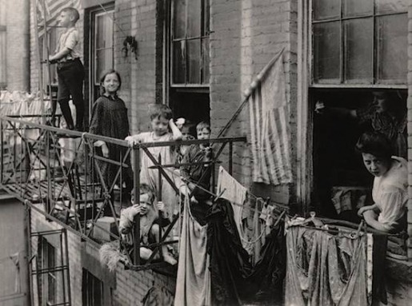
Looking to Improve Conditions
The Social Gospel Movement and Progressives worked to improve conditions in cities
Supported programs to help the poor
Established settlement houses to help poor residents, mostly immigrants
Supported legislation to improve citizens lives

