Slide 1
The Ideological Origins of the American Revolution
Events and Ideas #2
U.S. History
Unit 1

Slide 2
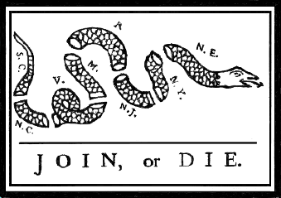
What is this political cartoon by Benjamin Franklin trying to say?
What does the snake represent?
What do the letters represent?
What is the implication if the colonies do not join?
Notes:
'Join, or Die' is a well-known political cartoon, created by Benjamin Franklin and first published in his Pennsylvania Gazette on May 9, 1754. The original publication by the Gazette is the earliest known pictorial representation of colonial union produced by a British colonist in America. The cartoon appeared along with Franklin's editorial about the "disunited state" of the colonies, and helped make his point about the importance of colonial unity.
At that time, the colonists were divided on whether to fight the French and their Indian allies for control of the land west of the Appalachian Mountains, in what came to be known as the French and Indian War. It became a symbol for the need of organized action against an outside threat posed by the French and Indians in the mid 18th century.

Slide 3
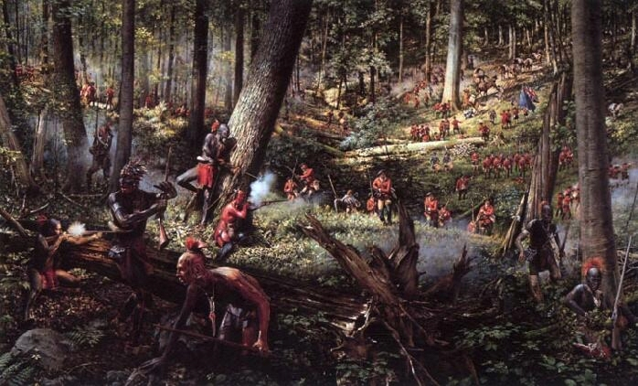
French and Indian War 1754 – 1760
French and Indian vs. British and Colonials
France loses and Great Britain becomes the dominate European power in America
Notes:
1754 – 1760 French and Indian War raged along the North American frontier.
i. French and their Indian allies versus the British Army and the colonial militias.
ii. War started for a couple of reasons:
a. Both European powers ignored Native American claims to the land (beaver pelt economies).
b. British feared catholic influence from French holdings (Catholic).
c. France feared protestant influence from the British.
The attack on Fort William Henry in 1757.
Surrender by British, Native misunderstand surrender and attack as column attempts to returned to Ft. Edward. Indians take prizes (scalps) off life soldiers and family members (women and children). They enter the fort and scalp the dead from the cemetery. Some of the dead, died of smallpox. The natives take the disease back to their villages.
Using one of the best movies out there to show what this time period was like (Last of the Mohicans), Although there are inaccuracies in the movie, like any movie dealing with a historical subject, it really does a great job showing the vast wilderness of the North American continent and the beauty and brutality of life in the mid-1700s.
Four scenes: The ambush on the way to Fort William Henry (Ex. La Petite Guerre )
The siege of Fort William Henry by the French (European siege tactic - digging to get close for mortars/howitzers)
The demonstration of mortars/howitzers to force forts surrender (European siege tactic)
The massacre after the surrender (Ex. La Petite Guerre)

Slide 4
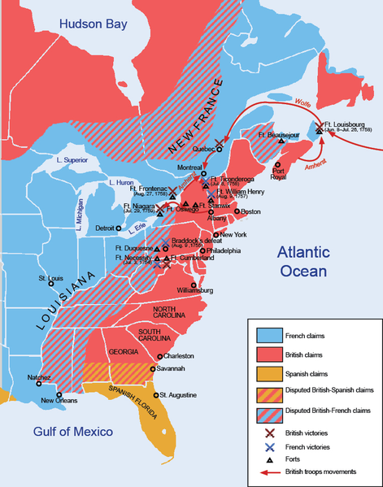
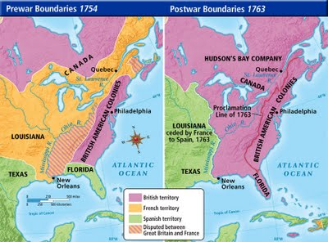
North America before and after the French Indian War
Notes:
Treaty of Paris:
France:
Lost its Canadian possessions and claims
lands east of the Mississippi River.
Spain:
Got all French lands west of the Mississippi
River, New Orleans, but lost Florida to
England.
England:
Got all French lands in Canada, exclusive
rights to Caribbean slave trade, and
commercial dominance in India.
North American was now divided between Great Britain and Spain with the Mississippi River forming the boundary

Slide 5
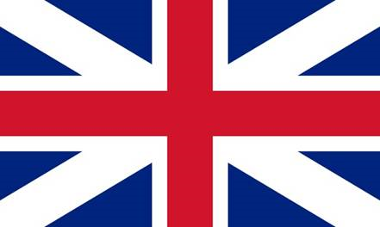
The Effects of War
Britain
The Colonies
Increased its colonial empire in the Americas.
Greatly enlarged England’s debt.
England wanted the Colonies to pay for the costs of the war.
England felt like the colonists should be thankful.
Resistance to British control, taxation.
United colonists against a common enemy (Great Britain).
Increasing feelings of being “American”

Slide 6
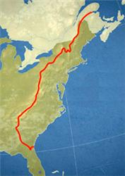
The Proclamation Act of 1763
This line drawn to end colonial settlement west of the Appalachian Mountains
Colonists protested that the Proclamation deprived them of land they had a right to settle
Caused more friction between colonists and Britain
Notes:
Pontiac's War or Pontiac's Rebellion was a war that was launched in 1763 by a Native American tribes from the Illinois Country, and Ohio Country who were dissatisfied with British postwar policies after the British victory in the French and Indian War (1754–1763). Warriors from numerous tribes joined the uprising in an effort to drive British soldiers and settlers out of the region. The war is named after the Ottawa leader Pontiac, the most prominent of many native leaders in the conflict.
The war began in May 1763 when Native Americans, offended by the policies of British General Jeffrey Amherst, attacked a number of British forts and settlements. Eight forts were destroyed, and hundreds of colonists were killed or captured, with many more fleeing the region. Hostilities came to an end after British Army expeditions in 1764 led to peace negotiations over the next two years. Native Americans were unable to drive away the British, but the uprising prompted the British government to modify the policies that had provoked the conflict.
Proclamation Act of 1763.
i. This act tried to halt colonial expansion into Native American lands west of the Appalachian Mountains.
ii. King George III wanted to avoid another costly war with Native Americans.
iii. Colonists – who fought in the colonial militia during the French and Indian War had fought to gain access to the Ohio River Valley.
iv. Western farmers especially denounced this Act and refused to follow it.
Warfare on the North American frontier was brutal, and the killing of prisoners, the targeting of civilians, and other atrocities were widespread. In what is now perhaps the best-known incident of the war, British officers at Fort Pitt attempted to infect the besieging Native Americans with smallpox using blankets that had been exposed to the virus. The ruthlessness and treachery of the conflict was a reflection of a growing divide between the separate populations of the British colonists and Native Americans. The British government sought to prevent further violence between the two by issuing the Royal Proclamation of 1763, which created a boundary between colonists and Native Americans. This proved unpopular with British colonists, and may have been one of the early contributing factors to the American Revolution.

Slide 7
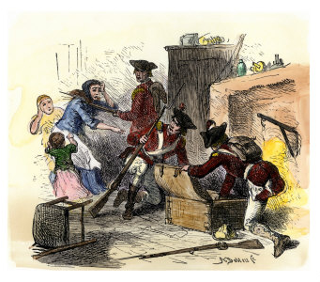
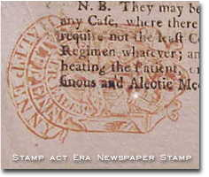
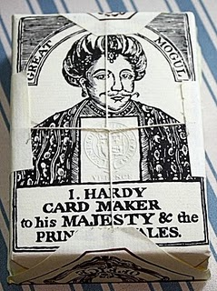
Unpopular Regulations
Sugar Act of 1764
Raised taxes on raw sugar and
molasses.
Quartering Act of 1765
Forces colonists to give British troops a place to stay, feed them, and provide transportation.
Stamp Act of 1765
In 1765, British imposed taxes upon all paper products and stamped the item once the tax had been played.
Products affected ranged from documents and wills, to playing cards and newspapers
Notes:
Sugar Act of 1764.
i. Britain finally started to notice that the colonies had a pretty good smuggling operation going on and they wanted to stop it.
ii. The Sugar Act was passed in bring in more revenues by raising taxes on raw sugar and molasses.
iii. New taxes were also passed on silk, wine, coffee, and indigo.
Quartering Act of 1765.
i. Britain wanted the colonists to pay for their own defense and so passed the Quartering Act of 1765.
ii. "To quarter" means to give soldiers a place to stay. This act required colonists to provide a place to stay, goods, and transportation to the British soldiers. This made the colonists suspicious of the soldiers. The soldiers felt that they were sent to America not to protect the colonists but to control them. The colonists think the British should of asked for their permission first.

Slide 8
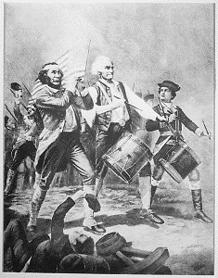
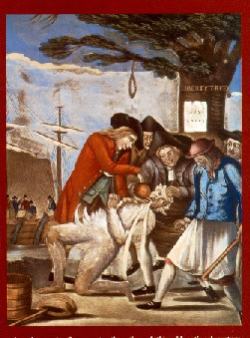
Sons of Liberty
Carried out organized resistance by keeping watch on shopkeepers suspected of selling British goods
Existed in almost every colony
Included middle and upper class citizens, anyone trustworthy could join
Famous members included Paul Revere, John Adams and his cousin, Samuel Adams.
Notes:
Which Enlightenment thinker talker about the duty to rebel against tyranny?
The concept of the right of revolution was also taken up by John Locke in Two Treatises of Government as part of his social contract theory. Locke declared that under natural law, all people have the right to life, liberty, and estate; under the social contract, the people could instigate a revolution against the government when it acted against the interests of citizens, to replace the government with one that served the interests of citizens. In some cases, Locke deemed revolution an obligation. The right of revolution thus essentially acted as a safeguard against tyranny.

Slide 9
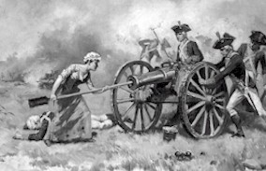
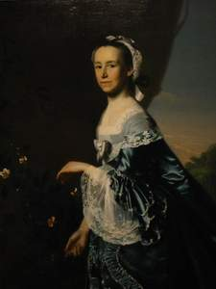
Daughters of Liberty
Colonial women organized the Daughters of Liberty to boycott British goods
They gave up imported clothes, made tea out of local herbs, and produced homespun cloth
Most influential Daughters of Liberty was Mercy Otis Warren, who published pamphlets supporting the resistance – she had to publish under under a man’s name
Notes:
Mercy Otis Warren (September 25, 1728 – October 19, 1814) was a Massachusetts author who lived during the era of the American Revolution.
At a time when politics was considered to be the exclusive province of white men, Warren was one of the first women to publish works dealing with political matters.
Beginning in 1772, she gained the support of patriot John Adams and began to publish satirical plays and political propaganda in Massachusetts newspapers. Designed to undermine royal authority, these works aimed to stir up popular alarm about British assaults on colonial rights and liberties and to generate support for the cause of independence.
During the debate over the U.S. Constitution in 1788, she issued a pamphlet opposing ratification and advocating the inclusion of a Bill of Rights, which she published under the pseudonym, "A Columbian Patriot." In 1805, she published one of the earliest histories of the American Revolution, History of the Rise, Progress, and Termination of the American Revolution. This work, which she published under her own name, was also the first history of the Revolution authored by a woman.

Slide 10
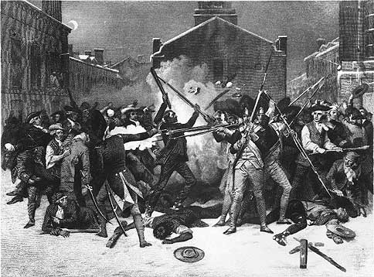
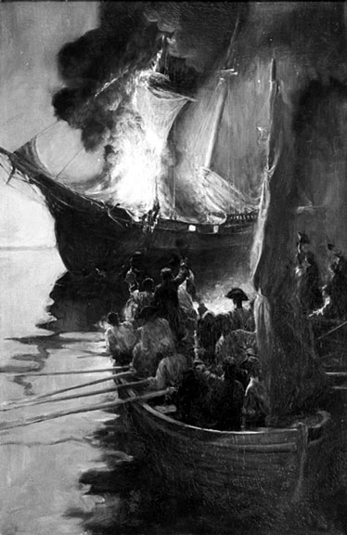
The Colonist Defy Britain
Townshend Acts of 1767
Customs on glass, lead, paper,
paint, and tea imported into the colonies.
Boston Massacre of March 5, 1770
Colonists gathered to taunt and throw things at the British soldiers guarding a customs house.
5 colonists killed, 6 wounded.
All of the Townsend Acts were repealed, except the tax on tea.
The Burning of the Gaspee
150 colonists seized and burned the customs ship Gaspee
Patrick Henry, House of Burgess, March 23, 1775
Notes:
Townshend Acts of 1767.
i. These Acts replaced the unpopular Stamp Act of 1765.
ii. These Acts put new custom duties on glass, lead, paper, paint, and tea imported into the colonies.
iii. Custom agents also had new powers to arrest smugglers.
Boston Massacre of March 5, 1770.
i. As resistance against the Townshend Acts grew, anger grew to violence.
What actions by the British inflamed the colonists? The hated Townshend Acts, competition in a tough economy and immediate anger of that preceding week (when 11-year-old Christopher Seider had been shot by a customs employee) set of colonists.
What events triggered the blowup that night? When British soldier Hugh Montgomery was struck on the head and then knocked down by a flying board, the shots would begin to explode. Crispus Attucks, a mulatto dock worker in the front line, was first shot in liver and lung; four others, three of them aged 17, lay dead or dying. Six more were wounded.
vi. Tensions relaxed when weeks later all of the Townsend Acts were repealed, save one – the tax on tea.

Slide 11
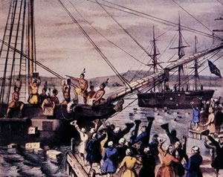
The Colonist Defy Britain
The Tea Act of 1773
Created favorable business terms for the British East India Company, hurting American merchants
The Boston Tea Party
150 men board a ship and dump 342 chests
of tea into the Boston harbor.
Result: Intolerable Acts
Boston’s port shut down until the cost of
the tea was paid for.
Town meetings banned, powers of the royal governor expanded.
First Continental Congress 1774
Delegates from 12 of the colonies meet in response to the Intolerable Acts
Notes:
The Burning of the Gaspee.
i. After trade with England resumed, so did smuggling.
ii. When 150 colonists seized and burned the stranded customs ship Gaspee, the British gave investigators the right to bring the accused back to England for trial.
iii. Colonist thought that this would deny them a right to a jury of their peers.
The Tea Act of 1773.
i. The Tea Act created favorable business terms for the struggling British East India Company.
ii. American merchants, feared they were being squeezed out of business.
iii. American harbors were soon blocked preventing British East India Company ships from entering.
The Boston Tea Party.
i. In Boston, they took it one step further.
ii. On the night before the tea was to be unloaded, 150 men (dressed up as Indians) boarded the ship and dumped 342 chests of tea into the Boston harbor.
iii. Several thousand people watching from the shore, cheered.
iv. Coercive Acts soon follow: Boston’s port shut down until tea paid. Town meetings banned. Powers of the royal governor expanded.

Slide 12
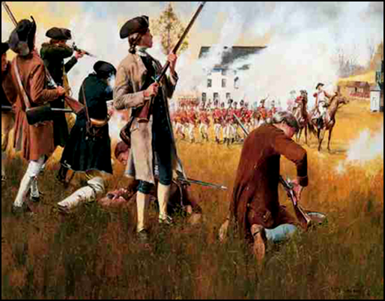
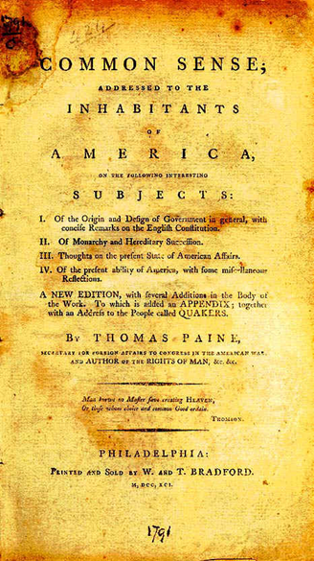
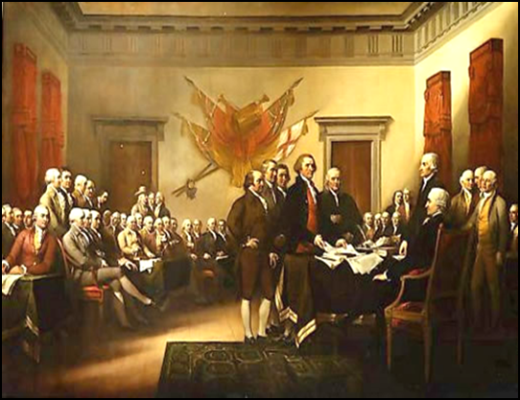
The Revolution Begins
Fighting breaks out between colonists and British
Thomas Paine’s pamphlet Common Sense, points out the advantages of freedom from British rule.
The book divided Americans into either Patriots or Loyalists
July 4, 1776:
the Declaration of Independence announced that the thirteen American colonies then at war with Great Britain were now independent states

Slide 13
