Slide 1
Social Darwinism vs. Social Gospel
Events and Ideas U.S. History Unit 2

Slide 2
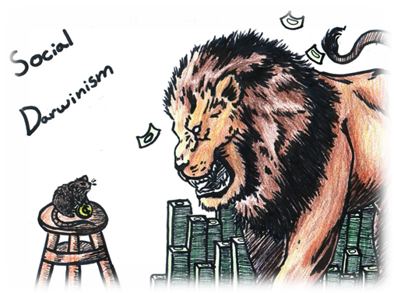
Social Darwinism
Industry leaders embraced Social Darwinism.
Competition would eliminate those who could not adapt.
Only the “fittest” companies survived.
The rich industrialists used the excuse of Social Darwinism for why they were so rich.
Notes:
Social Darwinism paralleled economic doctrine of laissez-faire.
i. “Hand-off” the economy.
Competition would eliminate those who could not adapt.
i. It was the “fittest” companies that would survive and grow.
John D. Rockefeller and other industry leaders embraced Social Darwinism.
i. If a company succeeded, it was because it had best adapted to the business environment.
America is growing, immigration is increasing, unions are far and few between and big business dominates the working class. Well, there are a lot of poor people in America. The working poor, new immigrants, etc. Out of all of this, American religion rises to the challenge through the Social Gospel movement.

Slide 3
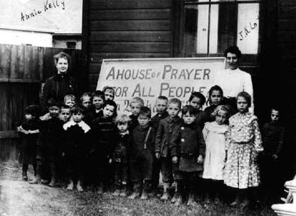
Social Gospel
The Social Gospel movement takes hold from 1870 to 1920.
Churches expand their functions to include social programs to improve:
poor working conditions
problems of society
poor schooling
child labor
crime

Slide 4
Activity: Social Darwin or Social Gospel?
Read each quote
Determine which ideology each historical person advocated
Each person in your group holds up the correct card either Social Gospel or Social Darwinism.
The first group that gets it correct, gets a point
After each turn, fill in appropriate boxes in the graphic organizer

Slide 5
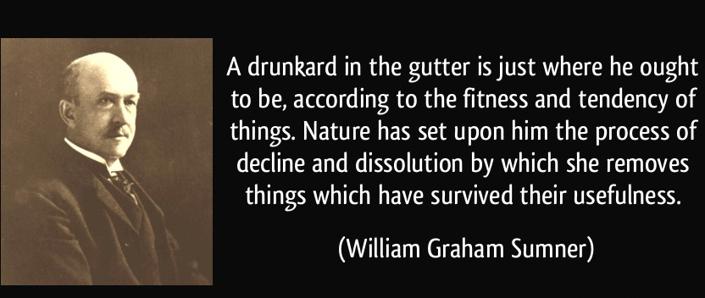
William Graham Sumner
Social Darwinist
Notes:
1840-1910)
was a leading American social scientist of the late 19th century
Yale Professor
Defended radical laissez-faire as being justified by laws of evolution
He heavily criticized socialism/communism

Slide 6
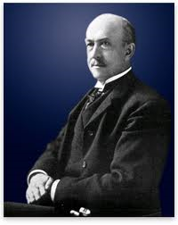
William Graham Sumner (1840-1910)
Who was he?
Influential professor at Yale
Defended laissez-faire as being justified by laws of evolution
Opposed the Spanish-American War

Slide 7
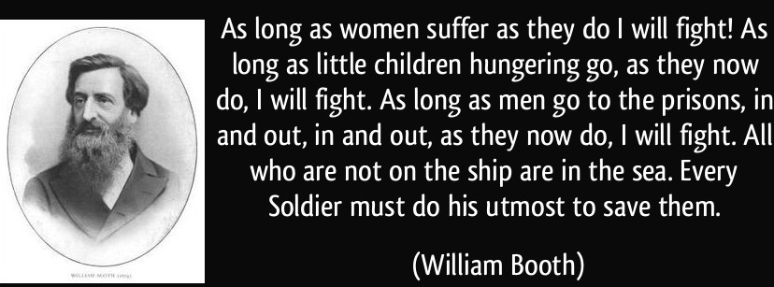
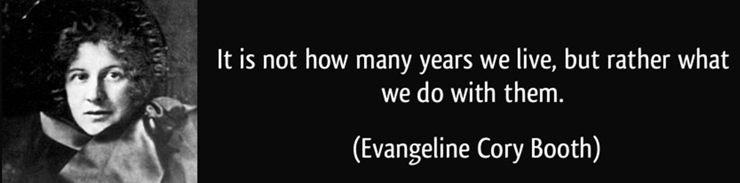
William Booth and Daughter Evangeline Booth

Slide 8
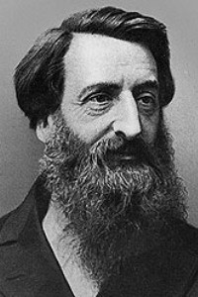
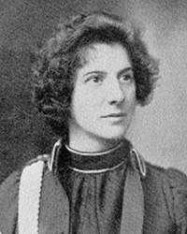
William and Evangeline Booth
Who was he?
Methodist preacher
Founded the Salvation Army
Mission was to work with the most needy: the poorest including alcoholics, criminals and prostitutes
Who was she?
1st female General of The Salvation Army
Raised 12,000 for relief work after the 1906 San Francisco earthquake
Took 250 Salvationists to France during the WWI to provide help to the troops and care after the war
Notes:
William Booth was a British Methodist preacher who founded The Salvation Army and became its first General. The Christian movement with a quasi-military structure and government founded in 1865 has spread from London, England to many parts of the world and is known for being one of the largest distributors of humanitarian aid.
Evangeline Cory Booth, (December 25, 1865 – July 17, 1950) was the 4th General of The Salvation Army from 1934 to 1939. She was its first female General.She was appointed temporary Territorial Commander of the United States, then Territorial Commander of Canada. In 1904 she returned as Commander of the United States, and held this position until 1934. In the aftermath of the 1906 San Francisco earthquake, she led a mass meeting in Union Square, New York, and raised over $12,000 for Salvation Army relief work amongst the victims of the disaster. During this period she became a US citizen.
In August 1917 Evangeline Booth took the first of 250 Salvationists left New York for the front line of the Great War in France. They soon won the confidence of the troops with their cheerful brand of ‘seven-days-a-week’ Christianity. As tributes poured in, Evangeline protested: ‘The Salvation Army has had no new success; we have only done an old thing in an old way.’ The American people disagreed, and subscribed an unprecedented $13 million to clear debts incurred by The Army, through its provision of canteens, hostels, rest rooms during the war, and afterwards on the provision of care and accommodation for the returning forces.

Slide 9
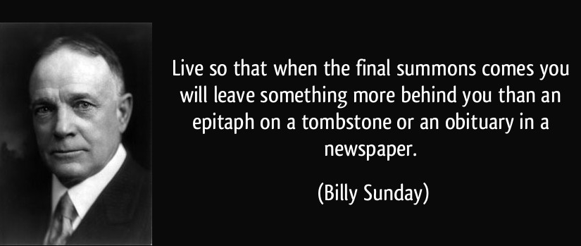
Billy Sunday
Social Gospel
Notes:
Billy Sunday
A Evangelical minister
What was he in favor of?
1. Prohibition
2. Against child labor
3. For woman’s right to vote
4. Against big business
5. Churches helping the poor

Slide 10
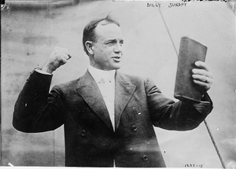
1Billy Sunday 1935
Who was he?
A Evangelical minister
For Prohibition
Against child labor
For woman’s right to vote
Against big business
Advocated that churches
should help the poor
Notes:
William Ashley "Billy" Sunday (November 19, 1862 – November 6, 1935) was an American athlete who, after being a popular outfielder in baseball's National League during the 1880s, became the most celebrated and influential American evangelist during the first two decades of the 20th century.^{[1]}
Born into poverty in Iowa, Sunday spent some years at the Iowa Soldiers' Orphans' Home before working at odd jobs and playing for local running and baseball teams.
His speed and agility provided him the opportunity to play baseball in the major leagues for eight years, where he was an average hitter and a good fielder known for his base-running.
Converted to evangelical Christianity in the 1880s, Sunday left baseball for the Christian ministry.
He gradually developed his skills as a pulpit evangelist in the Midwest and then, during the early 20th century, he became the nation's most famous evangelist with his colloquial sermons and frenetic delivery.
Sunday held widely reported campaigns in America's largest cities, and he attracted the largest crowds of any evangelist before the advent of electronic sound systems.
He also made a great deal of money and was welcomed into the homes of the wealthy and influential. Sunday was a strong supporter of Prohibition, and his preaching likely played a significant role in the adoption of the Eighteenth Amendment in 1919.

Slide 11
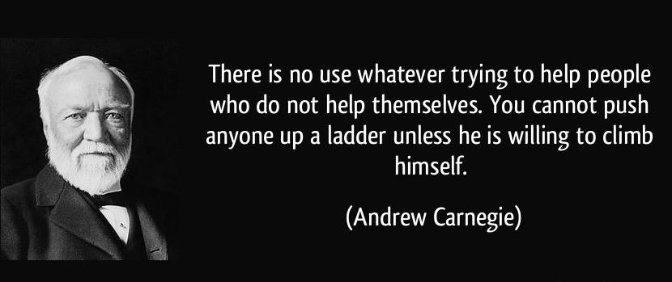
Andrew Carnegie
Social Darwinist

Slide 12
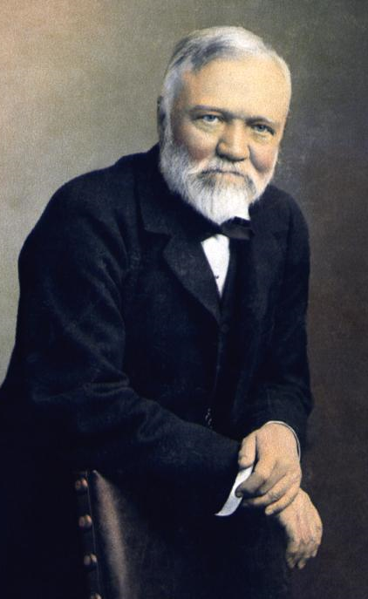
Andrew Carnegie
Who was he?
Founded Carnegie Steel
Strict laissez faire capitalist
Against unions
Supported survival of the fittest in business
In later years, donated much of his wealth to charity
Notes:
Carnegie's conclusions were best summarized when he said:
“the law of competition, be it benign or not, is here; we cannot evade it; no substitutes for it have been found; and while the law may be sometimes hard for the individual, it is best for the race, because it ensures the survival of the fittest in every department” (quoted in Hsü, 1986, p. 10).
Andrew Carnegie appears was a strict laissez-faire capitalist and follower of Herbert Spencer, often referring to himself as a disciple of Spencer.
Carnegie embodied all of the qualities of Spenceria survival of the fittest. The two men enjoyed a mutual respect for one another and maintained correspondence until Spencer’s death in 1903.

Slide 13
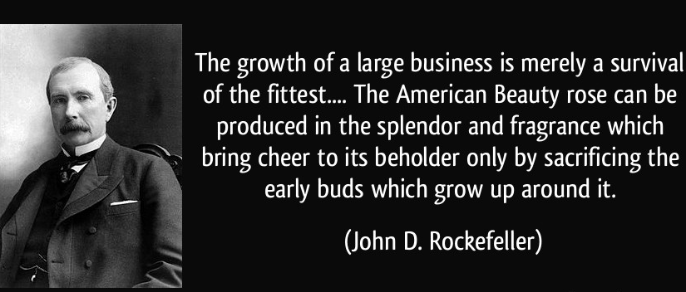
John D. Rockefeller
Social Darwinist

Slide 14
John D. Rockefeller
Who was he?
Billionaire – richest man
Believed "the growth of a large business is merely a survival of the fittest.“
Devoted Baptist
Donated millions
Notes:
John D. Rockefeller reportedly once said that the "growth of a large business is merely a survival of the fittest . . . the working out of a law of nature . . ." (Ghent, 1902, p. 29). The Rockefellers, while maintaining a Christian front, fully embraced evolution and dismissed the Bible's early books as mythology (Taylor, 1991, p. 386). When a philanthropist pledged 1,000 to help found a university named after William Jennings Bryan, John D. Rockefeller Jr. retaliated the very same day with a 1,000,000 donation to the openly anticreationist University of Chicago Divinity School (Larson, 1997, p. 183). Morris and Morris noted that the philosophy expressed by Rockefeller also was embraced not only by railroad magnate James Hill, but probably most other capitalists of his day (1996, p. 87). Morris and Morris have suggested that many modern evolutionists:

Slide 15
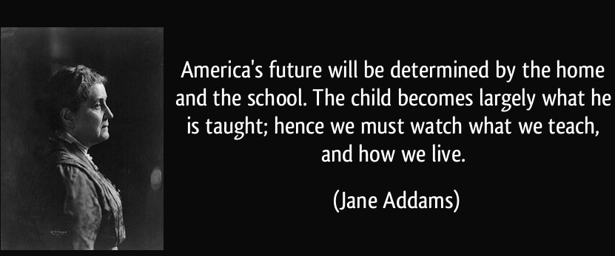
Jane Addams
Social Gospel

Slide 16
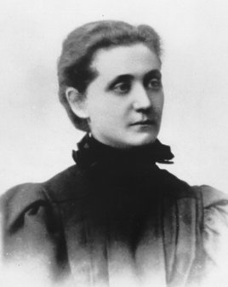
Jane Addams
Who was she?
Daughter of an upper middle class family
Established settlement houses for immigrants
Was a missionary to city slums
Established Hull House in Chicago
Notes:
Established Hull House, Chicago
Branches in many cities
Daughter of a upper middle class family
Settlement House for immigrants
Missionary to city slums, not just go home at night

