Slide 1
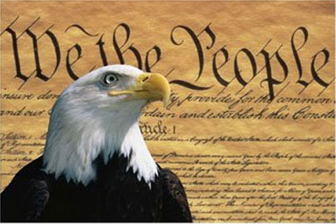
A Weak Government gives way to the Constitution
Events and Ideas #3
U.S. History
Unit 1

Slide 2
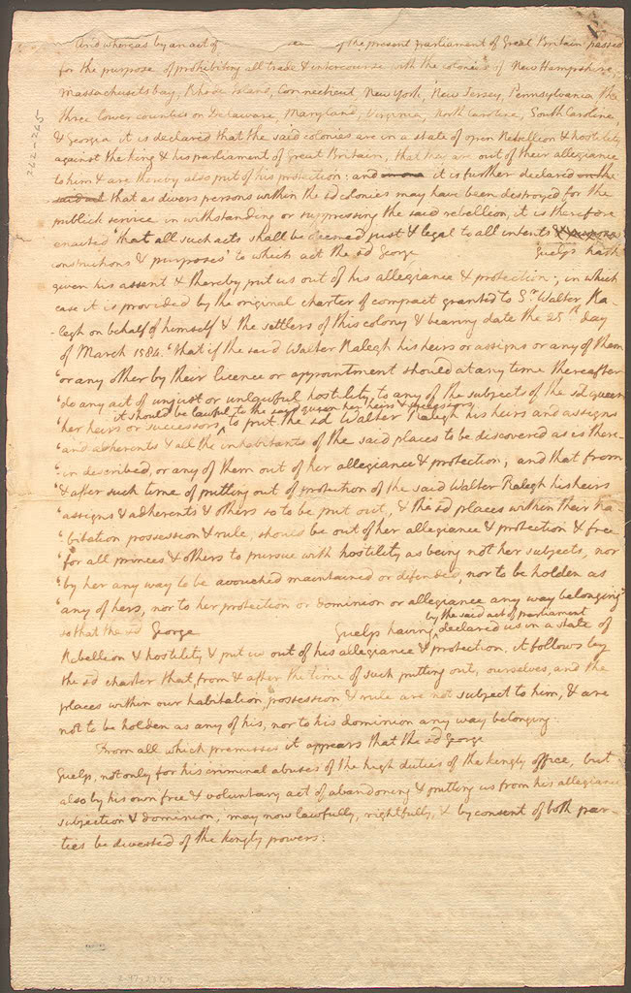
New State Constitutions
State constitutions were written before end of Revolutionary War.
State Constitutions called for separations of powers.
Executive, legislative, and judicial branches set up.
Bicameral legislatures were set up.
Draft of the first Virginia State Constitution
Notes:
State constitutions written before end of Revolutionary War.
i. Before the war ended, the colonists knew that they wanted a republic or a representative style government.
ii. Virginia wrote their state constitution in 1776.
iii. Massachusetts was drafted in 1780.
iv. Both of these constitutions were models for the other states to follow.
These Constitutions called for separations of powers.
i. Colonists were afraid of power and the last thing they wanted was to replace a tyrant King with a tyrant government.
ii. A separation of powers was needed to keep the government in check.
Executive, legislative, and judicial branches set up.
i. The executive branch of state governments – the Governor’s Office would execute the law.
ii. The legislative branch would write and pass the laws.
iii. The judicial branch would interpret the law to the state constitution.
Bicameral legislatures were set up.
i. Most states had 2 legislative houses.
ii. Senate was to represent people of property.
iii. Assembly was to represent the common man.
iv. These constitutions also included a list of rights guaranteeing essential freedoms to their citizens.

Slide 3
Articles of Confederation - 1781
After the Revolution, American leaders worked to plan a central government
It was a loose association of states under a Constitutional Congress
After fighting to free themselves from tyranny they were concerned over giving a central government too much power
Notes:
Recap….

Slide 4
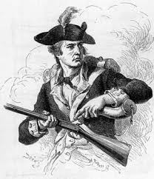
Weak National Government Leads to Constitutional Convention
Daniel Shay
An economic slowdown (recession) grips the country.
Shay’s Rebellion over debts and taxes, Aug. 1786 – Feb. 1787
Lack of national response to the uprising brings calls to re-evaluate the Articles of Confederation
Convention begins May 1787 in Philadelphia
Many came with the idea to fix the problems with the Articles of Confederation
James Madison and Alexander Hamilton wanted to create a new Government
Notes:
Trade problems due to a lack of uniform trade policies.
i. Did not have uniform trade policies between states and Congress had no authority to intervene.
An economic slowdown (recession) grips the country.
i. without tax, Congress could not raise enough money to pay its war debts or its expensed.
states issued their own currency
Shay’s Rebellion – Jan. 1787
i. Shays' rebellion was an armed uprising in Western Massachusetts from 1786 to 1787. The rebels, led by Daniel Shays and were mostly small farmers angered by crushing debt and taxes. Failure to repay such debts often resulted in imprisonment in debtor's prisons or the claiming of property by the state. The rebellion started on August 29, 1786. A Massachusetts militia that had been raised as a private army defeated the main Shay site force on February 3, 1787. There was a lack of an institutional response to the uprising, which energized calls to reevaluate the Articles of Confederation and gave strong impetus to the Constitutional Convention which began in May 1787

Slide 5
Made up of 55 Delegates
Notable facts:
Professions of Delegates:
Almost all served in the Continental forces
75% were members of the Confederation Congress
25 owned slaves
16 depended on slave labor to run plantations or businesses
All but two were wealthy
½ were lawyers
Merchants
Manufacturers
Shippers
Land speculators
Bankers
Physicians
Ministers
Farmers

Slide 6
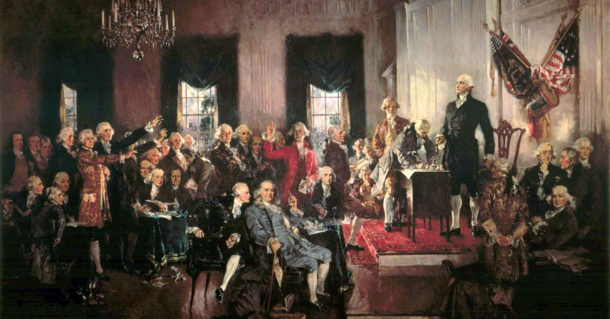
Issues Debated
Solutins
How to make the Legislative branch fair to both small and large states
How to elect a president & term served
Abolish or allow the importation of slaves
Would slaves be counted in the population that determined the number of delegates from each state?

Slide 7
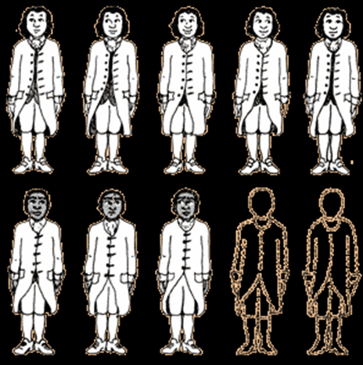
Plans/Compromises
Virginia Plan (Favored large states)
House of Representatives will be based on population.
New Jersey Plan (Favored small states)
Senate will contain equal number of senators from each state
Hamilton’s Plan
Favored British type government
Three-Fifths Compromise: 5 slaves = 3 free persons.
Congress could not ban the slave trade for 20 years or impose a tax on imported slaves
Connecticut Compromise/the Great Compromise
Combined elements of Virginia and New Jersey Plans
Notes:
Great Compromise: Senate and House of Representatives. Also known as Connecticut Compromise.
i. Large state versus small state argument.
ii. House of Representatives will be based on population.
iii. Senate will contain equal number of senators from each state (chosen by state legislatures).
iv. Founding fathers scared of popular vote of senators by the people (keep in with educated men).
Three-Fifths Compromise: 5 slaves = 3 free persons.
i. What about slaves? Do you count them? Southern colonies said yes, northern said no.
ii. It was determined that for the purposes of determining number of representatives in the House of Representatives that 5 slaves would equal 3 free persons.

Slide 8
The New Constitution
Based on the idea of popular sovereignty (rule by the people).
Created a system of Federalism (power divided between federal (national) and state governments).
Separation of Powers with three branches of government:
Legislative, Judicial, Executive
Checks and Balances: each branch limits another branch.
Powers not expressly given to the Constitution are reserved for the states or the people
Congress would have the right to amend the Constitution
Notes:
New Constitution crafted based on the idea of Popular sovereignty
i.
The idea of rule by the people.
i.
Constitution created a system of Federalism.
i. Federalism is the system in which the power to govern is shared between the national & state
Power is divided by the federal (national) and state governments.
i.

Slide 9
Amending the Constitution
Changes could be made to the Constitution through Amendments
To prevent frivolous changes, the process is difficult.
2/3 vote in both houses to propose amendment.
3/4 of state legislatures to would be needed to ratify.
U.S. Constitution
Notes:
Changes made to the Constitution through Amendments.
i.
To prevent frivolous changes, the process is difficult.
i.
2/3 vote in both houses to propose amendment.
i.
3/4 of state legislatures to ratify.
i.

Slide 10
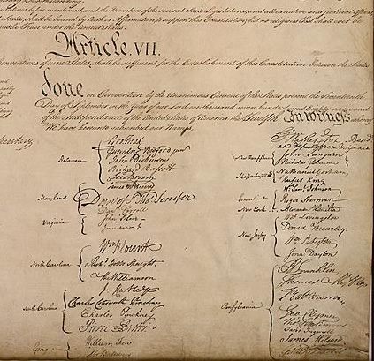
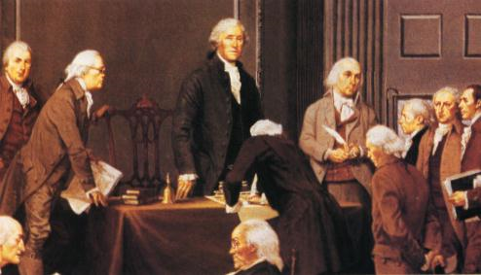
Signing of the Constitution
September 17, 1787 the approved Constitution is signed by 38 delegates from 12 states (all but Rhode Island)
George Washington as president of the convention signed first.
Notes:
The approved Constitution is signed by thirty-eight delegates from twelve states (all but Rhode Island). Three delegates present declined to sign the document–Edmund Randolph, George Mason, and Elbridge Gerry. Additionally, John Dickinson, who was ill and not present, had George Read sign his name by proxy. George Washington, as president of the convention, signed first. The other delegates then signed, grouped by state in strict congressional voting order. Washington, however, had signed beginning at the middle of the page, and when the delegates ran out of space beneath his signature, they began a second column of signatures to the left. Jackson, the convention secretary, also signed as a witness.

