Slide 1
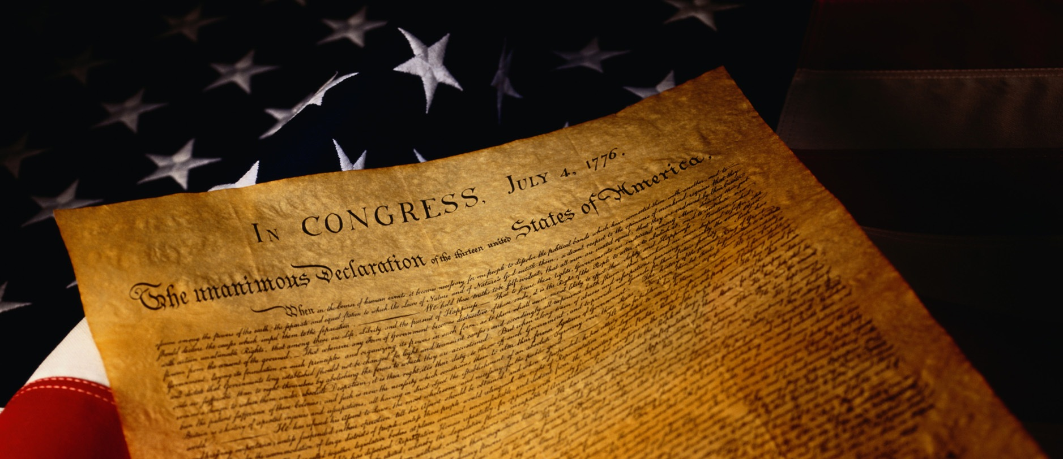
Ratification of the Constitution
Events and Ideas #4
U.S. History
Unit 1

Slide 2
On Sept. 28, 1787 the delegates of the Constitutional Convention voted to submit the United States Constitution to the 13 states
Each state would hold a convention to vote on the Constitution
It required 9 of the 13 states to ratify the constitution

Slide 3
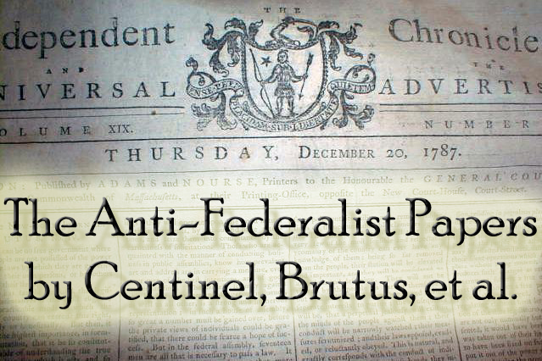
Debates Begin
Sept. 27th – Oct 18th - five Antifederalists papers against the Constitution are published
Oct 27th the first of eighty-five Federalists papers were published to:
"give a satisfactory answer to all the [Anti-Federalist] objections which shall have made their appearance, that may seem to have any claim to your attention."
Notes:
October 27
First Federalist Papar by "Publius" is published. The planned series of essays would, the authors hoped, "give a satisfactory answer to all the [Anti-Federalist] objections which shall have made their appearance, that may seem to have any claim to your attention."

Slide 4
Federalists
Many Federalists were large land owners and merchants, and artisans.
Federalists felt a stronger central government was needed to protect property and trade.
Federalists fear that without a stronger central government that the country would soon fail.
Federalists support the U.S. Constitution
Federalist Papers
Notes:
Federalists were large land owners and merchants, and artisans.
i.
A strong central government would protect property and help trade.
i.
Antifederalists thought the government would be too powerful.
i.
Concerned over states rights.
i.

Slide 5
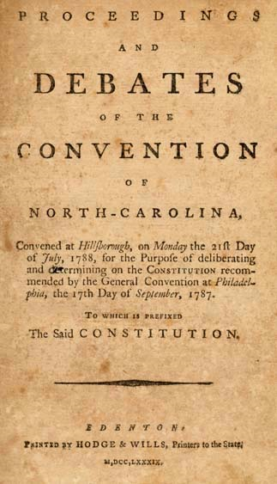
Antifederalists
Main objections to the constitution:
The new Constitution would create a too powerful central government
the government's potential to become corrupt and become tyrannical
the Congress would pass oppressive taxes that they would enforce by creating a standing national army
Concerned over states rights
Concerned over individual liberties
the Constitution did not include a Bill of Rights to protect citizens from the government
Notes:
Federalists = supporters of the new U.S. Constitution.
i. Federalists knew that if the new country didn’t form a stronger central government, it was only a matter of time before the country would fall to the wolves (British Empire).

Slide 6
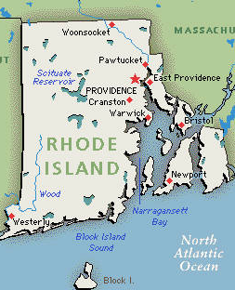
Two Holdouts…
By July 1788 all but two states had ratified the Constitution: Rhode Island and North Carolina
The Confederation Congress proceeded to set up the new government under the Constitution
After the new government was in place the last two states finally ratified
North Carolina – Nov. 1789
Rhode Island – May 1790
Notes:
Ratification of the Constitution by the State of Rhode Island, May 29, 1790. Rhode Island was the thirteenth state to do so. Rhode Island's ratification message is lengthy, with a list similar to that of New York's, listing a bill of rights and listing several proposed amendments. Most of the amendments were not original, having been suggested in prior ratification documents. Rhode Island was the last of the original thirteen states to ratify the Constitution

