Slide 1
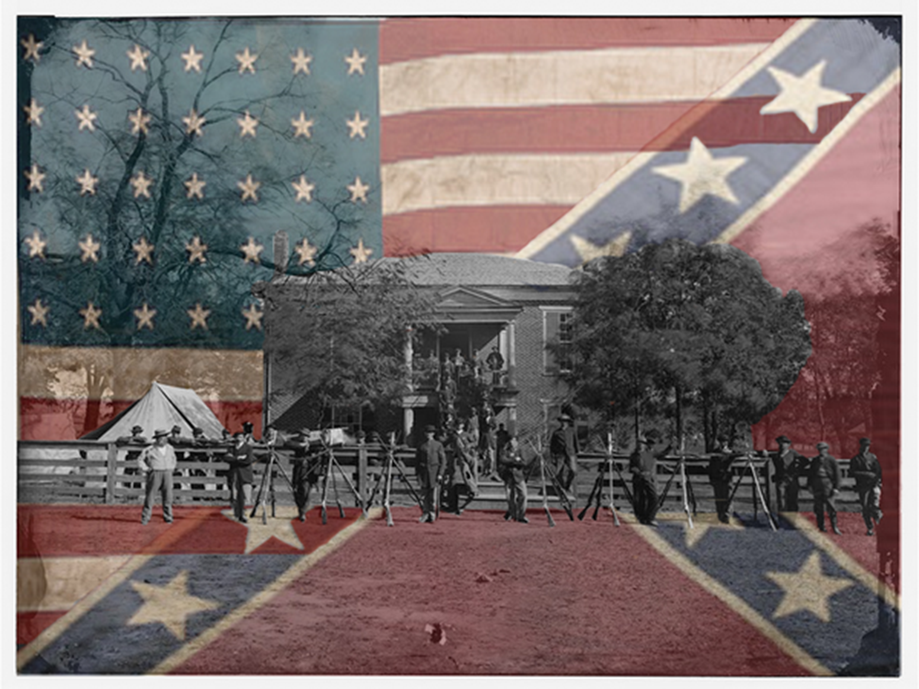
THE Effects OF THE Civil WAR
Events and Ideas # 6
U.S. History
Unit 1

Slide 2
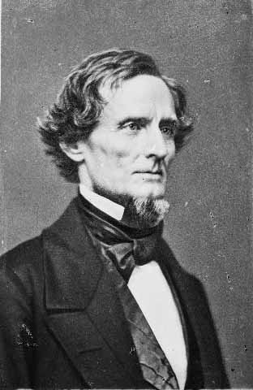
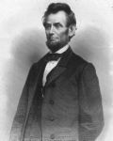
The Civil War
Long-term Causes
Conflict over slavery
Economic Differences
Conflict over states’ rights
Short-term Causes
Dred Scott Decision
Election of Lincoln
Secession of Southern states
Firing on Ft. Sumter

Slide 3
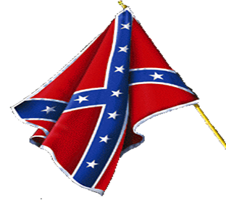
Southern States Secede
State Secession Date
South Carolina December 20, 1860
Mississippi January 9, 1861
Florida January 10, 1861
Alabama January 11, 1861
Georgia January 19, 1861
Louisiana January 26, 1861
Texas February 1, 1861
Virginia April 17, 1861
Arkansas May 6, 1861
North Carolina May 20, 1861
Tennessee June 8, 1861
Notes:
The official formation of the Confederate States of America occurred on March 11, 1861 when the seven seceded states signed the new constitution.
This process was started when South Carolina seceded on December 20, 1860 and was then closely followed by seven other southern states.
The event marking this beginning of hostilities took place on April 20, 1861 when General P. G. T. Beauregard and a group of cadets from The Citadel fired on Fort Sumpter in Charleston Bay.
South Carolina and the other seceding states were joined by four others during the early part of 1861.
These states were united in a quest for independence from the United States, an untested right under the United States Constitution.
Specifically the eleven States forming the Confederacy

Slide 4
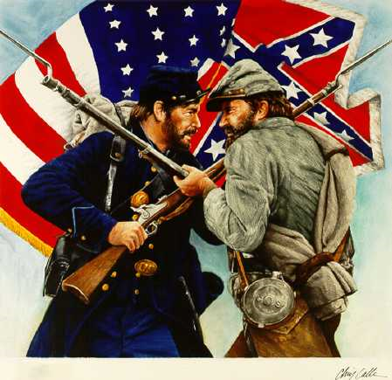
During the War

Slide 5
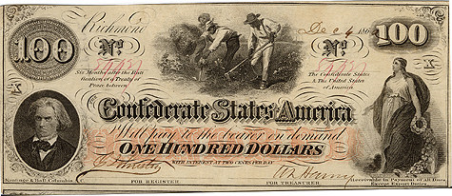
Economic Effects in the South
The South lost its greatest revenue – selling cotton to the North
It became increasingly difficult to export goods due to the North’s naval blockade
Inflation due to large amounts of worthless paper currency printed to finance the war
Notes:
The twin disadvantages of a smaller industrial economy and having so much of the war fought in the South hampered Confederate growth and development. Southern farmers (including cotton growers) were hampered in their ability to sell their goods overseas due to Union naval blockades. Union invasions into the South resulted in the capture of Southern transportation and manufacturing facilities.

Slide 6
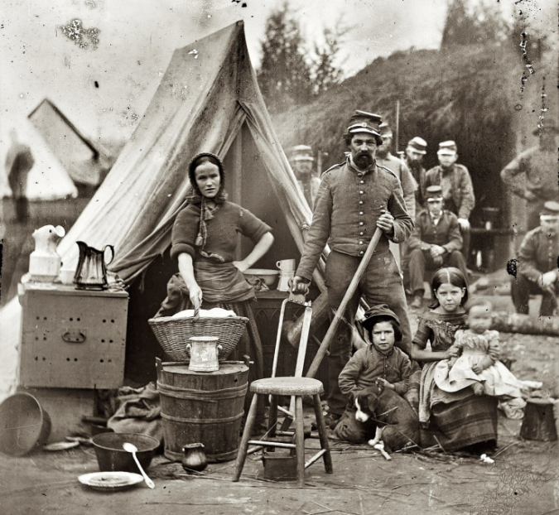
Effects on Traditional Roles of Women in the South
Women:
took over normally male dominated positions
learned how to work the land
managed slaves
followed and cared for troops
became teachers and nurses

Slide 7
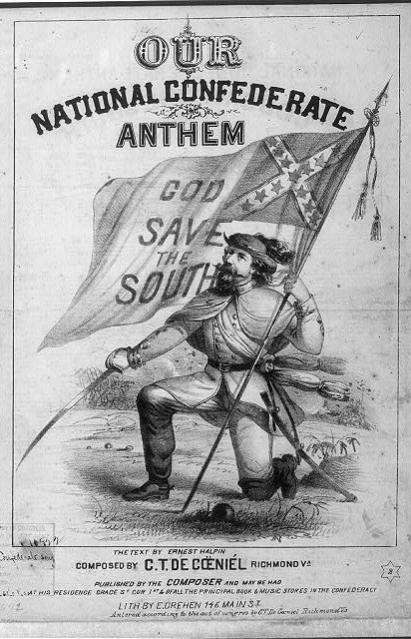
Political Effects in the South
Developed Southern Nationalism
Created a government with greater emphasis on states rights
Created a weak central government
If states didn't agree with something they just refused participate
Confederate government asked states for money that they refused to give
some states set up their own armies

Slide 8
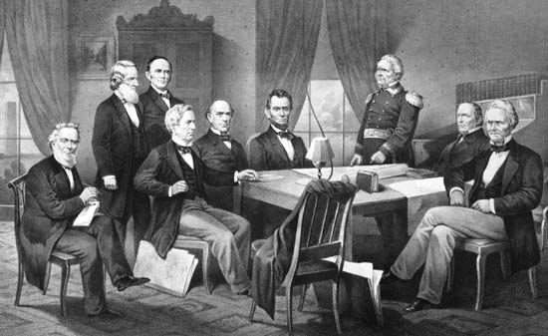
Political Effects in the North
Lincoln refused to acknowledge the Confederacy as a country
Foreign countries agreed with the abolishment of slavery so they backed the Union
Power of federal government is supreme— states’ don’t have the right to secede
Extension of Federal Power— more involved in daily lives of Americans
Civil liberties suppressed— habeas corpus suspended

Slide 9
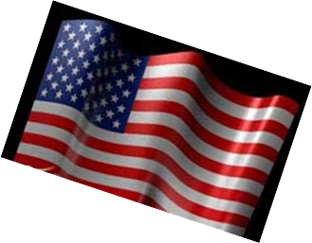
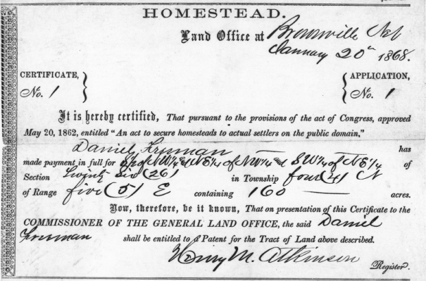
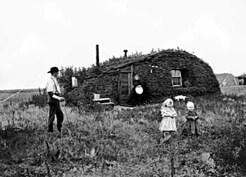
Political Changes in the North
Homestead act of 1862
Offered to those who had never taken up arms against the U.S. government
Anyone (including women and slaves) could claim up to 160 aces of public land
Notes:
the United States Homestead Acts were initially proposed as an expression of the "Free Soil" policy of Northerners who wanted individual farmers to own and operate their own farms, as opposed to Southern slave-owners who could use groups of slaves to economic advantage. Anyone who had never taken up arms against the U.S. government (including freed slaves and women), was 21 years or older, or the head of a family, could file an application to claim a federal land grant. There was also a residency requirement.
In 1863, the government passed the Homestead Act
i. It was hoped that this act would encourage people to move out West.
$10 registration fee allowed an individual to “homestead” a tract of public land.
i. The person had to live on the land for 5 years before getting title to the land.

Slide 10
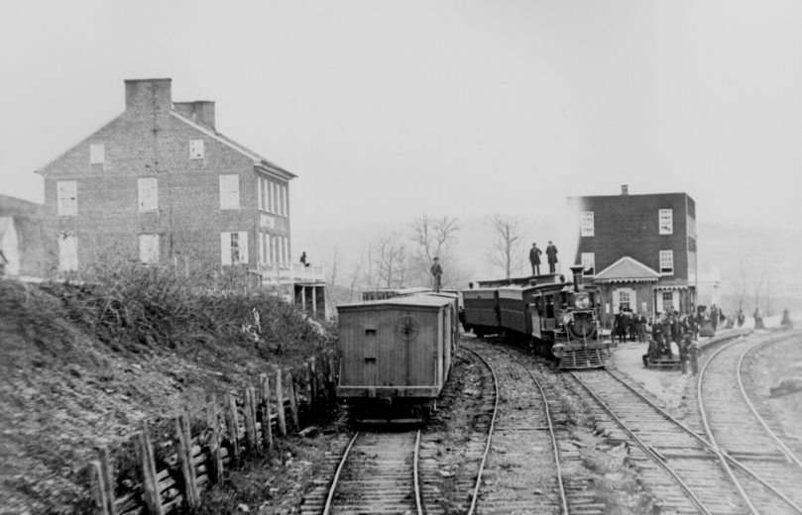
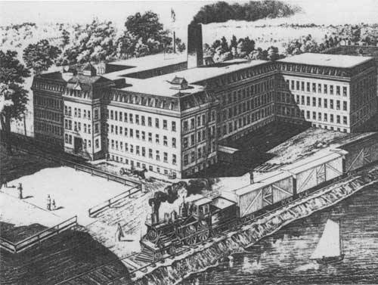
Economic Changes in the North
War department created Military Railroads – at wars end it was the worlds largest railroad system
Roughly $ 3.3 billion spent on the war, Inflation due to printing paper money
Northern Industry grows due to manufacturing and selling war supplies
Notes:
Nearly every sector of the Union economy witnessed increased production. Mechanization of farming allowed a single farmer growing crops such as corn or wheat to plant, harvest, and process much more than was possible when hand and animal power were the only available tools. (By 1860, a threshing machine could thresh 12 times as much grain per hour as could six men.) This mechanization became even more important as many farmers left home to enlist in the Union military. Those remaining behind could continue to manage the farm through the use of labor-saving devices like reapers and horse-drawn planters. Northern transportation industries boomed during the conflict as well--particularly railroads. The North's larger number of tracks and better ability to construct and move parts gave it a distinct advantage over the South. Union forces moving south or west to fight often rode to battle on trains traveling on freshly lain tracks. In fact, as Northern forces traveled further south to fight and occupy the Confederacy, the War Department created the United States Military Railroads, designed to build rails to carry troops and supplies as well as operating captured Southern rail lines and equipment. By war's end, it was the world's largest railroad system. Other Northern industries--weapons manufacturing, leather goods, iron production, textiles--grew and improved as the war progressed. The same was not true in the South.

Slide 11
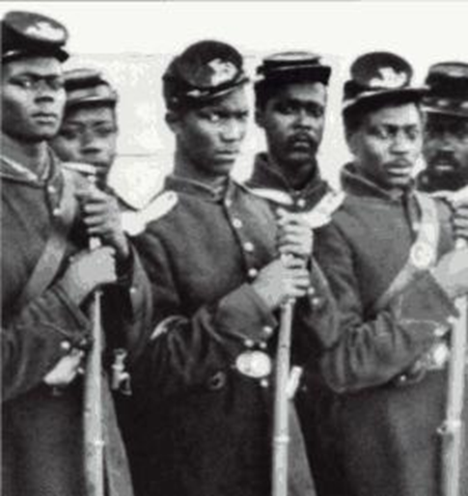
Social Changes in the North
Run away slaves were free if they joined the Union army
Many fought and died in the war
Others performed manual labor
Women took positions as..
Teachers
Nurses
factory workers
took over family business
Notes:
The New York City draft riots (July 13–16, 1863; known at the time as Draft Week were violent disturbances in New York City that were the culmination of working-class discontent with new laws passed by Congress that year to draft men to fight in the ongoing American Civil War. The riots remain the largest civil insurrection in American history, aside from the Civil War itself.
President Abraham Lincoln was forced to divert several regiments of militia and volunteer troops from following up after the Battle of Gettysburg to control the city. The rioters were overwhelmingly working-class men, primarily ethnic Irish, resenting particularly that wealthier men, who could afford to pay a $300 (equivalent to $5,746 in 2014) commutation fee to hire a substitute, were spared from the draft.
Initially intended to express anger at the draft, the protests turned into a race riot, with white rioters, mainly but not exclusively Irish immigrants, attacking blacks wherever they could be found. At least 11 blacks are estimated to have been killed. The military did not reach the city until after the first day of rioting, when mobs had already ransacked or destroyed numerous public buildings, two Protestant churches, the homes of various abolitionists or sympathizers, many black homes, and the Colored Orphan Asylum at 44th Street and Fifth Avenue, which was burned to the ground.

Slide 12
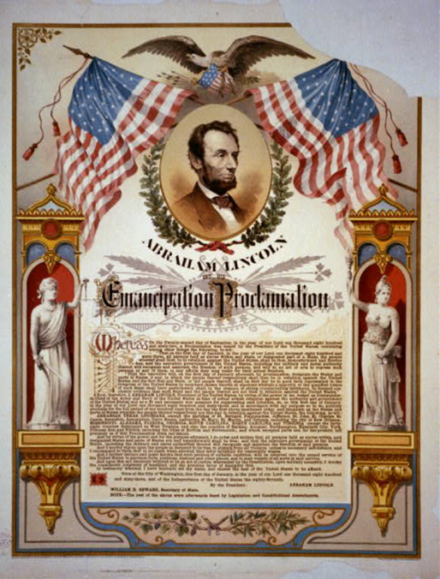
The Emancipation Proclamation
1863 - Lincoln issued the Emancipation Proclamation
It declared freedom for the slaves in Confederate states
Due to fear of losing the support for the Union, it did not give freedom to slaves in the Border States
Notes:
The Emancipation Proclamation was a presidential proclamation issued by President Abraham Lincoln on January 1, 1863, as a war measure during the American Civil War, directed to all of the areas in rebellion and all segments of the Executive branch (including the Army and Navy) of the United States.
It proclaimed the freedom of slaves in the ten states that were still in rebellion, thus applying to 3 million of the 4 million slaves in the U.S. at the time.
The Proclamation was based on the president's constitutional authority as commander in chief of the armed forces; it was not a law passed by Congress.
The Proclamation also ordered that suitable persons among those freed could be enrolled into the paid service of United States' forces, and ordered the Union Army (and all segments of the Executive branch) to "recognize and maintain the freedom of" the ex-slaves.
The Proclamation only applied to slaves in Confederate-held lands; it did not apply to those in the four slave states that were not in rebellion (Kentucky, Maryland, Delaware, and Missouri, which were unnamed), nor to Tennessee (also unnamed), and specifically excluded counties of Virginia soon to form the state of West Virginia. Also specifically excluded (by name) were some regions already controlled by the Union army.

Slide 13
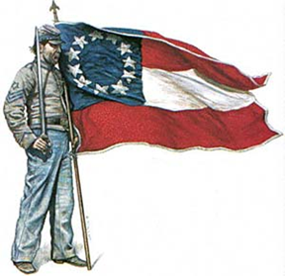
After the War

Slide 14
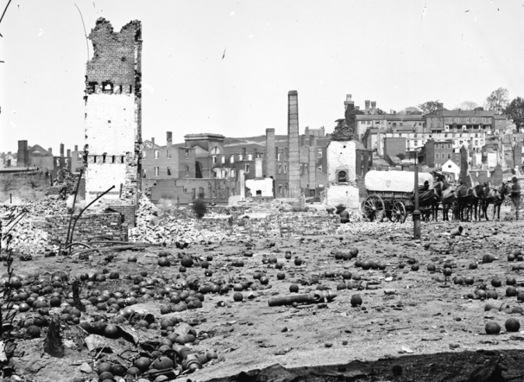
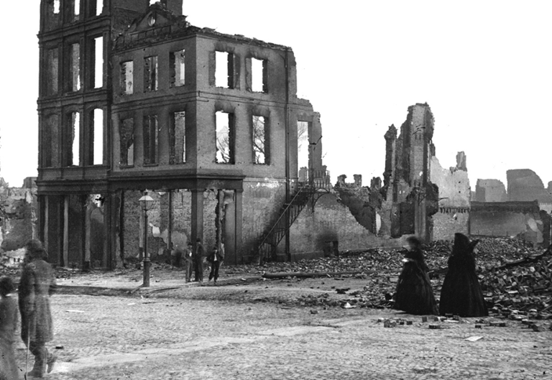
Economic Changes in the South
Southern economy is destroyed
source of labor gone
Some freed slaves move to the North
Others stayed and worked for their previous owners
physically devastated
Cities and towns had to be rebuilt
war debt
Before the war, the South owned 30% of nation’s wealth, after war only 12%
Sharpsburg, Maryland
Notes:
This September 1862 photo provided by the Library of Congress shows Allan Pinkerton on horseback during the Battle of Antietam, near Sharpsburg, Maryland.

Slide 15
Effects of the War
President of the United States, Abraham Lincoln, was Assassinated
620,000 Americans will lose their lives before it is over (more than total lost in ALL wars since!)
Abolition of slavery (13th Amendment)
Reconstruction begins!
Notes:
John Wilkes Booth — Southern sympathizer, Whig member, well-known actor, blamed Lincoln for the South’s problems
Ford’s Theatre (only 5 days after the Civil War ended) Lincoln is assassinated
Lincoln died at 7:22 am the next morning, and Andrew Johnson was sworn in shortly thereafter

