Slide 1
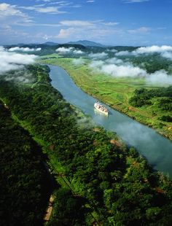
The Panama Canal
Events and Ideas #6
U.S. History
Unit 2

Slide 2
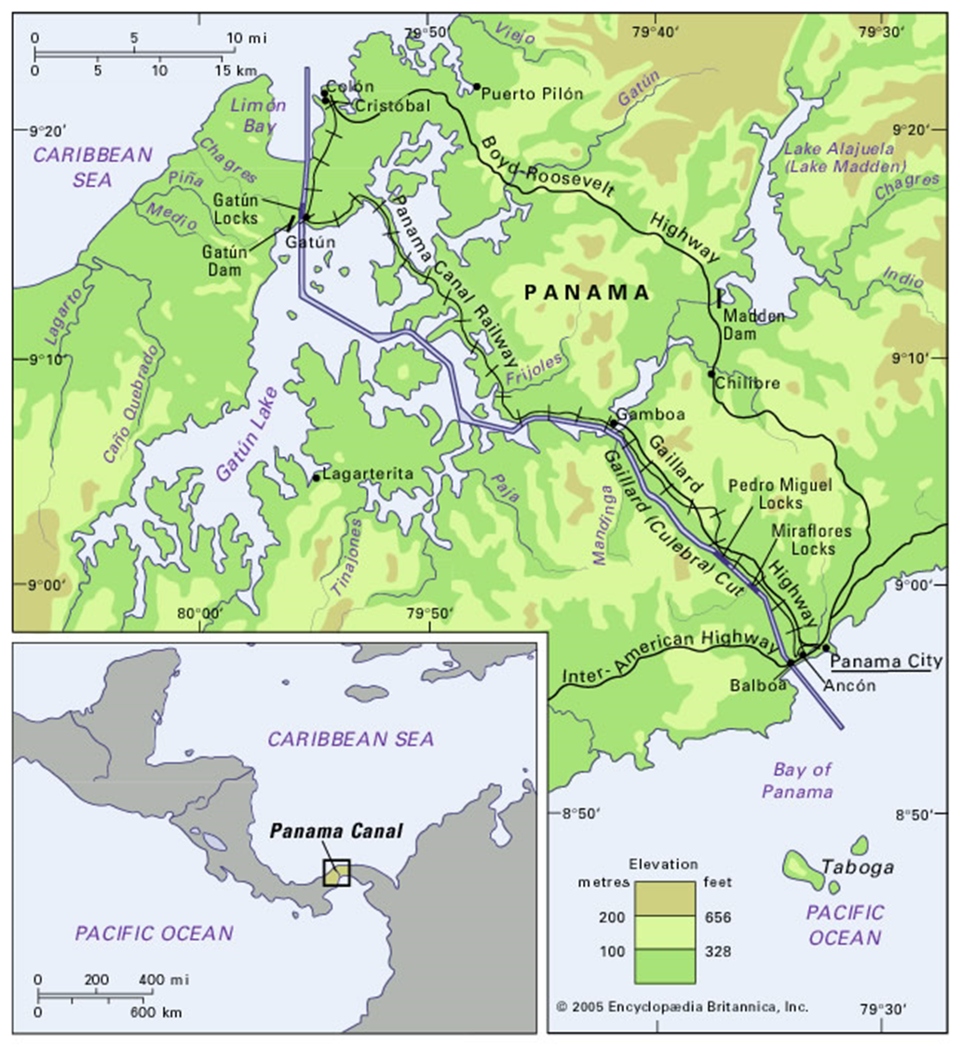
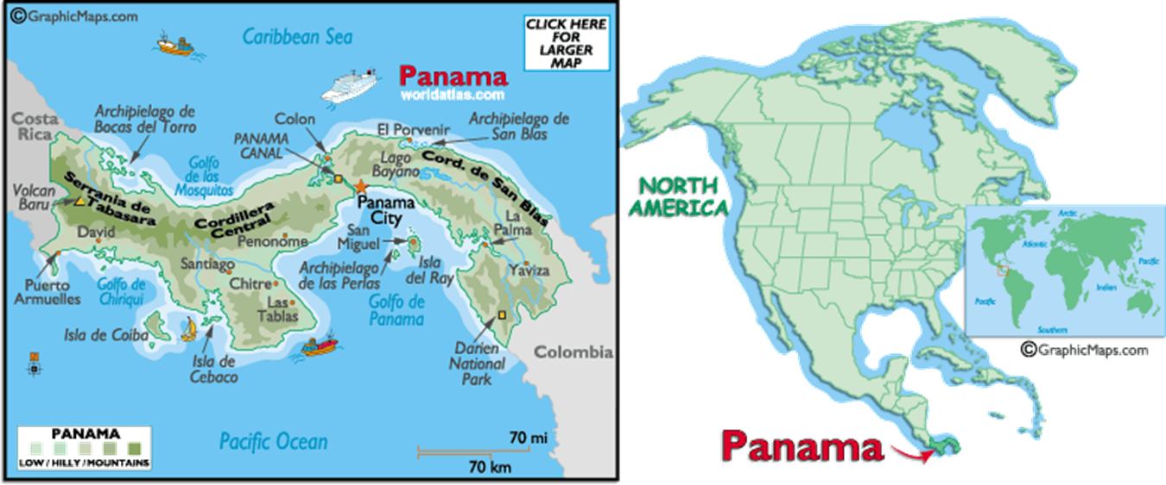
Location

Slide 3
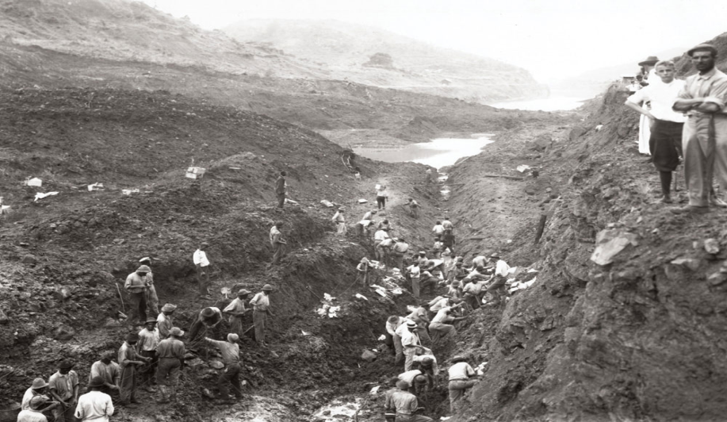
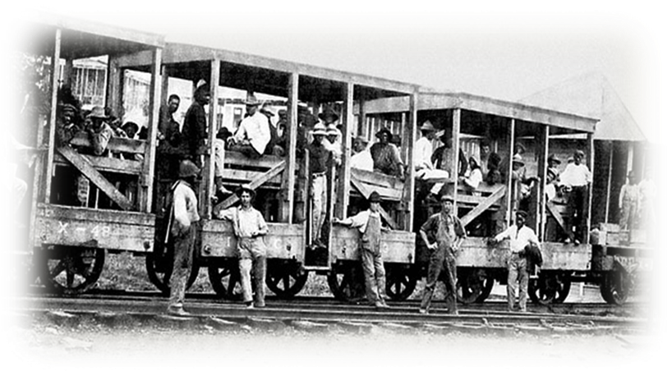
Columbia, Panama, and the French
Columbia had control of Panama
The New Panama Co, a French business started construction of the canal
Yellow fever and malaria killed at least 22,000 French workers
Sickness and problems with construction plagued construction
The French company went bankrupt in 1889

Slide 4
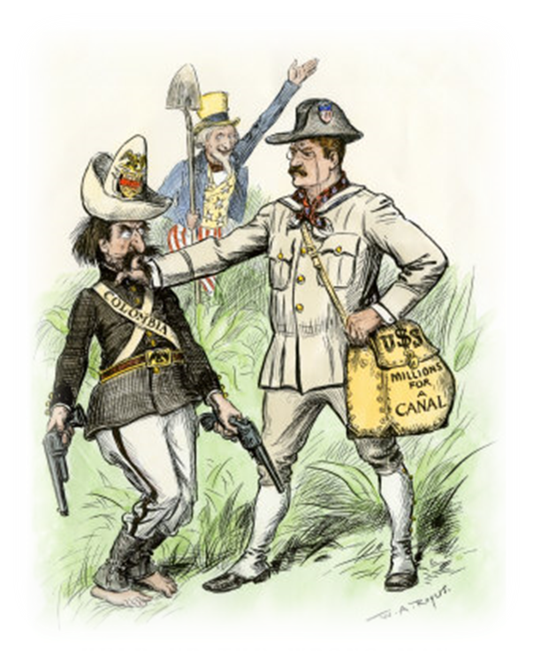
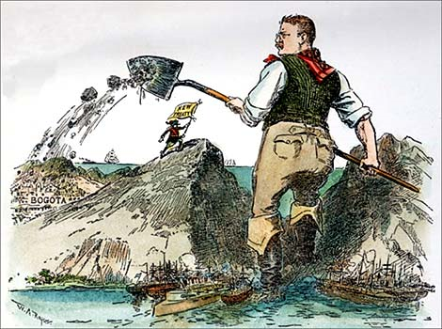
United States Involvement
President Roosevelt agreed to pay $40 million to the French business for the rights to the project
Roosevelt offered Columbia $10 million for a 51 mile strip of land across Panama
Columbia refused
Roosevelt viewed the construction of a canal through Central America as vital to American power in the world

Slide 5
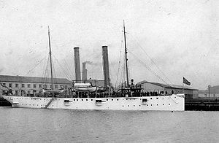
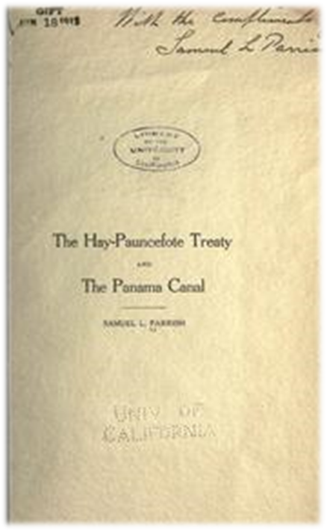
Panama Revolts and Wins Independence
USS Nashville
Panama had opposed Colombian rule since the mid-1800’s
Roosevelt encouraged Panama to revolt against Colombia
1903 Panama rebels led a revolt against Columbia
The U.S. sent a warships to aid them
Panama is victorious and declares their independence
U.S. immediately recognizes Panama as a sovereign nation
Two weeks later the U.S. and Panama sign a treaty allowing the U.S. to build the canal
Notes:
The Thousand Days' War (1899–1902) was one of the many armed struggles between the Liberal and Conservative Parties which devastated Colombia and Panama during the 19th century. This last civil war ended with the signature of the "Treaty of Wisconsin". However, the Liberal leader Victoriano Lorenzo refused to accept the terms of the agreement and was executed on May 15, 1903.
On July 25, 1903, the headquarters of the Panamanian newspaper El Lápiz were assaulted by orders of the military commander for Panama General José Vásquez Cobo, brother of the then Colombian Minister of War, as a retaliation for the publication of a detailed article narrating the execution and protests in Panama. This event damaged the trust of Panamanian liberals in the Conservative government based in Bogotá, and they later joined the separatist movement.
In 1903, the United States and Colombia signed the Hay–Herrán Treaty to finalize the construction of the Panama Canal but the process was not achieved because the Colombian congress rejected the measure (which Colombia had proposed) on August 12, 1903. The United States then moved to support the separatist movement in Panama to gain control over the remnants of the French attempt at building a canal.
The Tiradores Battalion was led by Generals Juan Tovar and Ramón Amaya and arrived in the Panamanian city of Colón in the morning of November 3, 1903. The battalion suffered delays on its way to Panama City caused by the complicity of the Panama Railway authorities who sympathized with the separatist movement. Upon arrival in Panama City, the troops were put under the command of Col. Eliseo Torres. General Esteban Huertas commander of the Colombia Battalion in Panama ordered the arrest of Tovar and his other officials.
The Colombian gunboat Bogotá fired shells upon Panama City the night of November 3 causing injuries and mortally wounding Mr. Wong Kong Yee of Hong Sang, China.
A US Navy gunboat, USS Nashville, who had also helped to delay the disembarkation of the Colombian troops in Colón, continued to interfere with their mission by alleging that the "neutrality" of the railway had to be respected.

Slide 6
Agreement Reached
U.S. paid Panama $10 million for “sovereign rights over the Canal Zone,” an area extending 8 km on either side of the entire canal
U.S. also greed to $250,000 a year
In 1933 it was increased to $430,000 a year
In 1955 it was increased to $1,930,000 a year

Slide 7
Disease and the Canal
Disease continued to plague workers
By 1906 85% of canal workers were hospitalized
Chief Medical Officer asked Congress for $1 million to eradicate yellow fever and malaria in Panama but Congress refused
One quarter of the U.S. workforce left the project fearing disease, forcing the Government to act
4,000 people worked on the “mosquito brigades”
Revolutionary developments in the canal project:
eradication of yellow fever
reduction of malaria cases
Notes:
For the men leading the Panama Canal project in 1904, challenges of building the canal were exacerbated by the infectious diseases that ran rampant in the hot, wet Panamanian climate. By 1906, more than 85% of the canal workers had been hospitalized. The threat of yellow fever created panic and made the site undesirable and feared by employees. Malaria was no better -- someone who fell ill usually required a stay in the hospital, and recovery did not ensure immunity. During the course of canal construction, tens of thousands of workers fell ill with yellow fever or malaria.
Yellow fever's gruesome symptoms and high death rate were so horrifying to American canal workers that even a whisper of an outbreak sent boatloads of men fleeing. Early symptoms of yellow fever were headaches, fever, and muscle pain. As the disease progressed, however, the patient experienced jaundice, thirst, and a dark black vomit caused by internal hemorrhaging. Ultimately, the disease could lead to kidney failure, delirium, seizures, coma, and often death.
Patients with malaria also experienced chills, headaches, fever, aching, fatigue, and nausea. In the worst cases, malaria caused kidney failure and potentially even coma or death. Unlike survivors of yellow fever, however, malaria survivors were not immune to recurrences of the disease. Malaria's lower fatality rate and frequent reappearance resulted in frequent and expensive hospital stays.
At the time, doctors disagreed on how to stop either yellow fever or malaria; mosquitoes had not yet been accepted as the primary transmitters. Hospitals treated patients with high doses of whiskey, eggnog, or by rubbing a solution of kerosene and oil on the skin. There were mustard baths and ice baths. Quinine, made from the bark of a cinchona tree, was taken as a fever reducer and painkiller, although the bitter-tasting liquid often caused deafness as a side effect. The most common treatment was simply to keep the patient quiet and comfortable, and hope that they survived.
Doctor William Gorgas saw malaria as a bigger threat than yellow fever because of its prevalence not only in the cities and camps, but along the entire Canal Zone. "If we can control malaria, I feel very little anxiety about other diseases, " Gorgas stated. "[And] our mortality is going to be heavy."
Colonel Gorgas arrived in the canal zone in June of 1904 as Chief Medical Officer. A few years earlier, he had read about discoveries linking mosquitoes with malaria while living in Havana, Cuba. Acting on the possibility that the insects could also be the primary transmitters of yellow fever, he successfully eradicated the mosquitoes -- and thus the disease -- from the area in 1901. He was confident he could stop infection in Panama, but he needed the political will and the financial resources to rid nearly 500 square miles of swamp and jungle clear of the disease-carrying mosquitoes.
In the fall of 1904, Gorgas returned to Washington with a $1 million plan to fumigate the isthmus and eradicate the disease. But officials scoffed at Gorgas' high price tag and his mosquito hypothesis, instead adhering to the prevailing "miasma theory" which stipulated that diseases are carried by bad air or toxins in tropical soil.

Slide 8
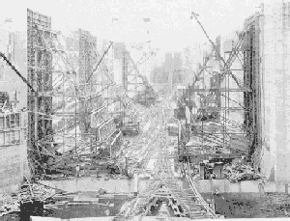
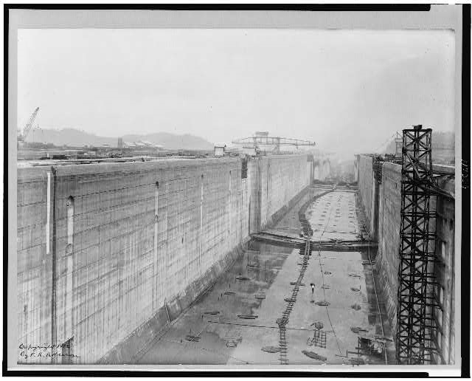
Panama Canal Lock System

Slide 9
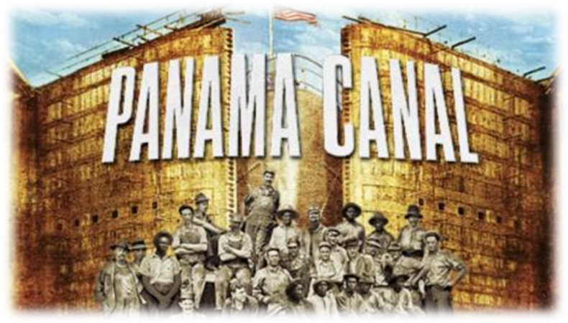
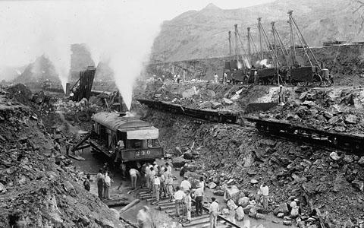
Panama Canal Statistics
Construction of the canal took 10 years
More than 75,000 men worked on the canal
Over 60 million lbs. of dynamite used
The Panama Canal opened in 1914 with the first ship going through on August 15th
U.S. cost: $375, 000,00
Deaths: French: 25,000, American: 5,609
Notes:
The Panama Canal cost Americans around $375,000,000, including the $10,000,000 paid to Panama and the $40,000,000 paid to the French company. It was the single most expensive construction project in United States history to that time. Fortifications cost extra, about $12,000,000.
There was, of course, also a cost in lives. According to hospital records, 5,609 lives were lost from disease and accidents during the American construction era. Adding the deaths during the French era would likely bring the total deaths to some 25,000 based on an estimate by Gorgas. However, the true number will never be known, since the French only recorded the deaths that occurred in hospital.
By July 1, 1914, a total of 238,845,587 cubic yards had been excavated during the American construction era. Together with some 30,000,000 cubic yards excavated by the French, this gives a total of around 268,000,000 cubic yards, or more than four times the volume originally estimated for de Lesseps’ sea level canal.

Slide 10
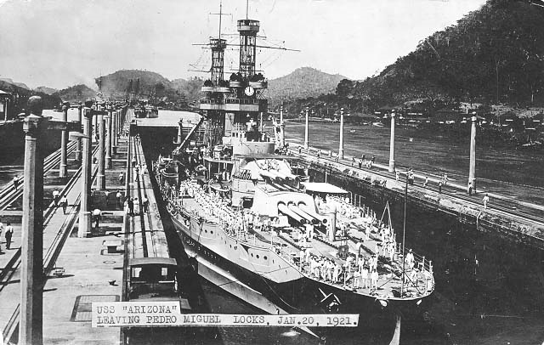
U.S. Motives
The Panama Canal would be a new and faster trade route
The U.S. would profit from ships using the canal
U.S. business interests would have quicker trade access = money for the U.S. economy
Gave a quick route for U.S. military vessels and troops
Notes:
Ships pay according to their weight, with the average fee around US$ 30,000
The highest amount paid was $184,114.80 by a US container ship
The lowest amount paid was $.36 paid by Richard Halliburton, who swam through.

Slide 11
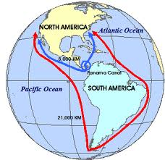
Cut sailing distance from NYC to SF from 13,000 to 5,200 miles
Before
After

Slide 12
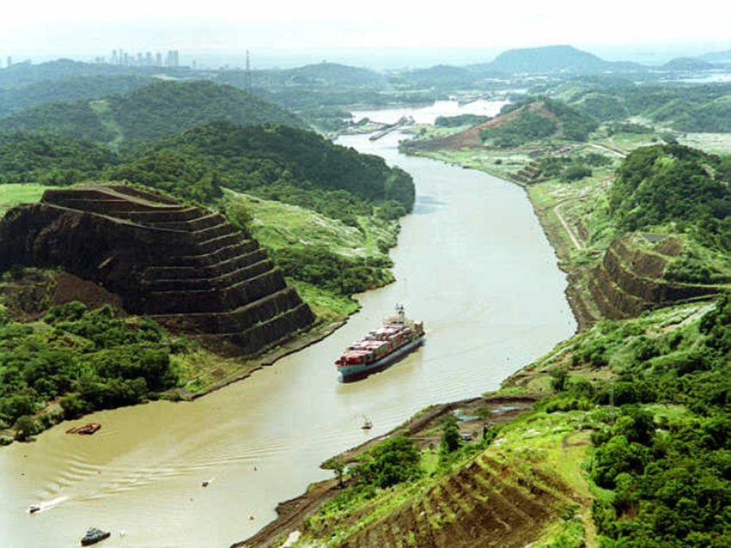
U.S. Justifications
The U.S. was helping Panama free itself from Columbia
The Canal would help Panama by increasing their trade and tourism
Panama’s economy would improve
Panama’s economy is mostly dependent on the Canal
The U.S. eventually gave Panamanians complete control
over Panama and the Panama Canal

