Slide 1
Efforts to Rebuild and Reunite the County: Reconstruction 1863-1877
Events and Ideas #7
U.S. History
Unit 1

Slide 2
Considerations:
How should the South be brought back into the Union?
What branch of government should control the process of Reconstruction?
How should the
South be rebuilt after its destruction from the war?
How does the
governemnt integrate and protect newly- emancipated black freedmen?

Slide 3
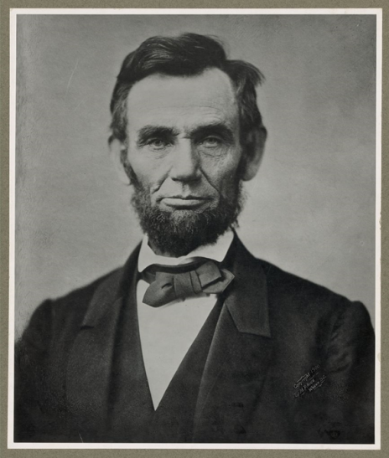
President Abraham Lincoln
Lincoln wanted the country to come back together peacefully.
Lincoln’s plan was created in 1863, two years before the end of the war.
The war had just ended when Lincoln was assassinated, so his ideas were not put into practice.
The Ten Percent Plan
10% of voters in the seceded states must swear loyalty under oath to the Union.
Pardon to all but the highest ranking military and civilian Confederate officers
The seceded states must abolish slavery.
Notes:
Although Lincoln died before Reconstruction began, he had already started planning for reunification several years before the end of the war. Lincoln wanted to mend the Union by carrying out the Ten percent plan. He believed it would be too difficult to repair all of the ties within the Union if the Wade–Davis bill passed.
During the American Civil War in December 1863, Abraham Lincoln offered a model for reinstatement of Southern states called the 10 percent Reconstruction plan.
It decreed that a state could be reintegrated into the Union when 10% of the 1860 vote count from that state had taken an oath of allegiance to the U.S. and pledged to abide by emancipation.
Voters could then elect delegates to draft revised state constitutions and establish new state governments. All southerners except for high-ranking Confederate army officers and government officials would be granted a full pardon.
Lincoln guaranteed southerners that he would protect their private property, though not their slaves.
By 1864, Louisiana, Tennessee, and Arkansas had established fully functioning Unionist governments.
Included: LA, TN and AR. aka "loyal assemblies" who accepted Lincoln's plan and protection because they were weak and dependent on the Northern army for survival
This policy was meant to shorten the war by offering a moderate peace plan. It was also intended to further his emancipation policy by insisting that the new governments abolished slavery.

Slide 4
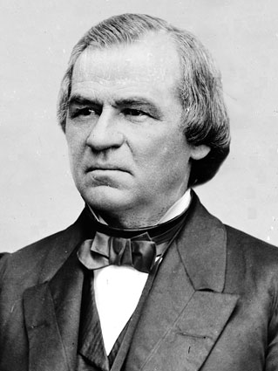
President Andrew Johnson
Wanted to be strict with the States that had rebelled, but ended up making it relatively easy for them.
Allowed for segregation of the races.
Johnson Plan
The majority of white men from formerly Confederate states must swear loyalty to the United States.
Formerly Confederate states must ratify the 13th Amendment.
Former Confederate officials may hold office and vote.

Slide 5
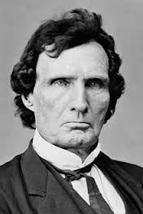
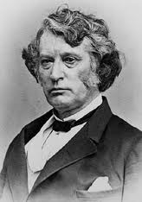
Radical Republicans
Thaddeus Stevens
Charles Sumner
Radical republicans, often abolitionists, represented a large part of Congress.
Wanted to be strict with the States that had rebelled.
Wanted to protect the newly freed slaves.
Reconstruction Act
Formerly Confederate states must:
disband their state governments
write new state constitutions
ratify the 14th Amendment
allow African Americans to vote.
Notes:
Thaddeus Stevens of Pennsylvania
Charles Sumner Of Massachusetts

Slide 6
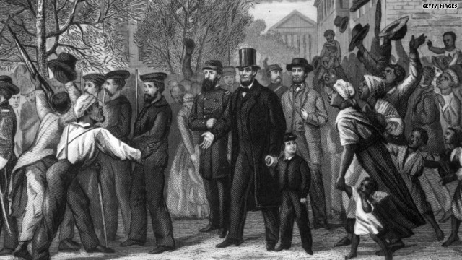
13th Amendment
Ratified in December, 1865.
Neither slavery nor involuntary servitude, except as punishment for crime whereof the party shall have been duly convicted, shall exist within the United States or any place subject to their jurisdiction.
Congress shall have power to enforce this article by appropriate legislation.
Notes:
The Thirteenth Amendment to the United States Constitution abolished slavery and involuntary servitude, except as punishment for a crime. It was passed by the Senate on April 8, 1864, by the House on January 31, 1865, and adopted on December 6, 1865. It was the first of the three Reconstruction Amendments adopted following the American Civil War.
Though many slaves had been declared free by Lincoln's 1863 Emancipation Proclamation, their post-war status was uncertain.
On April 8, 1864, the Senate passed an amendment to abolish slavery.
After one unsuccessful vote and extensive legislative maneuvering by the Lincoln administration, the House followed suit on January 31, 1865.
The measure was swiftly ratified by nearly all Northern states, along with a sufficient number of border and "reconstructed" Southern states, to cause it to be adopted.
Though the amendment formally abolished slavery throughout the United States, factors such as Black Codes, white supremacist violence, and selective enforcement of statutes continued to subject some black Americans to involuntary labor, particularly in the South.
In contrast to the other Reconstruction Amendments, the Thirteenth Amendment was rarely cited in later case law, but has been used to strike down peonage and some race-based discrimination as "badges and incidents of slavery".

Slide 7
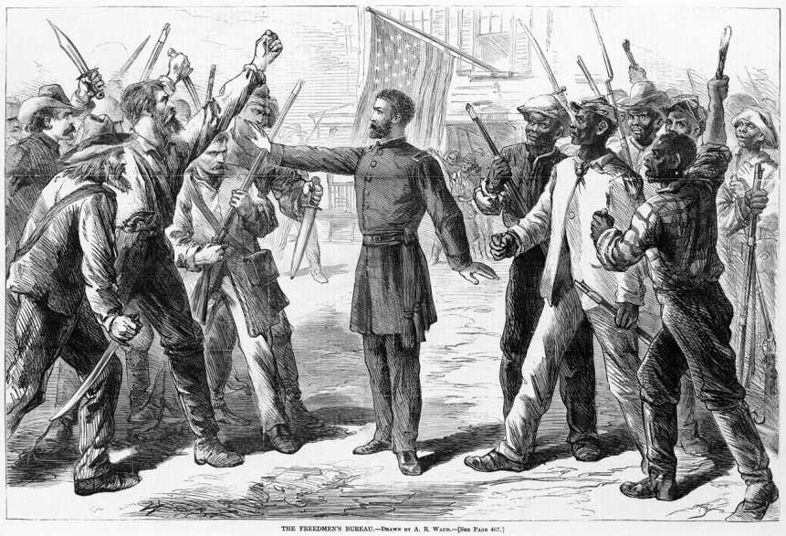
Freedmen’s Bureau (1865)
Initiated by President Lincoln
Gave food and clothing to war refugees in the South
Helped former slaves find work
Many Northerners wanted the former slaves to receive land from their previous masters
Others argued that it would violate constitutional property rights (Congress confirmed this right)
A Bureau agent stands between armed groups of Southern whites and Freedmen (1868 Harper's Weekly)
Notes:
The Freedmen's Bureau, was a U.S. federal government agency that aided distressed freedmen (freed slaves) during the Reconstruction era of the United States, though by 1870 it had been considerably weakened.
The Freedmen's Bureau Bill, which established the Freedmen's Bureau in March 3, 1865, was initiated by President Abraham Lincoln and was intended to last for one year after the end of the Civil War.
The Freedmen's Bureau was an important agency of the early Reconstruction, assisting freed ex-slaves in the South. The Bureau was operational from 1865 to 1872. It was disbanded under President Ulysses S. Grant.
The Bureau encouraged former plantation owners to rebuild their plantations, urged freed Blacks to gain employment, kept an eye on contracts between labor and management, and pushed both whites and blacks to work together as employers and employees rather than as masters and as slaves.
Throughout the first year, it became clear that these tasks were more difficult than had been previously believed.
In 1866, Congress renewed the charter for the Bureau, which President Andrew Johnson vetoed because it encroached into states' rights, used the military in peacetime, and would keep freed slaves from becoming independent.
Its powers were expanded to help find lost family for African Americans and teach them to read and write so they could better do so themselves.
Bureau agents also served as legal advocates for African Americans in both local and national courts, mostly in cases dealing with family issues.
By 1869, the Bureau had lost most of its funding and as a result been forced to cut much of its staff.

Slide 8
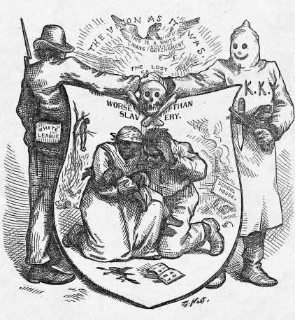
Growing Northern Alarm!
Republican Congress votes to reject elected Southern Congressional delegates.
Congress was angered when Southern state legislatures passed laws know as Black Codes
Codes were intended to keep Blacks in a condition similar to slavery
Blacks required to enter into labor contracts

Slide 9
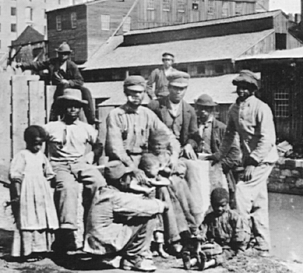
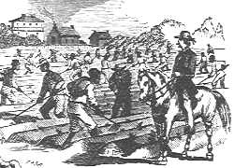
Black Codes
Laws passed by Southern states 1865-66
Intent/effect: restrict Blacks freedoms
Blacks forced into involuntary servitude
Purpose was to maintain the system of white supremacy
Forced many blacks to become sharecroppers [tenant farmers].
Notes:
The most notorious Black Codes were laws passed by Southern states in 1865 and 1866, after the Civil War.
These laws had the intent and the effect of restricting African Americans' freedom, and of compelling them to work in a labor economy based on low wages or debt.
A major purpose of these laws was maintenance of the system of white supremacy that had made slavery possible.
With legal prohibitions of slavery ordered by the Emancipation Proclamation, acts of state legislature, and eventually the Thirteenth Amendment, Southern states adopted new laws to regulate Black life.
Although these laws had different official titles, they were (and are) commonly known as Black Codes.
The defining feature of the Black Codes was vagrancy law which allowed local authorities to arrest the freed people and commit them to involuntary labor.

Slide 10
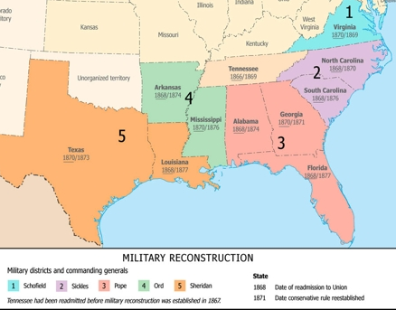
Military Reconstruction Act of 1867
Restart Reconstruction in the 10 Southern states that refused to ratify the 14th Amendment.
Divide the 10 “unreconstructed states” into 5 military districts.
Troops were located in each to maintain order and civil rights
Required new state constitutions, including black suffrage and ratification of the 13th and 14th Amendments.

Slide 11
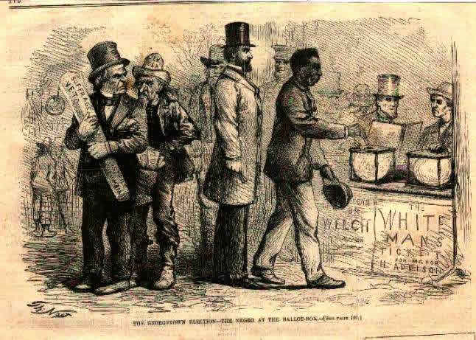
14th Amendment
Ratified in July, 1868.
Provide a constitutional guarantee of the rights and security of freed people.
Makes everyone born in the U.S. a citizen.
Ensures every citizen of the U.S. due process under the law.
Southern states would be punished for denying the right to vote to black citizens!
Notes:
14th Amendment said all persons born or naturalized in the US were citizens and have unalienable rights. Passed to prevent any acts repealing the 1866 Civil Rights Act

Slide 12
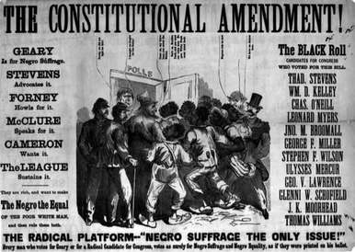
15th Amendment
Ratified in 1870.
The right of citizens of the United States to vote shall not be denied or abridged by the United States or by any state on account of race, color, or previous condition of servitude.
The Congress shall have power to enforce this article by appropriate legislation.
Women’s rights groups were furious that they were not granted the vote!

Slide 13
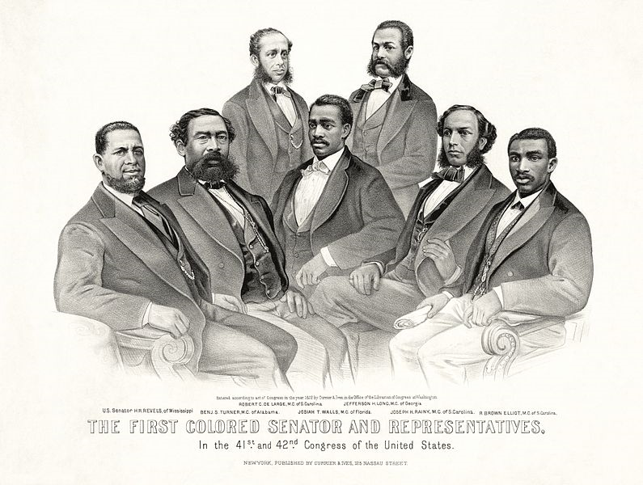
1872 – First African American Representatives elected to Congress
Notes:
1872 "First Colored Senator and Representatives in the 41st and 42nd Congress of the United States." (Left to right)
Senator Hiram Revels of Mississippi
Representatives Benjamin Turner of Alabama
Robert DeLarge of South Carolina
Josiah Walls of Florida
Jefferson Long of Georgia
Joseph Rainey and Robert B. Elliot of South Carolina.

Slide 14
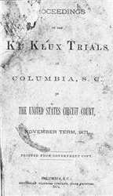
The Enforcement Acts of 1870 & 1871
Made state officials liable in federal court for depriving Blacks of their civil rights or equal protection
Established penalties for interfering with any persons right to vote
Outlawed KKK intimidation tactics and made them a federal offense
Authorized the President to employ the army to uphold the act
Notes:
The Enforcement Act of 1871, the third Enforcement Act passed by Congress and also known as the Ku Klux Klan Act (formally, "An Act to enforce the Provisions of the Fourteenth Amendment to the Constitution of the United States, and for other Purposes"), made state officials liable in federal court for depriving anyone of their civil rights or the equal protection of the laws.
It further made a number of the KKK's intimidation tactics into federal offenses, authorized the president to call out the militia to suppress conspiracies against the operation of the federal government, and prohibited those suspected of complicity in such conspiracies to serve on juries related to the Klan's activities.
The Act also authorized the president to suspend the writ of habeas corpus if violence rendered efforts to suppress the Klan ineffective. It was passed at the request of Ulysses S. Grant

Slide 15
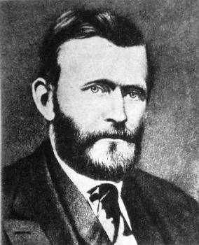
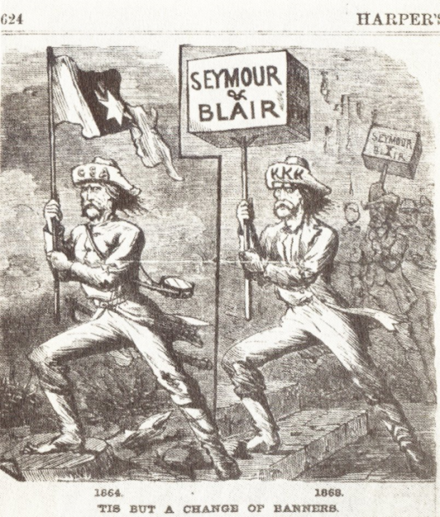
Political Downfall of Republicans
Grant administration is plagued with scandal
Full Fledged economic depression hits
1870’s – Democrats began to regain power in the South through:
Intimidation
Fraud
Promise to cut taxes
Accuse Republicans of corruption

Slide 16
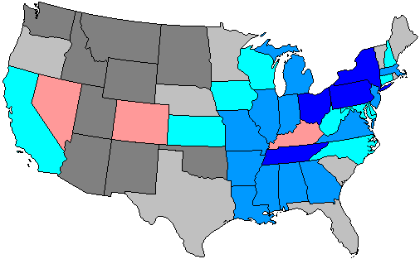
Democrats take Control
6+ Democratic gain
3-5 Democratic gain
1-2 Democratic gain
1-2 Republican gain
1874 Democrats won back control of the House of Representatives and made significant gains in the Senate
1876- Democrats had taken control of all but 3 Southern state legislatures

Slide 17
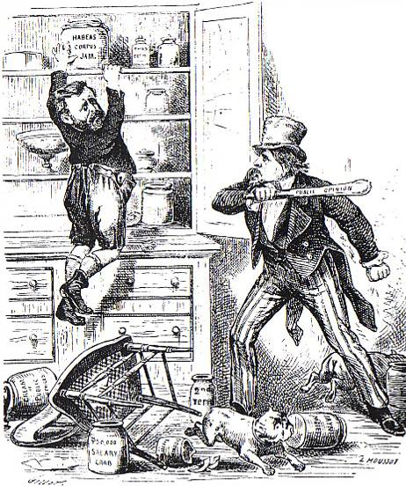
Northern Support of Reconstruction Wanes
Corruption in the Whitehouse/President Grant
Panic of 1873 with a 6-year depression.
Concern over westward expansion and Indian wars.
Monetary issues left over from the Civil War:
Money issued during the War
How War bonds should be paid back

Slide 18
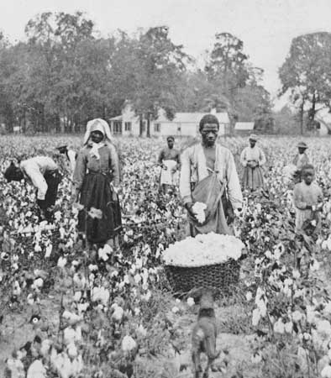
The New South/the Old South
For Blacks in the South, the end of Reconstruction meant the return of the “old South”
Many returned to plantations to work for their old masters
They worked for wages or became tenant farmers
Most could not afford to become sharecroppers
Economic circumstances and traditions of White Supremacy plagued their daily lives

