Slide 1
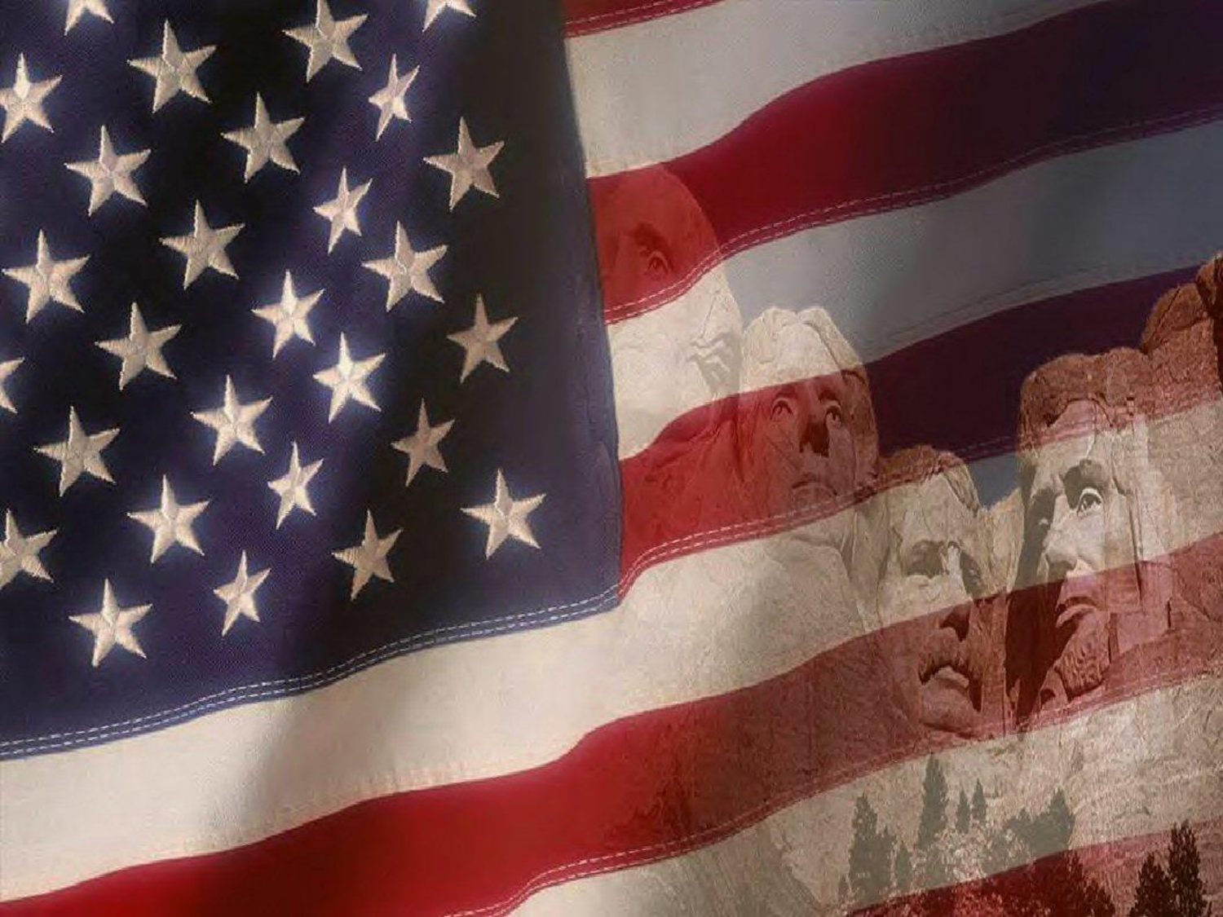
Historical People
U.S. History - Unit 2

Slide 2
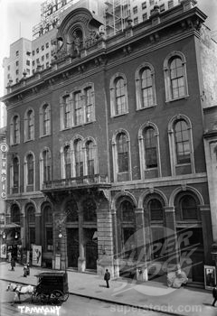
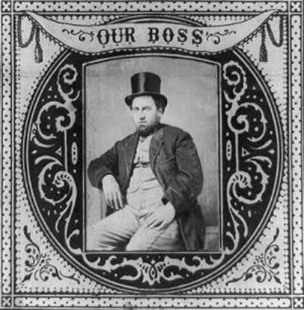
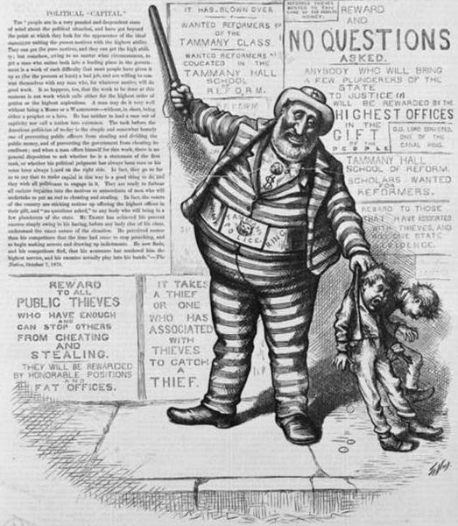
1. William “Boss” Tweed
American politician & Head of Tammany Hall (Democrat Political machine in NYC, 1790-1860)
Tweed, like many bosses was very corrupt and abused the power he gained from being a political boss
Often sold city contracts to friends in exchange for a cut of the money
Eventually convicted of stealing between $25 – 45 million from N.Y.C. throughout his tenure as boss
Convicted of stealing, died in jail
Tweed “catching” young criminals
Notes:
William Magear Tweed (April 3, 1823 – April 12, 1878) –known as "Boss" Tweed – was an American politician most notable for being the "boss" of Tammany Hall, the Democratic Party political machine that played a major role in the politics of 19th century New York City and State.
At the height of his influence, Tweed was the third-largest landowner in New York City, a director of the Erie Railroad, the Tenth National Bank, and the New-York Printing Company, as well as proprietor of the Metropolitan Hotel.
Tweed was elected to the United States House of Representatives in 1852 and the New York County Board of Supervisors in 1858, the year he became the head of the Tammany Hall political machine.
He was also elected to the New York State Senate in 1867, but Tweed's greatest influence came from being an appointed member of a number of boards and commissions, his control over political patronage in New York City through Tammany, and his ability to ensure the loyalty of voters through jobs he could create and dispense on city-related projects.
Tweed was convicted for stealing an amount estimated by an aldermen's committee in 1877 at between $25 million and $45 million from New York City taxpayers through political corruption, although later estimates ranged as high as $200 million. Unable to make bail, he escaped from jail once, but was returned to custody. He died in the Ludlow Street Jail.

Slide 3
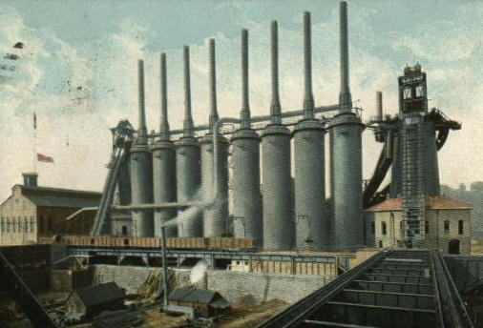
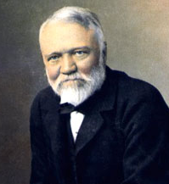
2. Andrew Carnegie (1835 – 1919)
Scottish immigrant, worked in a bobbin factory and as a messenger boy
“Self-Made” Man
Built a massive fortune in the steel industry
Second richest man in History
Notes:
Andrew Carnegie, November 25, 1835 – August 11, 1919, was a Scottish-American industrialist who led the enormous expansion of the American steel industry in the late 19th century.
Carnegie was born in Dunfermline, Scotland, and emigrated to the United States with his very poor parents in 1848. Carnegie started as a telegrapher and by the 1860s had investments in railroads, railroad sleeping cars, bridges and oil derricks.
He built further wealth as a bond salesman raising money for American enterprise in Europe.
He built Pittsburgh's Carnegie Steel Company, which he sold to J.P. Morgan in 1901 for $480 million (the equivalent of approximately $13.6 billion in 2013), creating the U.S. Steel Corporation.
He earned most of his fortune in the steel industry. In the 1870s, he founded the Carnegie Steel Company, a step which cemented his name as one of the "Captains of Industry". By the 1890s, the company was the largest and most profitable industrial enterprise in the world. Carnegie sold it in 1901 for $480 million to J.P. Morgan, who created U.S. Steel.

Slide 4
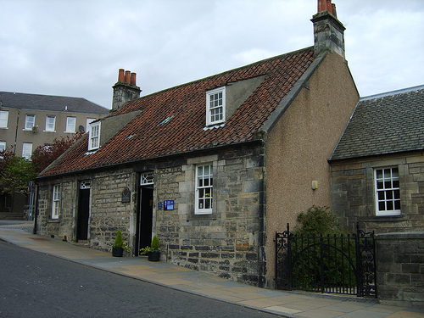
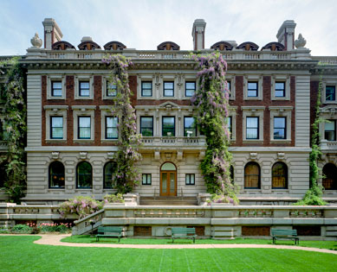
2. Andrew Carnegie
His life is referred to as a “rags to riches” story.
Believed in the “Gospel of Wealth”
Donated over $350 million to education, libraries, universities
Carnegie Hall, Carnegie-Mellon University, etc.
Childhood Home
Carnegie Mansion
Notes:
He was also one of the highest profile philanthropists of his era; his 1889 article proclaiming "The Gospel of Wealth" called on the rich to use their wealth to improve society, and stimulated a wave of philanthropy.
Carnegie devoted the remainder of his life to large-scale philanthropy, with special emphasis on local libraries, world peace, education and scientific research.
With the fortune he made from business, he built Carnegie Hall, and founded the Carnegie Corporation of New York, Carnegie Endowment for International Peace, Carnegie Institution for Science, Carnegie Trust for the Universities of Scotland, Carnegie Hero Fund, Carnegie Mellon University and the Carnegie Museums of Pittsburgh, among others. His life has often been referred to as a true "rags to riches" story.

Slide 5
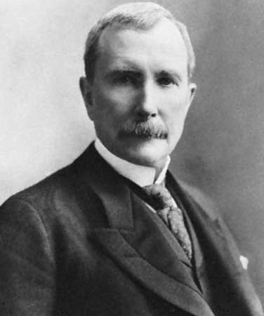
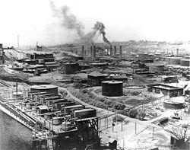
3. John D. Rockefeller (1839 – 1937)
Revolutionized the petroleum industry
Started the Standard Oil Company
Advocated Social Darwinism
Used Vertical and Horizontal integration (mergers) to create a monopoly
Richest man in history ($663 Billion today)
Notes:
John Davison Rockefeller, (July 8, 1839 – May 23, 1937) was an American business magnate and philanthropist.
He was a co-founder of the Standard Oil Company, which dominated the oil industry and was the first great U.S. business trust.
Rockefeller revolutionized the petroleum industry, and along with other key contemporary industrialists such as Andrew Carnegie, defined the structure of modern philanthropy. In 1870, he co-founded Standard Oil Company and actively ran it until he officially retired in 1897.
As kerosene and gasoline grew in importance, Rockefeller's wealth soared and he became the world's richest man and the first American worth more than a billion dollars. Adjusting for inflation, he is often regarded as the richest person in history.
Rockefeller was also considered a supporter of capitalism based in a perspective of social darwinism, and is often quoted saying "The growth of a large business is merely a survival of the fittest".

Slide 6
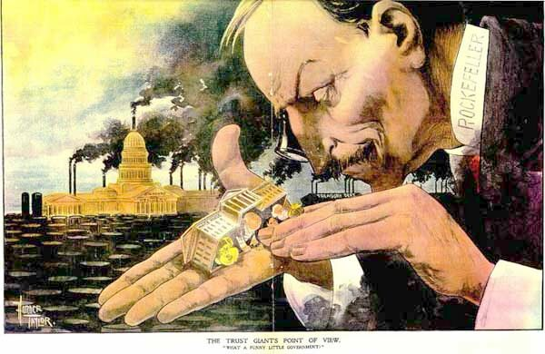
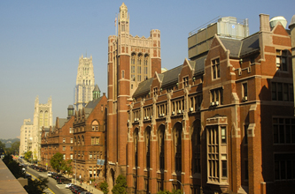
3. John D. Rockefeller
At one point controlled over 90% of the oil refining in the world
Donated money to medical research and elimination of disease (hook worm, yellow fever)
Started University of Chicago, Rockefeller University
Rockefeller University
Notes:
His fortune was mainly used to create the modern systematic approach of targeted philanthropy. He was able to do this through the creation of foundations that had a major effect on medicine, education and scientific research. His foundations pioneered the development of medical research and were instrumental in the eradication of hookworm and yellow fever.
Rockefeller was also the founder of both the University of Chicago and Rockefeller University and funded the establishment of Central Philippine University in the Philippines. He was a devoted Northern Baptist and supported many church-based institutions.
Rockefeller adhered to total abstinence from alcohol and tobacco throughout his life.
He was a faithful congregant of the Erie Street Baptist Mission Church, where he taught Sunday school, and served as a trustee, clerk, and occasional janitor.
Religion was a guiding force throughout his life, and Rockefeller believed it to be the source of his success.

Slide 7
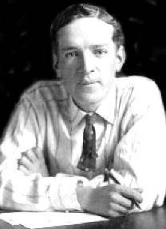
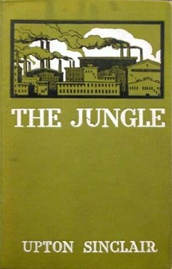
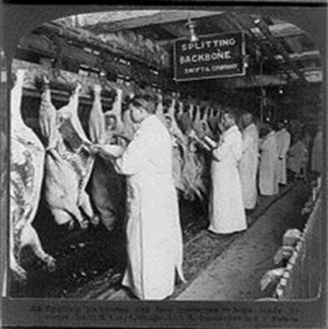
4. Upton Sinclair (1878-1968)
Pulitzer-Prize winning American author
His book, The Jungle, exposed inhuman conditions in the meat industry and unhealthy standards for meat products
He contributed to passing of:
Pure Food and Drug Act (1906)
Meat Inspection Act (1906)
He supported socialism
Notes:
Upton Sinclair Jr. was an American author who wrote close to 100 books in many genres.
He achieved popularity in the first half of the 20th century, acquiring particular fame for his 1906 muckraking novel The Jungle.
It exposed conditions in the U.S. meat packing industry, causing a public uproar that contributed in part to the passage a few months later of the 1906 Pure Food and Drug Act and the Meat Inspection Act.
Time magazine called him "a man with every gift except humor and silence."
In 1943, he won the Pulitzer Prize for Fiction.

Slide 8
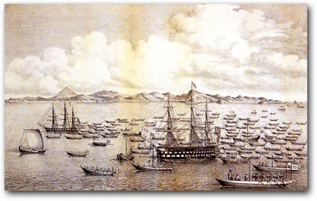
5. Matthew C. Perry
American Naval Commodore
First American to enter Tokyo Bay (1853)
Led Naval expedition to Japan to negotiate trade treaty. (Appointed by Pres. Fillmore)
“Convinced” Japan to open their ports to foreign trade
First efforts by Americans to trade with people in the far east
Treaty opened Japan to “Western Society” as well as goodwill between countries

Slide 9
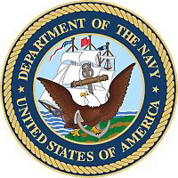
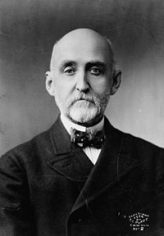
6. Alfred T. Mahan
Officer in the U.S. Navy
Taught at Naval War College late 1800’s
1890 Publishes The Influence of Sea Power Upon History, 1660-1783
Lectured & stressed about the importance of a large navy to protect our merchant ships.
Needed to acquire territory overseas for naval bases.
Major influence in convincing Congress to support building a strong, modern navy.

Slide 10
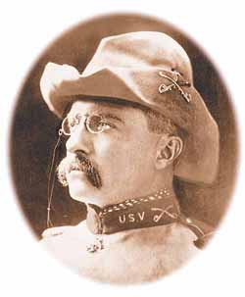
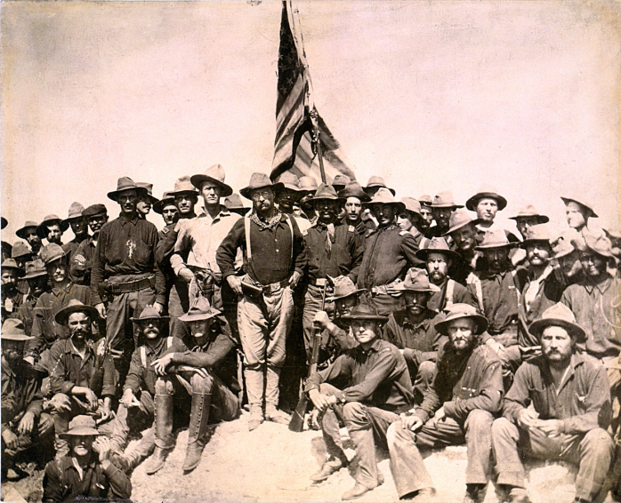
7. Theodore Roosevelt (1858 – 1919)
Organized the First U.S. Volunteer Calvary Regiment (Rough Riders)
Captured San Juan Hill in the Spanish-American War
Became the youngest President at 42 when McKinley was assassinated
“Square Deal” – promised a fair shake for the average citizen.
Knocked out big business
Teddy Roosevelt and the Rough Riders
Notes:
He organized and helped command the 1st U.S. Volunteer Cavalry Regiment, the Rough Riders, during the Spanish-American War. Returning to New York as a war hero, he was elected Republican governor in 1899.
He was a professional historian, a lawyer,
In 1901, as Vice President, Roosevelt succeeded President William McKinley after McKinley's assassination. He is the youngest person ever to become President (John F. Kennedy is the youngest elected President). 26th president
Roosevelt was a Progressive reformer who sought to move the dominant Republican Party into the Progressive camp. He distrusted wealthy businessmen and dissolved 40 monopolistic corporations as a "trust buster".
He was clear, however, to show that he did not disagree with trusts and capitalism in principle but was only against their corrupt, illegal practices. His "Square Deal" promised a fair shake for both the average citizen (through regulation of railroad rates and pure food and drugs) and the businessmen.
An outdoorsman, he promoted conservation, emphasizing efficient use of natural resources.
After 1906 he attacked big business and suggested the courts were biased against labor unions.

Slide 11
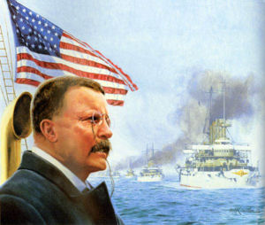
7. Theodore Roosevelt
Negotiated peace between Russia and Japan
1st American to win the Nobel Peace Prize
“Speak softly and carry a big stick”
Negotiated control and final construction of the Panama Canal

Slide 12
Assassination Attempt
Speech
The glass case and speech in his pocket over his heart saved his life
After being shot he delivered his speech with the bullet still in his body. The former "Rough Rider" pulled the torn and bloodstained manuscript from his breast pocket and declared, "You see, it takes more than one bullet to kill a Bull Moose." He spoke for an hour and then was rushed to the hospital.
Eyeglass Case
Notes:
Before a campaign speech in Milwaukee, Wisconsin, Theodore Roosevelt, the presidential candidate for the Progressive Party, was shot at close range by saloonkeeper John Schrank while greeting the public in front of the Gilpatrick Hotel.
Schrank's .32-caliber bullet, aimed directly at Roosevelt's heart, failed to mortally wound the former president because its force was slowed by a glasses case and a bundle of manuscript in the breast pocket of Roosevelt's heavy coat--a manuscript containing Roosevelt's evening speech. Schrank was immediately detained and reportedly offered as his motive that "any man looking for a third term ought to be shot.“
Roosevelt, who suffered only a flesh wound from the attack, went on to deliver his scheduled speech with the bullet still in his body. After a few words, the former "Rough Rider" pulled the torn and bloodstained manuscript from his breast pocket and declared, "You see, it takes more than one bullet to kill a Bull Moose." He spoke for nearly an hour and then was rushed to the hospital.

Slide 13
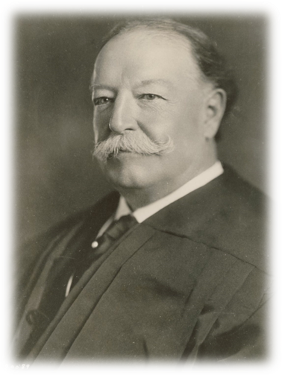
8. William Taft (1857 - 1930)
27th President, Emphasized trust-busting
New Mexico, Arizona added to the Union (1912)
Worked toward the passage of the 16th Amendment (income tax)
President Harding nominated him Chief Justice (only president to fulfill role).
Preferred law over politics.
“Dollar Diplomacy”…develop economy of lesser developed nations in Latin America and Asia by investing in their infrastructure.
Notes:
Riding a wave of popular support for fellow Republican Roosevelt, Taft won an easy victory in his 1908 bid for the presidency.
In his only term, Taft's domestic agenda emphasized trust-busting, civil service reform, strengthening the Interstate Commerce Commission, improving the performance of the postal service, and passage of the Sixteenth Amendment.
Abroad, Taft sought to further the economic development of underdeveloped nations in Latin America and Asia through "Dollar Diplomacy". However, Taft often alienated his own key constituencies, and was overwhelmingly defeated in his bid for a second term in the presidential election of 1912.
In 1921, after the First World War, President Warren G. Harding appointed Taft Chief Justice of the United States. Taft served in this capacity until shortly before his death in 1930. He is the only former president to administer the oath of office to another President and the only Chief Justice to serve with associate justices whom he had appointed to the court.
Weighed 330 lbs

Slide 14
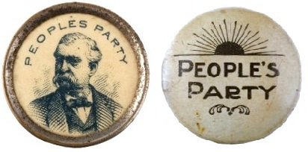
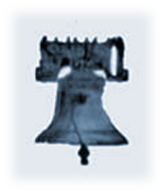
9. Populists – “The People’s Party”
Political party with influence from 1891-1896 formed to support farmers, laborers, and middleclass Americans.
Wanted the Government to regulate the railroads, break up monopolies.
Favored government ownership of major industries = Socialism
Supported a graduated income tax (progressive taxation) in order to shift a larger tax burden to the wealthy
Argued for the Silver Standard in order to help solve monetary shortages.
Supported the direct election of Senators (eventually 17th Amendment)

Slide 15
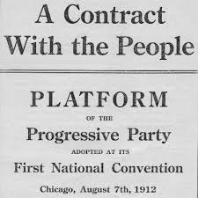
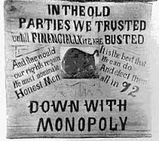
10. Progressives
Agenda:
Pass child labor laws
Create 8 hour work day
Safer working conditions
Break up monopolies
End power of the political machines
Women’s suffrage
Prohibition
Direct Democracy (referendum, initiative, recall)
Movement inspired by the problems of rapid industrialization in the late 1800’s.
Supporters came from both political parties and a wide range of Socioeconomic factors.
Goal was to “clean up” society, business, and politics.

