Slide 1
U.S. History - Unit 3 Key Terms
From WWI to the Roaring 20s

Slide 2
WWI – “The Great War”
Global military conflict which took place primarily in Europe from 1914 to 1918.
Over 40 million casualties resulting in approximately 20 million military and civilian deaths.
The Entente Powers /Allies defeated the Central Powers
France, Russia, the UK and later Italy -1915 and the United States -1917)
Central Powers (Austro-Hungarian, German, and Ottoman Empires.)
Russia withdrew from the war after the revolution in 1917.
The fighting that took place along the Western Front occurred along a system of trenches and fortifications separated by an area known as no man's land.

Slide 3
4 M.A.I.N. Causes of WWI
M ilitarism
A lliances
I mperialism
N ationalism

Slide 4
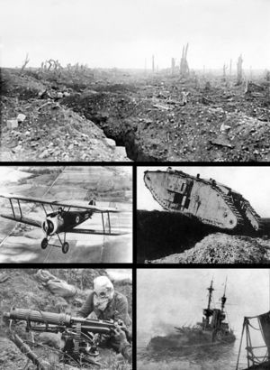
Clockwise from top: Trenches on the Western Front; a British Mark IV Tank crossing a trench; Royal Navy battleship HMS Irresistible sinking after striking a mine at the Battle of the Dardanelles; a Vickers machine gun crew with gas masks and a Sopwith Camel biplane

Slide 5
Trench Warfare
WWI battlefields were known for machine guns and trenches.
Trench line on the Western Front ran from the English Channel to the Swiss border.
Space between trench lines was known as “no man’s land.”
Trench lines were cleared by massive artillery barrages, followed by infantry assaults.
Water filled trench
Notes:
WWI battlefields were known for machine guns and trenches.
Trench line on the Western Front ran from the English Channel to the Swiss border.
Space between trench lines was known as “no man’s land.”
Trench lines were cleared by massive artillery barrages, followed by infantry assaults.
i. The term “over the top” comes from WWI.
ii. You start an assault with a barrage of artillery.
iii. You then launch an infantry assault (bayonets fixed) over the top at the opposing trench line.
iv. Throwing grenades into the opposing trench line (if you made it across no man’s land) you cleared the trench.
v. This type of assault normally resulted in hundreds of thousands of casualties for both sides.
vi. Germans introduce poison gas into the mix in 1915 (vomiting, blindness and suffocation).
vii. Allies respond in kind.
viii. Tanks and airplanes are introduced in WWI but are not sophisticated enough to change how warfare is fought.

Slide 6
Notes:
These fortifications stretched 475 miles (more than 600 kilometers) and defined the war for many. On the Eastern Front, the vast eastern plains and limited rail network prevented a trench warfare stalemate, though the scale of the conflict was just as large as on the Western Front. The Middle Eastern Front and the Italian Front also saw heavy fighting, while hostilities also occurred at sea, and for the first time, in the air.
The war caused the disintegration of four empires: the Austro-Hungarian, German, Ottoman and Russian. Germany lost its colonial empire and states such as Czechoslovakia, Estonia, Finland, Latvia, Lithuania, Poland and Yugoslavia gained independence.
The cost of waging the war set the stage for the breakup of the British Empire as well and left France devastated for more than a generation. World War I marked the end of the world order which had existed after the Napoleonic Wars, and was an important factor in the outbreak of World War II.

Slide 7
Conscription
Forced military service.
Selective Service Act of 1917.
All men between 21 and 30 had to register for draft.
A lottery randomly determined the order people were called.
Local draft board determined fitness.
In WWI 24 million registered, 3 million were drafted.
Advertising the Navy life!
Notes:
Forced military service.
Selective Service Act of 1917.
All men between 21 and 30 had to register for draft.
A lottery randomly determined the order people were called.
Local draft board determined fitness.
i. There were thousands of local draft boards.
ii. Members were from local communities.
iii. Progressives believed that local people, understanding community needs, would know which men to draft.
iv. 2.8 million Americans were drafted.

Slide 8
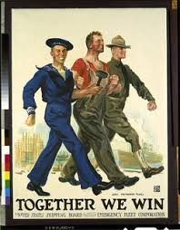
War Industries Board
Government agency established in 1917 to coordinate production of war supplies.
Encouraged companies to use mass production techniques to increase efficiency.
Increased industrial production by 20%.
The WIB set production quotas and gave recommendations on allocation of raw materials.
Helped discourage labor disputes during the war.
Opponents called it socialism.

Slide 9
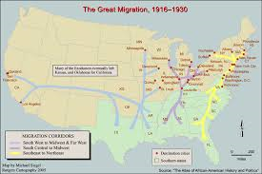
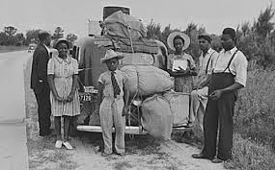
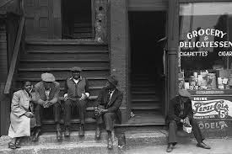
Great Migration
During and after WWI, hundreds of thousands of blacks move to the North.
Blacks were looking to escape the segregated life of the South.
Industrial North held more economic opportunities than the rural South.
Chicago and Harlem became centers of black music, literature, and art.
Notes:
Page 427
After WWI, hundreds of thousands of blacks move from the South to the North.
Blacks were looking to escape the segregated life of the South.
Industrial North held more economic opportunities than the rural South.
Chicago and Harlem became centers of black music, literature, and art.
i. After WWI hundreds of thousands of American Americans joined in what was called the Great Migration.
ii. It was an exodus from the Southern states in the US to the Northern states in the US.
iii. African Americans could not catch a break from segregation in the South.
iv. Many African Americans – having experienced real man hood in the battlefields of WWI – would unwilling to return to the segregated South.
v. After living through trench warfare, German mustard gas, and the fact that the French (of all people) treated black US servicemen with dignity and respect, many blacks refused to return to the South and to their way of life they had before the war.
vi. The Northern states had many more industrial areas where work was to be found and in the 1920s, there was plenty of work.
vii. The North – like in placed like Harlem – African Americans were able to earn a living and express their themselves and their own American culture.

Slide 10
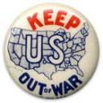
Isolationism
Americans wanted to be left alone to pursue personal prosperity after the war.
Tired of being entangled in the dangerous politics of Europe.
Refused to be a member in the League of Nations.
PROBLEM: Too powerful and economically connected with foreign countries for this attitude to succeed.
Notes:
Page 458
Americans wanted to be left alone to pursue prosperity.
Tired of being entangled in the dangerous politics of Europe.
Refused to be a member in the League of Nations.
Too powerful and economically connected with foreign countries for this attitude to succeed.

Slide 11
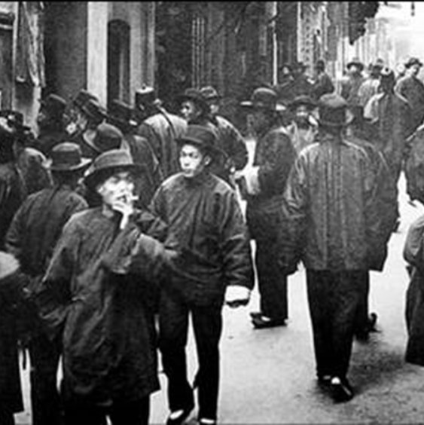
Nativism
A preference for native-born people and a desire to limit immigration.
1815 and 1860, 5 million foreigners journeyed to America.
1840s and 1850s, Irish immigrants were scorned.
1880s, Asians, Jews, Eastern Europeans, and Catholics were looked down upon.
Workingman’s Party of California forms in the 1870s (against Chinese).
American Protective Association formed in 1887 (against Catholics).
Chinese Exclusion Act passed in 1882.
Spindle Boys, 1910
Groups fought Chinese immigration.
Notes:
1820s, Industrialization takes hold in America.
i. The United States industrializes quickly for two main reasons.
ii. American system of free enterprise based on private property rights.
iii. People could use capital (money free for investment) without government interference.
iv. 1830s, many states pass laws that encourage incorporation (forming a business).
1815 and 1860, 5 million foreigners journeyed to America.
i. In 1820, only New York City had over 100,000 residents.
ii. By 1860, eight other cities had reached that size.
iii. In 1845, a large number of Irish arrive due to a devastating potato blight caused widespread famine in Ireland.
A preference for native-born people and a desire to limit immigration.
i. The presence of people from different cultures, languages and different religions, produce feelings of Nativism.
ii. This is not racism as racism has connotations that one ethnic group is superior to another ethnic group.
iii. Pretty darn close to racism though.
Groups try to keep foreigners and Catholics from holding public office.
i. Local public office jobs (elected positions) such as town sheriff, mayor, country registrar of voters, were positions established ethnic groups wanted “reserved.”
ii. 1830s, Irish and Germans immigrant in large numbers (they are primarily Catholic).
iii. But by the 1870s, they have settled into society and would protest and picket the Chinese who were immigrating to American in large numbers in the 1870s.

Slide 12
Red Scare
Fear of communism or political radicalism as a threat to U.S. democracy.
Nationwide strikes in 1919 were considered a threat to government.
April, 1919, Postal Service intercepted 30 “mail bombs.”
After the Bolshevik Revolution in Russia (1917) people feared the same may happen in the U.S.
1919 Political Cartoon of an “European anarchist” trying to blow up the Statue of Liberty
Notes:
Page 393
Nationwide strikes held in 1919 were considered a threat to government.
April, 1919, Postal Service intercepted 30 “mail bombs.”
US Attorney General A. Mitchell Palmer has the FBI conduct raids.
Raids were without search warrants. Thousands were arrested and 500 were deported.

Slide 13
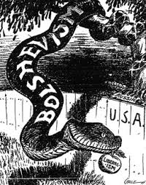
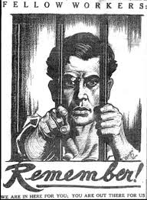
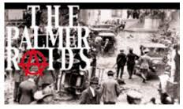
Palmer Raids
US Attorney General Mitchell Palmer has the FBI conduct raids (1918-1921).
Purpose was to crackdown on radical political groups.
Raids were without search warrants. Thousands arrested and 500 deported.
Over 10,000 arrested.
Public supported due to the Red Scare.

Slide 14
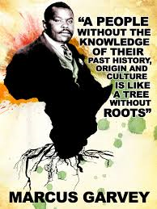
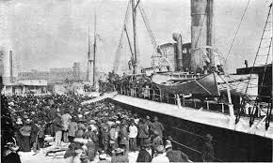
Back-to-Africa Movement
Many African Americans had left the south looking for a better life.
They found better economic, social and political, opportunities but were still “second class” citizens.
Back-to-Africa movement was an alternative to integration.
A movement to encourage African Americans to return to their ancestral roots and move back to Africa.
Movement gained attention in the 1920s through the efforts of Marcus Garvey.

Slide 15
Flapper
Women had new freedom in the moral attitudes of the 1920s.
A flapper was a young, dramatic, stylish and unconventional woman.
A flapper smoked cigarettes, drank prohibited liquor, had short hair , listened to jazz, and dressed in revealing attire.
Flappers sought social freedom while most women just sought financial freedom.
Actress Louise Brooks, 1927
Notes:
Page 410

Slide 16
Flapper Slang
Snugglepup
man who frequently goes to parties
“I have to go see a man about a dog”
going to buy whiskey
“handcuff”
engagement or wedding ring
“that’s so jake”, “that’s the bee’s knees”, “the cat’s pajamas”
ways to say fantastic
“big cheese”
important person
to “bump off”
murder
“baloney”
nonsense

Slide 17
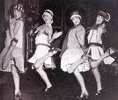
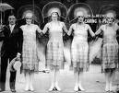

Slide 18
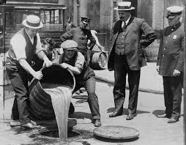
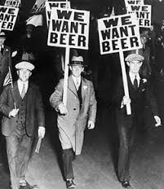
Volstead Act
AKA – National Prohibition Act (1919) meant to enforce the 18th Amendment.
to prohibit intoxicating beverages
to regulate the manufacture, sale, or transport of liquor (but not consumption)
Forced the liquor business to turn “underground”
Production, importation, and distribution of liquor was taken over by organized crime and infamous gangsters such as Al Capone.

Slide 19
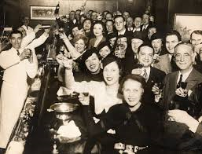
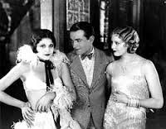
Speakeasies
People flocked to illegal bars known as speakeasies.
In New York City alone there were 32,000 such bars.
Liquor was available in rural America as bootlegging was common.
21st Amendment repeals the 18th Amendment in 1933.
A 1920s era Speakeasy
Notes:
Page 413
People flocked to illegal bars known as speakeasies.
In New York City alone there were 32,000 such bars.
Liquor was available in rural American as bootlegging was common.
21st Amendment repeals the 18th Amendment in 1933.

