Slide 1
Chapter 5
Language

Slide 2
Language
Intro
Where are English-Language Speakers Distributed?
A. Origin and diffusion of English
  1. Intro
  2. English colonies
  3. Origin of English in England

Slide 3
Language
B. Dialects of English
  1. Dialect
  2. Dialects in England
  3. Differences between British & American
  English
  Dialects in the United States
  1. Settlement in the East

Slide 4
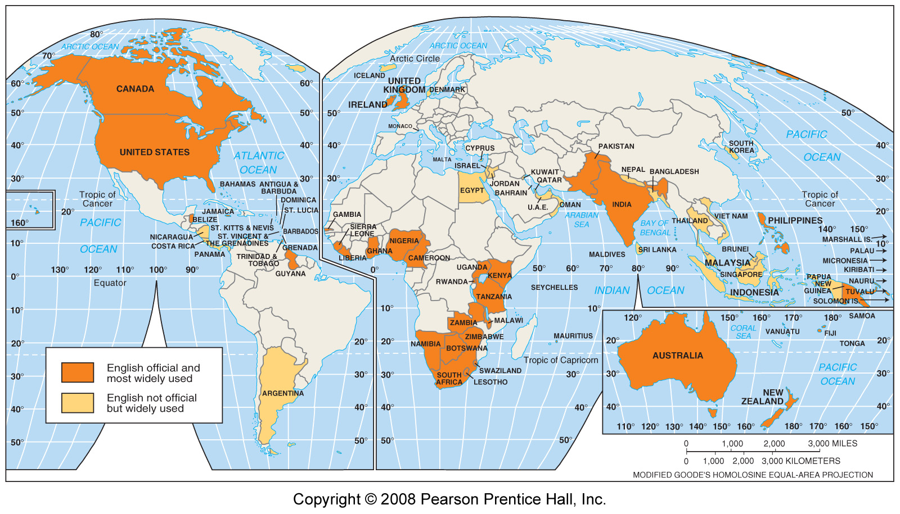
English Speaking Countries
Fig. 5-1: English is an official language in 50 countries, including some in which it is not the most widely spoken language. It is also used and understood in many others.

Slide 5
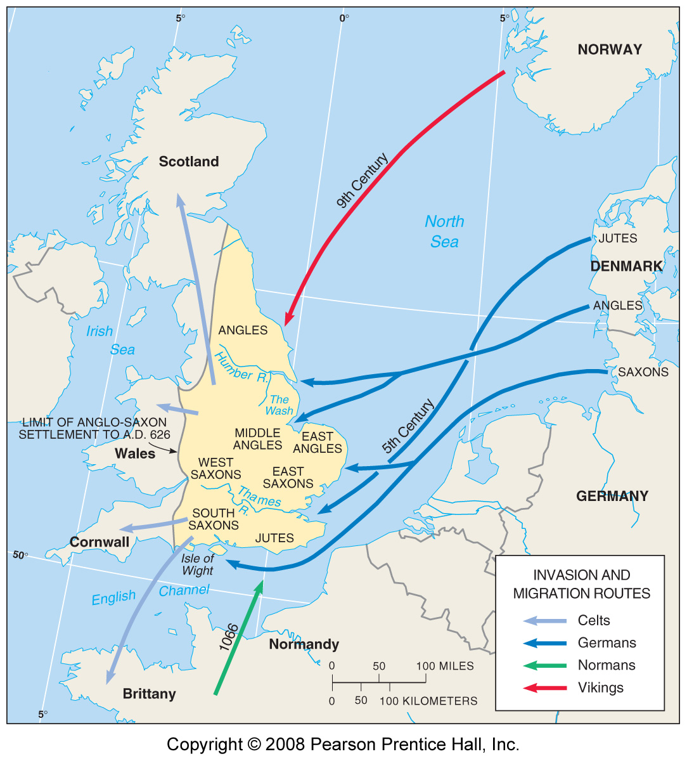
Invasions of England
5th - 11th centuries
Fig. 5-2: The groups that brought what became English to England included Jutes, Angles, Saxons, and Vikings. The Normans later brought French vocabulary to English.

Slide 6
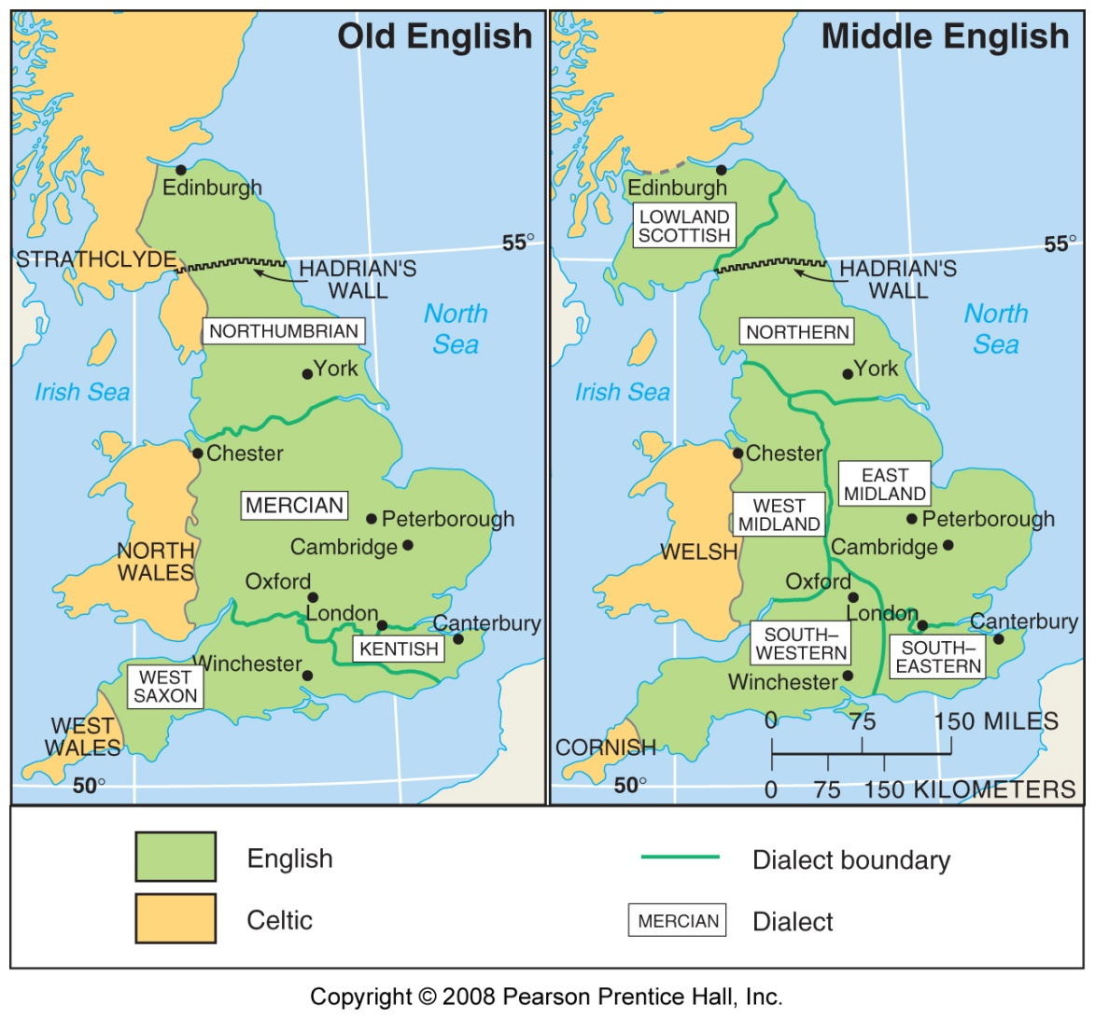
Old & Middle English Dialects
Fig. 5-3: The main dialect regions of Old English before the Norman invasion persisted to some extent in the Middle English dialects through the 1400s.

Slide 7
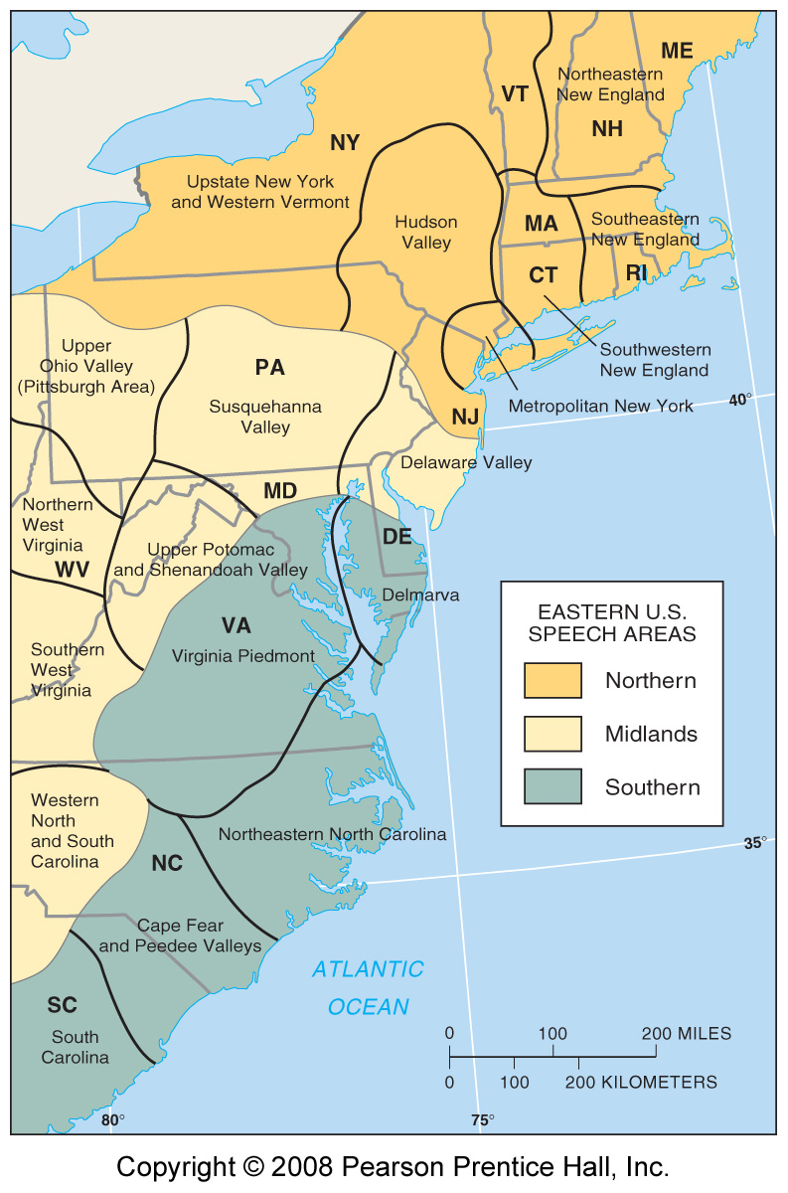
Dialects in the Eastern U.S.
Fig. 5-4: Hans Kurath divided the eastern U.S. into three dialect regions, whose distribution is similar to that of house types (Fig. 4-9).

Slide 8
Language Family
III. Why is English Related to Other Languages?
A. Branches of Indo-European
  1. Germanic branch
  2. Indo-Iranian branch
  3. Balto-Slavic branch
  4. Romance branch
B. Origin and diffusion of Indo-
European
  Kurgan and Anatolian theories

Slide 9
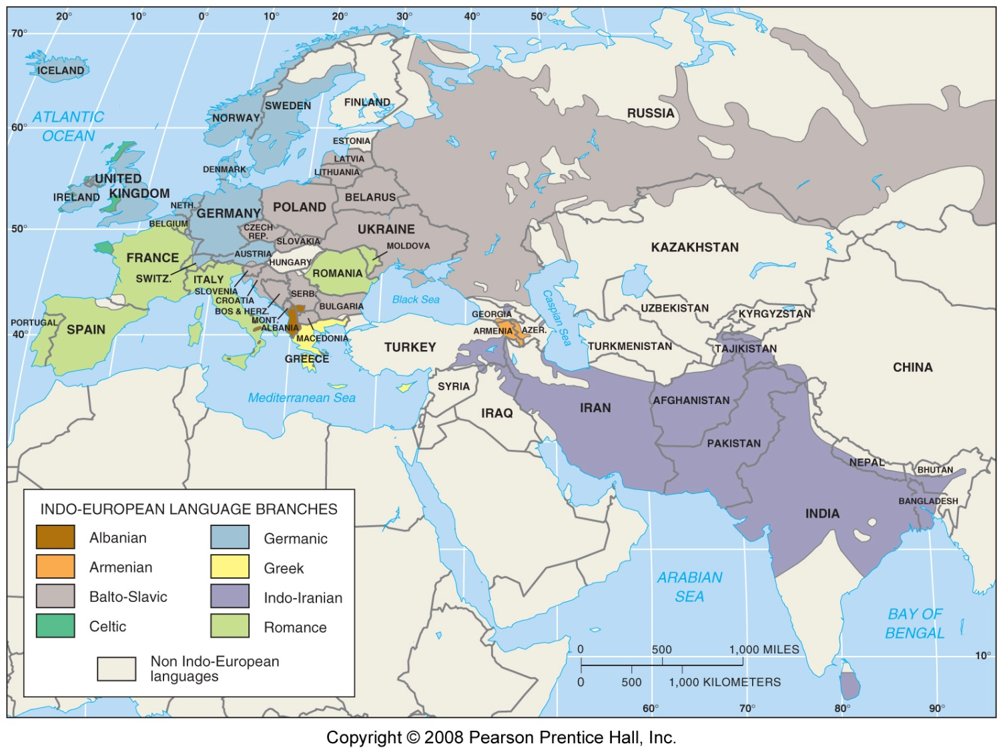
Indo-European Language Family
Fig. 5-5: The main branches of the Indo-European language family include Germanic, Romance, Balto-Slavic, and Indo-Iranian.

Slide 10
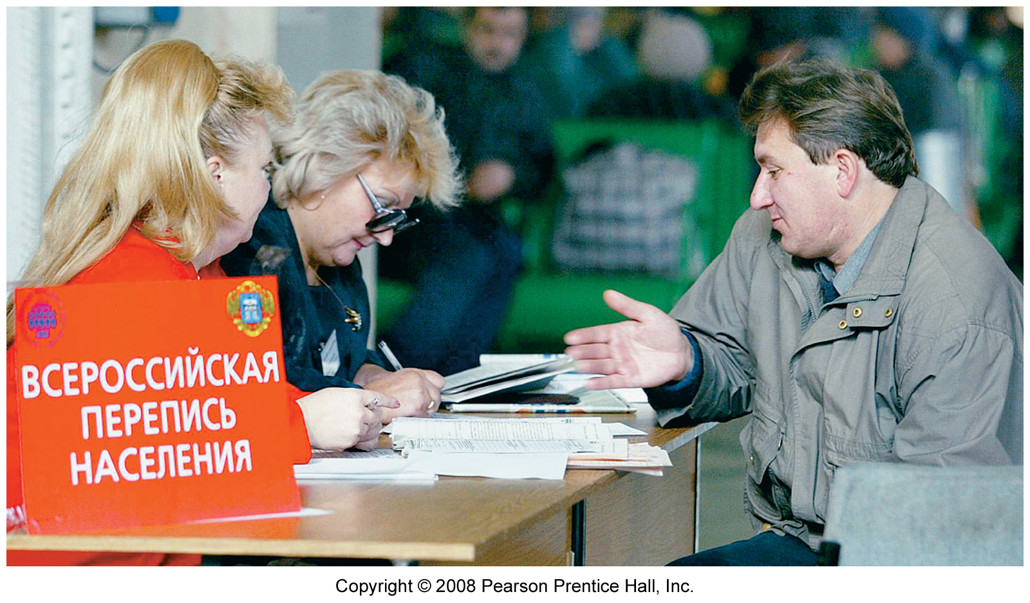
Russian Sign
Russian is an Indo-European language written in the Cyrillic alphabet, originally brought to Russia by Greek missionaries

Slide 11
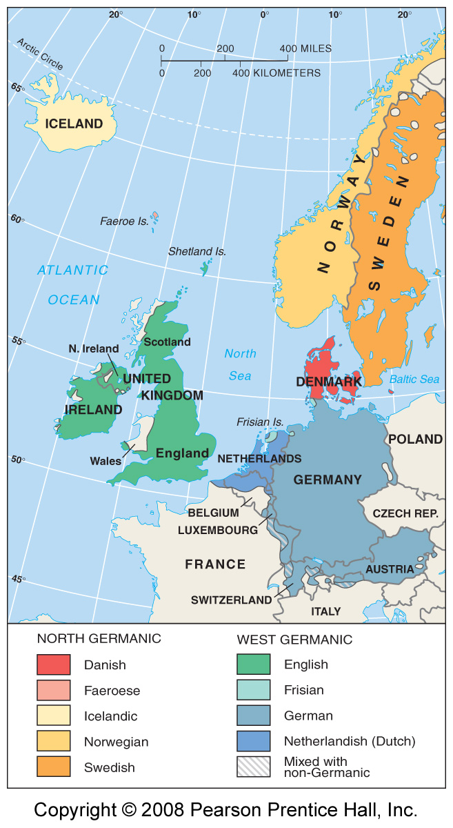
Germanic Branch of Indo-European
Fig. 5-6: The Germanic branch today is divided into North and West Germanic groups. English is in the West Germanic group.

Slide 12
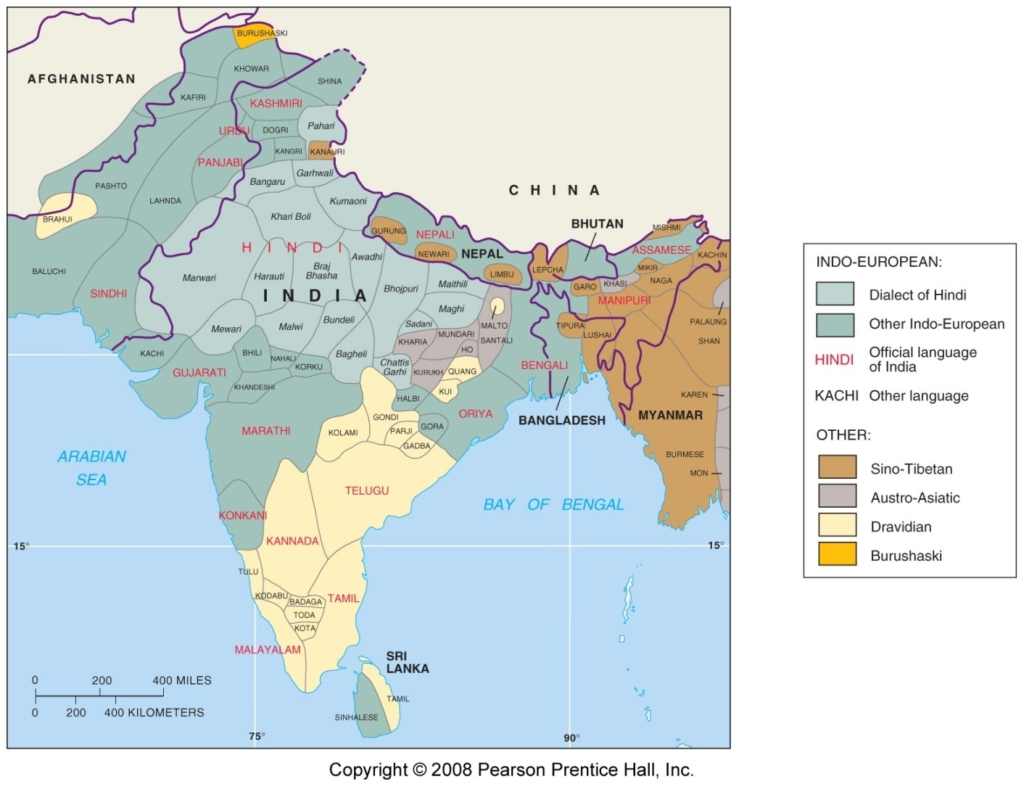
South Asian Languages & Language Families
Fig. 5-7: Indo-European is the largest of four main language families in South Asia. The country of India has 18 official languages.

Slide 13
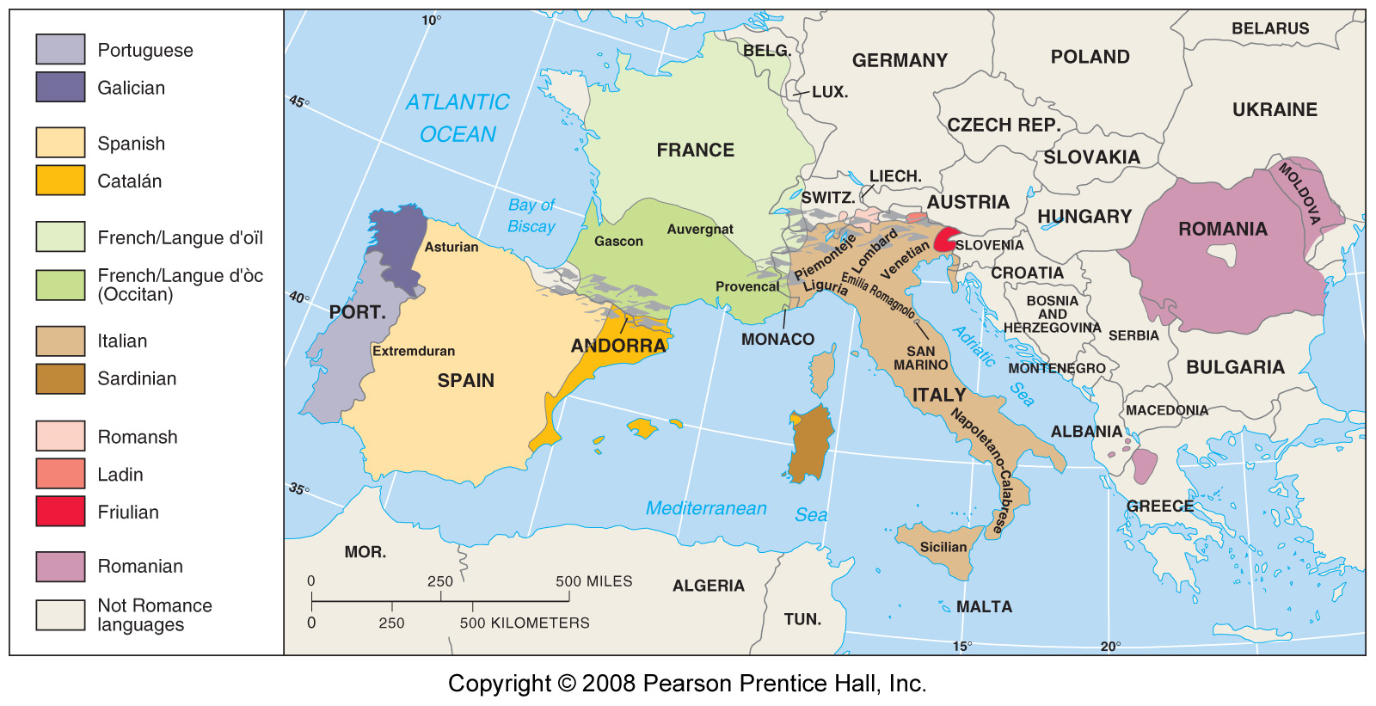
Romance Branch of Indo-European
Fig. 5-8: The Romance branch includes three of the world’s 12 most widely spoken languages (Spanish, French, and Portuguese), as well as a number of smaller languages and dialects.

Slide 14
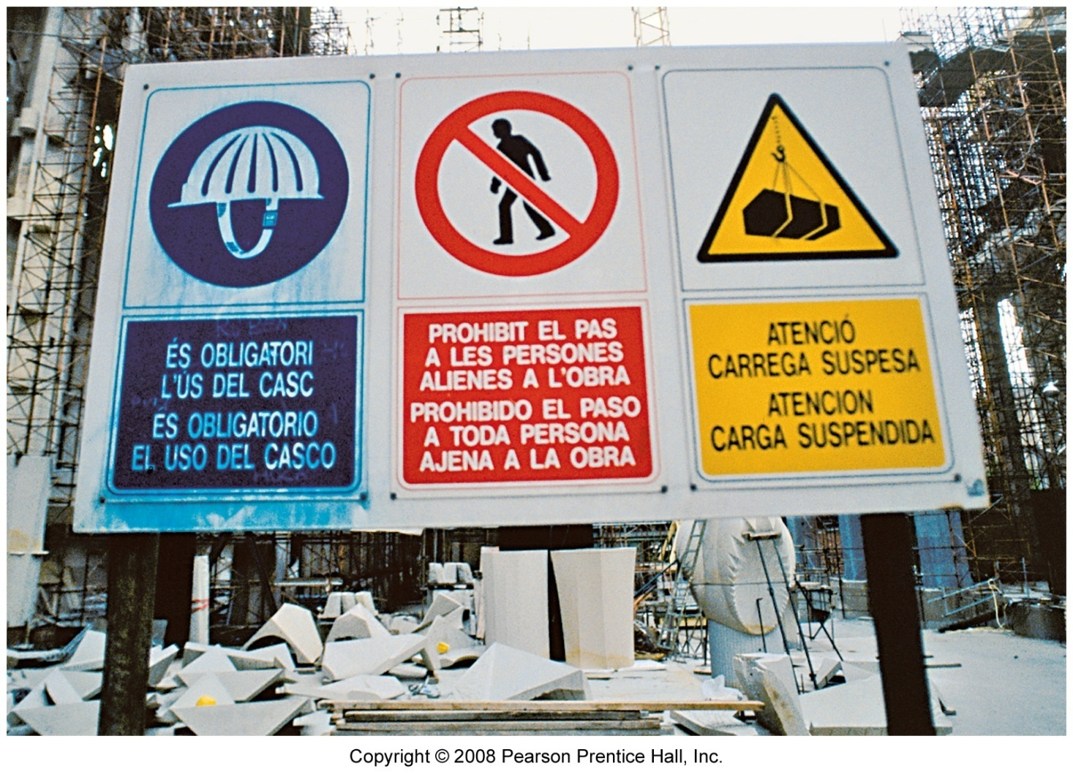
Signs in Barcelona, Spain
Signs in Barcelona are written both in Catalán (top) and Spanish (bottom).

Slide 15
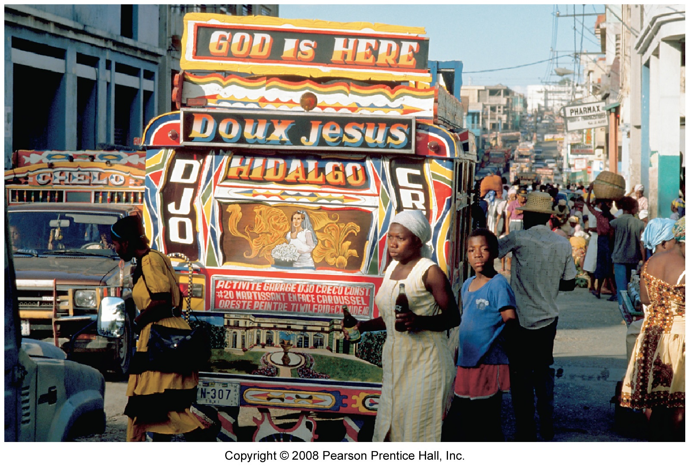
Port-au-Prince, Haiti
Haitian Creole and French are both official languages in Haiti, although English is also used.

Slide 16
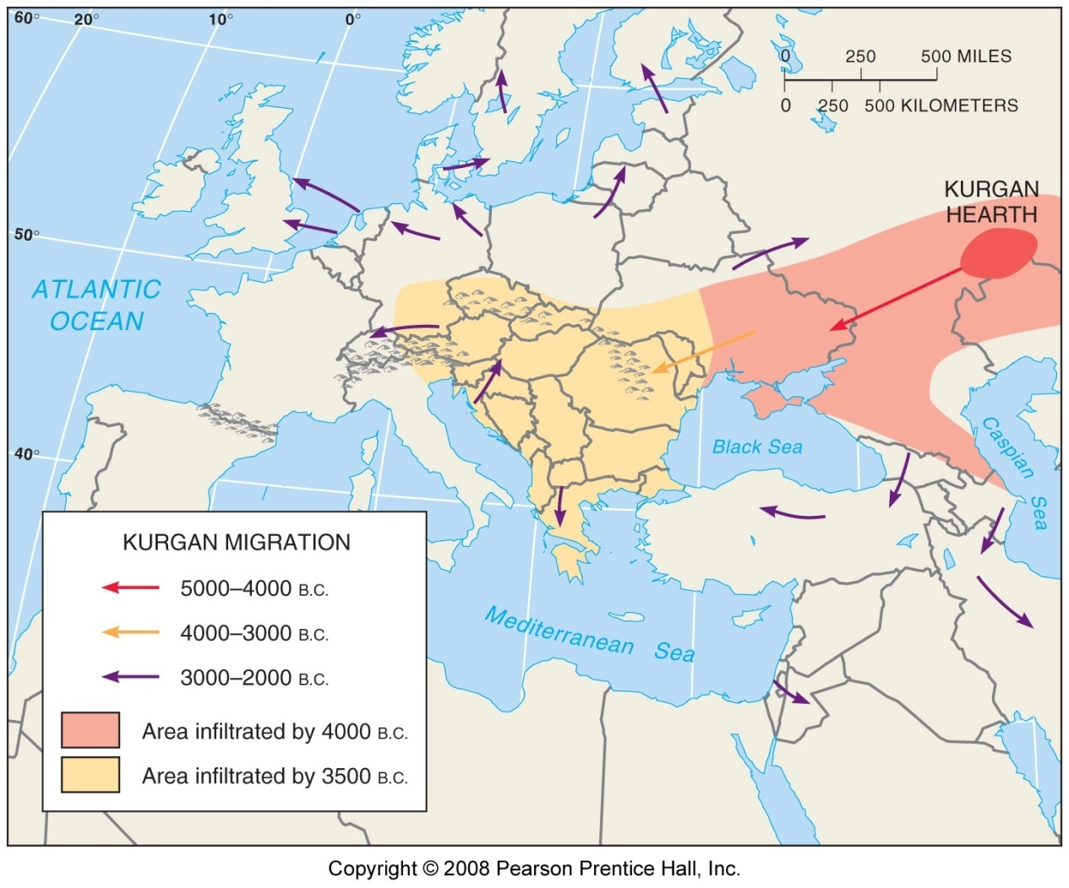
Kurgan Theory of Indo-European Origin
Fig. 5-9: In the Kurgan theory, Proto-Indo-European diffused from the Kurgan hearth north of the Caspian Sea, beginning about 7000 years ago.

Slide 17
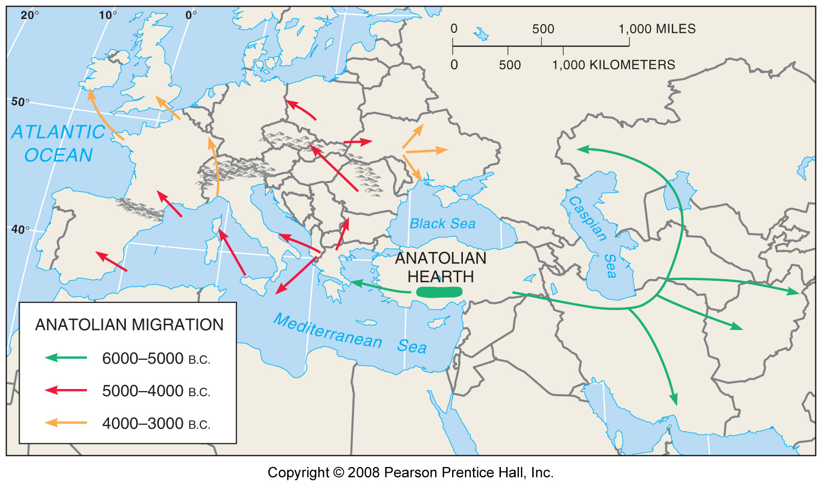
Anatolian Hearth Theory of Indo-European Origin
Fig. 5-10: In the Anatolian hearth theory, Indo-European originated in Turkey before the Kurgans and diffused through agricultural expansion.

Slide 18
Distribution of Other Language Families
Classification of languages
Distribution of language families
  Sino-Tibetan language family
  Other East and Southeast Asian language families
  Afro-Asiatic language family
  Altaic and Uralic language families
  African language families

Slide 19
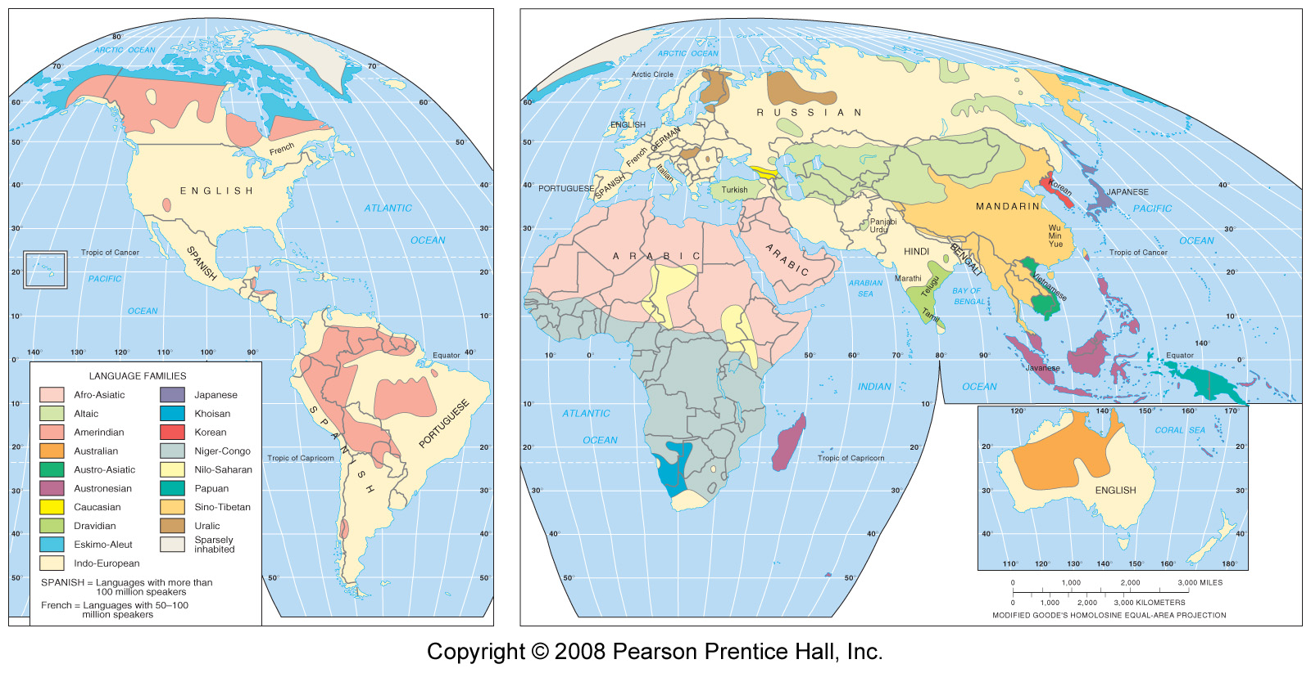
Language Families of the World
Fig. 5-11: Distribution of the world’s main language families. Languages with more than 50 million speakers are named.

Slide 20
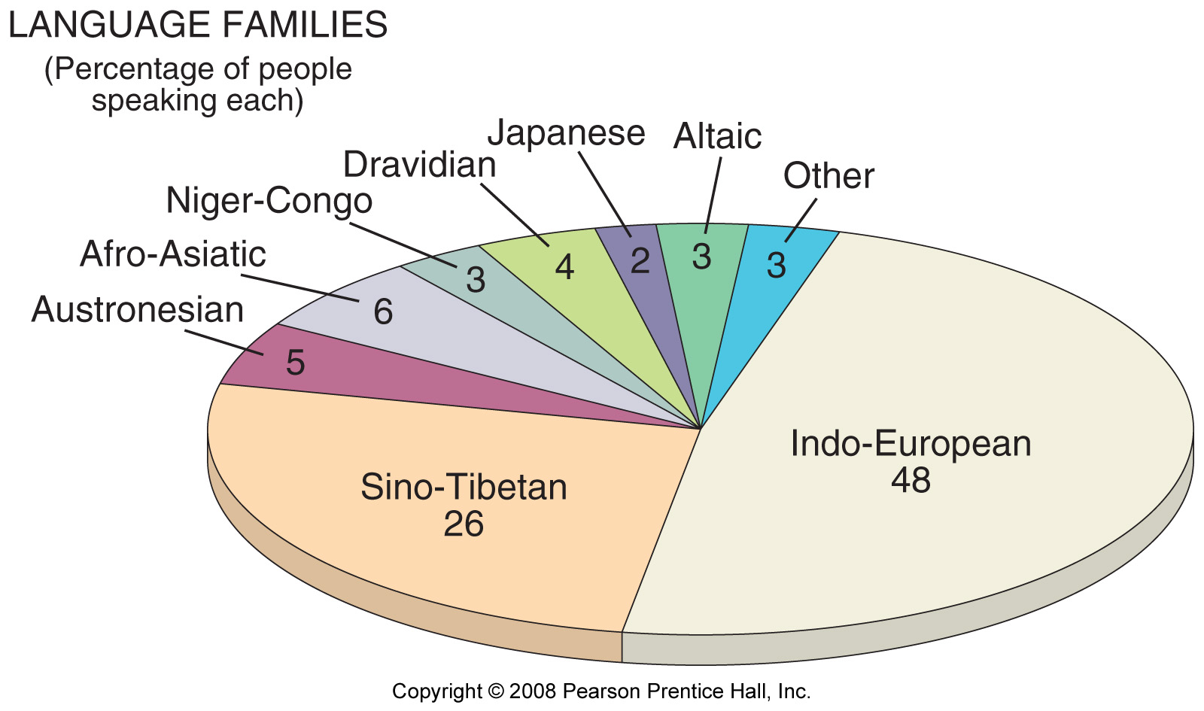
Major Language Families
Percentage of World Population
Fig. 5-11a: The percentage of world population speaking each of the main language families. Indo-European and Sino-Tibetan together represent almost 75% of the world’s people.

