Slide 1
Chapter 5
Language

Slide 2
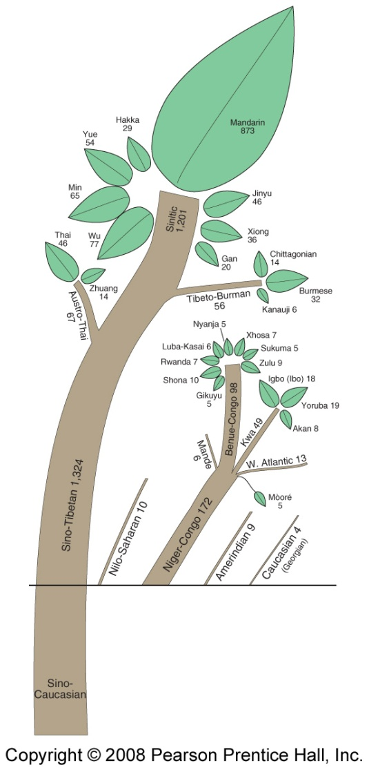
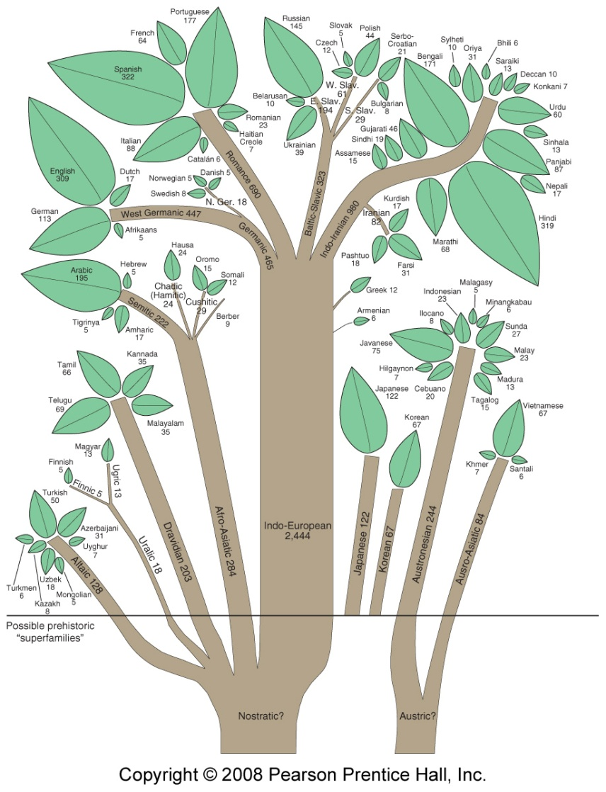
Language Family Trees
Fig. 5-12: Family trees and estimated numbers of speakers for the main world language families.

Slide 3
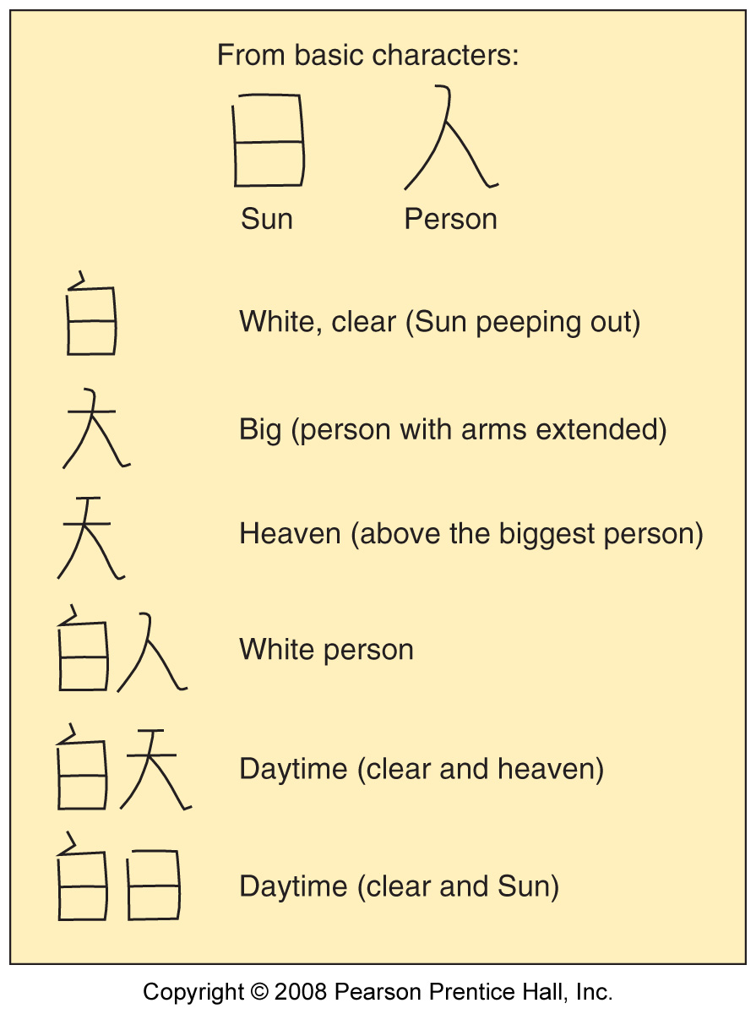
Chinese Ideograms
Fig. 5-13: Chinese language ideograms mostly represent concepts rather than sounds. The two basic characters at the top can be built into more complex words.

Slide 4
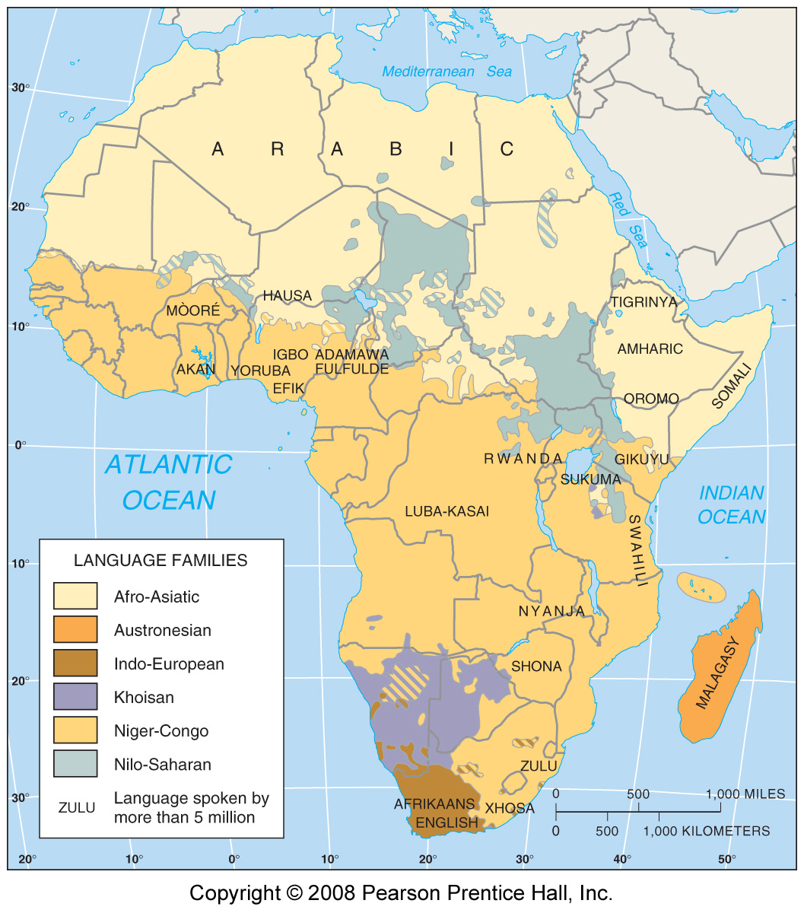
Language Families of Africa
Fig. 5-14: The 1000 or more languages of Africa are divided among five main language families, including Austronesian languages in Madagascar.

Slide 5
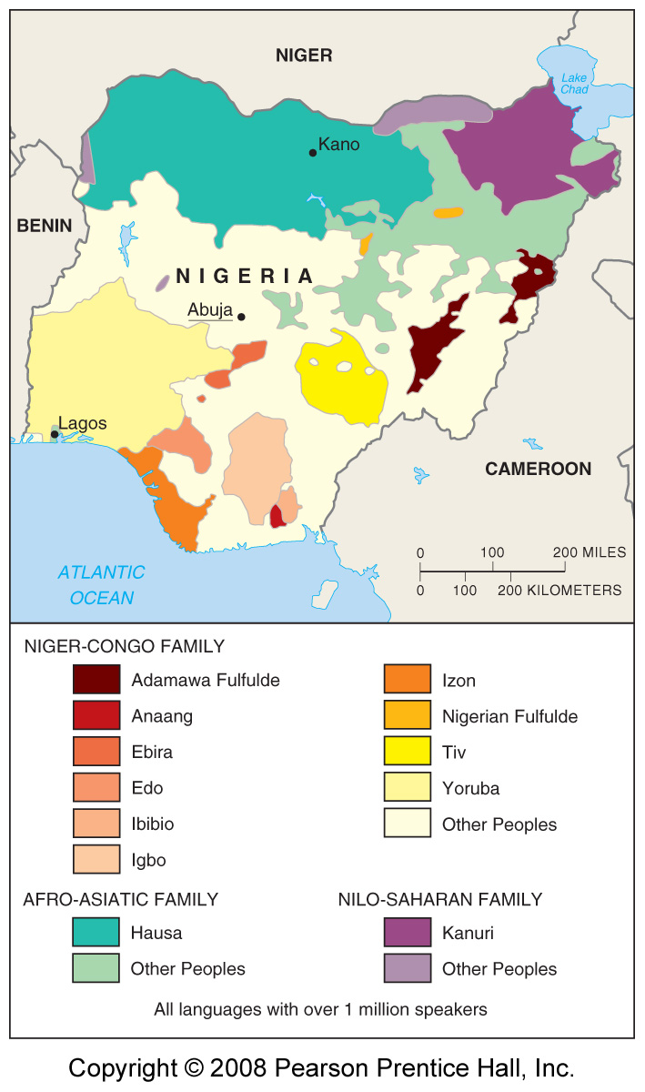
Languages of Nigeria
Fig. 5-15: More than 200 languages are spoken in Nigeria, the largest country in Africa (by population). English, considered neutral, is the official language.

Slide 6
Language Diversity & Uniformity
Preserving language diversity
  Hebrew: reviving extinct languages
  Celtic: preserving endangered languages
  Multilingual states
  Isolated languages
Global dominance of English
  English as a lingua franca
  Diffusion to other languages

Slide 7
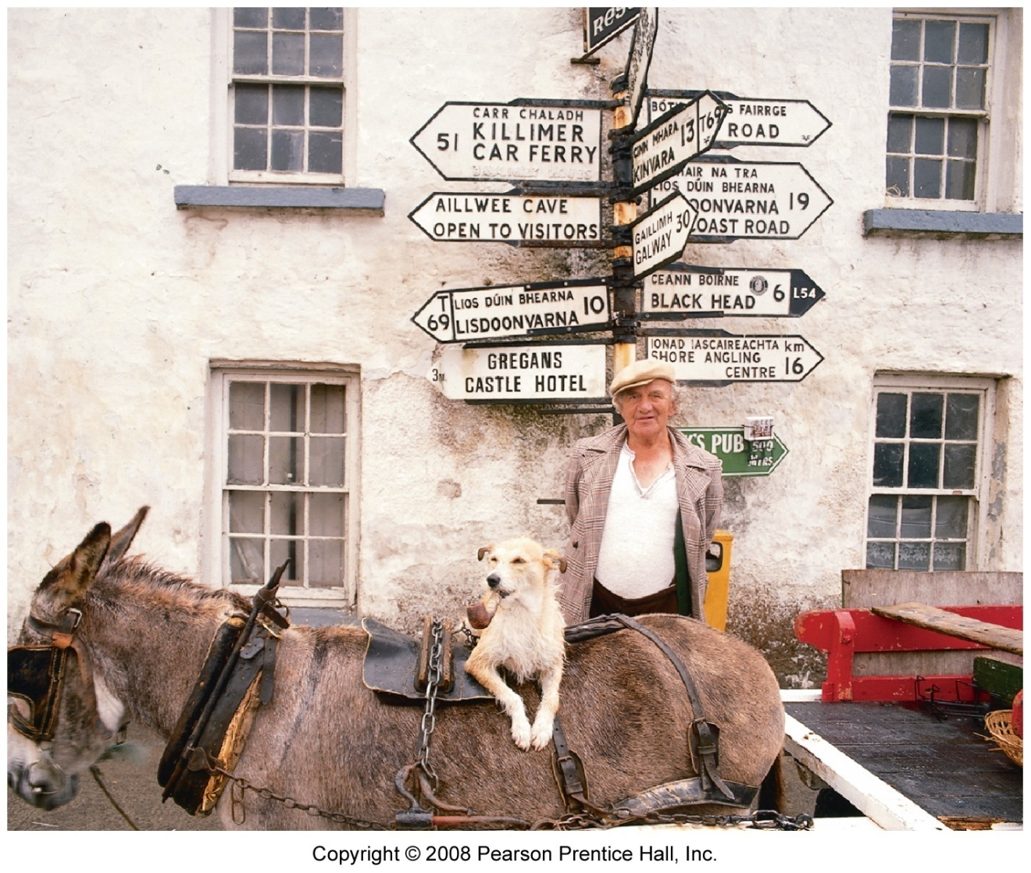
Ireland Road Signs
Road signs in Ireland are written in both English and Gaelic (Goidelic).

Slide 8
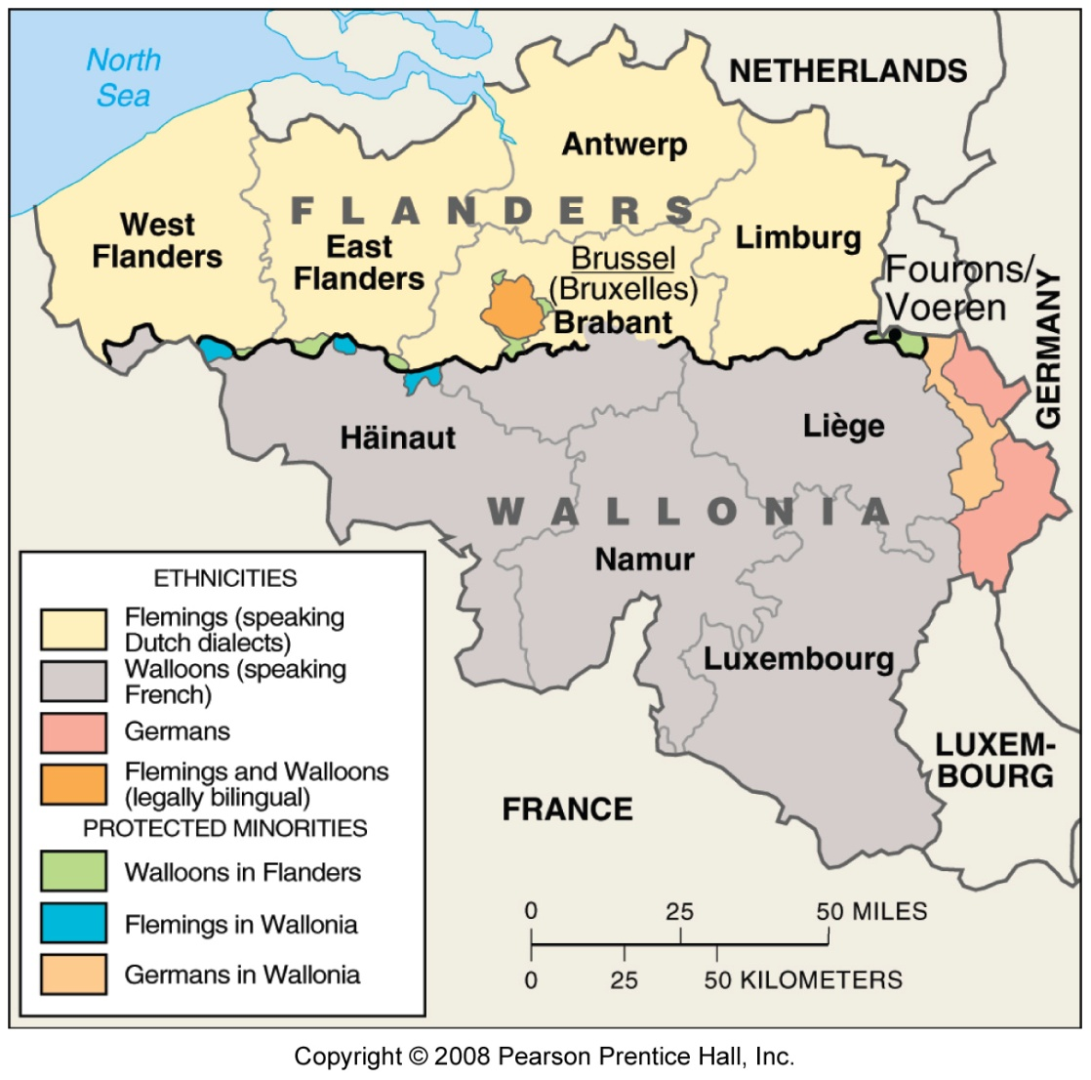
Language Divisions in Belgium
Fig. 5-16: There has been much tension in Belgium between Flemings, who live in the north and speak Flemish, a Dutch dialect, and Walloons, who live in the south and speak French.

Slide 9
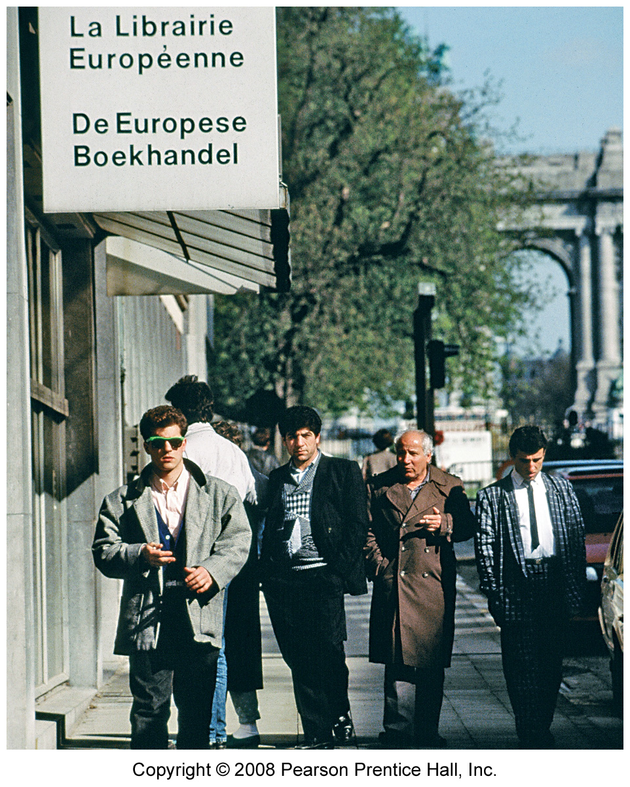
Bookstore in Brussels, Belgium
The name of the bookstore is printed in both French (top) and Flemish (bottom).

Slide 10
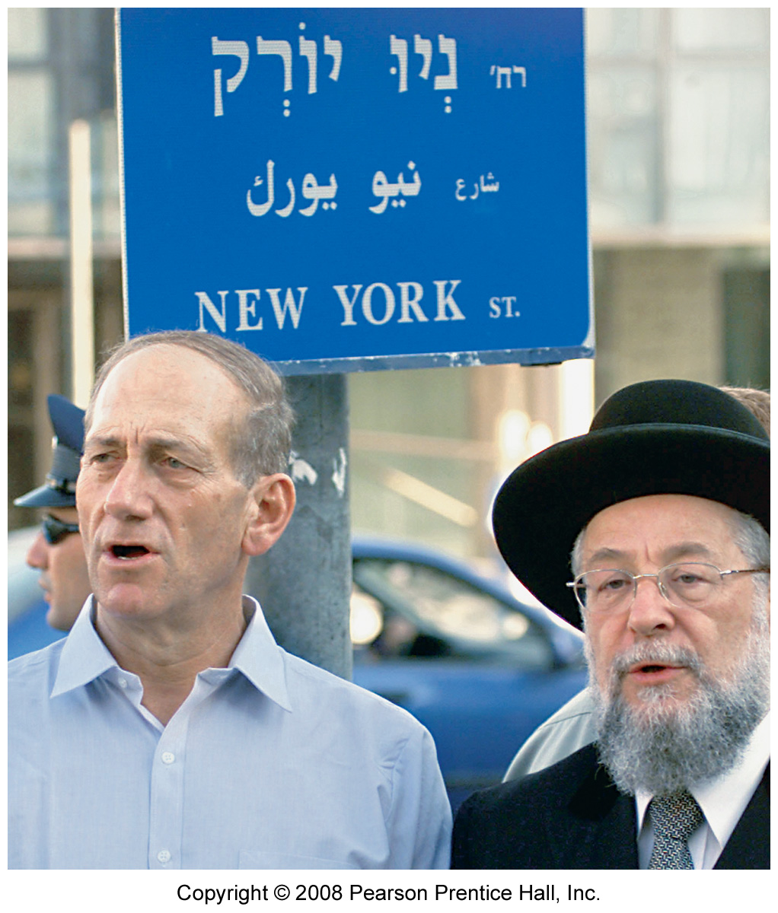
Jerusalem Street sign
A street in Jerusalem was re-named New York after Sept. 11, 2001. The street name is shown in Hebrew, Arabic, and English

Slide 11
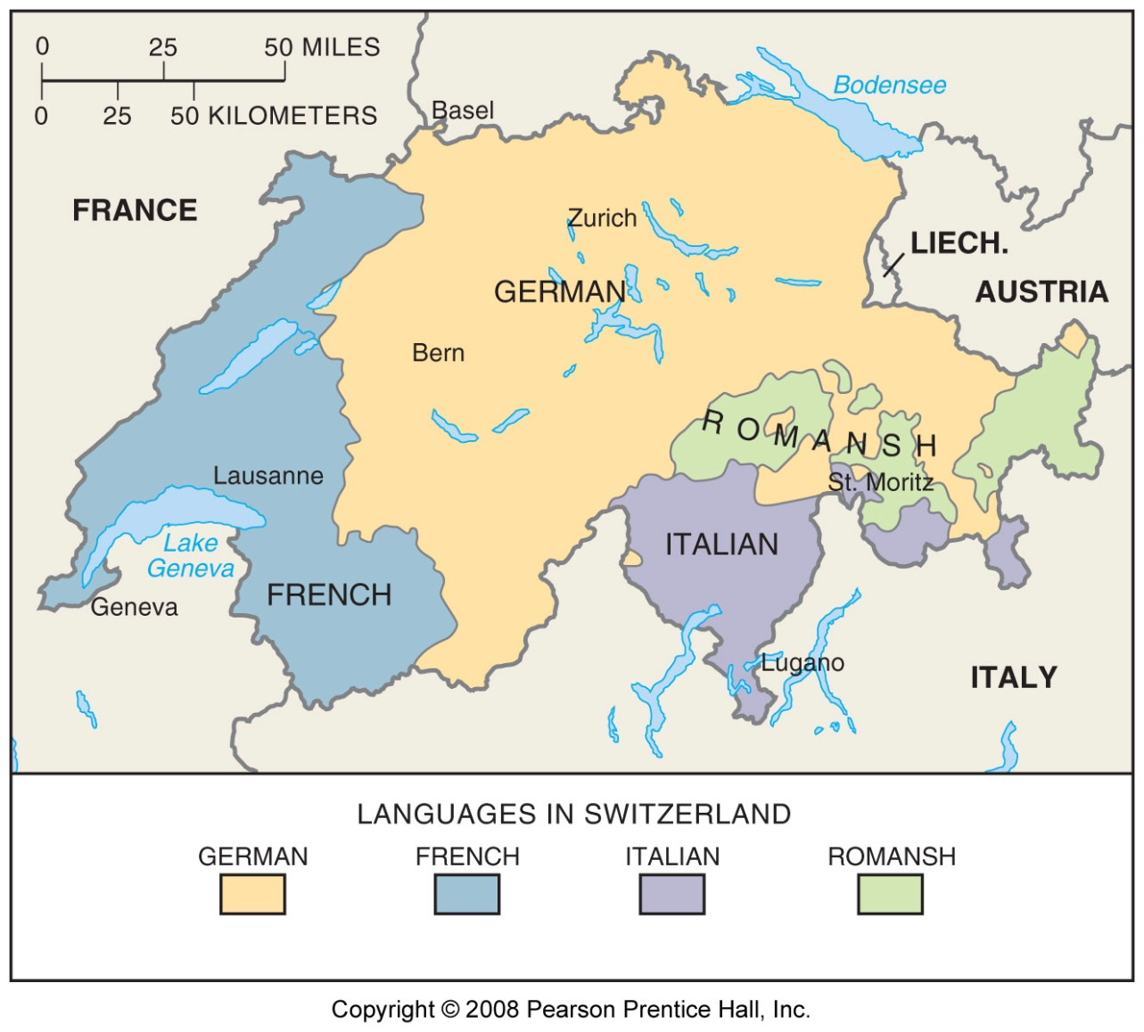
Language Areas in Switzerland
Fig. 5-17: Switzerland remains peaceful with four official languages and a decentralized government structure.

Slide 12
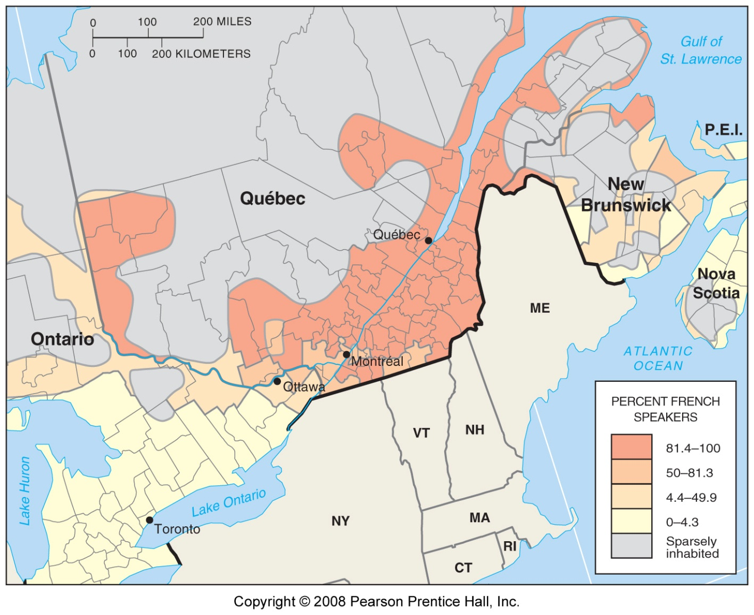
French-English Boundary in Canada
Fig. 5-18: Although Canada is bilingual, French speakers are concentrated in the province of Quebec, where 80% of the population speaks French.

Slide 13
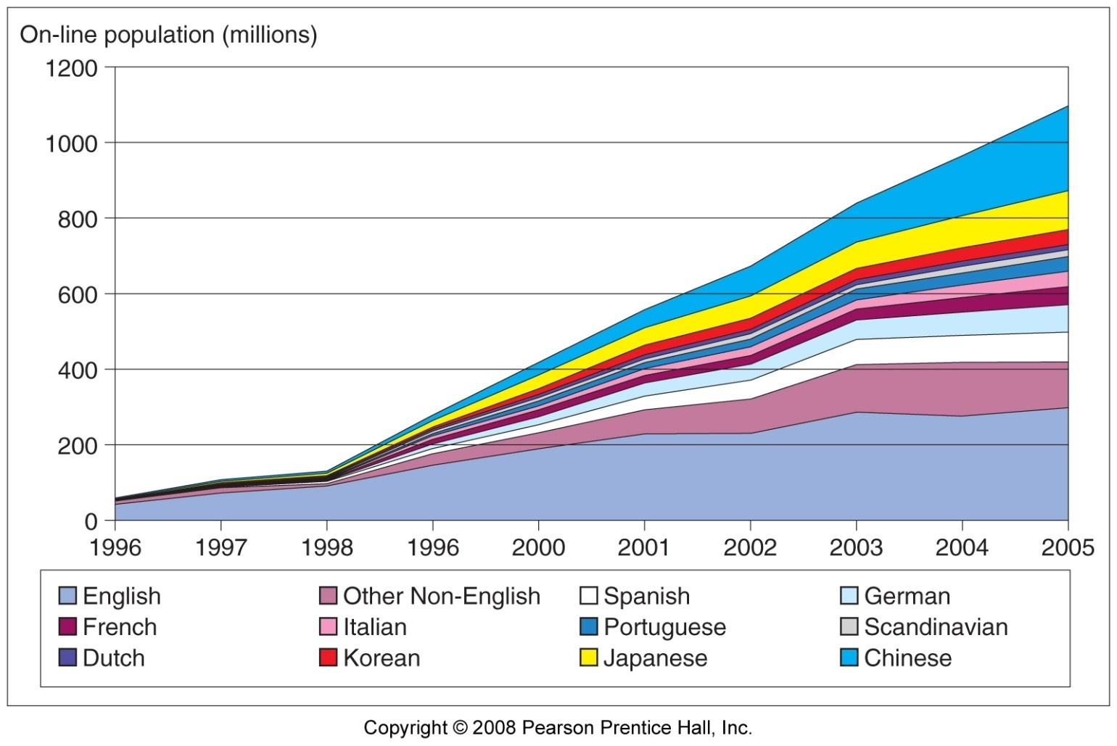
Online Population, 1996 - 2005
Fig. 5-1.1: English is still the largest language on the internet, but there has been rapid growth in many others, especially Chinese.

Slide 14
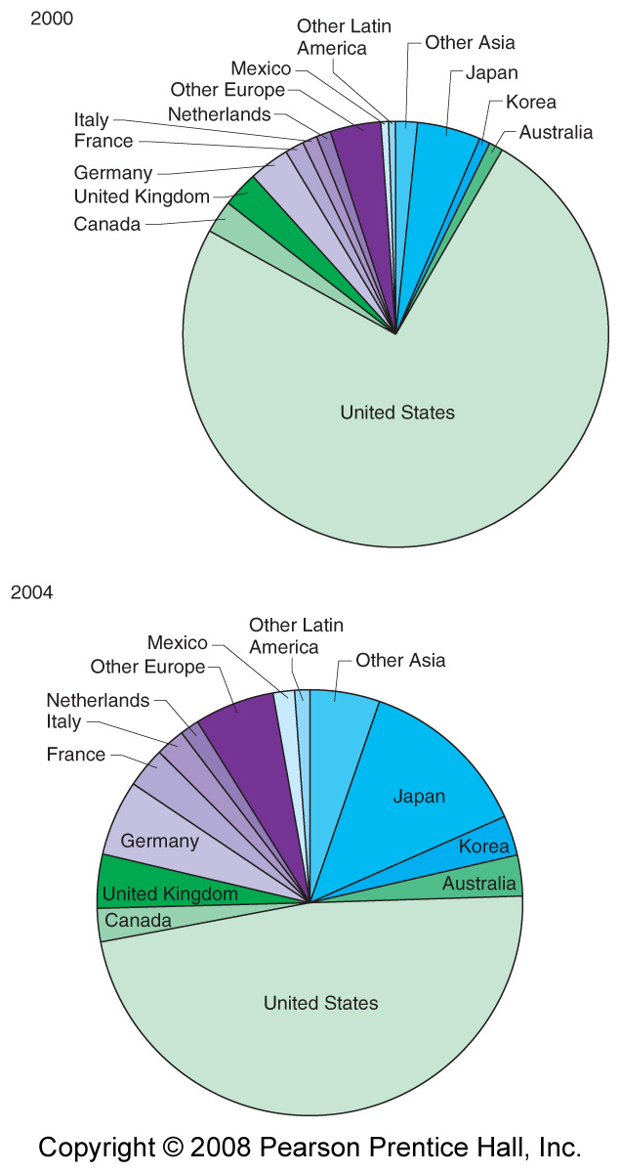
E-Commerce Languages
2000 & 2004
Fig 5-1.2: English and English-speaking countries still dominate e-commerce, but other languages are growing rapidly.

Slide 15
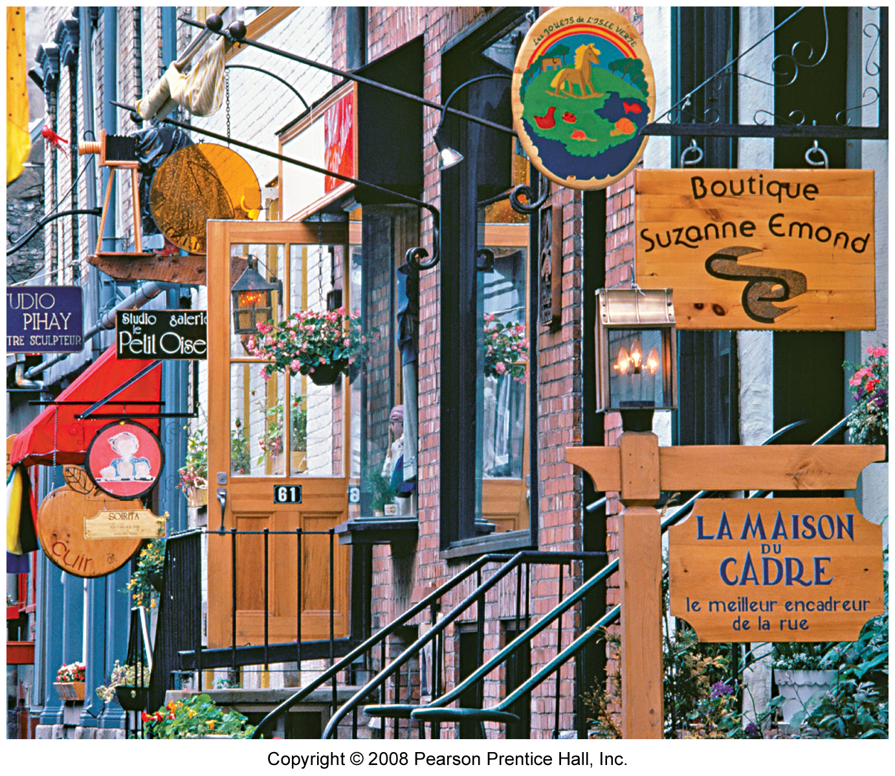
French Signs in Québec City

Slide 16
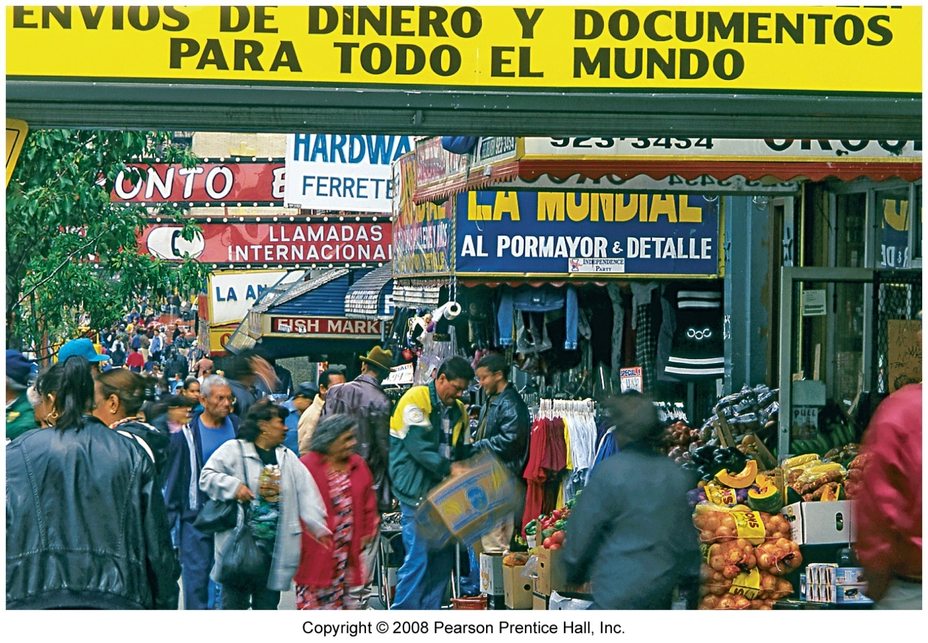
Spanish Signs in New York City

