Slide 1
POPULATION & MIGRATION
AP HuG
Unit 2 (Chapters 2 & 3)

Slide 2
Distribution of World Population
POPULATION CONCENTRATIONS
Clusters
The four largest population clusters [East Asia, South Asia, Southeast Asia, Western Europe]
Other population clusters [W. Hemisphere, West Africa]
Sparsely populated regions
Dry lands – 20% too dry to farm; contain natural resources?
Wet lands – near equator b/t 20° north & south latitude; large amounts of rainfall
Cold lands – covered with ice or permafrost; unsuitable
High lands – mountains are steep, snow covered

Slide 3
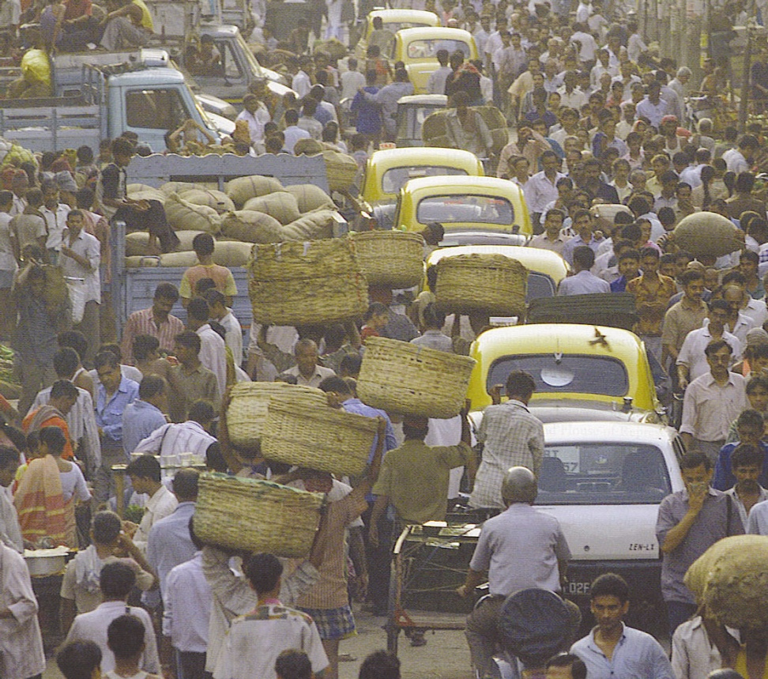
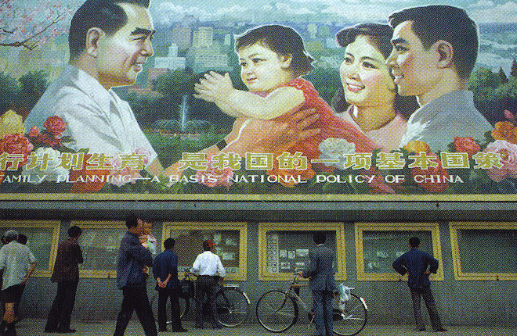
Asia
India has reached 1 billion and rising.
China imposed 1 child policy in the 1980s and growth rate dropped from 1.2% to 1% by late 1990s, but has 1.3 billion.
East Asia as a whole has a growth rate of .9% which is half the rate of 20 years ago.
Notes:
Top Kolkata, India street scene
Bottom-China’s One Child Policy Poster

Slide 4
East Asia
China, South Korea, North Korea, Japan
1.5 billion people (1/4 of the world’s population)
1.3 billion in China alone!!!
Eastern 1/3 of the country
Favorable climate conditions for food growth and transportation routes
West dominated by (a high) Tibetan Plateau
Rest of the country very mountainous

Slide 5
South Asia
India, Pakistan, Bangladesh
Population growth is outpacing policies to reduce growth
Within the next 50 years, India on pace to pass China as the world’s most populated country
Pakistan & Bangladesh also among top 10 most populated countries of the world

Slide 6
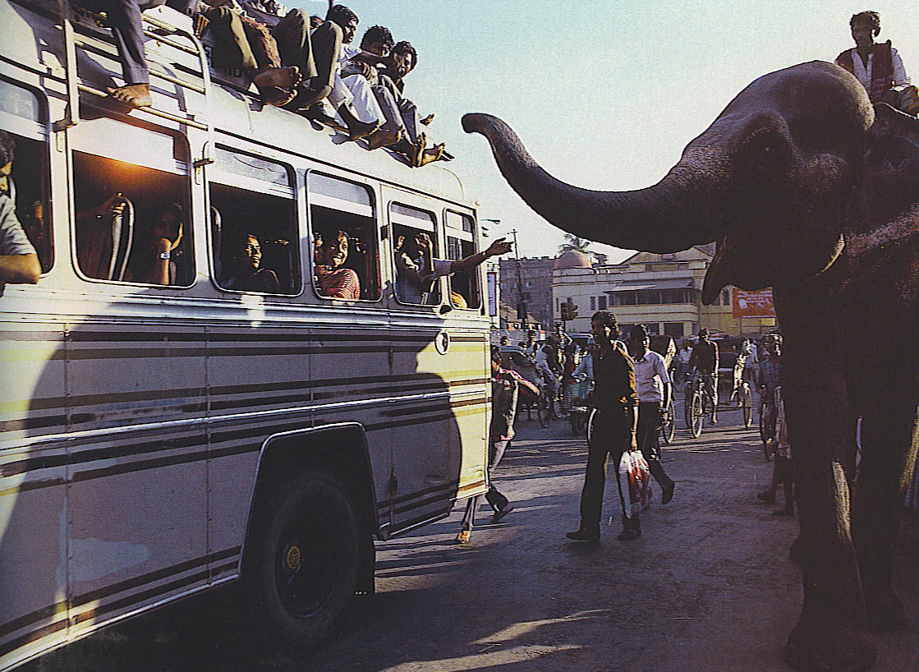
Major Population Concentrations
South Asia-the 2nd major population cluster.
Like East Asia there are finger-like extension of dense pop. that follows the Ganges and Indus rivers.
There are 1.5 billion in South Asia and India recently passed the 1 billion mark.
Bangladesh (size of Iowa) with 141 million.

Slide 7
Notes:
Street scene in Kolkata, India

Slide 8
Southeast Asia
Vietnam, Phillipines, Malaysia, Indonesia, and Thailand
Vietnam one of the fastest growing nations of the world.

Slide 9
Western & Central Europe
Large cities such as London, Paris, Moscow
Mostly urbanized unlike East Asia & South Asia
Due to subsistence agriculture & rural economies

Slide 10
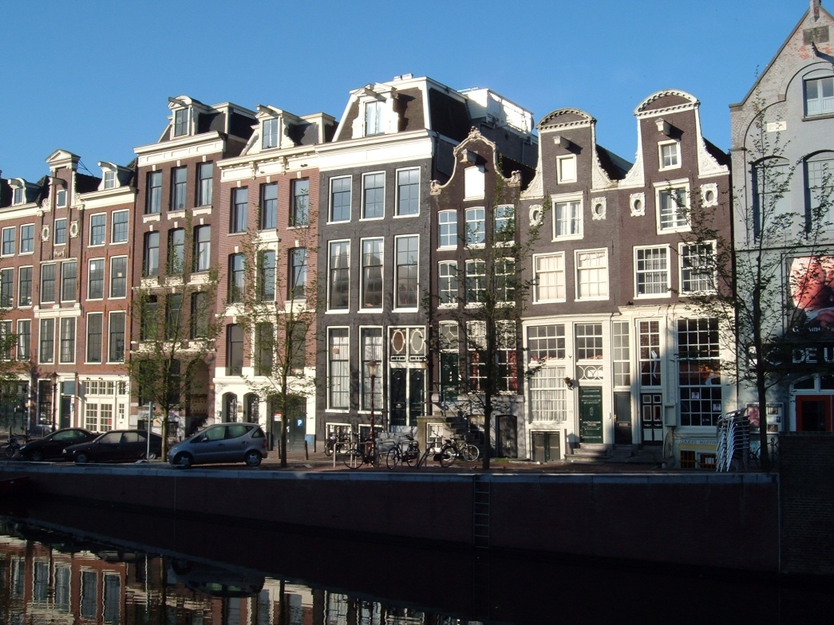
Major Population Concentrations
Europe-the 3rd in population with 700 million.
Europe is very urbanized with 75% to 90% living in cities.
Europe’s population distribution is not closely tied to terrain, but more closely tied to coal fields.
Population density varies from the highest in the Netherlands to very low in Iceland.
Closely spaced houses in
Amsterdam, Netherlands

Slide 11
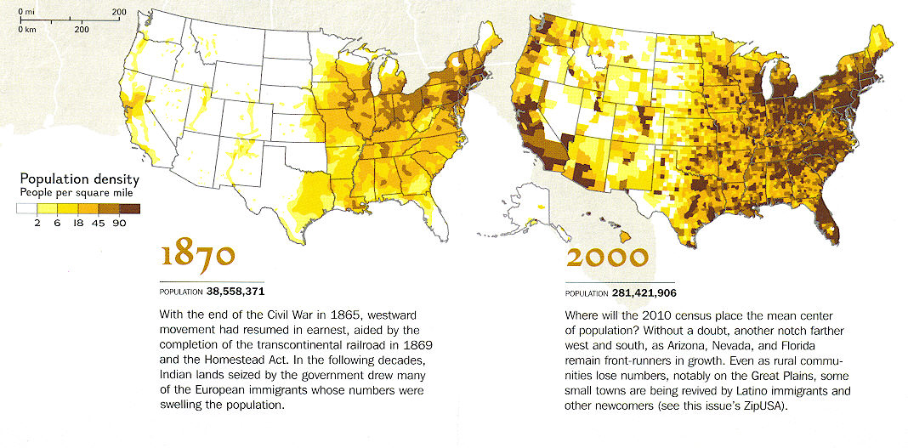
United States Population Distribution

Slide 12
World Population Cartogram
Fig. 2-1: This cartogram displays countries by the size of their population rather than their land area. (Only countries with 50 million or more people are named.)

Slide 13
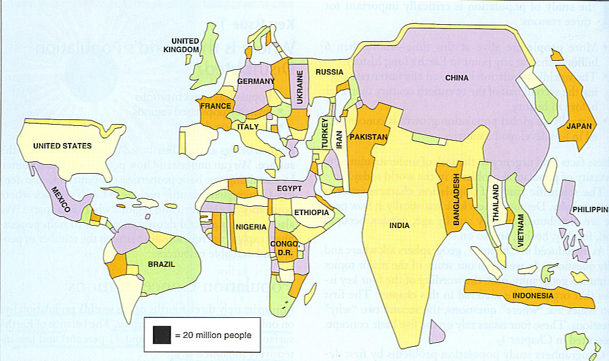
World Population Cartogram
Countries named have at least 50 million

Slide 14
Measures of Population Density

Slide 15
World Population Growth 1950 - 2005
Fig. 2-6: Total world population increased from 2.5 to over 6 billion in slightly over 50 years. The natural increase rate peaked in the early 1960s and has declined since, but the number of people added each year did not peak until 1990.

