Slide 1
POPULATION & MIGRATION
AP HuG
Unit 2 (Chapters 2 & 3)

Slide 2
Will the World Face an Overpopulation Problem?
Thomas Malthus
Argued world’s rate of population increase was far outrunning development of food supplies
Population increased geometrically, whereas food supply increased arithmetically
Neo-Malthusians
Medical technology resulted in gap between population growth & resources widening in some countries
World population growth surpassing a variety of resources which will lead to war & civil violence in people’s desperate search for food, etc

Slide 3
Overpopulation Problem
Critics of Malthus
Possibilists, Contemporary analysts, Marxists, Economic, Political leaders
Declining birth rates
Malthus theory & reality
Food production increased more rapidly than he projected
Population increased at a slower rate; NIR declined
Reasons for declining birth rates
Economic development
Distribution of contraceptives

Slide 4
Food & Population, 1950-2000 Malthus vs. Actual Trends
Fig. 2-20: Malthus predicted population would grow faster than food production, but food production actually expanded faster than population in the 2nd half of the 20th century.

Slide 5
Variations in Population Growth
The Demographic Transition [4 stages]
Low growth (high birth and high death rates produce no long-term growth)
agricultural revolution allowed for more people to survive
***no country here anymore (most people previously depended on hunting & gathering)
High growth (CDR decreasing, CBR stable to high)
Industrial revolution spurs movement into stage
Medical revolution pushed LDCs into stage in late 20th century
Moderate growth (Decreasing) (CBR begins to drop sharply, CDR continues to decline as CBR stays higher than CDR)
People decide to have fewer offspring => decline in mortality & IMR; economic changes (work in cities)
Gap narrows between CBR and CDR
Low growth (low birth and low death rates produce no long term growth…possibly a decrease)
CBR = CDR & NIR nears zero (0) => Zero population growth (ZPG)

Slide 6
The Demographic Transition
Fig. 2-13: The demographic transition consists of four stages, which move from high birth and death rates, to declines first in death rates then in birth rates, and finally to a stage of low birth and death rates. Population growth is most rapid in the second stage.

Slide 7
The Classic Demographic Transition
Stage 1
Stage 2
Stage 3
Stage 4
Birth rate
Natural
increase
Death rate
Time
Note: Natural increase is produced from the excess of births over deaths.
Notes:
This chart explains the typical changes in the birth rate and death rate that happen as a country industrializes (including the U.S.).
It models the classic demographic transition. This shift occurred throughout Europe, North America, and a number of other areas in the 19th and early 20th centuries, and started in many developing countries in the middle of the 20th century.
Stage 1: The trend of high birth and death rates (and minimal population growth)
Stage 2: Starts when the death rate begins to drop for years, and often decades, until the beginning of its stabilization at a new, low level. (In Europe, this stage happened because of improved health and living conditions and marked beginning a period of rapid population growth.)
Stage 3: Next the birth rate falls to about the same, low level as the death rate.
Stage 4: With birth and death rates at similar low levels, the equilibrium of slow population growth is regained.
[FYI - Declines in the birth rate around the world have also become steeper due to the widespread availability of contraceptives in the last half of the 20th Century. In 1960 10% of married women worldwide had access to family planning. By 2003 60% of married women had access to family planning. (PRB, “Transitions in World Population,” Population Bulletin, p. 8)]

Slide 8
Demographic Transition in England
Fig. 2-14: England was one of the first countries to experience rapid population growth in the mid-eighteenth century, when it entered stage 2 of the demographic transition.

Slide 9
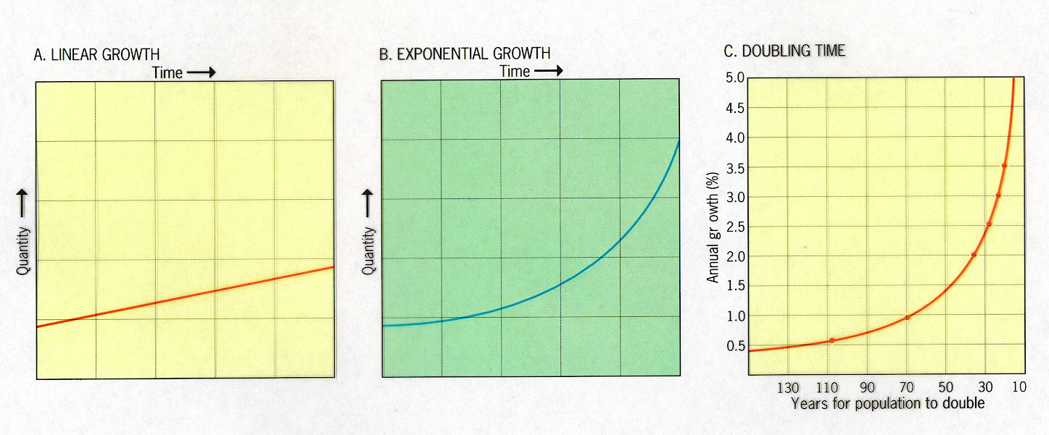
80 million people added to the world pop. each year.
Demographers estimate growth will stabilize in the 21st cent.
Doubling time-the number of years needed to double a population-divide the % of increase by 70 to get doubling time in years.
Notes:
Food production is linear or arithmetic in growth
Population is exponential or geometric in growth
In 1995 the US growth rate was .7% which gives us a doubling time of 98 years.
Nigeria with a growth rate of 3% will double in just 20 years.
Africa’s growth rate up from 2.4% to 2.8% despite AIDS epidemic, the fastest growth rate in the world.
In Africa and in the Muslim realm cultural traditions and constricted opportunities for women contribute to the rapid population growth rate.
Doubling time-divide the % of increase by 70 to get the doubling time in years

Slide 10
Distribution of World Population Growth
Natural Increase
Crude Birth Rate (CBR) – total # of live births per year for every 1,000 people alive
Crude Death Rate (CDR) – total # of deaths per year for every 1,000 people alive
Natural Increase Rate (NIR) - % by which population grows in a year [(CBR-CDR)/10 = NIR]…natural=excludes migration
High base population means small changes in NIR have dramatic effect
Doubling Time - # of years needed to double population assuming constant rate of natural increase
Virtually 100% of natural increase clustered in LDCs

Slide 11
Distribution of World Population Growth
Fertility
Total Fertility Rate – average number of children a woman will have throughout her child-bearing years
Vary between LDCs & MDCS
2.7 for world as whole
Mortality
Infant Mortality Rate – annual # of deaths of infants compared w/ total live births
Higher rates in poorer countries; reflects country’s health-care system
Life expectancy – measures the average # of years a newborn infant can expect to live at current mortality levels

Slide 12
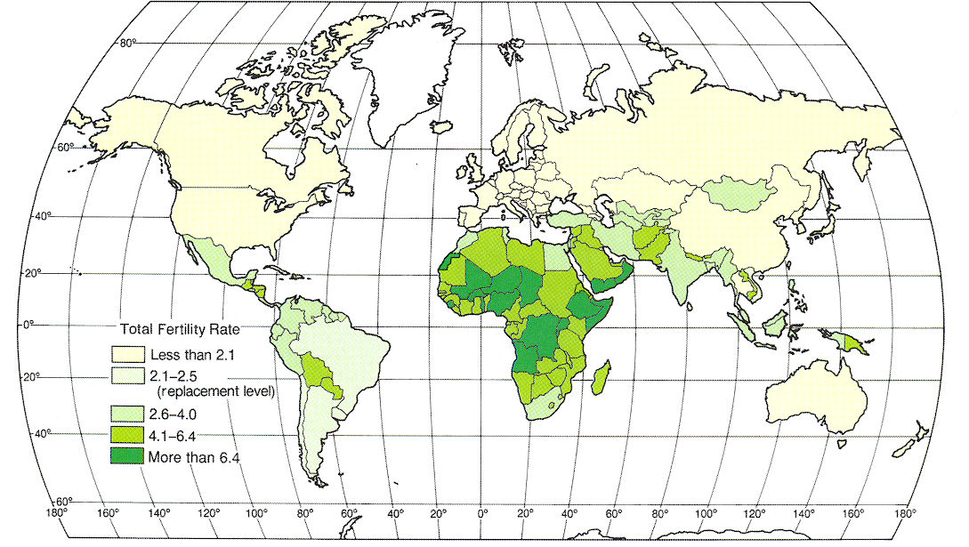
Total Fertility Rate (TFR) of 2.1 to 2.5 children per
woman is considered “replacement level.”
Notes:
TFR is the average number of children that would be born to each woman if during her child-bearing years, she bore children at the same rate as women of those ages actually did in a given year. It is age-adjusted, thus 2 nations with identical birth rates may have quite different fertility rates and prospects for growth.

Slide 13
Natural Increase Rates
Fig. 2-7: The natural increase rate (NIR) is the percentage growth or decline in the population of a country per year (not including net migration). Countries in Africa and Southwest Asia have the highest current rates, while Russia and some European countries have negative rates.

Slide 14
Crude Birth Rates
Fig. 2-8: The crude birth rate (CBR) is the total number of births in a country per 1000 population per year. The lowest rates are in Europe, and the highest rates are in Africa and several Asian countries.

Slide 15
Total Fertility Rates
Fig. 2-9: The Total fertility rate (TFR) is the number of children an average woman in a society will have through her childbearing years. The lowest rates are in Europe, and the highest are in Africa and parts of the Middle East.

Slide 16
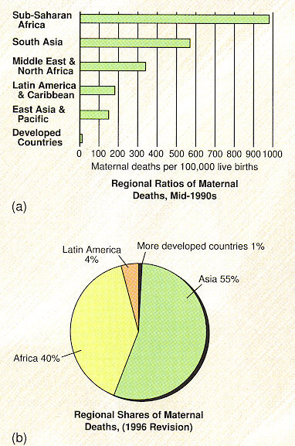
Maternal mortality ratio is the greatest health disparity between the developed and developing countries.
The World Health Organization reports that 600,000 women die each year from complications of pregnancy.
Social, cultural and economic barriers prevent women in the developing countries from receiving proper health care.
Notes:
Issues facing pregnant women in the developing world are malnutrition, anemia, lack of access to maternal health care, pregnancy at a young age when the body is not fully mature. Women are considered expendable in parts of the world where they have low status.

Slide 17
Infant Mortality Rates
Fig. 2-10: The infant mortality rate is the number of infant deaths per 1000 live births per year. The highest infant mortality rates are found in some of the poorest countries of Africa and Asia.

Slide 18
Life Expectancy at birth
Fig. 2-11: Life expectancy at birth is the average number of years a newborn infant can expect to live. The highest life expectancies are generally in the wealthiest countries, and the lowest in the poorest countries.

Slide 19
Crude Death Rates
Fig. 2-12: The crude death rate (CDR) is the total number of deaths in a country per 1000 population per year. Because wealthy countries are in a late stage of the Demographic Transition, they often have a higher CDR than poorer countries.

Slide 20
Crude Birth Rate Decline, 1980-2005
Fig. 2-21: Crude birth rates declined in most countries during the 1980s and 1990s (though the absolute number of births per year increased from about 120 to 130 million).

Slide 21
Use of Family Planning
Fig. 2-22: Both the extent of family planning use and the methods used vary widely by country and culture.

Slide 22
Women Using Family Planning

Slide 23
Family Planning Methods used in three countries

