Slide 1
POPULATION & MIGRATION
AP HuG
Unit 2 (Chapters 2 & 3)

Slide 2
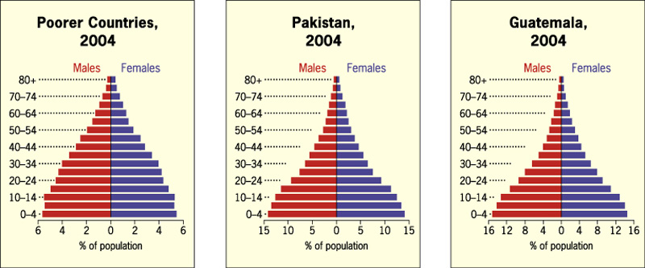
Population Pyramids –
Charts that show the percentages of each age group in the total population, divided by gender.
For poorer countries, the chart is shaped like a pyramid. Infant mortality rates are high, life expectancy is shorter.

Slide 3
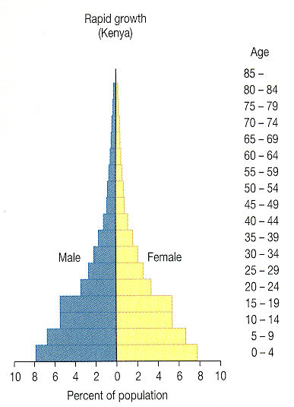
Population Pyramids-display a country’s population in a bar graph form.
Each 5 year group with the youngest 0-4 years old at the base of the pyramid are called cohorts.
Males are shown on the left side and females are shown on the right.
A wide-based pyramid indicates a country in Stage 2 of the Demographic transition.

Slide 4
Population Pyramids
Charts that show the percentages of each age group in the total population, divided by gender.
For wealthier countries, the chart is shaped like a lopsided vase. Population is aging, TFRs are declining.

Slide 5
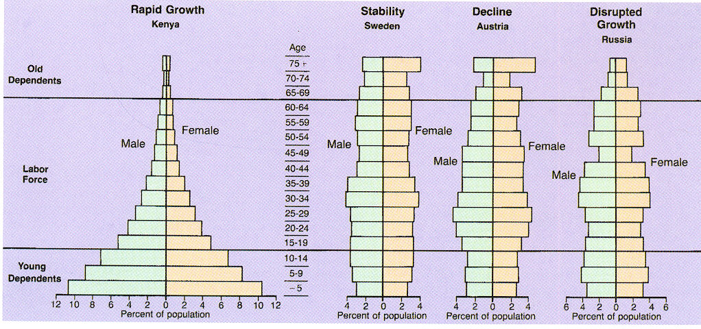
Four Patterns of Population Structure
Each nation faces different problems due to a large base with many young or negative growth.
Notes:
Kenya will face many employment problems when the bottom cohort is old enough to work.
Austria’s negative growth means a future with fewer workers to support social services.
Russia’s 1992 pyramid shows the sharp decline in births during WW II as the “pinching” of 45-49 cohort. Also note the large deficits of men above 65 due to the heavy male mortality during the World Wars

Slide 6
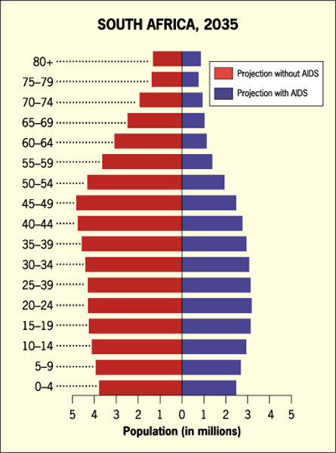
Affect of AIDS on population pyramid for South Africa.
Predicted population for 2035, without and with AIDS.
With AIDS, looks like a population “chimney.”

Slide 7
Population Pyramids in U.S. cities
Fig. 2-16: Population pyramids can vary greatly with different fertility rates (Laredo vs. Honolulu), or among military bases (Unalaska), college towns (Lawrence), and retirement communities (Naples).

Slide 8
Rapid Growth in Cape Verde
Fig. 2-17: Cape Verde, which entered stage 2 of the demographic transition in about 1950, is experiencing rapid population growth. Its population history reflects the impacts of famines and out-migration.

Slide 9
Moderate Growth in Chile
Fig. 2-18: Chile entered stage 2 of the demographic transition in the 1930s, and it entered stage 3 in the 1960s.

Slide 10
Low Growth in Denmark
Fig. 2-19: Denmark has been in stage 4 of the demographic transition since the 1970s, with little population growth since then. Its population pyramid shows increasing numbers of elderly and few children.

Slide 11
Cholera in London, 1854
Fig. 2-23: By mapping the distribution of cholera cases and water pumps in Soho, London, Dr. John Snow identified the source of the water-borne epidemic.

Slide 12
Tuberculosis Death Rates
Fig. 2-24: The tuberculosis death rate is good indicator of a country’s ability to invest in health care. TB is still one of the world’s largest infectious disease killers.

Slide 13
Avian Flu, 2003 - 2006
Fig. 2-25: The first cases of avian flu in this outbreak were reported in Southeast Asia.

Slide 14
HIV/AIDS Prevalence Rates, 2005
Fig. 2-26: The highest HIV infection rates are in sub-Saharan Africa. India and China have large numbers of cases, but lower infection rates at present.

