Slide 1
AP HuG
Unit 1 Geography: It’s Nature & Perspectives (Basic Concepts)

Slide 2
What Do You Call It?
Most people would call this area the Middle East. But when you think about it geographically, what is it the Middle East to?

Slide 3
Can this be the Middle East too?

Slide 4
Is This the Far East?

Slide 5
Or Is This the Far East?

Slide 6
The terms “Middle East” and “Far East” were in relation to Western Europe (mainly the British Empire) during the 18th and 19th centuries. The correct geographic terms for these places are Southwest Asia and East Asia.
Southwest Asia
East Asia

Slide 7
THE FIVE THEMES OF GEOGRAPHY
Location
Place
Human-Environment Interaction
Movement
Regions

Slide 8
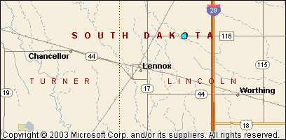
LOCATION
Where are we?
Absolute Location
  A latitude and longitude (global location) or a street address (local location).
      Paris France is 48º North Latitude and 2º East Longitude.
      The White House is located at 1600 Pennsylvania Ave.
Relative Location
  Described by landmarks, time, direction or distance. From one place to another.
      Go 1 mile west on main street and turn left for 1 block.
You are Here

Slide 9
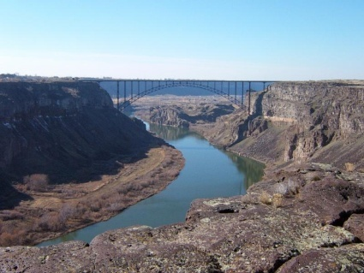
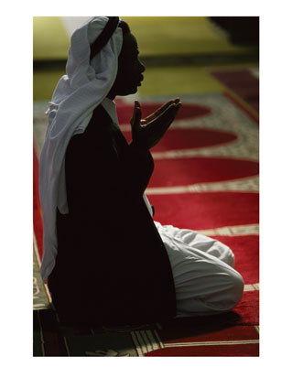
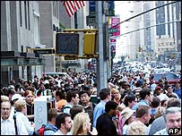

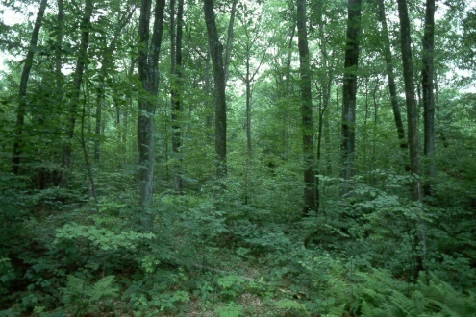
PLACE
What is it like there, what kind of place is it?
Human Characteristics
    What are the main languages, customs, and beliefs.
    How many people live, work, and visit a place.
Physical Characteristics
    Landforms (mountains, rivers, etc.), climate, vegitation, wildlife, soil, etc.

Slide 10
Uniqueness of Places & Regions
Place – location→ describes feature’s place on Earth
4 Ways to Identify:
  Place names - toponym
  Site – physical character of a place; essential in selecting locations for settlement; can be modified
  Situation – location of a place relative to other places; valuable because (1) can find unfamiliar place, (2) understand importance of location (accessibility)
  Mathematical location – precise description
    Meridians (longitude) – arcs drawn between North & South; human creation (John Harrison); 15° = 1 hr of travel; Greenwich Mean Time & International Date Line
    Parallels (latitude) – circles drawn around globe; measured by length of daylight & position of Sun & starts; 0° = largest circumference

Slide 11
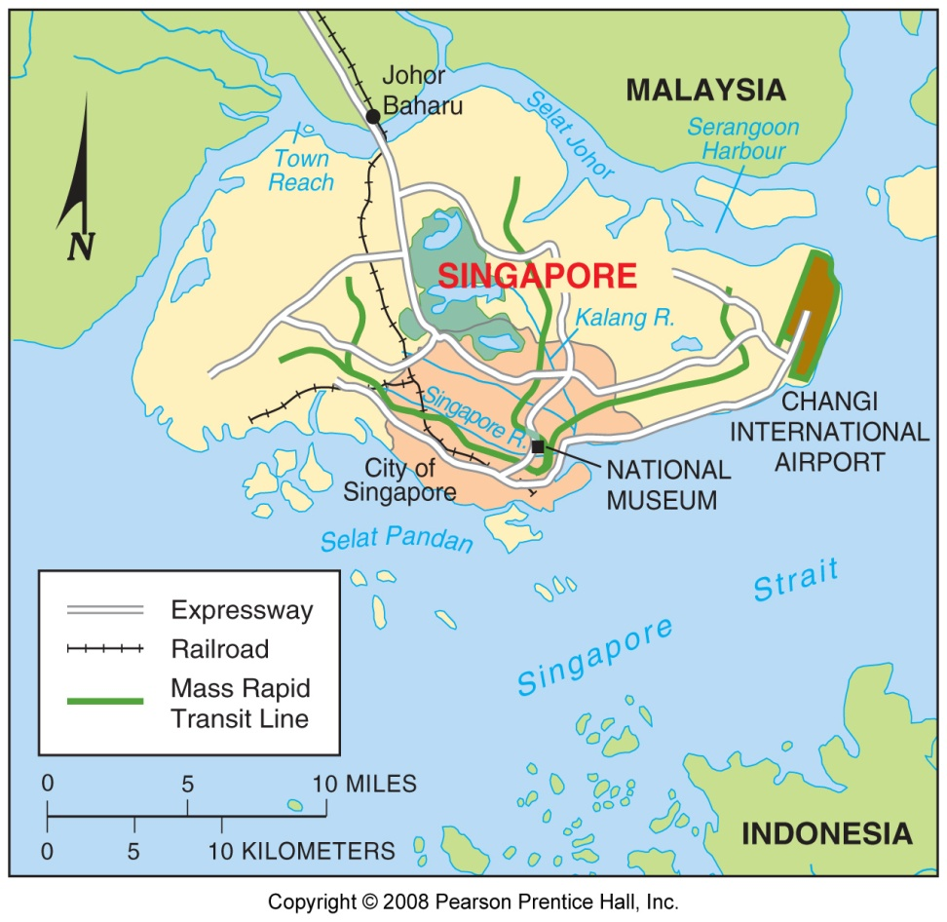
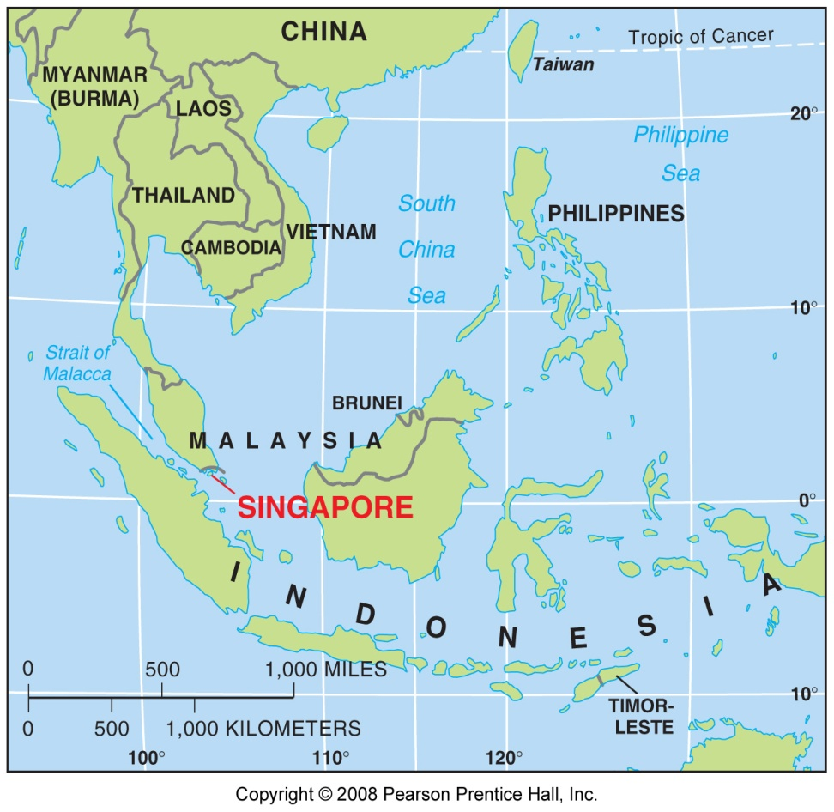
Situation: Singapore
Fig. 1-7: Singapore is situated at a key location for international trade.

Slide 12
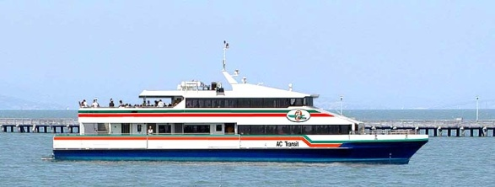

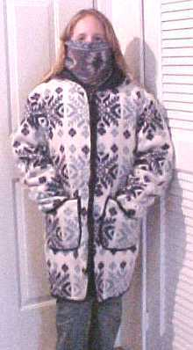
HUMAN-ENVIRONMENT INTERACTION
How do humans and the environment affect each other?
  We depend on it.
    People depend on the Tennessee River for water and transportation.
  We modify it.
    People modify our environment by
    heating and cooling buildings for comfort.
  We adapt to it.
    We adapt to the environment by wearing
    clothing suitable for summer (shorts) and
    winter (coats), rain and shine.

Slide 13
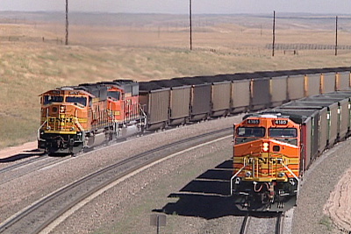



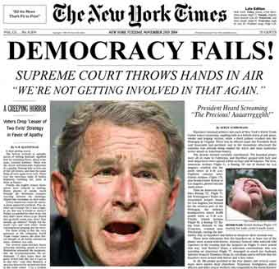
MOVEMENT
How are people, goods, ideas moved from place to place?
  Human Movement
    Trucks, Trains, Planes
  Information Movement
    Phones, computer (email), mail
  Idea Movement
    How do fads move from place to place?
    TV, Radio, Magazines

Slide 14
Uniqueness of Places & Regions
Region – area of Earth defined by one or more distinctive characteristics
  Cultural landscape
    combination of cultural, economic, and physical features (Carl Sauer)
    region gains uniqueness from possessing combination of humans & environmental characteristics
    fundamental principal – people are the most important agents of change on Earth’s surface
  Spatial Association – region can encompass area of widely varying scale causing different conclusions
    Cultural, economic, environmental factors w/ similar distributions have spatial association

Slide 15
REGIONS
How are Regions similar to and different from other places?
  Formal Regions (Uniform)
    Regions defined by governmental or administrative boundaries (States, Countries, Cities)
    Regions defined by similar characteristics (Corn Belt, Rocky Mountain region, Chinatown).
  Functional Regions (Nodal)
    Regions defined by a function (newspaper service area, cell phone coverage area).
  Vernacular Regions (Perceptual)
    Regions defined by peoples perception (middle east, the south, etc.)

Slide 16
3 TYPES OF REGIONS
FORMAL (Uniform/Homogeneous)
  Area within which everyone shares in common one or more distinctive characteristics
  Selected characteristic is present throughout; some easy to identify
  Predominant rather than universal
  Help explain broad global or national patterns
FUNCTIONAL (Nodal)
  Organized around a node or focal point; characteristic chosen dominates at central focus & diminishes in importance outward
  Use to display information about economic areas
  Technology breaking down traditional functional regions
VERNACULAR (Perceptual)
  Place that people believe exists as part of their cultural identity; emerge from people’s informal sense of place rather than scientific model
  Mental Map – internal representation

Slide 17
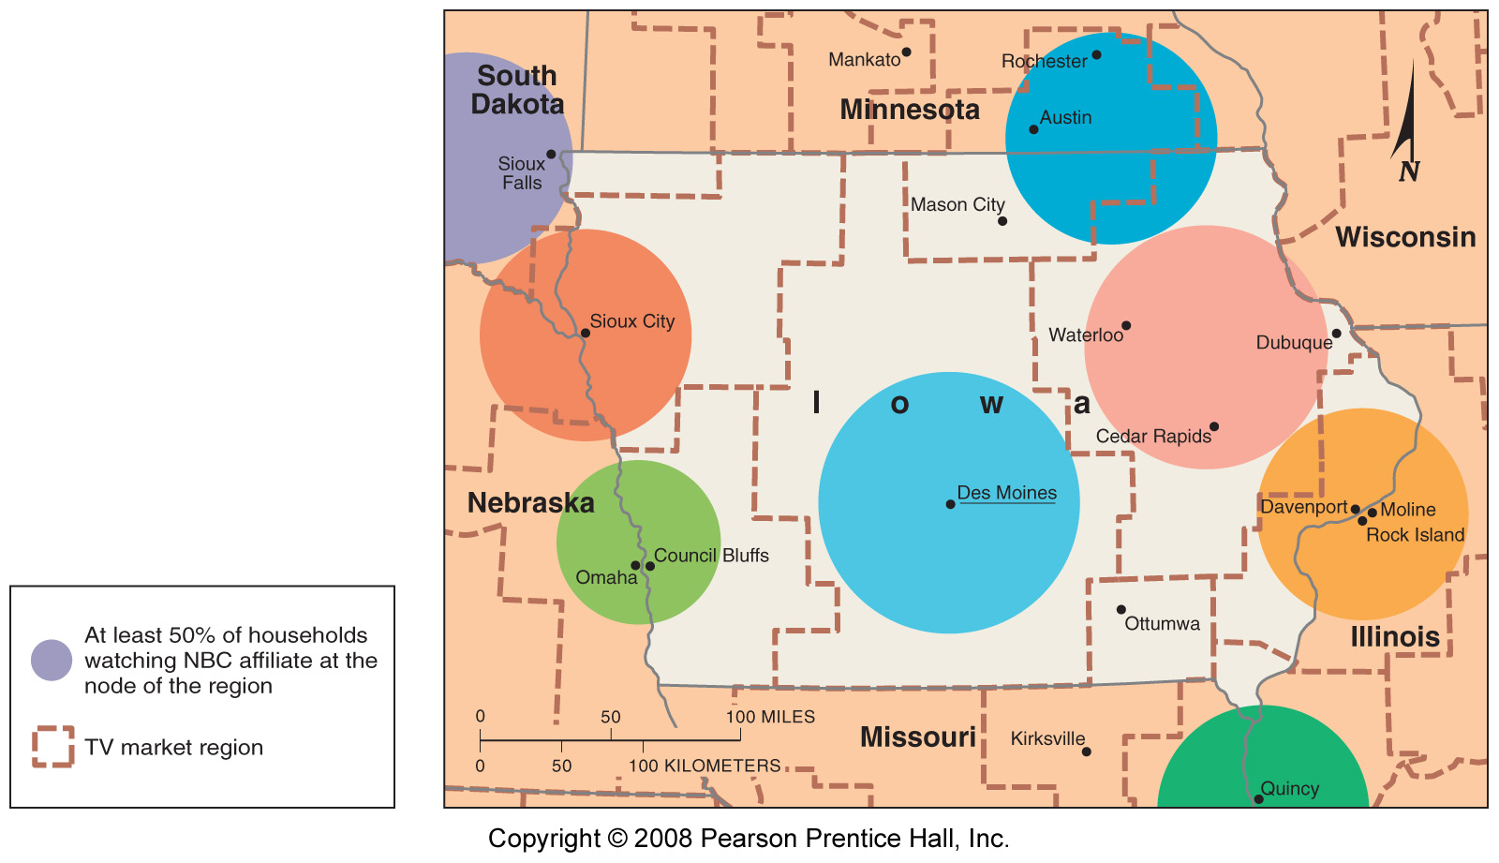
Formal and Functional Regions
Fig. 1-11: The state of Iowa is an example of a formal region; the areas of influence of various television stations are examples of functional regions.

Slide 18
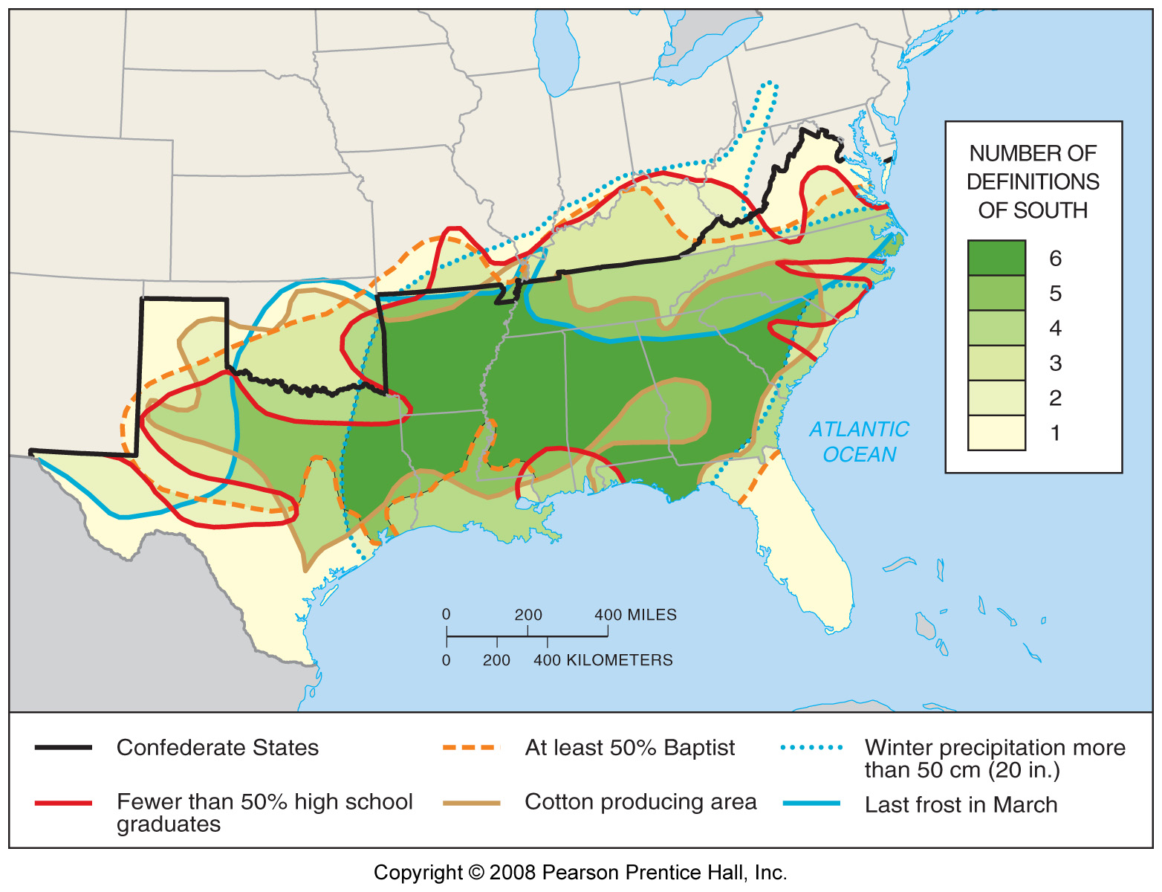
Vernacular Regions
Fig. 1-12: A number of features are often used to define the South as a vernacular region, each of which identifies somewhat different boundaries.

Slide 19
How Geographers Address Location
Maps
  Early mapmaking
    Babylonians – earliest surviving on clay tablet about 2300BC
    Eratosthenes – 1st to use “geography”; accepted earth as spherical; correctly divided Earth into 5 climatic regions
    Ptolemy – used info from merchants & sailors; codified basic principles of mapmaking
    Age of Exploration & Discovery – Ptolemy rediscovered & translated
    Mercator & Ortelius – created more accurate maps
    By 17th century, accurately displayed the outline of most continents & positions of oceans

Slide 20
MAP PROJECTION
Scientific method of transferring locations on Earth’s surface to a flat map
4 types of problems of distortion (especially severe on world maps)
  Shape – more elongated than in reality
  Distance – may be increased or decreased
  Relative Size – one area may appear larger than another on a map but is in reality smaller
  Direction – from one place to another can be distorted
Types of projection:
  Equal area – minimizes distortion; problem of interruption
  Robinson – uninterrupted; allocates space for oceans, land areas smaller
  Mercator – uninterrupted; little shape distortion; area towards poles is grossly distorted (Greenland vs Africa/South America)

Slide 21
CULTURAL ECOLOGY
Geographic study of human-environment relationships
Humboldt & Ritter urged the adoption of scientific inquiry; concentrated on how physical environment caused social development => environmental determinism
Possibilism → physical environment may limit some human actions, but people have the ability to adjust to their environment
  People can choose a course of action from many alternatives in the physical environment

Slide 22
Diffusion movement of any characteristic
Relocation Diffusion
  Physical spread of cultures, ideas, & diseases through people
    Migration…..people bring culture with them (migration diffusion)
Expansion Diffusion
  Physical spread from a central node or hearth
    Hierarchical…..group spreads (usually social elite)
      The “way to dress”……the “music to listen to”
    Contagious…..usually associated with disease
      Others…..the internet
    Stimulus…..take part of an idea and spread to create a new product
      Windows operating system taken from

