Slide 1
Global Migration

Slide 2
Forced Migration: Criminals and The Atlantic Slave Trade
Convicts were often sent over to the New World for labor; Australia was originally a penal colony (place of imprisonment at a remote place)
However before 1800, 80% of those coming to the New World from the Old were from Africa (forced slavery)

Slide 3
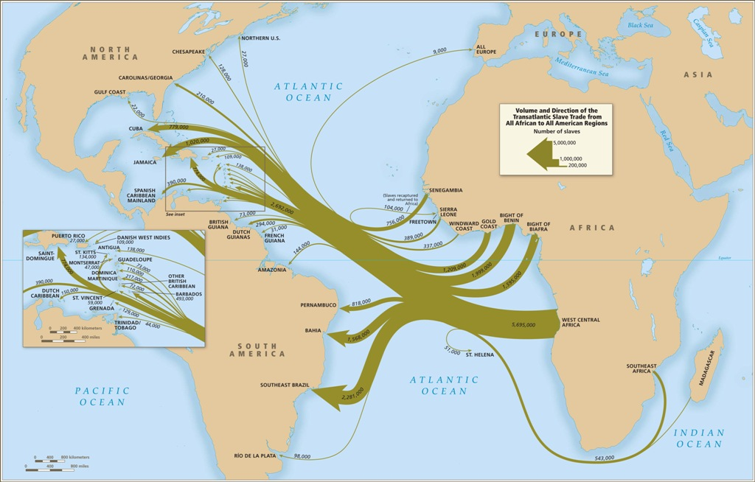

Slide 4
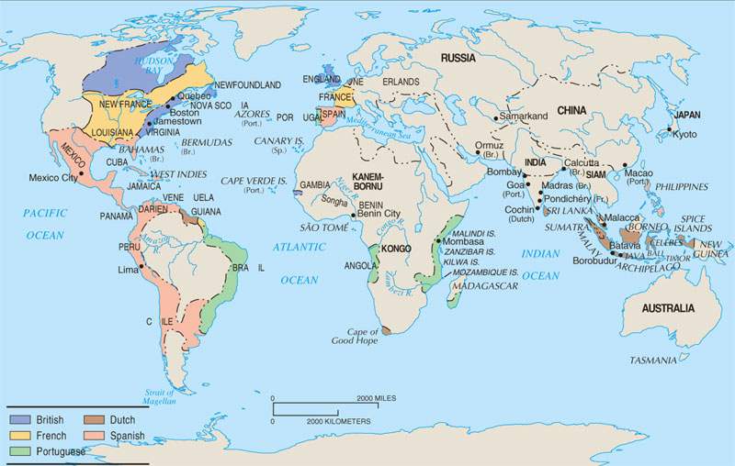
Colonialism/Imperialism
Colonies began to gain in population as people migrated from the “mother country” to the colonies… some forcibly others for better opportunities

Slide 5
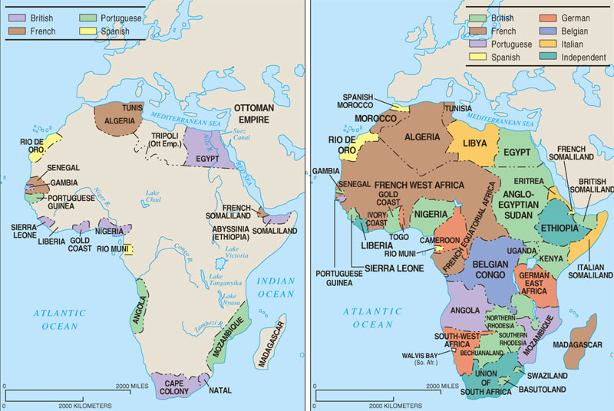
The Europeans took over the continent of Africa with Britain and France holding the most colonies

Slide 6
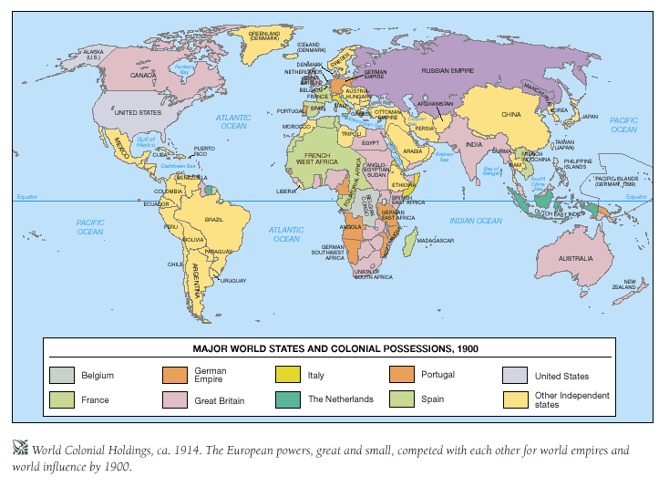
Colonialism not only brought on a great migration across the world but will lead to the diffusion of cultural, political and economic practices as well…

Slide 7
Industrial Revolution
The onset of the Industrial Revolution came a great need for workers
Many people began migrating from the rural communities into the cities for factory jobs
Many European immigrants began coming to America and provided a cheap labor force

Slide 8
Post Industrial Rev.
Came after World War II
USA experienced its Baby Boom
Many families began expanding out to the Sunbelt states of the western U.S.
Many African Americans left the Southern States to get industrial jobs in Northern region
Seen as a time of increasing international economic integration on a global scale

Slide 9
Cold War/Post Cold War
“Brain drain” people wanting to escape Communist influence began leaving Eastern Europe = Berlin Wall to separate East (communist states) to West (capitalist states)
1960-1964: The US admitted only 42% of its immigration from developing nations; Canada only 12%
However from 1985-1989 those numbers rose to 88% and 77%

Slide 10
Continue…
Fall of Soviet Union created an economic collapse and freedom to seek foreign residence
East Germans move to west
Hungary, Poland, Czech Rep., & Slovakia emerge as immigration buffer zones between more unstable places to the East and Western Europe
Poles seek work in Dutch and German agriculture, and Russians and Ukrainians work in Poland
Bulgarian Turks return to Turkey

Slide 11
Latin America
Most internal migration is from rural to urban
Massive external migration is to places like United States
Over 53% of the foreign born population in the United States comes from Latin America
(Latin America is Mexico, Central America, South America and Caribbean)

Slide 12
Latin America Continue…
After the abolishment of slavery there was a great need for workers
Many Asians came to South America as laborers; many Japanese settled in Brazil and Peru (Former Peruvian president was of Japanese ancestry)
Between 1942 & 1964 the US introduced the Bracero Program that brought 4.6 million guest workers from Mexico to work in agriculture

Slide 13
Africa
National borders, drawn by Europeans, do not reflect ethnic or tribal boundaries
Africa displays a wide range of patterns for migration: economic/ecological problems, intra-regional disparities in economic well-being, political instability, and restrictive migration policies
African international migration involves a wide range of voluntary and forced cross-border movements within the continent
Migration streams within Africa are much larger than those out of Africa, and forced migration plays a significant part

Slide 14
Some examples…
Environmental migrants – from Mauritania and Mali because of drought.
South Africa imports mine workers from Lesotho, Swaziland, and Mozambique
Civil war in Liberia
Darfur crisis in Sudan (to Chad)
Economic migrants to former colonial rulers
Fighting in Somalia→ fleeing to ME for work
Tutsi vs. Hutu people in Rwanda→ leave for neighboring countries like Tanzania & Zaire

Slide 15
Asia
Today one out of four refugees is from Afghanistan
U.S., Canada, and Australia relaxed immigration laws in 1960s and 1970s
US military presence in SE Asia. GI brides seeded networks as well as refugees: Vietnam and Philippines
Labor migrants from India and China
Contract labor to Middle East
Labor migration from Thailand, Indonesia, and Philippines to S. Korea, Taiwan, and Singapore
To Japan
Women from Philippines and Korea to work as dancers, waitresses, and hostesses
Return of South American Japanese

