Slide 1
Economics Unit 4 Notes
Business Organizations
Market Structure
Labor

Slide 2
Sole Proprietorships
A business owned by one person, known as the proprietor.
Advantages:
Be your own boss.
Make your own hours and schedule.
owner receives all the profits and has full control of the business.
Disadvantages:
May work longer hours than an employee, no “overtime”
Must make all contribution for healthcare, retirement, taxes, etc.
Must have significant start-up money.
Must have wide variety of skills.
owner has unlimited liability (personally responsible for all debts and damages from doing business).
Personal assets may be seized to pay off business debts.

Slide 3
Partnerships
A business owned and operated by two or more people.
Partners sign a legally binding agreement describing the duties of each partner, division of profits and distribution of assets at end of partnership.
Advantages:
Shared responsibility, decision making, etc.
Team up with other people that have different skills.
Disadvantages:
Must have good working relationship, trust.
both partners have unlimited liability.

Slide 4
Partnerships (cont.)
Limited partnerships are businesses in which the partners are not equal.
The general partner is fully responsible for debts of company.
Other partners contribute money or property, but have no voice in the company’s management.
The limited partners have no liability beyond their initial investment.

Slide 5
What Is a Corporation?
An organization owned by many people but treated by law as if it were a person.
Corporations can own property, pay taxes, make contracts, sue and be sued.
Corporations have a distinct existence from stockholders.

Slide 6
What Is a Corporation? (cont.)
Advantage: stockholders have limited liability, they are not personally responsible, only the business loses money and assets.
Disadvantage: corporations pay more taxes than other forms of business organizations.
To form a corporation, its founders must register with the state government, sell stock, and elect a board of directors.

Slide 7
Corporate Structure
State grants a corporate charter that allows the corporation to operate in that state.
Raise capital by selling stocks or bonds.
Common stock gives stockholders right to vote and a percentage of future profits.
Preferred stock doesn’t give voting rights, but pays a dividend.

Slide 8
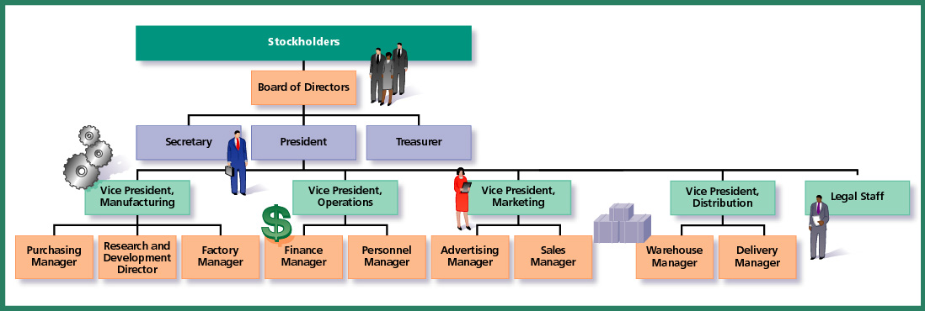
Corporate Structure (cont.)
Stockholders elect a board of directors who will supervise and control the corporation by hiring people to run the day-to-day operations of the business.

Slide 9
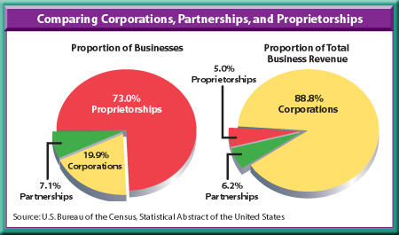
Although proprietorships make up about 73 percent of American businesses, they generate only about 5 percent of total business revenues.

Slide 10
Franchises
A contract in which a franchisor sells the right to use its name and sell its product.
The business buying it, the franchisee, pays a fee that could include a percentage of all money taken in.
Franchises often have training programs to teach the franchisee and to set the standards of business operations.
Advantages:
Name recognition, reputation, loyal customers.
Marketing – national advertising, prepared materials.
Reduced risk
You can still be the boss!
Disadvantages:
Fees, start-up costs, royalty payments, marketing fees.
Limitations - must follow specific rules, no creativity.
Risk…you can still fail!

Slide 11
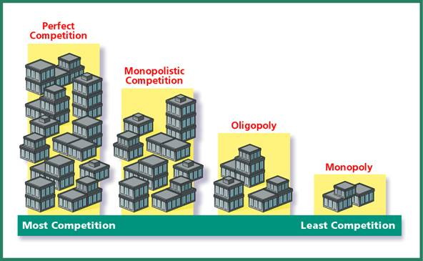
Market Structure
Market structures are a way to categorize businesses by the amount of competition they face.
Four basic market structures in the American economy are: perfect competition, monopolistic competition, oligopoly, and monopoly.

Slide 12
Conditions of Perfect Competition
Many buyers and sellers.
Products are almost identical (no product differentiation).
Easy Entry: initial investment costs are low, and the good/service is easy to learn to produce.
Sellers or buyers cannot group together to control price.
Supply and demand control the price.
“Price Takers”

Slide 13
Benefits to Society
Price will drop to a level that benefits both consumer and entrepreneur.
Economic efficiency.
Resources are used in most productive manner.
Requires no government intervention.
Adam Smith’s “invisible hand” guides producers into their most productive capacity.

Slide 14
Imperfect Competition
There are three types of imperfect competition that differ in how much competition and control over price the seller has.
All firms operating in imperfect competition reduce output (Q↓) and charge higher prices (P↑) = INEFFICIENT!
Monopolistic Competition
Oligopoly
Monopoly

Slide 15
Monopoly
Most extreme form of imperfect competition
A single seller controls the supply and price of product.
No substitutes: no competitor offers good or service that closely replaces what monopoly sells.
No entry: a competitor cannot enter the market due to government regulations, large initial investment, or ownership of raw materials.
Natural monopolies are the result of an economy of scale–which means because of its size, the company can produce the largest amount for the lowest cost.

Slide 16
Mergers
Horizontal merger is the merging of two corporations in the same business.
Vertical merger is merging of two corporations in same chain of supply.
Conglomerates are the merging of two corporations involved in at least four or more unrelated businesses.

Slide 18
Antitrust Legislation
Sherman Antitrust Act (1890) prevented new monopolies or trusts from forming and broke up existing ones.
Clayton Act (1914) sought to clarify the laws in Sherman Antitrust Act by prohibiting or limiting a specific number of business practices.
Federal government must determine whether merging of two companies will significantly lessen competition.

Slide 19
Oligopoly
Market is dominated by a few sellers.
Capital costs are high and it is difficult for new companies to enter market.
Goods/services provided by the few sellers are nearly identical.
All the companies are interdependent; change in one will affect the others.
Interdependence can lead to price wars or the illegal act of collusion or teaming up to raise prices.
Cartels are international groups that use collusion to seek monopoly power.

Slide 20
Monopolistic Competition
Numerous sellers
Easy entry into market
Differentiated product
Nonprice competition
Some price control by the seller
Advertising tries to convince consumers of the superiority of given product, enabling companies to charge more than the market price for a product

Slide 21
The Civilian Labor Force
Definition: the total number of people 16 years or older who are employed or seeking work.
NOT included in the civilian labor force: mentally or physically disabled people, prisoners, people in the armed forces, and those not looking for a paying job.

Slide 22
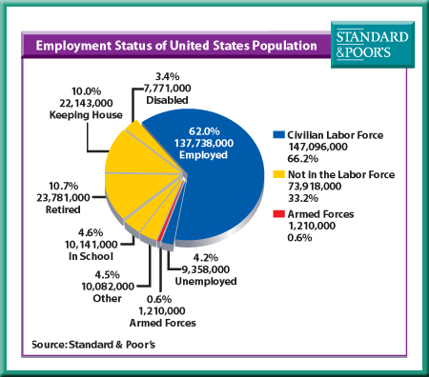
The Civilian Labor Force (cont.)

Slide 23
Categories of Workers
Blue collar: craft workers, manufacturers, and nonfarm laborers
White collar: office workers, salespeople, highly trained workers
Unskilled: no specialized training
Semiskilled: some training
Skilled: learned trade or craft
Professionals: college degrees and training
Factors that affect wages: skill, type of job, and location.

Slide 24
Development of Labor Unions
In the 1800s working conditions were terrible and unions were often illegal.
Strikes often resulted in violence between workers and the police.
The first permanent union, The American Federation of Labor (AFL) was made up of craft unions and led by Samuel Gompers.
In 1938, the Congress of Industrial Organizations (CIO) was created, and the automobile and steel industries were the first to be organized.
AFL and CIO joined forces in 1955 because they felt greater gains could be made if the craft and industrial unions worked together.

Slide 25
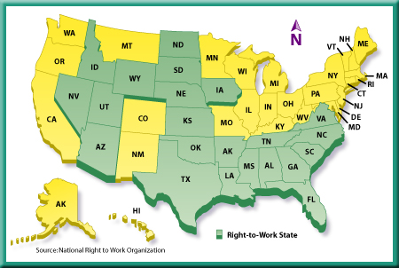
Labor Policies
Closed shops allow the company to hire only union workers; these were outlawed in 1947.
Right-to-Work Laws: prevent employers from excluding non-union workers, workers can’t be forced to join or pay union dues.

Slide 26
Collective Bargaining
Definition: the process by which unions and employers negotiate the conditions of employment.
The company wants to keep wages and benefits low to hold its labor costs down and remain competitive in the market.
The union wants to increase wages and benefits for its members as much as possible.

Slide 27
Negotiations
Labor and management meet to discuss contract issues.
Mediation takes place when labor and management cannot agree or become hostile; instead they find a neutral person to try to help them reach an agreement.
Arbitration takes place when mediation fails; labor and management then ask a third party to make a decision, agreeing to unconditionally accept that decision.

Slide 28
Strikes and Management
Picketing is when workers carry signs in front of the place of business until their needs are satisfactorily met in the contract.
Strikebreakers or scabs are people who fill in for striking workers.
Lockouts are when management prevents workers from returning to work until a new contract is signed.
Injunctions are court orders that limit picketing or prevent a strike from continuing or occurring at all.

Slide 29
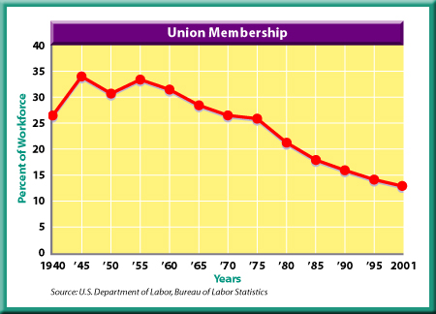
Why Have Unions Declined?
Over time, working conditions have improved so workers see little benefit to belonging to a union.
More jobs are available in white collar and service sectors; blue-collar jobs are decreasing.
Critics of unions claim increased wages given to union workers are passed on to consumers in price increases.

