Slide 1
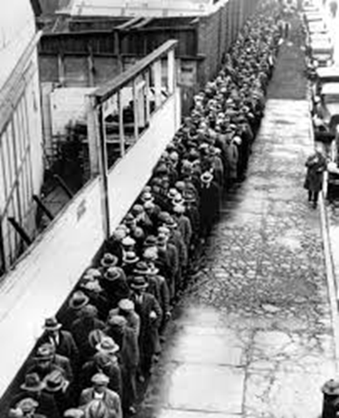
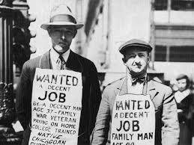
U.S. History Unit 4 Terms
The Worst of Times – The Great Depression

Slide 2
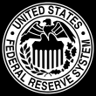
Federal Reserve
Congress created the Federal Reserve System in 1913 as the central banking organization in the United States.
The Fed is responsible for regulating banks, and stabilizing the financial system through monetary policy.
Monetary policy involves the changing rate of growth of the supply of money in circulation in order to affect the amount of credit, which affects business activity in the economy.
Most economists agree that the Fed made the Great Depression worse by increasing interest rates (which slowed economic recovery) when it should have decreased interest rates (encouraging economic growth).

Slide 3
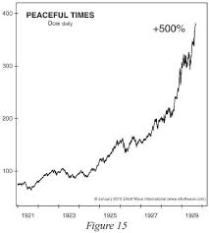
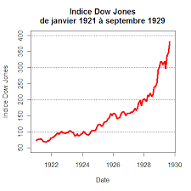
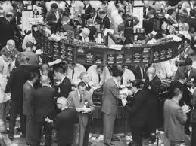
Stock Market
A method of buying and selling shares of a company.
It allows a company to raise money.
It allows businesses to go public, or raise capital for expansion.
“Buy low, sell high!” Investors make money when the value of the stock they hold increases in value before the sell it.
Stock market = stock exchange.
Notes:
A method of buying and selling shares of a company.
It allows a company to raise money.
It allows businesses to go public, or raise capital for expansion.
Stock market = stock exchange.

Slide 4
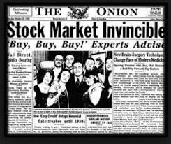
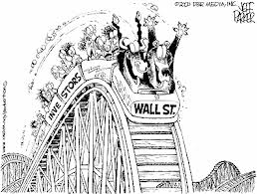
Margin
To maximize investment, investors bought on margin.
Bought with a down payment.
A $1,000 investment could get you $10,000 in stock.
Stockbroker loaned you $9,000 (commission and interest).
Margin call = full payment due.
Notes:
To maximize investment, investors bought on margin.
Bought with a down payment.
A $1,000 investment could get you $10,000 in stock.
Stockbroker loaned you $9,000 (commission and interest).
Margin call = full payment due.
As long as stock kept rising, buying on the margin was safe. Once $10,000 in stock hit $11,000, you could sell, repay the loan and interest and walk away with $1,000 profit. You have doubled your money. Bull markets last only as long as investors keep putting more money into the market.

Slide 5
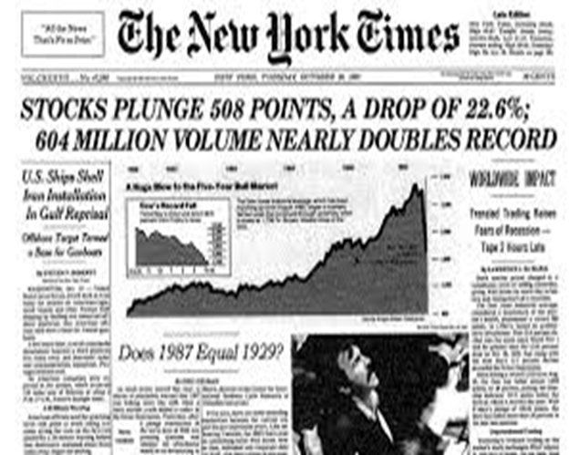
Black Tuesday
Later half of 1929, stock market starts to run out of new investors.
Professional investors start to sell off stocks.
Prices start to dip – panic selling, stocks are dumped.
October 29th – Black Tuesday - $10 to $15 billion in stock value is lost. November – $30 billion.
Notes:
Latter half of 1929, stock market starts to run out of new investors.
Professional investors start to sell off stocks.
Prices start to dip – in a panic, people start dumping stocks.
October 29th – Black Tuesday - $10 to $15 billion in stock value is lost.
i. By mid-November stock prices have dropped by a third.
ii. $30 billion was lost – a sum equal to all wages of Americans earned in a entire year.
iii. The stock market is not the only reason the Great Depression occurred but it undermined the economy to a great extent.
iv. Banks were undermined in two ways: they loaned money to stock speculators, many banks invested depositor’s money in the stock market. When margin call came due and all of the those loans were called in, there wasn’t enough money to pay off all of the loans. Banks borrowed money to pay off loans, taking money out of the economy. This put the economy into a recession. Banks closed and customers lost their savings. People got scared started to pull their money from banks. Banks lost money as they lost customers, more banks foreclosed.

Slide 6
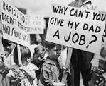
Depression
The Great Depression was a worldwide economic depression that many nations experienced during the decade of the 1930s.
In the U.S. it started with the stock market crash of Oct. 29, 1929 and lasted until we entered WWII in 1941.
Banks closed, many people lost everything, unemployment reached 25%!
A sustained economic downturn.
Longer and more severe than a recession.
Typically characterized by high unemployment, low aggregate demand, large numbers of bankruptcies, and other banking or financial crises.

Slide 7
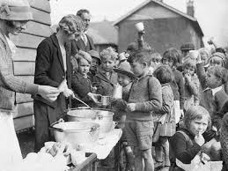
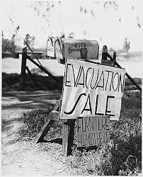
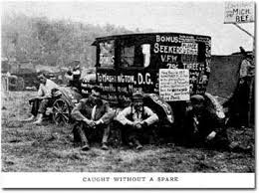
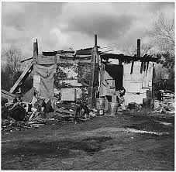
The Great Depression
Change in economic indicators 1929–32]
 | United States | Great Britain | France | Germany
Industrial production | –46% | –23% | –24% | –41%
Wholesale prices | –32% | –33% | –34% | –29%
Foreign trade | –70% | –60% | –54% | –61%
Unemployment | +607% | +129% | +214% | +232%

Slide 8
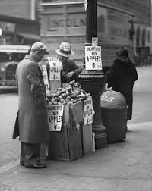
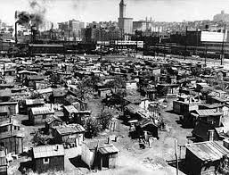
Hoovervilles
1933: 9,000 banks had failed, 12 million people out of work.
People lose jobs and homes, shantytowns start to appear across the American landscape.
Blaming the president, people referred to them as Hoovervilles.
“Hobos” wander the countryside.
Notes:
1933: 9,000 banks had failed, 12 million people were out of work.
i. 25% of the workforce was out of work.
People lose jobs and homes, shantytown start to appear across the American landscape.
i. Average family income dropped from $2,300 to $1,600 a year. Families found that they could no longer afford housing. Sometimes people would refuse to move once they became so poor that they could not afford housing. Landlords had local bailiffs issue eviction notices for tenants – their belonging would be piled on the street. People starting setting up shacks on unused or public lands (they were called shantytowns).
Blaming the president, people referred to them as Hoovervilles.
“Hobos” wander the countryside.
i. In search of work or a better life, many homeless and unemployed Americans began to wander around the country. Walking, hitchhiking or “riding the rails” – they would sneak pass police and hop on open box cars to ride a train. Hundreds of thousands of people – mostly young men and boys – wandered from place to place eating and working where they could. “Of Mice and Men” by John Steinbeck is published in 1937 and chronicles the story of George and Lennie as they wander the California landscape and dream of better times.

Slide 9
Dust Bowl
Great plains farmers uprooted wild grasses that held in moisture.
Uncultivated fields and a drought caused most soil to turn to dust.
From Dakota to Texas, a “Dust Bowl” was created.
22 Dust Storms in 1934, 72 in 1937. People migrate to California and elsewhere.
Father and Sons – living in the Dust Bowl
Notes:
Great plains farmers uprooted wild grasses that held in moisture.
Uncultivated fields and a drought caused most soil to turn to dust.
From Dakota to Texas, a “Dust Bowl” was created.
22 Dust Storms in 1934, 72 in 1937. People migrate to California and elsewhere.

Slide 10
New Deal
The name for Roosevelt’s policies to end the Depression.
Dozens of programs and agencies created to solve financial problems and create jobs.
“I pledge you, I pledge myself, to a new deal for the American people.”
Roosevelt had a confidence that he could make things better.
Franklin D. Roosevelt
Notes:
The name for Roosevelt’s policies to end the Depression.
“I pledge you, I pledge myself, to a new deal for the American people.”
Roosevelt had a confidence that he could make things better.
“The country needs bold, persistent experimentation…. Above all, try something.”

Slide 11
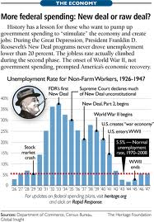
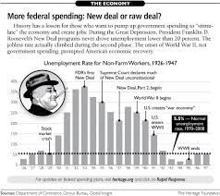
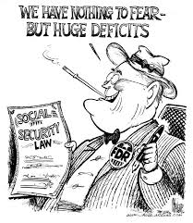
Deficit Spending
Spending more money than you have to spend.
Roosevelt abandoned the balance budget.
FDR borrowed money to pay for his programs.
Criticism of FDR’s New Deal grows.
Right: gone too far.
Left: not far enough.
Notes:
Spending more money that you have to spend.
Roosevelt abandoned the balance budget.
FDR borrowed money to pay for his programs.
Criticism of FDR’s New Deal grows.
Right: gone too far.
Left: not far enough.

Slide 12
Fireside Chats
Series of radio “chats” to the American people.
A way to let the American people know what he was doing.
As many as 60 million Americans would tune in.
The tradition of Presidential communication to the people was born!
Fireside Chat
Notes:
Series of radio “chats” to the American people.
A way to let the American people know what he was doing.
As many as 60 million Americans would tune in.
The tradition of Presidential communication to the People was born.

