Slide 1
Unit 5 Economics
Macroeconomics: The Nation’s Economy
Ch. 13 – “Measuring the Economy’s Performance”
Ch. 15 – “The Federal Reserve System and Monetary Policy”
Ch. 16 – “ Government Spends, Collects, and Owes”
Ch. 17 – “Stabilizing the National Economy”

Slide 2
Measuring GDP
Definition: the total dollar value of all final goods produced in a country during a year.
GDP only accounts for final products so that parts are not double counted.
Only new products are counted: used products are considered a transfer from one owner to another.
GDP is computed by adding products purchased by consumers (C), businesses (I), government (G), and net exports (X) (the difference between exports and imports).
C + I + G + X = GDP

Slide 3
Four Categories of GDP
To compute GDP, economists add the total amount of expenditures from the consumer sector, the investment sector, the government sector, and net exports.

Slide 4
Measurements of Income
National income (NI) is the total earned by everyone in the economy.
NI is made up of wages and salaries, income of self-employed people, rental income, corporate profits, and interest on savings and other investments.
Personal income (PI) is income received before paying personal taxes.
Disposable personal income (DI) is income left to purchase goods or put in savings after paying taxes.

Slide 5
The Purchasing Power of Money
When inflation occurs, the prices of goods and services rise, and the purchasing power of the dollar goes down.
Purchasing power of a dollar is equal to the real goods and services the dollar can buy.
Inflation can also be defined as the decline in the purchasing power of money.
Helps people with fixed debt
Hurts people with fixed income, and lendors
Inflation must be taken into account when calculating the GDP.
Deflation is a prolonged decline in the general price level.
Hurts anyone that owns anything, or produces anything!

Slide 6
Measures of Inflation
The consumer price index (CPI) is a measure of the change in price of a specific group of products and services (a market basket) used by the average household.
If the CPI > 100 = inflation (CPI=200 means prices have doubled)
If the CPI < 100 = deflation (CPI=50 means prices are half what they used to be)
http://www.usinflationcalculator.com/
Price of Market Basket
In Current Year
CPI
=
x
100
Price of Same Basket
In Base Year

Slide 7
Measures of Inflation
The CPI is used to calculate the rate of inflation from one year to another.
If the CPI in 1992 was 140 and the CPI in 2014 is 238, we can calculate the increase in inflation during the time period by the following method
Rate of Inflation = (CPI current year – CPI base year) X 100
CPI base year
70 = (238 – 140) X 100
140
The producer price index (PPI) measures the average change in prices that companies receive for their goods and services.
The PPI usually rises before the CPI (leading indicator).

Slide 8
Current and Real GDP
Inflation skews GDP by making it appear that more output was produced, when in reality only the prices of goods and services have increased.
The GDP price deflator is used to remove effects of inflation from GDP so that different years can be compared in terms of spending value = REAL GDP.

Slide 9
Macro…the Aggregate Approach
The laws of supply and demand can be applied to the economy as a whole as well as to individual consumer decisions.
When we look at the economy as a whole in this way, we are looking at aggregates—the summing up of all the individual parts in the economy.

Slide 10
Aggregate Demand
Definition: is the total quantity of goods and services demanded by all people in the economy.
If the price level goes down, a larger quantity of real domestic output is demanded per year.
(AD↑)
If the price level rises, A smaller quantity of real domestic output is demanded per year.
(AD↓)

Slide 11
Aggregate Demand Curve
Aggregate demand may increase (curve shifts to the right) if consumers collectively spend more and save less or if better economic conditions are forecast.
Aggregate demand may decrease (curve shifts to the left) if higher taxes are imposed on the overall economy or if bleak economic conditions are forecast.

Slide 12
Aggregate Supply
Definition: the quantity of all goods and services being produced at various prices.
If the price level increases producers will want to supply more (AS↑)
If the price level falls producers want to make less (AS↓)

Slide 13
Aggregate Supply Curve
Aggregate supply increases (curve shifts to the right) when all firms experience lower costs of production due to lower taxes or interest rates or lower prices for inputs.
Aggregate supply decreases (curve shifts to the left) for the opposite reasons: higher taxes, higher interest rates, higher prices for inputs.

Slide 14
Putting Aggregate Demand and Aggregate Supply Together
If you combine the aggregate supply curve and the aggregate demand curve, you can find the equilibrium price and quantity (where two curves meet).
The intersection of aggregate demand and aggregate supply gives the equilibrium price level and national output (real domestic product).

Slide 15
Business Cycle
Definition: irregular changes in the level of total output measured by real GDP
Begins with growth that leads to an economic peak, boom, or period of prosperity.
Real GDP levels off and begins to decline, while business activity slows down (contraction).
If real GDP doesn’t grow for at least 6 months, economy is in a recession (business activity falls at a rapid rate).
If recession continues to get worse, economy goes into a depression.
The downward direction of economy levels off in a trough (lowest point in the cycle) and real GDP stops going down.
Business activity increases and economy begins expansion or recovery.

Slide 16
Model of the Business Cycle

Slide 17
Business Activity in the United States

Slide 18
Causes of Business Fluctuations
Business investment—companies expanding or scaling back, or companies using innovations in their business practices.
Government activity—taxing and spending policies, and control of money supply in economy.
External factors—non-economy related factors, such as wars or raw material costs.
Psychological factors—people’s optimistic or pessimistic outlook on future and economy can contribute to increased spending or more saving.

Slide 19
Economic Indicators
Economists and the government create forecasts to try and aid in predicting the future of the economy
Leading indicators seem to lead to a change in overall business activity.
Coincident indicators change at the same time as the economic changes.
Lagging indicators change after the economic change has already begun, and help economists determine how drastic and long-lasting this economic phase will be.

Slide 20
The Federal Reserve System
Congress created the Federal Reserve System in 1913 as the central banking organization in the United States.
The Fed is responsible for monetary policy.
Monetary policy involves the changing rate of growth of the supply of money in circulation in order to affect the amount of credit, which affects business activity in the economy.

Slide 21
Organization of the Federal Reserve System
The Board of Governors oversees 12 district Federal Reserve banks and regulates activity of member banks.
The Federal Advisory Council reports to the board of governors on general business conditions in the country.
The Federal Open Market Committee decides what the Fed should do to control money supply.

Slide 22
Organization of the Federal Reserve System

Slide 23
The Twelve Districts of the Federal Reserve System

Slide 24
The Functions of the Federal Reserve System
Has many functions, including check clearing, supervising member banks, holding reserves, and supplying paper currency.
Its most important function is to regulate the money supply.
The Fed sets standards for consumer protection, mainly truth-in-lending legislation.

Slide 25
Loose and Tight Money Policies
Monetary policy involves changing the growth are of the money supply in order to change the cost and availability of credit.
Loose money means credit is plentiful and inexpensive; used to encourage economic growth.
Tight money means credit is in short supply and expensive; used to control inflation.
The goal of monetary policy is to strike a balance between tight and loose money.

Slide 26
Balancing Monetary Policy

Slide 27
Fractional Reserve Banking
Banks are required to keep a percentage of their total deposits in cash reserves in their vaults or with the Federal Reserve bank.
This enables the bank to provide funds for customers who might suddenly want to withdraw large amounts of cash from their accounts.
Currently most financial institutions are required to reserve 10 percent of their checkable deposits.

Slide 28
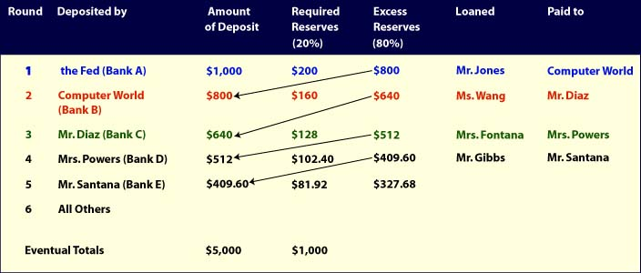
Money Expansion
Money banks lend and receive is usually spent or deposited in another bank who can also use the deposits to create new money.
This process is known as the multiple expansion of money. (Multipier)

Slide 29
Monetary Policy: Changing Reserve Requirements
The lower the percentage of deposits in reserve, the more money available to loan out.
If RR↓ = loose money
Raising the reserve decreases the amount of money in the economy and slows it down.
If RR↑ = tight money

Slide 30
Changing the Discount Rate
The discount rate is the interest rate the Fed charges its member banks when they borrow money to meet the reserve.
The prime rate is the interest rate banks charge to their best customers.
A higher discount rate means that members banks charge their customers higher interest, reducing the money supply. (tight money)
Discount Rate↓ = loose money

Slide 31
Open-Market Operations
The buying and selling of government securities is called open-market operations.
When the Fed buys securities, it makes a deposit into the reserve account of that bank, giving that bank more money to lend out = (loose money)
If the Fed sells securities, money is taken out of circulation = tight money.

Slide 32
Government Growth
The number of government workers and functions has increased dramatically.
Public-works projects are public facilities that are built and paid for with tax dollars.

Slide 33
Why Has Government Grown?
During the depression, more government services were needed.
Financing World War II caused more government growth.
Total government purchases represent 18 percent of GDP, and all government spending is more than one-third of GDP.
Government spending includes services to the people paid for by their taxes.

Slide 34
Providing Public Goods
Public goods are special goods or services provided by the government.
National defense is one of the few public goods only provided by the national government.

Slide 35
Redistributing Income
Social insurance programs are specifically geared to help retired people, disabled workers, and unemployed workers, and their families (Social Security and workers’ compensation).
Public assistance programs (welfare) help people based on their needs regardless of whether a person paid taxes into the program.

Slide 36
Critics of Government Involvement
Critics feel public goods should be provided by private organizations.
If people pay less tax, they can use that money to choose which goods they want.
Redistribution programs discourage personal progress, incentives, and self-development.
Government regulations raise the prices of goods and services; seek market solutions instead.

Slide 37
The Budget-Making Process
The Federal Budget is prepared about 18 months before the fiscal year.
The President and the Office of Management and Budget (OMB) work together to outline a budget plan.
The President approves a budget and then submits it to Congress.
Congress then examines and discusses the budget, and should pass it before the coming fiscal year.
Often the budget is not passed until after the fiscal year has already begun.

Slide 38
Federal Government Spending

Slide 39
Deficit Spending and the National Debt
Budget deficits are created when the government spends more than its revenues.
In order to make up the difference in funds, the government borrows the money, known as deficit funding.
The national debt is the total amount of money the federal government owes.
A budget surplus occurs when the government spends less than its revenues.

Slide 40
Principles of Taxation
Benefits-received principle states that people who use a service should support it with taxes in proportion to the benefit they receive.
Ability-to-pay principle states that people support programs based on their incomes, not their usage of the programs.

Slide 41
Forms of Taxation
Proportional taxes are based on a proportion or percentage of a person’s income.
Progressive taxes are taxes where a person pays a higher percentage of income in taxes as that income rises.
Regressive taxes are taxes where a person pays a lower percentage of income in taxes as that income rises.

Slide 42
Measuring Unemployment
The unemployment rate is the percentage of the civilian labor force that is without jobs but that is actively looking for work.
High unemployment is a sign that the economy is not doing well.
Types of unemployment:
structural (people have jobs skills no longer demanded)
seasonal/frictional (people are between jobs)
cyclical (low AD puts people out of work. BAD- sign of recession).
Full employment is when the unemployment rate is below 5 percent.

Slide 43
Unemployment Rates throughout U.S. History

Slide 44
Inflation
Acceptable levels of inflation are about 3 percent a year or lower.
Unpredictable inflation has a destabilizing effect on the economy.
Inflation can cause people’s standard of living to fall, especially people on fixed incomes, such as retired people.

Slide 45
Inflation (cont.)
Demand-pull theory of inflation states that prices rise because of high business and consumer demand.
Cost-push theory of inflation states that prices rise because of excessive labor costs and business profits.
Stagflation occurs when high inflation and unemployment occur at the same time.

Slide 46
Fiscal Policy
Definition: federal government’s use of taxation and spending policies to affect overall business activity.
John Maynard Keynes believed that the forces of aggregate supply and demand operated too slowly in a serious recession and that government should step in to stimulate aggregate demand.

Slide 47
Fiscal Policy
Expansionary Fiscal Policy = Tax cuts and/or increased spending.
Theory is that tax cuts lead to increasing investment and jobs which leads to increased AD. Used to solve a recession.
Contractionary Fiscal Policy = Increased taxes and/or decreased government spending.
Theory is that the government can slow the economy down and reduce inflation if necessary. Used to prevent the economy from “over-heating” or expanding too fast.
If people pay lower taxes, they will have more money to spend, save, and invest in a growing economy.
These are called supply-side effects of fiscal policy.

Slide 48
International Trade
No nation has the capacity to produce enough of everything it would take to satisfy all the wants and needs of it’s citizens.
Why? The Economizing problem = SCARCITY!
Therefore each nation must specialize in what it is best at and trade for the goods or resources it lacks.
Specialization and trade allows nations to get closer to fulfilling the wants and needs of it’s citizens.

Slide 49
The Economic Basis for Trade
Is it bad to rely on other nations for goods or resources?
No! Not if they can provide or produce those goods or resources at a lower cost!
Remember: Comparative Advantage – the ability to produce goods or services at a lower opportunity cost (every nation has comparative advantage in something!)
The Case for Free Trade
1. the world economy can achieve more efficient allocation of resources, higher standard of living
2. promotes competition (efficiency)
3. promotes positive relationships

Slide 50
Trade Barriers
Revenue Tariff – tax on imported goods in order to provide income for the gov (typically applied to products the US does not produce)
Protective Tariff – tax on imports meant to protect US producers from foreign competition
Import Quota – sets a limit on the quantity of a good that can be imported
Nontariff Barrier (NTB) – gov restriction that prevents or reduces imports EX – licensing, regulations

Slide 51
Financing International Trade
U.S. Export Transactions – create foreign demand for US $
U.S. Import Transactions – create domestic demand for foreign currency
Depreciation – more units of one currency are needed to buy another
$1=1Euro…$2 = 1 Euro
Appreciation – less units of one currency are needed to buy another
10 pesos = $1…7pesos = $1

Slide 52
Flexible Exchange Rates
Determinants of Exchange Rates
3 general rules:
1. If Demand for currency ↑ = appreciation, If Demand↓ = depreciation
2. If Supply of currency↑ = depreciation, If Supply ↓ = appreciation
3. If a nation’s currency appreciates, another nation’s will depreciate relative to it.

Slide 53
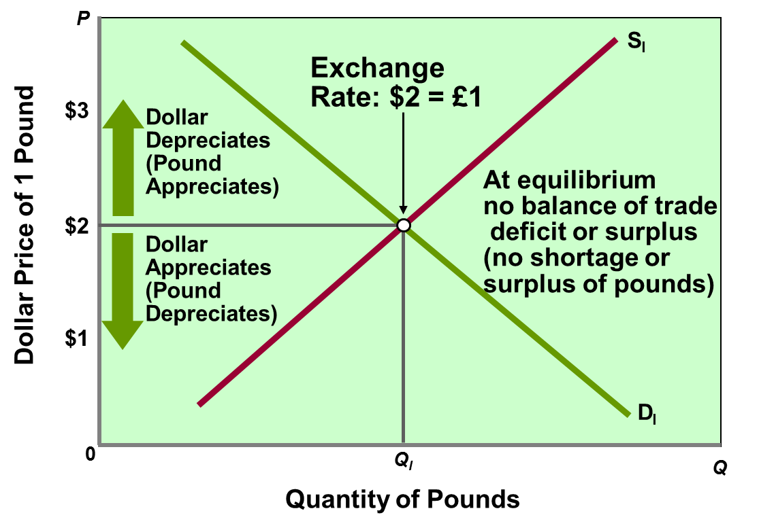
Flexible Exchange Rates
The Market for Foreign Currency (Pounds)

