Slide 1
US History Unit 5 – Terms #1-12

Slide 2
Fascism
A type of aggressive nationalism.
Started by Mussolini as a political party in 1919.
The idea that the nation is more important than the individual.
Individualism makes countries weak.
A strong government and leader is needed to secure society.
Great nations grow in power through military expansion.
Partners in Fascism
Notes:
Individualism makes countries weak.
A strong government and leader is needed to secure society.
Great nations grow in power through military expansion.

Slide 3
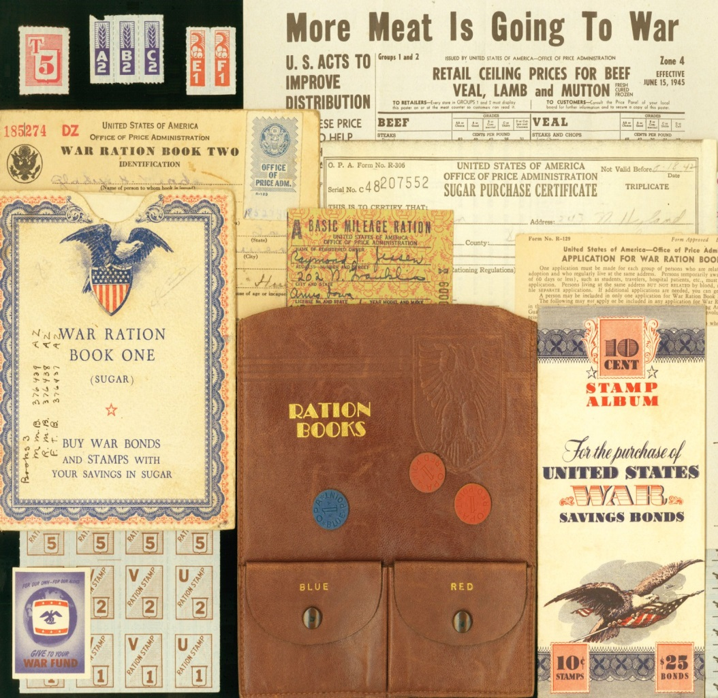
Rationing
During WWII, you couldn't buy as much sugar or butter or meat or gas as you wanted.
These things were rationed, which meant you were only allowed to buy a small amount (even if you could afford more).
The government introduced rationing because certain things were in short supply during the war, and rationing was the only way to make sure everyone got their fair share.

Slide 4
Victory Gardens
The government encouraged citizens to plant "Victory Gardens." They wanted individuals to provide their own fruits and vegetables.
Nearly 20 million Americans planted gardens in backyards, empty lots and even city rooftops.
Neighbors pooled their resources, planted different kinds of foods and formed cooperatives, all in the name of patriotism.

Slide 5
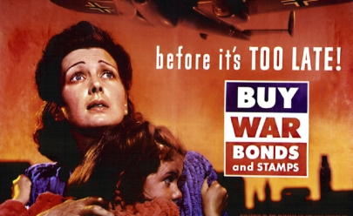
War Bonds
The United States spent more than $300 billion fighting the Axis Powers and supplying our Allies—that equals more than $4 trillion today!
To help fund this effort, The United States Treasury offered Americans a series of War Bonds they could purchase during the war.
A War Bond was both an investment in one’s country and an investment in one’s own financial future.

Slide 6
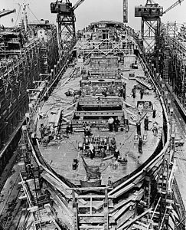
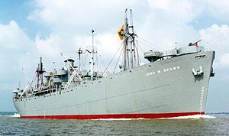
Liberty Ships
Liberty ships were cargo ships built in the United States during World War II.
They were cheap and quick to build, and came to symbolize U.S. wartime industrial output.
Previously ships took about 230 days to build, Liberty Ships were completed in 24 days!

Slide 7
Lend-Lease Act
Neutrality Act of 1939.
OK to sell arms to warring nations but
Had to pay cash.
Had to transport arms.
Britain ran out of funds by 1940.
Allowed the US to lend or lease arms to any country “vital to the defense of the United States.”
Britain had to promise to pay “rent” on the arms or return them at the end of the war.
Support the war effort – buy bonds!
Notes:
Neutrality Act of 1939.
OK to sell arms to warring nations but
Had to pay cash.
Had to transport arms.
1940 Churchill asks for old American destroyers.
FDR traded building rights on Newfoundland, Bermuda and the Caribbean.

Slide 8
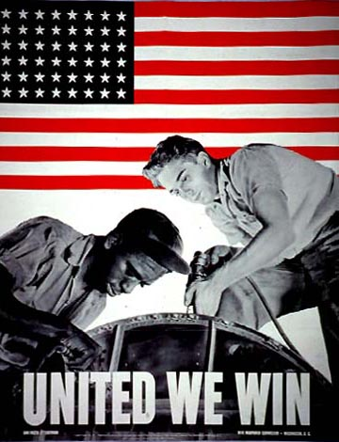
Cost-Plus Contract
The German blitzkrieg into France in May 1940 shocked America.
Roosevelt declared a national emergency.
FDR announced a plan to build 50,000 warplanes a year.
Businesses needed incentive so…
Government agreed to pay costs “plus” profits.
Cost-plus contracts convinced many factories to convert to war production.
4 million women took government clerical jobs.
Notes:
The German blitzkrieg into France in May 1940 shocked America.
President Roosevelt declared a national emergency.
He announced a plan to build 50,000 warplanes a year.
FDR knew business needed an incentive.

Slide 9
Bracero Program
1950 to 1960: Program brought 5 million Mexicans to the US.
Temporary contract workers.
About 350,000 settle permanently in the US.
Worked large farms and lived in pitiful conditions for low pay.
The first Braceros arrive in Los Angeles by train in 1942.

Slide 10
Aviation
WWII warplanes were highly advanced compared to those used during WWI.
Jet engines, improved speed and handling, greater distance, increased carrying capacity.
Planes were not only land based but some were especially equiped for aircarft carriers.
Also high altitude planes were used for reconnaissance.

Slide 11
Weaponry
Massive U.S. production was a key component in the Allies victory.
Weapons were more accurate, powerful, longer range and more deadly.
The development of Atomic bombs and their use to help end the war showed how important military technology had become.

Slide 12
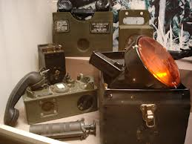
Communication
Telephone, telegraph, and radio were the primary sources of communication during WWII.
All were vulnerable to interception and therefore nations developed codes for sending secret messages.
Much effort was put into decoding messages sent from other nations.
The U.S. had the only unbreakable code, the Navajo Code from Native Americans who volunteered to help by using their unique unwritten language for sending messages.

Slide 13
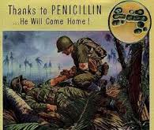
Medicine
World War II created the need for more effective and urgent treatments that could be administered easily on the battlefield.
Researchers and medical experts responded with new drugs and practices.
Penicillin, plasma, and morphine were among the chief wartime medical advancements.

