Slide 1
US History – Unit 5 Events & Ideas

Slide 2
Roosevelt’s Foreign Policy: He oppossed to Isolationism and
Roosevelt and Europe
Lend-Lease Act kept Britain fighting.
Continuously bent the rules to keep supporting Britain.
August 1941, Churchill and Roosevelt sign the Atlantic Charter.
Roosevelt and Asia
Japan depended on American iron, steel and oil.
FDR blocked a sale of fuel and iron to Japan and froze all Japanese assets in the United States.
Japanese attack Pearl Harbor on December 7th, 1941.
US now in World War II.

Slide 3
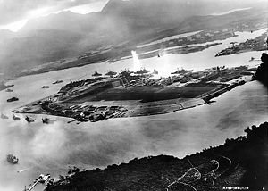
Pearl Harbor
December 7, 1941
Japanese attack several U.S. military installations at Pearl Harbor, Hawaii
Japanese goal: cripple U.S. Fleet allowing for easy conquests in the Pacific Ocean
Photo taken by a Japanese plane just prior to attacking battleship row

Slide 4
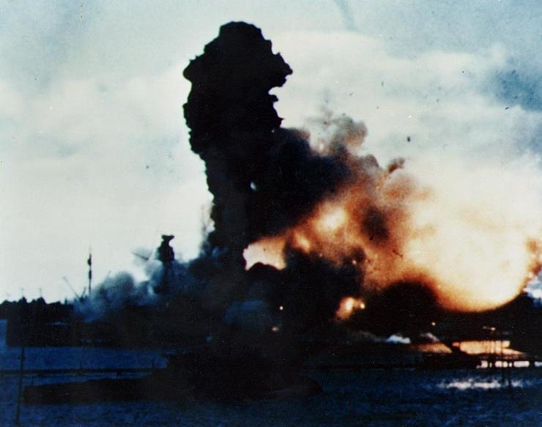
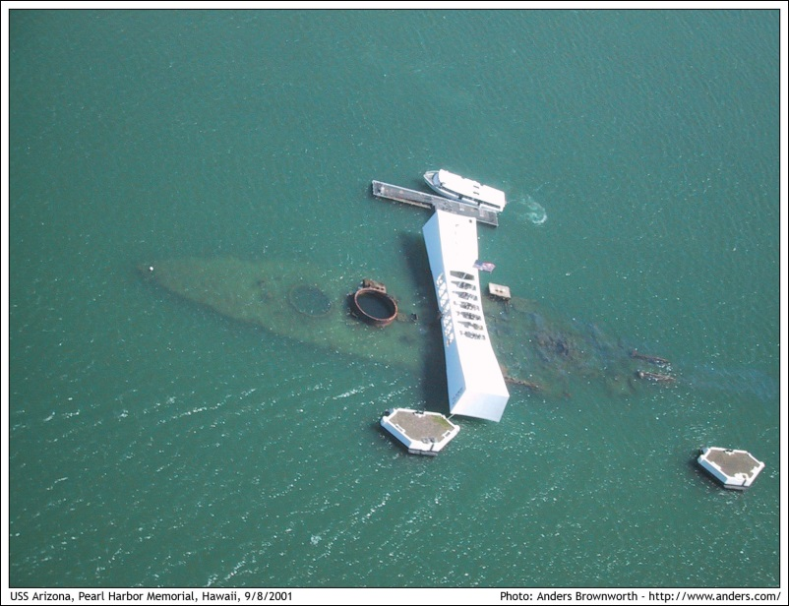
Pearl Harbor
Japanese catch the U.S. by surprise
21 ships sunk/damaged; 188 airplanes lost; 2,403 killed another 1,178 injured
Roosevelt asks congress for a declaration of war on December 8—receives an almost unanimous yes
Roosevelt: “a date which will live in infamy”
USS Arizona: then & now

Slide 5
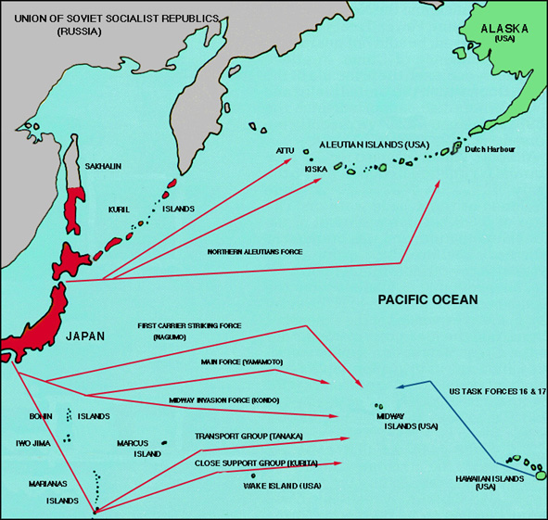
The Battle of Midway
U.S. code breakers had cracked the Japanese code and learned of their plan to attack Midway Island
U.S. Admiral Chester Nimitz sends part of his damaged Pacific Fleet to Midway to ambush the Japanese
Midway Island
Hawaii

Slide 6
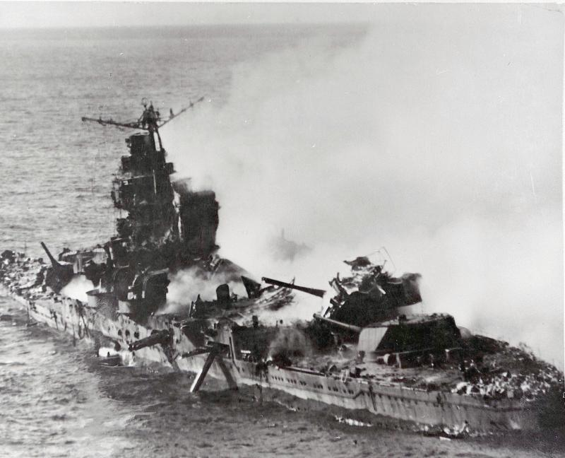
The Battle of Midway
The U.S. ambushed the Japanese attack and counterattacked inflicting heavy damage on their Navy
In one day the U.S. forces destroyed 4 major Japanese carriers
Midway was a major turning point in the war in the Pacific
A sinking Japanese cruiser at the battle of Midway

Slide 7
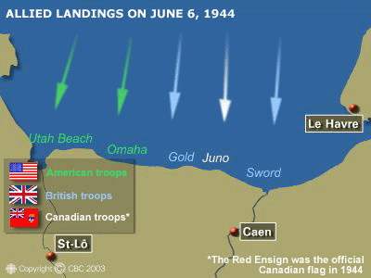
The Normandy Invasion
June 6, 1944 “D-Day” aka “Operation Overlord”
The attack was planned months in advance; the Nazi’s knew the Allies had to attack…but didn’t know where
Five “Landing Beaches” were chosen: Utah, Omaha, Gold, Sword, and Juno
D-Day map of the coast of France

Slide 8
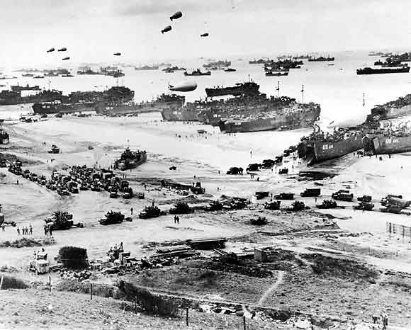
The Normandy Invasion
Largest single allied invasion in the war
1.5 million troops & 5 million tons of equipment sent to Britain in preparation
Dawn of June 6:
7,000 ships, 100,000 soldiers, 23,000 paratroopers land on the Normandy beaches
Troops & equipment landing at a captured beachhead

Slide 9
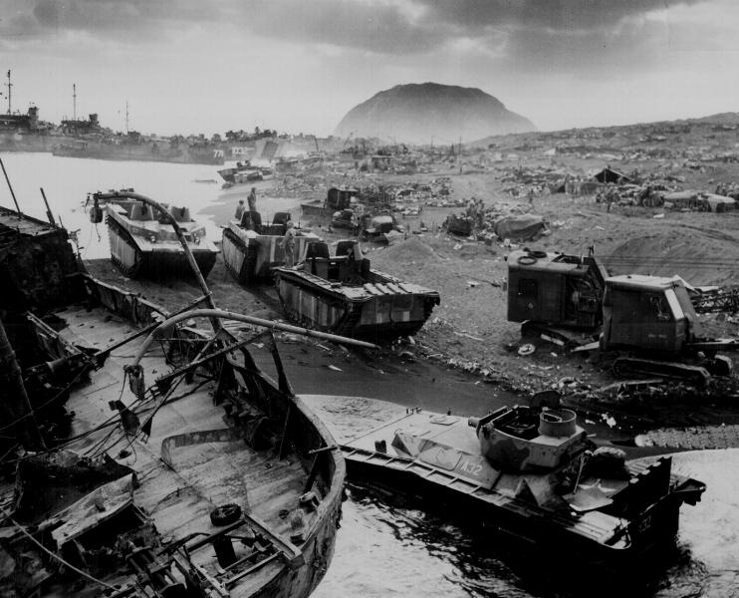
Attack on Iwo Jima
Attacked to give American bombers a refueling stop en route to Japan
Extremely rugged island, but its location made it necessary to capture
60,000 Marines invaded on Feb. 19, 1945
US Marines suffered heavy losses in the Iwo Jima invasion

Slide 10
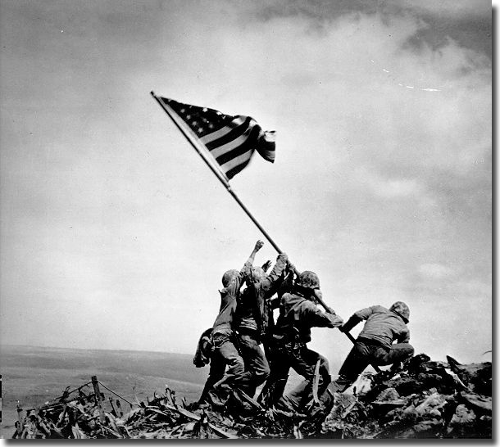
Attack on Iwo Jima
The Japanese defended the island with great intensity
Ultimately, U.S. forces captured the island, but at a high cost
“uncommon valor was a common virtue”

Slide 11
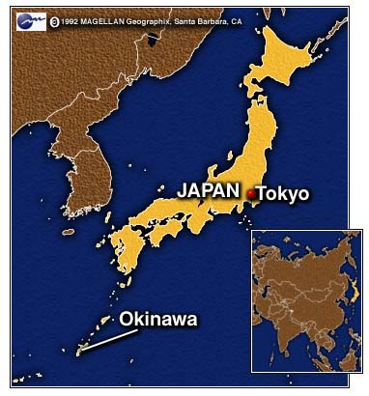
Invasion of Okinawa
Final island (350 miles away) U.S. forces captured en route to Japan
April 1, 1945 invasion begins
Japanese forces surrendered the coast and moved to the highlands

Slide 12
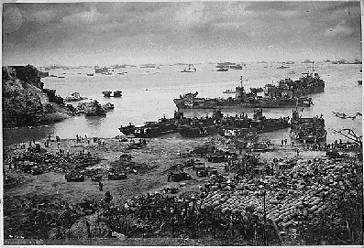
Invasion of Okinawa
More than 12,000 soldiers died in the invasion
June 22, 1945 U.S. forces secure and capture the island
American forces hit the beaches

Slide 13
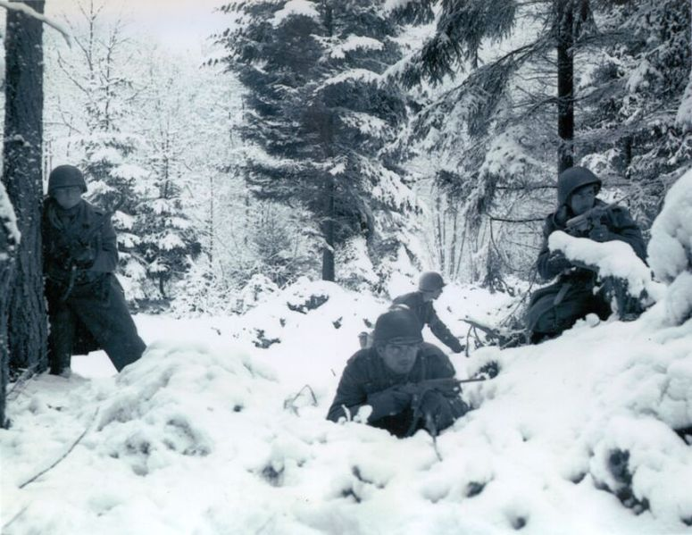
The Battle of the Bulge
Hitler’s final desperate attempt to keep the Allies out of Germany
Fight begins December 16, 1944
Centered in and around the Belgian town of Bastogne
Conditions were bitterly cold!

Slide 14
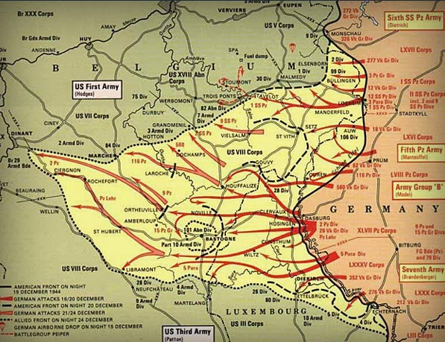
The Battle of the Bulge
Hitler’s goal was to cut off American supply lines at Antwerp, Belgium
Allied forces (mostly American) were able to hold the Germans at bay until reinforcements arrived (Patton)
January 1945 the Germans begin to withdraw after suffering heavy losses—Germany was now exposed
The Allies bent, but didn’t break

Slide 15
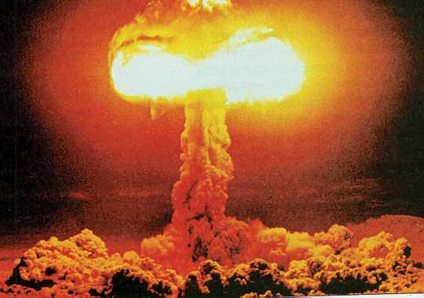
Hiroshima & Nagasaki
Decision to drop the Atomic Bomb was arrived at with much difficulty
The U.S. wanted unconditional surrender, the Japanese wanted the Emperor to remain in power
Truman did not want to concede anything

Slide 16
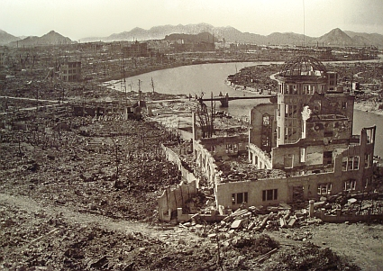
Hiroshima & Nagasaki
Rather than risk more than a million lives in an invasion, Truman decides to move forward with the Manhattan Project
Two nuclear weapons are dropped on Hiroshima (Little Boy: Aug. 6) and Nagasaki (Fat Man: Aug 9)
200,000 Japanese die; more than 100,000 buildings are destroyed

Slide 17
Manzanar
Japan attacks Pearl Harbor on Dec. 7th, 1941.
Feb. 19th, 1942. FDR allowed the military to ban anyone from the West Coast.
Americans of Japanese ancestry were rounded up and placed in camps.
120,000 Japanese were placed in camps (77,000 were American citizens).
Internment Camp
Notes:
Japan attacks Pearl Harbor on Dec. 7th, 1941.
Feb. 19th, 1942. FDR allowed the military to ban anyone from military areas.
Americans of Japanese ancestry were rounded up and placed in camps.
120,000 were placed in camps (77,000 were American citizens).

Slide 18
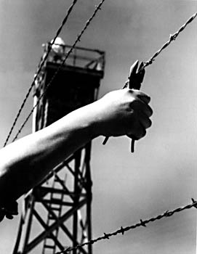
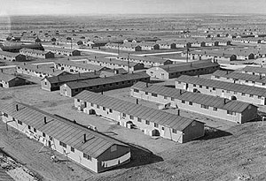
Japanese Internment
Dec. 8, 1941 (the day after Pearl Harbor) the U.S. declares war on Japan.
Previous distrust and discrimination against Japanese plus fears of sabotage and espionage created a hostile situation.
FBI conducted raids of Japanese homes and businesses.
Feb. 19, 1942 FDR signed executive order 9066 establishing “military areas” to house people that may threaten national security.
Approx. 110,000 Japanese Americans were “relocated” to these internment camps.
Families were given 48 hours notice and could only bring what they could carry.

Slide 19
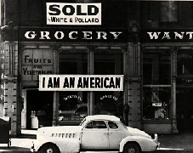
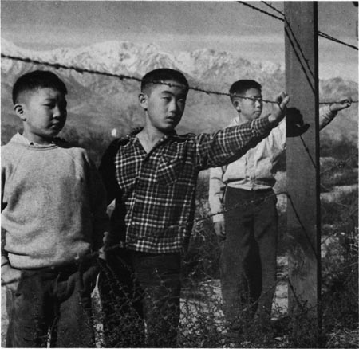
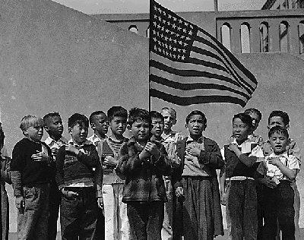
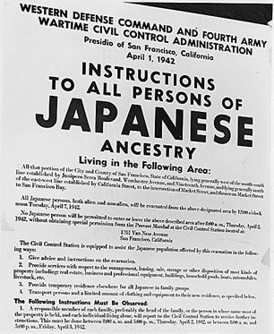
Japanese Internment
Families stayed in single rooms, parents worked & children went to school (in the camps).
Camps were in remote locations & surrounded by barbed wire and armed guards.
Prisoners were forced to answer questions to determine their “loyalty”, drafted into the military to fight and prove their loyalty.
Challenged in the Supreme Court case Korematsu V. United State (1944) – court ruled that the camps were constitutional and in the interest of national defense.
In 1988 legislation was signed that would pay $20,000 in reparations to living survivors.

Slide 20
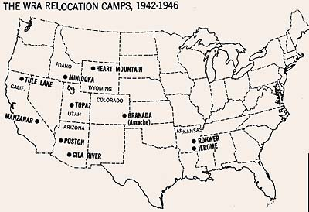

Slide 21
Nuremburg Trials
Nuremberg trials were a series of 13 trials carried out in Nuremberg, Germany, between 1945 and 1949.
The purpose of the trials was to hold Nazi officials accountable for war crimes during WWII.
The defendants included Nazi Party officials and high-ranking military officers, German industrialists, lawyers and doctors who were accused of human rights violations.
Nuremberg trials are now regarded as a milestone toward the establishment of a permanent international court.

