Slide 1
US History Unit 7 Civil Rights
Events and Ideas #4-6
4. Non- Violent Resistance
5. Birmingham/ Selma
6. Stonewall

Slide 2
SCLC
Southern Christian Leadership Conference.
Some churches played a vital role in the fight for civil rights.
SCLC worked against segregation in voting, public transportation, housing, and other public places.
SCLC used non-violent protests and boycotts to achieve goals.
SCLC’s first president, Martin Luther King, Jr.
Notes:
Southern Christian Leadership Conference.
Churches played a vital role in the fight for civil rights.
SCLC worked against segregation in voting, public transportation, housing, and other public places.
SCLC used non-violent protests and boycotts to achieve goals.

Slide 3
Notes:
Rosa Parks was born on February 4, 1913 in Tuskegee, Alabama. She was a seamstress by profession and secretary for the Montgomery chapter of the NAACP. Shortly before being arrested on December 1, 1955, she had completed a course in "Race Relations" at the Highlander Folk School in Tennessee where nonviolent civil-disobedience had been discussed as a tactic.
The boycott was triggered by her arrest, when she was charged for violating racial segregation laws in Montgomery after refusing to give up her bus seat to a white man. She was sitting in the fifth row (the first row that blacks could occupy), along with three other blacks.
Soon, all of the first four rows were filled up, and a white man walked on. Since blacks and whites could not be in the same row, the bus driver wanted all of the blacks to move. The other three blacks complied, but Parks refused and was practically dragged off of the bus. And then she had to go to jail. When found guilty on December 5, Parks was fined $10 plus a court cost of $4, but she appealed. As a result, Rosa Parks is considered one of the pioneers of the civil rights movement.

Slide 4
Montgomery Bus Boycott
Rosa Parks refused to give up her seat to a white man (Dec. 1, 1955).
She was arrested and fined $10. She appealed.
Blacks boycotted the bus system in Montgomery.
December, 1956: Supreme Court declared Alabama’s laws segregating busses unconstitutional.
The bus Rosa Parks was arrested on is now in the Henry Ford Museum.
Notes:
Rosa Parks refused to give up her seat to a white man.
She was arrested and fined $10. She appealed.
The bus system in Montgomery was boycotted.
December, 1956: Supreme Court declared Alabama’s laws segregating busses unconstitutional.
Jo Ann Robinson, head of a local organization called the Women’s Political Council, called on African Americans to boycott Montgomery’s bus system.
A young 26 year old preacher name Martin Luther King, Jr. was elected to lead the Montgomery Improvement Association to lead the boycott.
King drew upon the philosophy and techniques of Indian leader Mohandas Gandhi, embracing civil disobedience or passive protest of unjust laws. All people, regardless of place and time, had a right not to obey an unjust law even if that meant arrest, incarceration, beatings, etc. Public opinion would eventually force people the government to change, in this case to end segregation.

Slide 5
Sit-In Movement
Notes:
Farmville, VA. 1963. Student sit-ins being dragged away from the College Shoppe Restaurant.

Slide 6
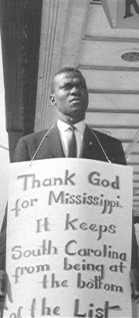

Slide 7
Sit-Ins
Students staged sit-ins at restaurants to end segregation.
Starts in Greensboro, North Carolina and spreads to 100 other cities.
People were often heckled, punched, kicked, beaten with clubs, burned with cigarettes, and hot coffee.
Most did not fight back.
The Greensboro Four
Notes:
The Greensboro Four, Ezell Blair, Jr. David Richmond, Franklin McCain and Joseph McNeil, were close friends at North Carolina A&T University before they became political activists. Two of the four had grown up where segregation was not legal, while another’s father was active in the NAACP. The Civil Rights Movement had stalled since the Brown decision and the Montgomery Bus Boycott. On the night of January 31, 1960 the four dared each other to do something that would change the South and their own lives forever. They decided to sit-in at the whites-only lunch counter at Woolworth’s in downtown Greensboro the next day.
On February 1st, dressed in their Sunday best, the four men sat down at the lunch counter. Frank McCain remembers that he knew then this would be the high point of his life, “I felt clean...I had gained my manhood by that simple act.” The four were refused service; when they did not leave the store the manager closed the lunch counter. In the days that followed they were joined by more students from local Black colleges and a few white students who also sat-in at other lunch counters in Greensboro. The Civil Rights Movement was the first major social movement to be covered by television news so word of the events in Greensboro spread across the nation like a prairie fire. Within just a few days students were sitting in at lunch counters in fifty-four cities around the South.
Greensboro’s civic leadership pressured the President of North Carolina A&T to halt the protests but he counseled the students to follow their own consciences. Finally after months of protests the Woolworth management quietly integrated its lunch counter. The wave of direct action started by the Greensboro Four coalesced in the formation of the Student Non-Violent Coordinating Committee (SNCC), the vanguard of the Civil Rights Movement of the 1960s.
From: http://www.newsreel.org/nav/title.asp?tc=CN0170&s=feb

Slide 8
Woolworth sit-in, Jackson, MS. May 28, 1963
Notes:
"This was the most violently attacked sit-in during the 1960s and is the most publicized. A huge mob gathered, with open police support while the three of us sat there for three hours. I was attacked with fists, brass knuckles and the broken portions of glass sugar containers, and was burned with cigarettes. I'm covered with blood and we were all covered by salt, sugar, mustard, and various other things.”
Seated, left to right, are myself, Joan Trumpauer (now Mulholland), and Anne Moody.
Coming of Age in Mississippi

Slide 9
Freedom Riders
Though illegal, bus terminals in the South were still segregated.
African-Americans and Whites rode buses into the South.
They came to the South to protest continued illegal segregation.
Police were “absent” whenever white mobs appeared at bus terminals to terrorize the riders.
May 14th, 1961: Freedom Riders’ bus attacked by angry white mob.
Notes:
Though illegal, bus terminals in the South were still segregated.
African-Americans and Whites rode buses into the South.
They came to the South to protest continued illegal segregation.
Police were “absent” whenever white mobs appeared at bus terminals to terrorize the riders.

Slide 10
Troops were called out to protect the Freedom Riders.
Notes:
The violence is Alabama made national news, shocking many Americans. The attack on the Freedom Riders came less than four months after President John F. Kennedy took office. The new president felt compelled to do something to get the violence under control.

Slide 13
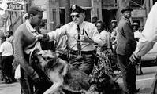
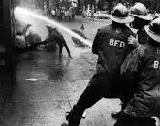
Birmingham
1963 – Birmingham was one of the worst examples of discrimination and segregation.
Birmingham had no black police officers, firefighters, sales clerks, bus drivers, bank tellers, or store cashiers. Virtually all jobs were manual labor.
The average income for blacks in the city was less than half that of whites.
The unemployment rate for blacks was two and a half times higher than for whites.
Only 10 percent of the city's black population was registered to vote.

Slide 14
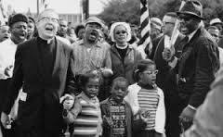
Birmingham
The Civil Rights Movement actively taught civil disobedience to students and children which many thought was controversial.
Ultimately these protests led to the passage of the Civil Rights Act of 1964.

Slide 15
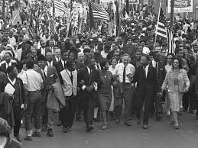
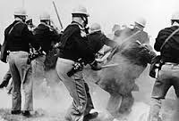
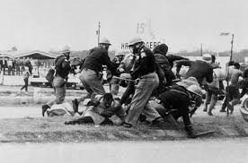
Selma
1965 – 3 marches from Selma to Montgomery, Alabama to protest disenfranchisement and demand voting rights.
54 mile walk to the State Capital, peaceful protest met with violence from police and state troopers.
Shocking photos and television coverage!
Gained lots of media attention and brought many people from around the country into the Civil Rights movement.

Slide 16
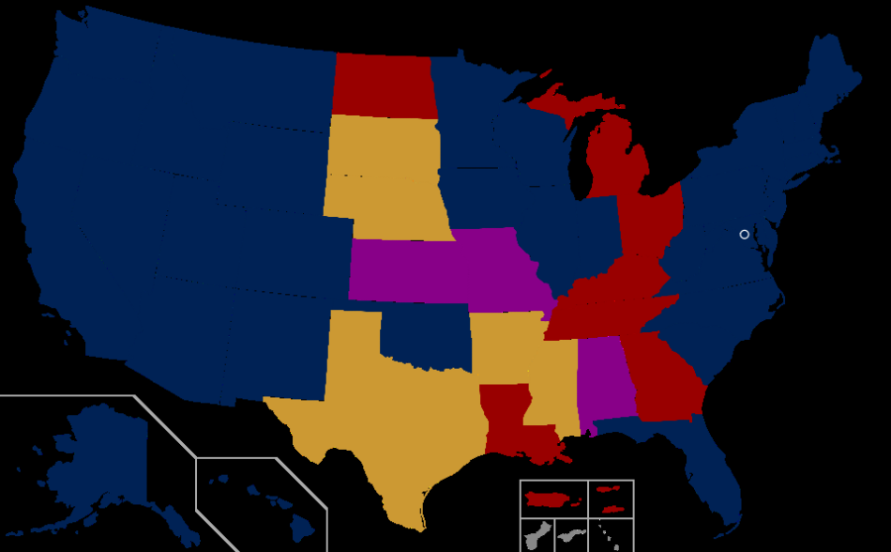
Stonewall
1969 – Riots in New York City that started when the police raided a known hangout for homosexuals.
Violence erupted and brought attention to the discrimination that Gays and Lesbians were facing.
The outcome was the first real effort to organize groups to fight against discrimination based on sexual orientation.
Also began a slow transition in society as more people came out as openly gay.
Over the years, many political action groups have successfully won more equal treatment in employment but there is no specific constitutional protection based on sexual orientation.
The current issue is gay marriage which is legally recognized in 36 states.

