Slide 1
US History Unit 7 Civil Rights
Events and Ideas #1-3
1. Foundations of Rights
2. Major Supreme Court Cases
3. Little Rock Nine

Slide 2
What are Civil Rights?
Civil Rights refer to the positive acts a government takes to protect us against arbitrary or discriminatory treatment by the government or individuals.
“All men are created equal” – Declaration of Independence, 1776.

Slide 3
Early Disputes
1787 - 3/5th compromise
1808 – Congress bans slave trade
1820- Missouri Compromise
1861-1865 -Civil War
Conflict, of course, over slavery, session
Conflict over States rights vs. Federal power
Southern agriculture v. Northern industry
1863 – Emancipation Proclamation

Slide 4
The Civil War Amendments
13th Amendment – banned all forms of slavery and involuntary servitude
14th Amendment -- guarantees equal protection of the laws and due process to all citizens
15th Amendment -- specifically gives blacks the right to vote
Women’s rights were not addressed in these Amendments!
19th Amendment (1920) - guaranteed all women the right to vote.

Slide 5
Avoidance
Black Codes - Southern states passed laws that prohibited Black Americans from
Voting, Sitting on juries, Appearing in some public places
Jim Crow Laws - During the years of Jim Crow, state laws mandated racial separation in
schools , parks, playgrounds
Restaurants, hotels, theatres
public transportation
Restrooms
These laws remained in effect throughout the 1960’s Civil Rights Movement.
Southerners excluded the African American voter with:
Poll taxes, Literacy Test, Whites only primaries, Grandfather clause

Slide 6
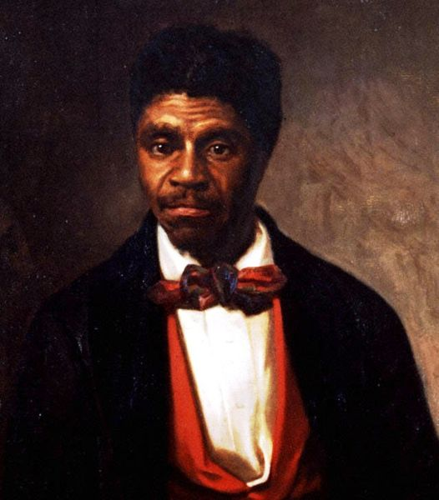
Dred Scott v. Sandford, 1857
Dred Scott was a Missouri slave who worked in free territory for years.
Slavery illegal North of Missouri.
Case went to the Supreme Court. Scott lost.
Supreme Court stated Congress’s ban on slavery illegal, African Americans were not citizens, slaves were private property.
Portrait of Dred Scott
Notes:
Dred Scott v. Sandford, also known as the Dred Scott Case, was a lawsuit, pivotal in the history of the United States, decided by the United States Supreme Court in 1857 that ruled that people of African descent, whether or not they were slaves, could never be citizens of the United States, and that Congress had no authority to prohibit slavery in federal territories. It was also ruled that slaves could not sue in court, and that slaves could be considered chattel or private property, and, being private property, could not be taken away from their owners without due process. The decision for the court, known as the Dred Scott Decision, was written by Chief Justice Roger B. Taney.
States do not have the right to claim an individual’s property that was fairly theirs in another state. Property cannot cease to exist as a result of changing jurisdiction. The majority decision held that Africans residing in America, whether free or slave, could not become United States citizens and the plaintiff therefore lacked the capacity to file a lawsuit. Furthermore, the parts of the Missouri Compromise creating free territories were unconstitutional because Congress had no authority to abolish slavery in federal territories. Judgment of Circuit Court for the District of Missouri reversed and dismissed for lack of jurisdiction.

Slide 7
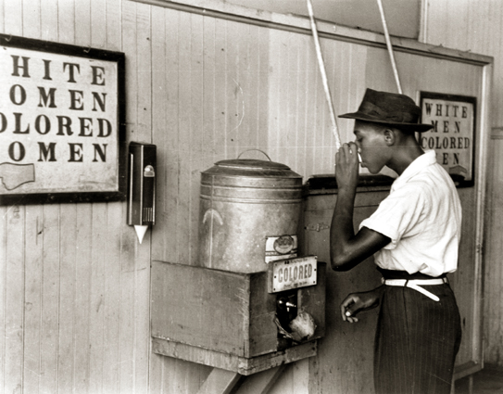
Plessy v. Ferguson, 1896
In 1896, the Supreme Court declared segregation constitutional.
Established the “separate but equal” doctrine.
Laws segregating African Americans from whites were permitted as long as equal facilities were provided.
“separate but equal”
Notes:
In 1896, the Supreme Court declared segregation constitutional.
Established the “separate but equal” doctrine.
Laws segregating African Americans from whites was permitted as long as equal facilities were provided.
In June 7, 1892, Plessy boarded a car of the East Louisiana Railroad that was designated by whites for use by white patrons only. Although Plessy was one-eighth black and seven-eighths white, under Louisiana state law he was classified as an African-American, and thus required to sit in the "colored" car. When Plessy refused to leave the white car and move to the colored car, he was arrested and jailed.
In his case, Homer Adolph Plessy v. The State of Louisiana, Plessy argued that the East Louisiana Railroad had denied him his constitutional rights under the Thirteenth and Fourteenth Amendments of the United States. However, the judge presiding over his case, John Howard Ferguson, ruled that Louisiana had the right to regulate railroad companies as long as they operated within state boundaries. Plessy sought a writ of prohibition.
Plessy took it to the Supreme Court of Louisiana where he again found an unreceptive ear, as the state Supreme Court upheld Judge Ferguson's ruling. Undaunted, Plessy appealed to the United States Supreme Court in 1896. The Supreme Court rejected his claim setting down the “separate but equal” precedent.

Slide 8
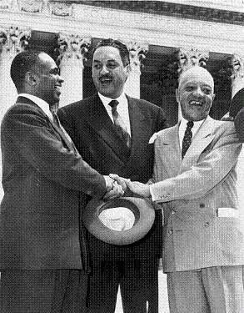
Brown v. Board of Education, 1954
School Board in Kansas was sued by African-American parents.
Supreme Court ruled that segregation in public schools was unconstitutional.
Segregation violated the equal protection clause of the 14th Amendment.
Public schools had to integrate.
George E.C. Hayes, Thurgood Marshall, and James Nabrit, congratulating each other.
Notes:
Much of the ninety years preceding the Brown case, race relations in the U.S. had been dominated by racial segregation. This policy had been endorsed in 1896 by the United States Supreme Court case of Plessy v. Ferguson, which held that as long as the separate facilities for the separate races were "equal," the segregation did not violate the Fourteenth Amendment ("no state shall . . . deny to any person . . . the equal protection of the laws").
The plaintiffs in Brown asserted that this system of racial separation, while masquerading as providing separate but relatively equal treatment of both white and black Americans, instead perpetuated inferior accommodations, services, and treatment for black Americans.
Racial segregation in education varied widely from the 17 states that required racial segregation to the 16 that prohibited it. Brown is undoubtedly the most famous of a series of U.S. Supreme Court cases that dealt principally with the efforts of civil rights activists to promote the interests of the people they represented.

Slide 9
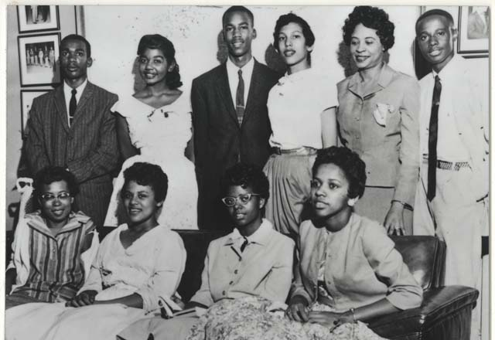
The Little Rock Nine
In September, 1957, the school board in Little Rock, Arkansas, won a court order to admit nine African American students to Central High, a school with 2,000 white students. Little Rock was a racially motivated Southern city, as was most of Arkansas.
Notes:
In September, 1957, the school board in Little Rock, Arkansas, won a court order to admit nine African American students to Central High, a school with 2,000 white students. Little Rock was a racially motivated moderate Southern city, as was most of Arkansas.

Slide 10
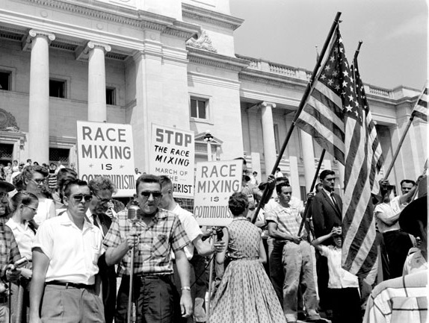
Little Rock, Arkansas
Governor Faubus and National Guard stop integration of Central High.
Eisenhower sends in Federal troops to integrate Central High.
Troops remain for the year – voters closed all four high schools the next year.
Segregationist rally protest at the Arkansas State Capitol in Little Rock (Pulaski County); August 1959.
Notes:
Governor Faubus and National Guard stop integration of Central High.
Eisenhower sends in Federal troops to integrate Central High.
Troops remain for the year – voters closed all four high schools the next year.

Slide 11
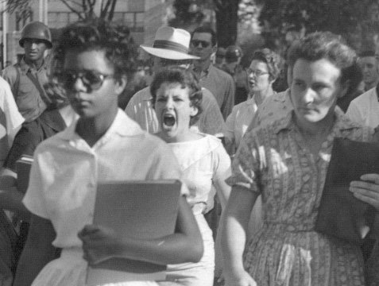
He ordered troops from the Arkansas National Guard to prevent the nine African American students from entering school.
The next day, an angry mob gathered along with National Guard troops guarding the school to protest the integration.
Governor Orval Faubs, a moderate on racial issues, was determined to win reelection and so began a campaign of white supremacy.
Notes:
Governor Orval Faubs, a moderate on racial issues, was determined to win reelection and so began a campaign of white supremacy. He ordered troops from the Arkansas National Guard to prevent the nine African American students from entering school. The next day, an angry mob gathered along with National Guard troops guarding the school to protest the integration.

Slide 12
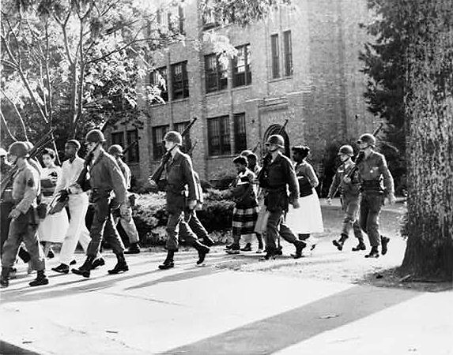
101st Airborne Protect the Little Rock Nine.
The idea of a governor and National Guard troops attempting to essentially block the rulings of the Supreme Court played out on television across the nation.
President Eisenhower was not an aggressive defender of integration but he could not let a governor use National Guard troops to defy the U.S. Supreme Court.
Eisenhower ordered 1,000 troopers from the 101st Airborne Division to secure the school.
Troops would remain at the school for the rest of the year protecting the Little Rock Nine.
Notes:
The idea of a governor and National Guard troops attempting to essentially block the rulings of the Supreme Court played out on television across the nation. Faubus had used the armed forces of the state to oppose the federal government – something that hadn’t happened since the Civil War.
President Eisenhower was not an aggressive defender of integration but he could not let a governor use National Guard troops to defy the U.S. Supreme Court. After failing to get Faubus to discuss the matter with him and come up with a resolution, Eisenhower ordered 1,000 troopers from the 101st Airborne Division to secure the school. By nightfall, 1,000 troops arrived and by 5 AM, a line of Airborne troops surrounding the school, rifles at the ready with bayonets attached. Troops would remain at the school for the rest of the year protecting the Little Rock Nine.

