Slide 1
Suffrage
U.S. History Event/Idea #4
Unit 3

Slide 2
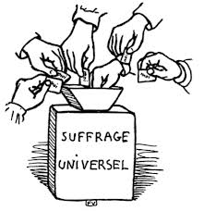
Suffrage
Definition: The right to vote
Usually means voting for representatives but includes initiatives or propositions, and referendums
Essential to a democratic form of government!

Slide 3
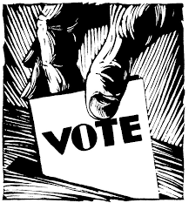
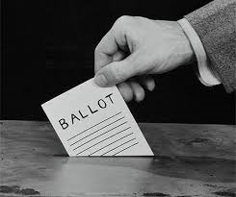
Expansion of Voting Rights
The Constitution did not originally define who was eligible to vote.
Each State made their own regulations.
Most states allowed only white, male, property owners to vote.
Gradually property requirements were lifted and most white men were free to vote.

Slide 4
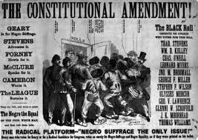
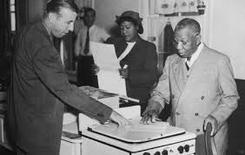
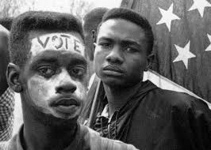
Expansion of Voting Rights
After the Civil War, Republicans controlled congress during Reconstruction and used their power to grant the right to vote to African Americans.
1870 – the 15th Amendment was ratified granting the right to vote to all men regardless of “race, color, or previous condition of servitude”
Many African Americans found it nearly impossible to exercise their voting right for nearly 100 years!

Slide 5
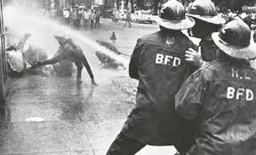
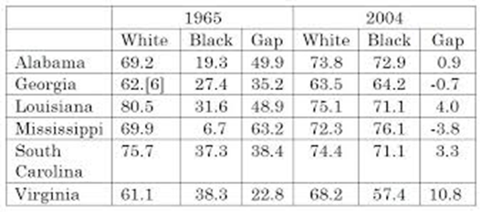
Barriers to Voting
Many states passed laws to prevent certain people from voting:
Literacy tests aimed at immigrants, uneducated people
Poll Taxes aimed at low income people
Grandfather Clause said people could only vote if their grandfather voted!

Slide 6
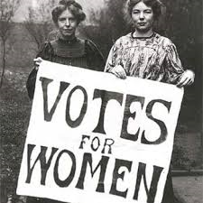
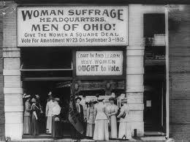
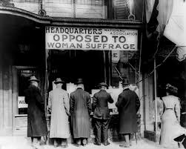
Women’s Suffrage
The Women’s Suffrage Movement began in 1848 at the Seneca Falls Convention.
Lobbied hard for inclusion in the 15th Amendment but failed.
Finally the cause was adopted by the Progressive Movement which provided enough support for passage.
1920 - 19th Amendment grants women the right to vote.
Approximately half the state already allowed women to vote.
Wyoming, 1869

Slide 7
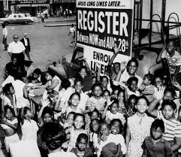
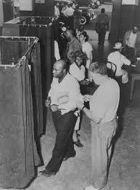
Enforcement of Voting Rights
Civil Rights Act of 1957 – created Civil Rights Division of the Department of Justice, allowed the federal government to sue states depriving people of the right to vote.
Civil Rights Act of 1960 – federal appointees to conduct voter registration.
Voting Rights Act of 1965 – federal government enforcement of the 14th and 15th Amendments, prevention of any law that results in voter discrimination based on race or language.

Slide 8
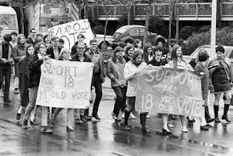
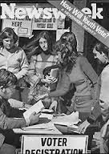
Young Voters
1971- the 26th Amendment grants the right to vote to 18 year olds.
Was proposed and ratified in response to protests to the Vietnam War.
The argument was based on the fact that 18 year old were eligible to be drafted into the armed forces, therefore they should be able to vote!

