Slide 1
U.S. History – Unit 4 People/Groups
The Worst of Times – The Great Depression

Slide 2
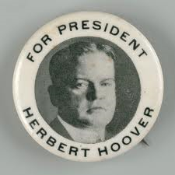
Herbert Hoover
Elected in 1928 at the peak of the economic boom.
Campaign slogan “A chicken in every pot and a car in every garage”
Economic prosperity seemed endless but warning signs included:
Over spending, credit
Over production
Inflation
Lack of regulation
Speculation
When the stock market crashed, he believed the economy was simply readjusting itself.
President Hoover was very cautious in his relief efforts
He tried to downplay fears over the severity of the depression
March 1930: “the worst effects of the crash…will have passed in the next 60 days”

Slide 3
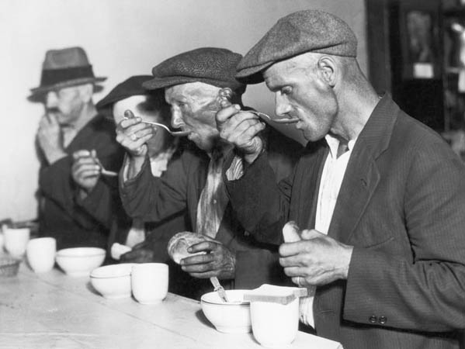
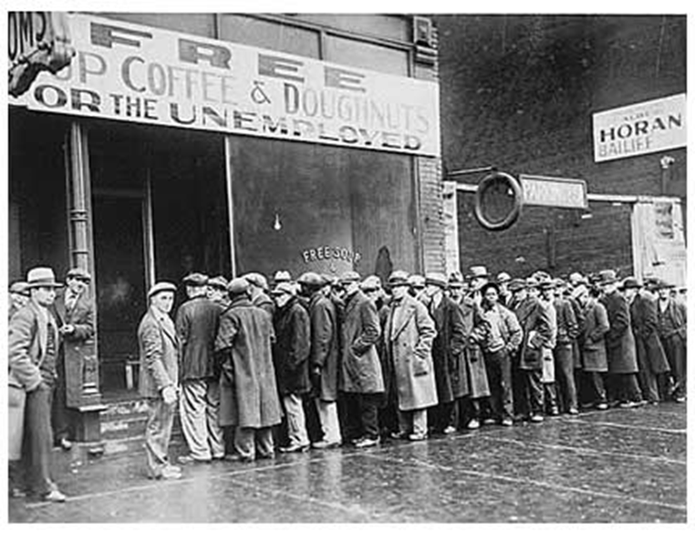
Voluntary Efforts & Public Works vs. Direct Help
Hoover tried to rally organize business & industry
Hoover encouraged local governments to increase spending on public works
Hoover opposed direct relief of citizens by the federal government
The responsibility falls on local governments
Under pressure, Hoover finally signs the Emergency Relief and Construction Act in 1932

Slide 4
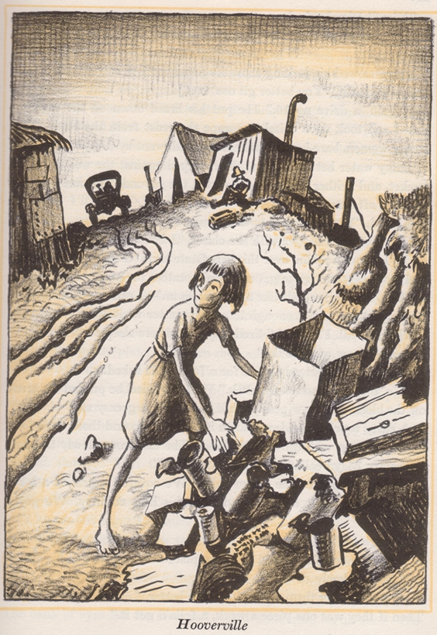
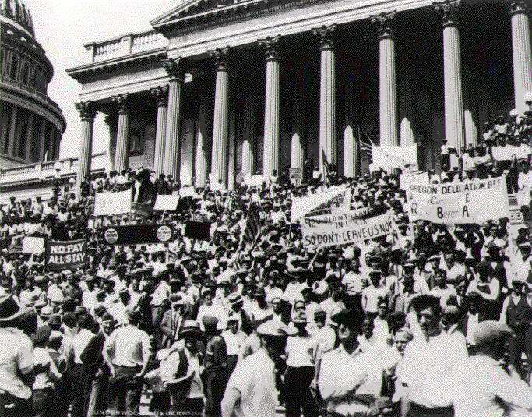
In An Angry Mood…
Hoover’s relief efforts were too conservative; people were very upset & frustrated
Citizen’s begin protesting:
Hunger Marches happen throughout U.S
Veterans march on Washington (Bonus Marches
Hoover failed to resolve the crisis of the Depression
He did increase government help to the economy, but it was not enough in the citizens’ minds
Hoover would be remembered for the Depression and little else

Slide 5
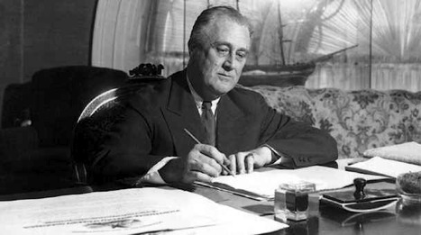
Franklin D. Roosevelt
Roosevelt needed to restore faith American Banks & Industries
Emergency Banking Relief Act
Bank Holiday
FDIC—Safeguards deposits in banks
SEC—Regulates stock trading
AAA—Regulate agricultural production
Roosevelt was elected in 1932, immediately began a program of change
His first 100 days in office produced 15 Acts & Agencies designed to assist with the depression

Slide 6
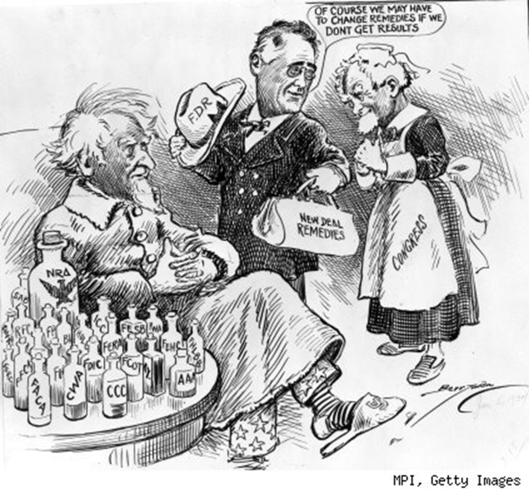
Spending & Relief Programs
Unemployment was very high causing foreclosures
Roosevelt introduced programs to avoid further foreclosures
HOLC—keep people in their homes
FCA—Prevent farmers from losing their farms
After debt relief & fixing the banks, Roosevelt turned his attention to putting Americans back to work
CCC, CWA, & PWA all put people back to work through government programs

Slide 7
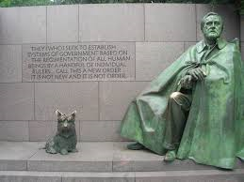
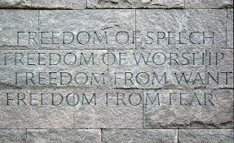
Legacy
Economic recovery was slow and costly (rising national debt)
People appreciated the help and his efforts
Created programs and safeguards to protect people and the economy from a future depression
F.D.R. elected 4 times!
Forever changed the role of government in solving economic problems
Defined the split between the modern Democratic and Republican parties

Slide 8
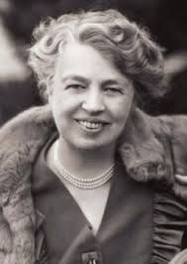
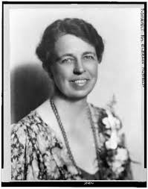
Eleanor Roosevelt
Longest serving First Lady of the U.S.
Educated in London
Actively campaigned for her husband
Outspoken, political, controversial
Wrote a newspaper column, gave speeches
Worked for Civil Rights
U.S. Delegate to the United Nations
Fought for human rights around the world
Appointed by J.F.K. to be chairperson to the Presidential Commission on the Status of Women
Considered one of the most influential people of the 20th Century

Slide 9
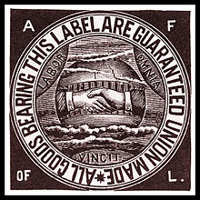
American Federation of Labor
Founded in 1886, led by Samuel Gompers until 1924.
First alliance joining several craft and industrial unions from around the nation into one organized group.
Members paid dues and elected delegates and leaders to handle collective bargaining negotiations
Greatly increased the power of unions by encouraging various trades to honor each others strikes.
Became politically active supporting labor and fought against immigration.

Slide 10
Congress of Industrial Organizations
In 1935 the CIO formed to create unions in industries where they didn’t exist.
Union membership grew dramatically during the Great depression
2 million in 1933 to12 million in 1943.
CIO supported F.D.R. and the New Deal.
CIO and the AFL were rivals until they merged in 1955.
The AFL-CIO still exists as a nation wide industrial, craft/trade union with significant political power.

Slide 11
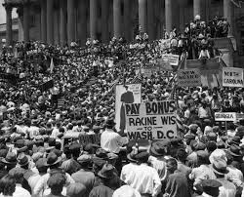
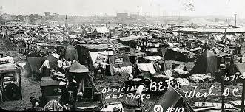
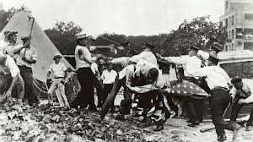
Bonus Army
17,000 WWI veterans and their families who went to Washington D.C. in 1932 to demand payment of their war bonuses.
Many had been unemployed for years and desperately needed the money but the money was not promised until 1945.
The group camped out in front of the capital, protested, marched etc.
Violence broke out when police and military tried to remove them by force, burning their camp.

