Slide 1
WAR AND THE CHALLENGES TO THE BILL OF RIGHTS
U.S.HISTORY - Unit 3
Espionage Act of 1917
Sedition Act of 1918
Schenck v. United States 1919
Abrams v. United States 1919

Slide 2
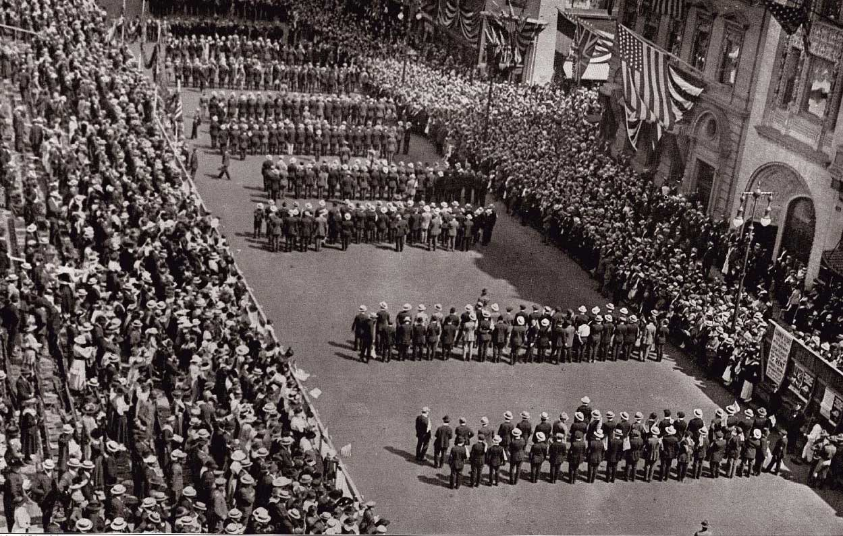
WWI on the HOMEFRONT
Building up the military
Selective Service Act of 1917
2.8 million drafted.
2 million volunteered.
400,000 African-Americans were drafted.
WWI was the first official war for women.
Women filled rolls vacated by men.

Slide 3
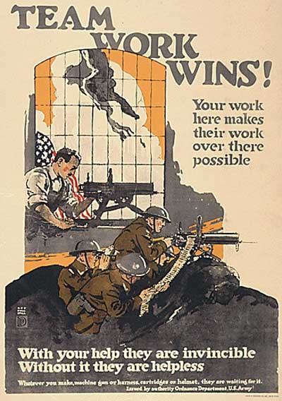
WWI on the HOMEFRONT
Organizing Industry
War Industries Board (WIB)
set war material production, controlled raw materials, and set prices.
The Food Administration
Americans were asked to “serve just enough.”
Fuel Administration
introduced daylight savings time
National War Labors Board (NWLB)
solved business and labor problems.
No disruption to war production with strikes or disturbances.

Slide 4
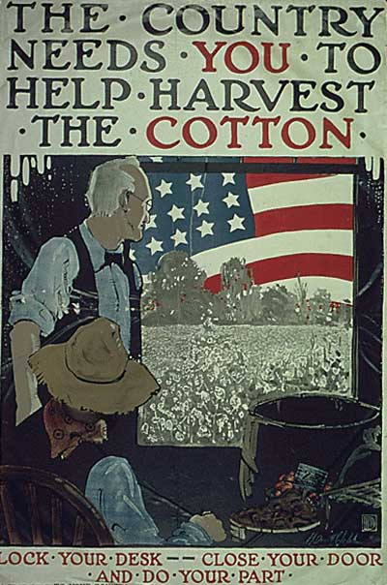
WWI on the HOMEFRONT
Mobilizing the Workforce
Women filled jobs left open by men but lost jobs when the war ended.
Jobs and high wages brought 300,000 to 500,000 African Americans to the North.
Mexicans migrated to Texas, Arizona, California, and New Mexico and faced hostility and discrimination.

Slide 5
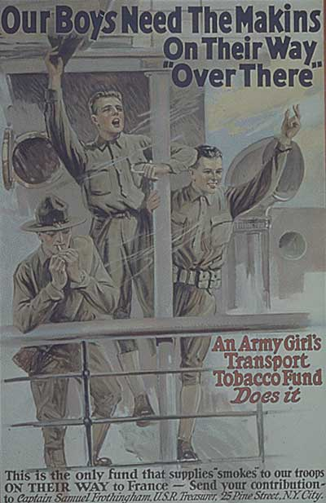
WWI on the HOMEFRONT
Ensuring Public Support
The Committee on Public Information (CPI)
had the job of selling the war to the American people.
CPI worked with:
advertising executives, commercial artists,
songwriters, entertainers, motion picture companies.
Anti-German backlash in America creates new “slang”
Sauerkraut renamed “Liberty cabbage.”
Hamburger renamed “Salisbury steak.”
Schools drop German language classes.

Slide 6
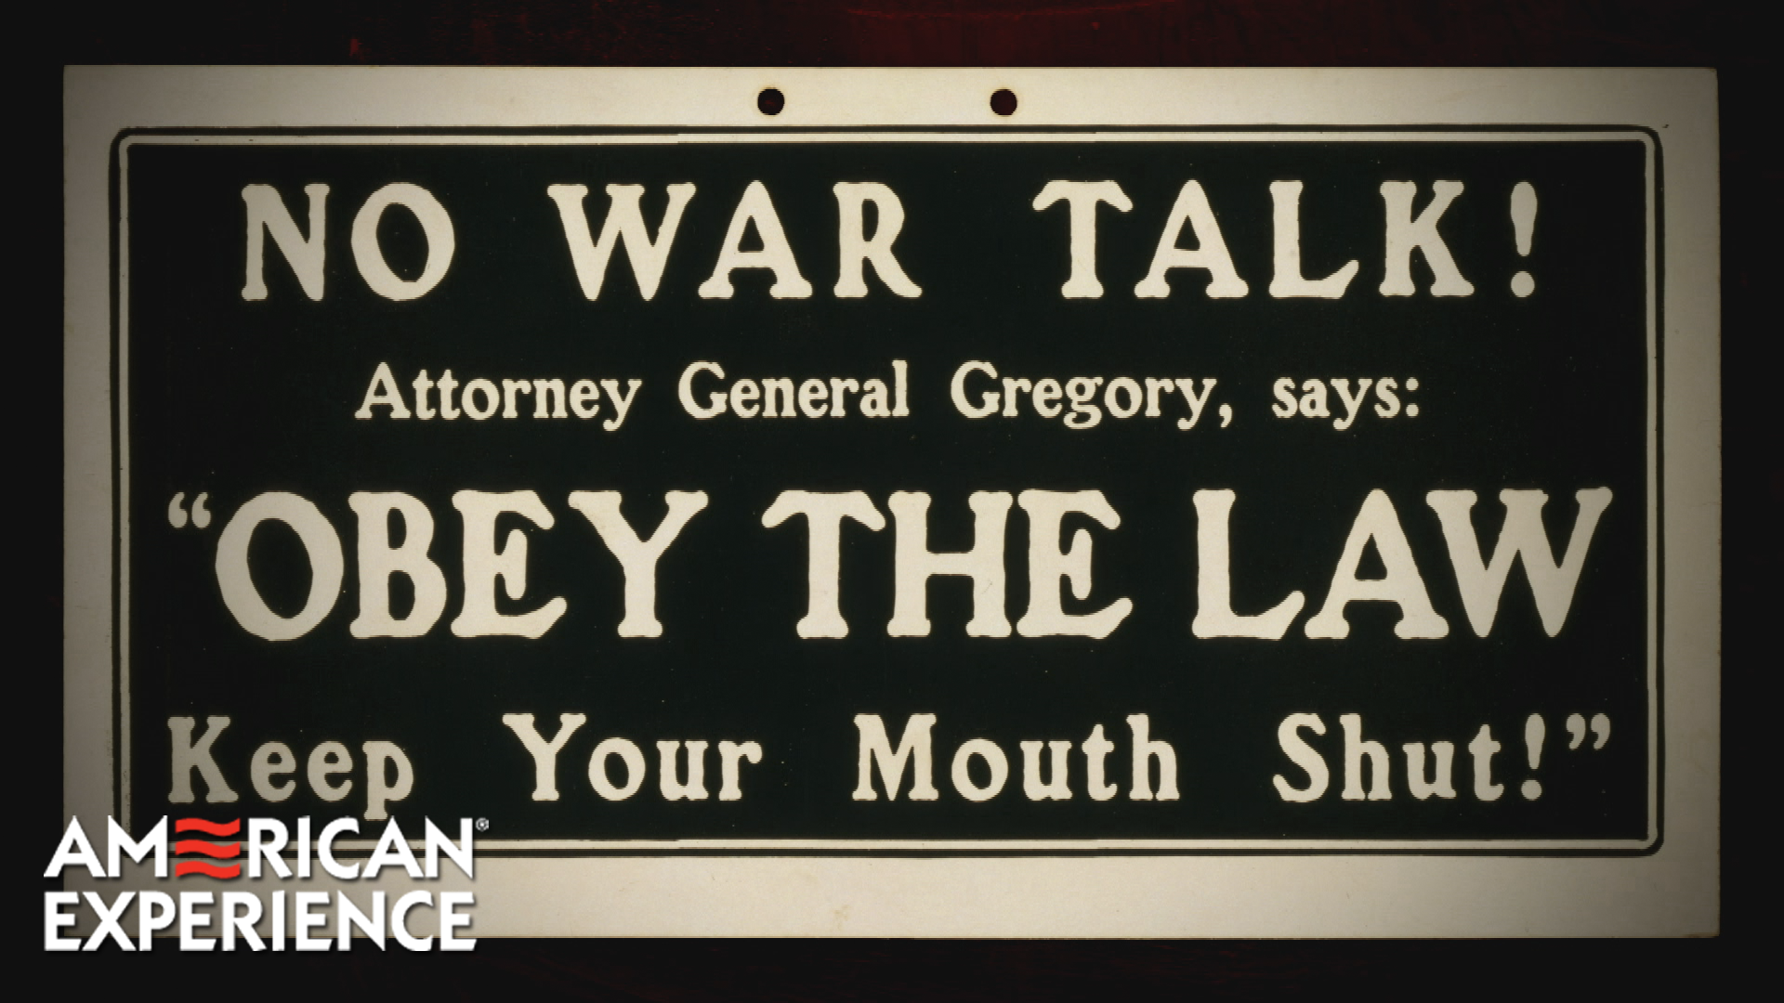
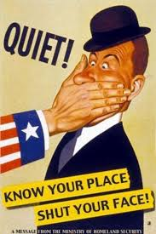
WWI on the HOMEFRONT
In addition to using propaganda, the government passed legislation to limit opposition to the war.
Espionage Act of 1917
made it illegal to aid the enemy (no spying), or interfere with the war effort.
Sedition Act of 1918
made it illegal to speak, write, publish, or distribute anything that hinders the war effot publicly.
Some people challenged these laws as unconstitutional and took their cases to the Supreme Court.

Slide 7
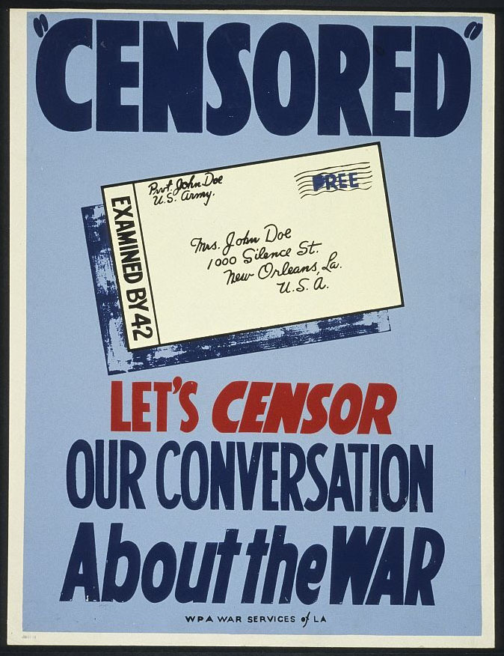
WWI on the HOMEFRONT
Schenck v. United States, 1919.
Background: Schenck was a leader in the Socialist Party, he was arrested for distributing leaflets urging people to refuse the draft during WWI on the grounds that it violated their 13th Amendment rights.
Case: the gov said he violated the Espionage Act but Schenck argued the law violated his 1st Amendment rights of free speech.
Verdict: the Supreme ruled unanimously against Schenck stating that the 1st Amendment did not protect speech encouraging insubordination during wartime. He spent 6 months in prison.

Slide 8
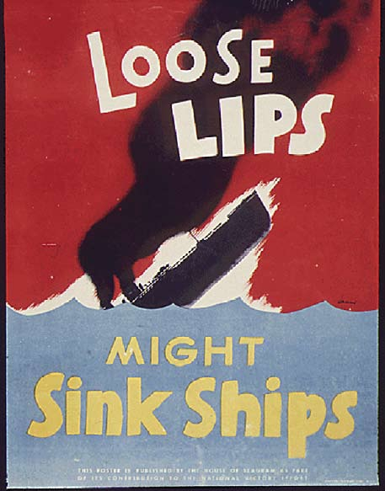
WWI on the HOMEFRONT
Abrams v. United States, 1919
Background: Abrams was a Russian immigrant and an anarchist, he was arrested for distributing leaflets criticizing President Wilson for sending troops to Russia.
Case: the gov said he violated the Sedittion Act, Abrams argued that the law violated his 1st Amendment rights of freedom of speech and protest.
Verdict: the Supreme Court ruled against him saying that his actions could hurt the war effort. He was sentenced to 15-20 years in prison.

